Slide 1
Symbol Tables
Symbol tables map identifiers to their attributes

Slide 2
Symbol Table
A compiler or interpreter maintains a symbol table containing information about known identifiers (and maybe other symbols).
Each new scope is given a number.
Scope 1 (this file)
Name Scope Cat. Type Other
f 2 func. float (param)
main 3 func. int (void)
float f(float x) {
float y = x*x + 1;
return y;
}
Scope 2
Name Scope Cat. Type Other
x 2 param float -
y 2 local float -
int main( ) {
float sum;
sum = f(1.0) + f(2.5);
}
Scope 3
Name Scope Cat. Type Other
sum 3 local float -

Slide 3
Predefined Symbols Table
The outer most symbol table (0) contains predefined identifiers, such as "int", "float". Each new scope needs its own symbol table.
Unresolved Symbols:
Scope 0 (predefined)
Name Scope Cat. Type Other
pow - func ? (float,int)
Name Scope Cat. Type Other
float 0 type float reserved
int 0 type int reserved
float f(float x, int n) {
float sum = 0;
for(int k=1;k<=n;k++) {
sum += pow(x,k);
}
return sum;
}
Name Scope Cat. Type Other
x 2 param float -
n 2 param int -
sum 2 local float -
Name Scope Cat. Type Other
k 3 local int -

Slide 4
Implementing symbol table structure
One strategy is to use a stack of symbol tables.
When a scope is entered, its symbol table is put on top of stack.
Name Scope Cat. Type Other
n 3 param int -
count 3 local int -
import static java.Math.PI;
class A {
private int count;
private int x;
/* new scope */
int fun( int n ) {
int count = 0;
count += n*x*PI;
}
...
Name Scope Cat. Type Other
count A attrib int private
fun A func. int (int)
x A attrib int private
Name Scope Cat. Type Other
PI

Slide 5
Implementing symbol table structure
Another strategy is to use a linked list of symbol definitions.
This requires a second data structure: a scope stack to indicate the order of active scopes.
Name Scope Cat. Type Next
x A param int -
count A attrib int *
fun A func. int (int)
n 3 param int -
count 3 local int -
...
class A {
private int count;
private int x;
/* new scope */
int fun( int n ) {
int count = 0;
count += n*x;
}
...
int main( ) {
A a = new A(20);
a.fun(10);
Scope stack
A
1 (main)
3 (fun)

Slide 6
Symbol Table and Scope
/* Java */
class who {
private String who;
public int who( ) {
...
}
public void main(...){
int who;
who =
(new who()).who();
}
}
/* C++ */
public int who( ) {
int n = 10;
for(int k=1;;k<10) {
int n = 10*k;
sum = sum + n;
}
cout << "n=" << n ;
}

Slide 7
Symbol table structure
Symbol table is constructed as declarations are encountered (insert operation).
Lookups occur as names are encountered in dynamic scope (in symbol table to that point).
In lexical scope, lookups occur either as names are encountered in symbol table to that point (declaration before use—C), or all lookups are delayed until after the symbol table is fully constructed and then performed (Java class—scope applies backwards to beginning of class).

Slide 8
Symbol table structure evaluated
Which organization is better?
Table of linked lists is simpler (C, Pascal).
Stack of symbol tables is more versatile, and helpful when you need to recover outer scopes from within inner ones or from elsewhere in the code (Ada, Java, C++). Examples:
  this.x = x; // assign local value to attrib.
  super.toString( );
  Math.PI;
Normally, no specific table structure is part of a language specification: any structure that provides the appropriate properties will do.

Slide 9
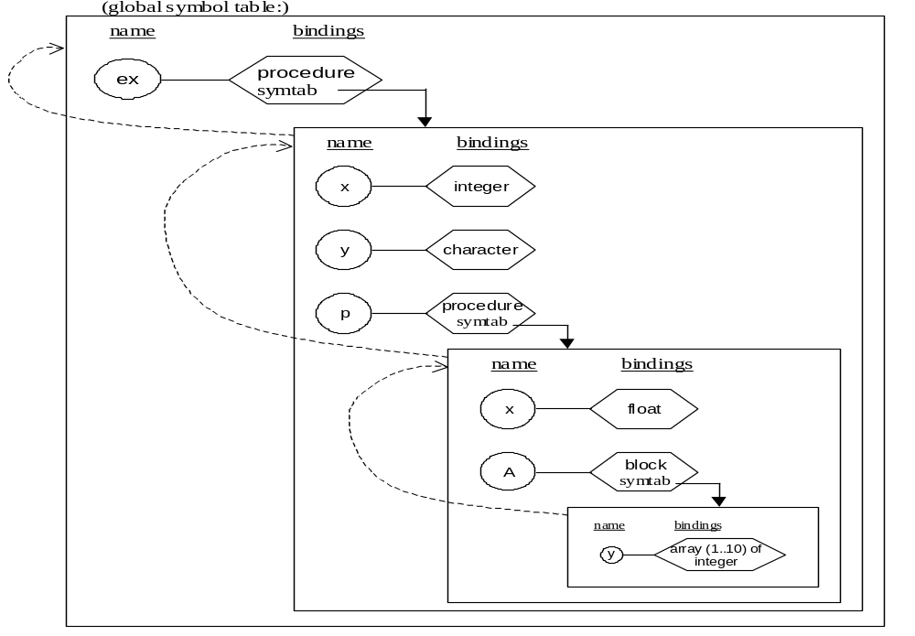
Ada example

Slide 10
Overloading
Overloading is a property of symbol tables that allows them to successfully handle declarations that use the same name within the same scope.
int max( int a, int b ) { return ( a > b ) ? a : b; }
float max ( int a, int b ) { return (a > b ) ? (float) a : (float)b; }
int max( int a, int b, int c ) { return ( max(a,b) > max(b,c) ) ? max(a,b) : ... }
float max ( float a, float b ) { return (a > b ) ? a : b; }
int main( ) {
float y = max( 3, 4);
max( 2.5, 7 );

Slide 11
Overloading
It is the job of the symbol table to pick the correct choice from among the declarations for the same name in the same scope.
This is called overload resolution.
It must do so by using extra information, typically the data type of each declaration, which it compares to the probable type at the use site, picking the best match.
If it cannot successfully do this, a static semantic error occurs.

Slide 12
Overloading (2)
Overloading typically applies only to functions or methods.
Overloading must be distinguished from dynamic binding in an OO language.
Overloading is made difficult by weak typing, particularly automatic conversions.
In the presence of partially specified types, such as in ML, overload resolution becomes even more difficult, which is why ML disallows it.
Scheme disallows it for a different reason: there are no types on which to base overload resolution, even during execution.

Slide 13
Overloading (3)
An example in Java:
public class Overload {
public static int max(int x, int y)
{ return x > y ? x : y;}
public static double max(double x, double y)
{ return x > y ? x : y;}
public static int max(int x, int y, int z)
{ return max(max(x,y),z);}
public static void main(String[] args)
{ System.out.println(max(1,2));
System.out.println(max(1,2,3));
System.out.println(max(4,1.3));
}
}
Adding more max functions that mix double and int parameters is ok.
Adding functions that mix double and int return values is not!

Slide 14
Overloading (4)
C++ and Ada are even more challenging for overload resolution:
  C++ allows many more automatic conversions,
  In Ada the return type is also used to resolve overloading (Ada can do this only because it allows no automatic conversions).
It is possible for languages to also keep different symbol tables for different kinds of declarations.
  In Java these are called "name spaces," and they also represent a kind of overloading.
  Java uses different name spaces for classes, methods, variables, labels, and even packages.

