Slide 1
NTRU: A Ring-Based Public Key Cryptosystem
Jeffrey Hoffstein, Jill Pipher, Joseph H. Silverman
LNCS 1423, 1998

Slide 2


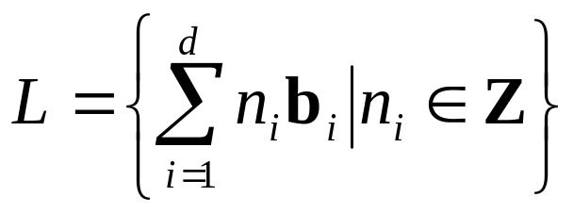
格
这里的格是指点格。它是 的一个离散子群。格的具体定义如下：
定义1.1.1 设 为 中一组线性无关向量，取 的整线性组合为集合L中的元素，即
这样的集合L称为格，其中称 为格的一组基或简称格基。

Slide 3
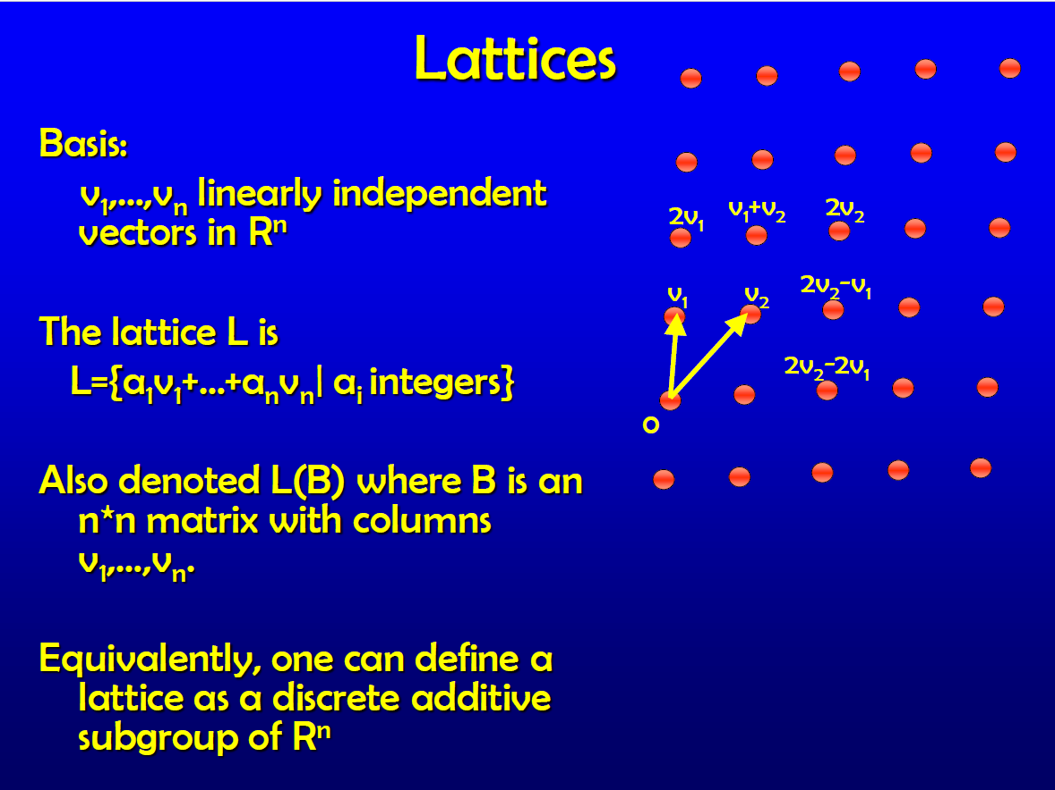

Slide 4
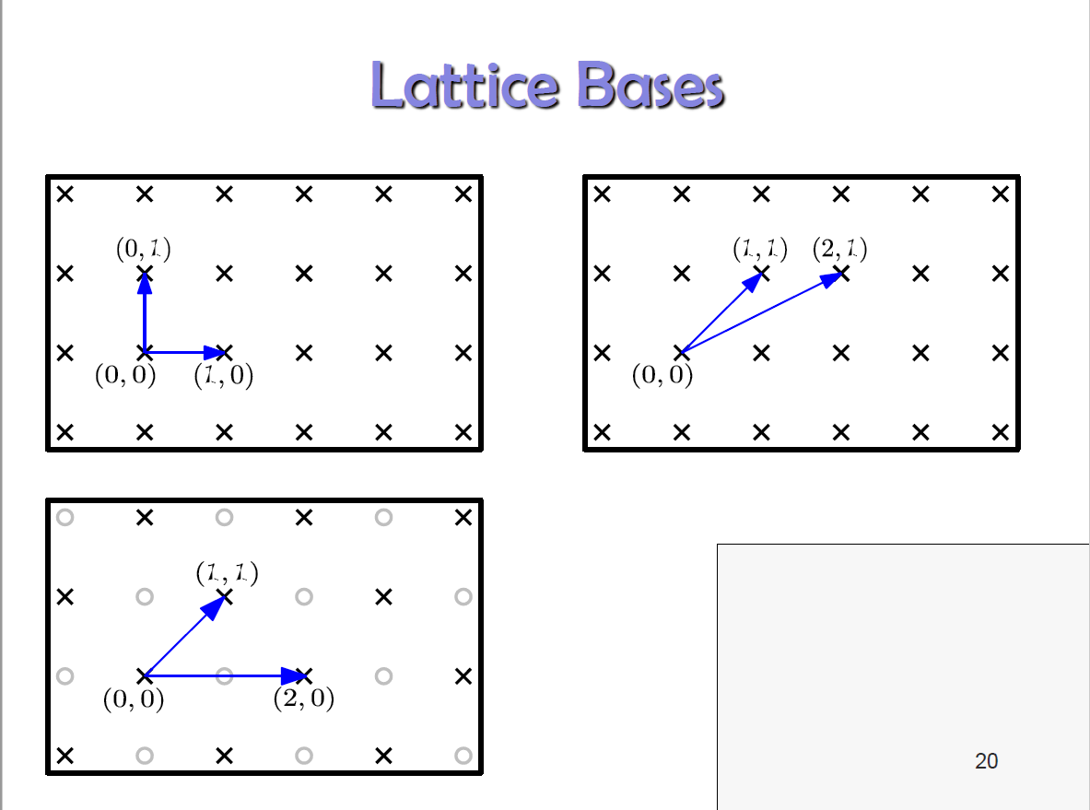

Slide 5
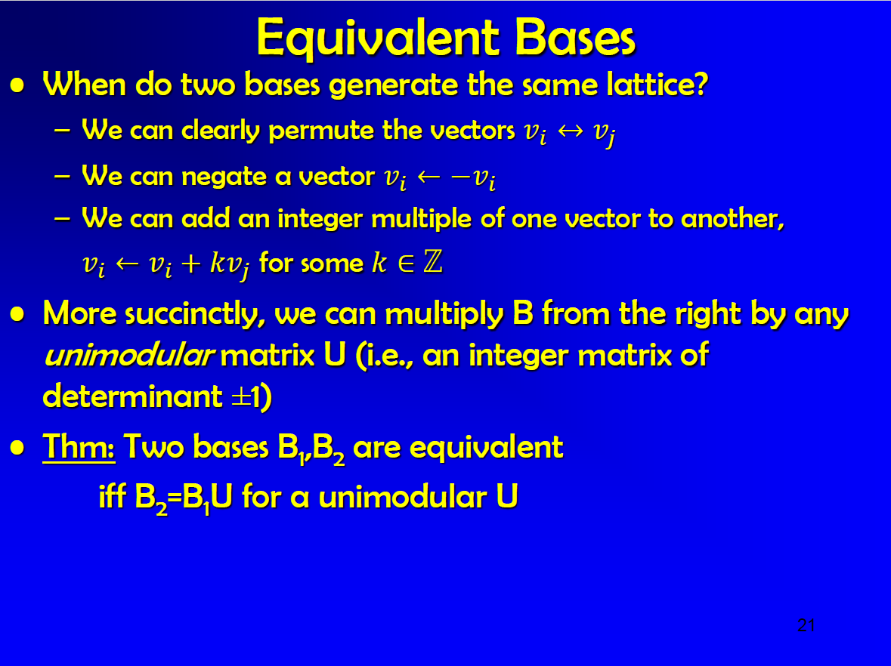

Slide 6
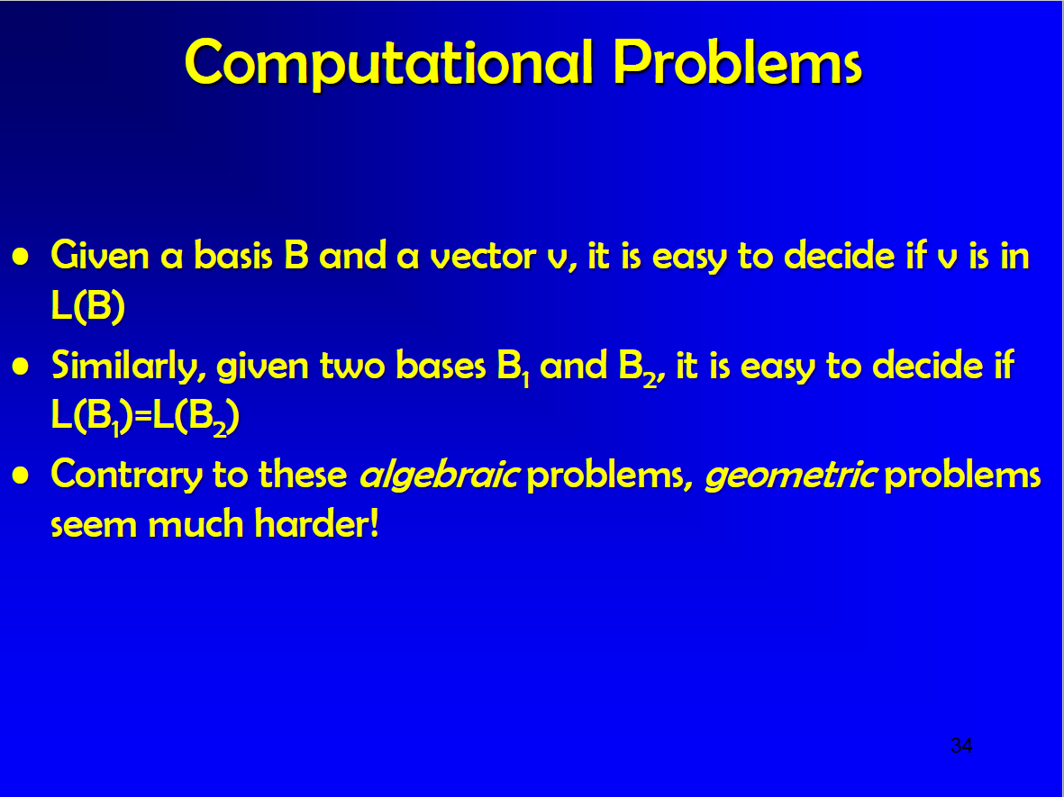

Slide 7

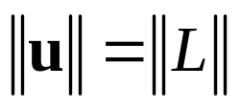
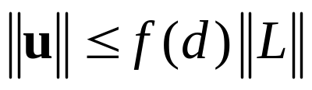
格中的NP问题
由于格是离散的，所以格中必有最短非零向量关于格有几个著名的NP问题。以下L代表一个格，d为格的维数， 为一范数。
①最短向量问题(SVP)：给定格L的一组基，寻找格中一非零向量u，使得 。
近似最短向量问题(APPR-SVP)：给定格L的一组基，寻找一非零向量u∈L，使得 ，其中f(d)是与维数d有关的某个近似因子。

Slide 8
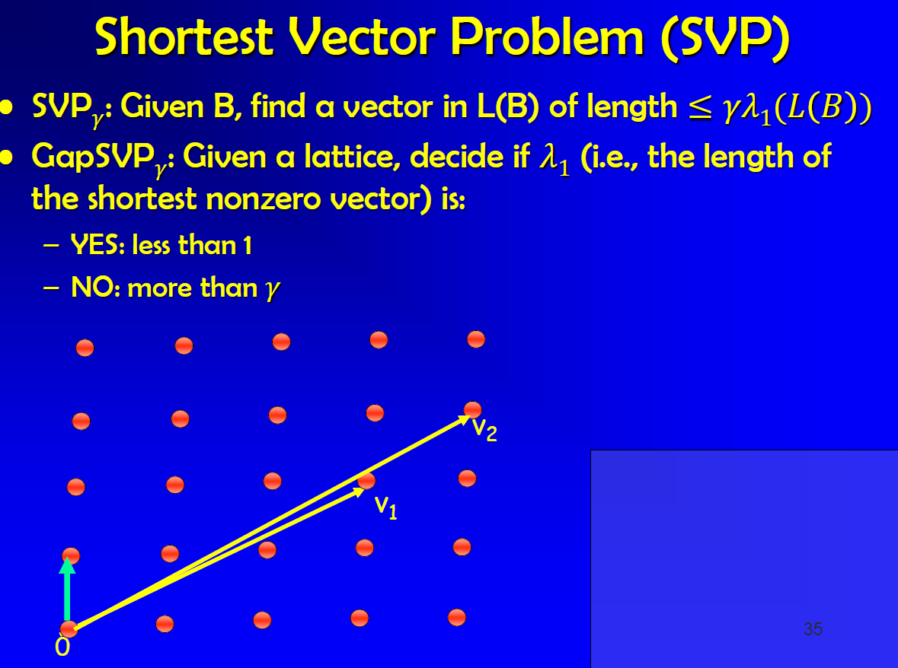

Slide 9
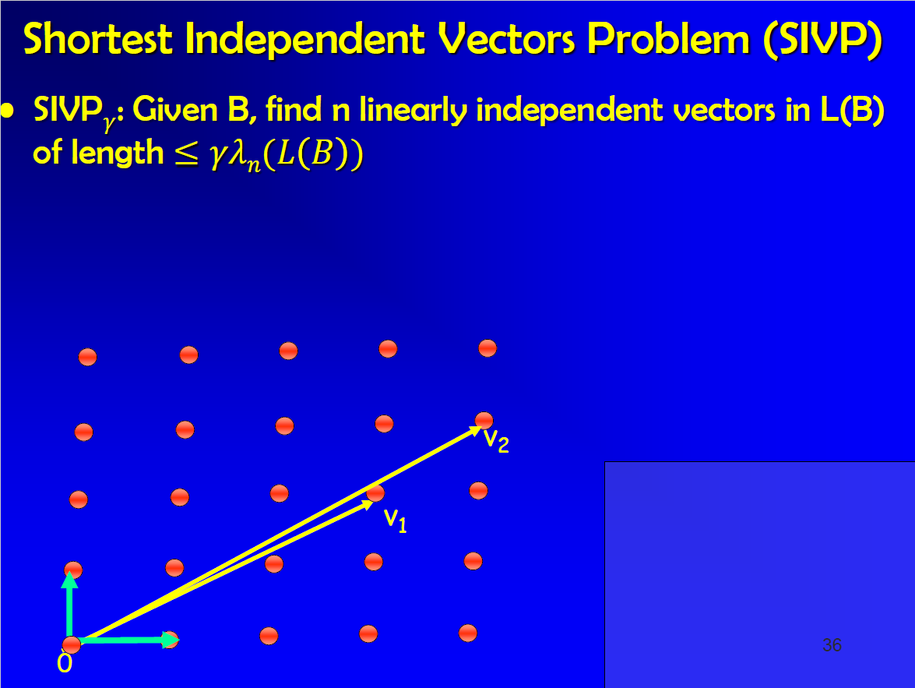

Slide 10
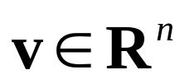


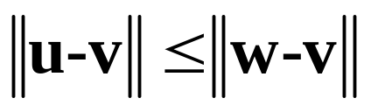
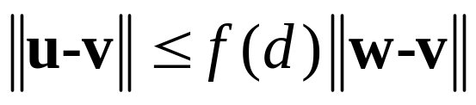
格中的NP问题(续)
②最近向量问题(CVP)，也称为最近格点问题：给定格L的一组基和向量 ，v不一定在L中，寻找一向量 ，使得 都有 。
近似最近向量问题定义为：给定格L的一组基和向量 ，v不一定在L中，寻找一向量 ，使得 都有

Slide 11
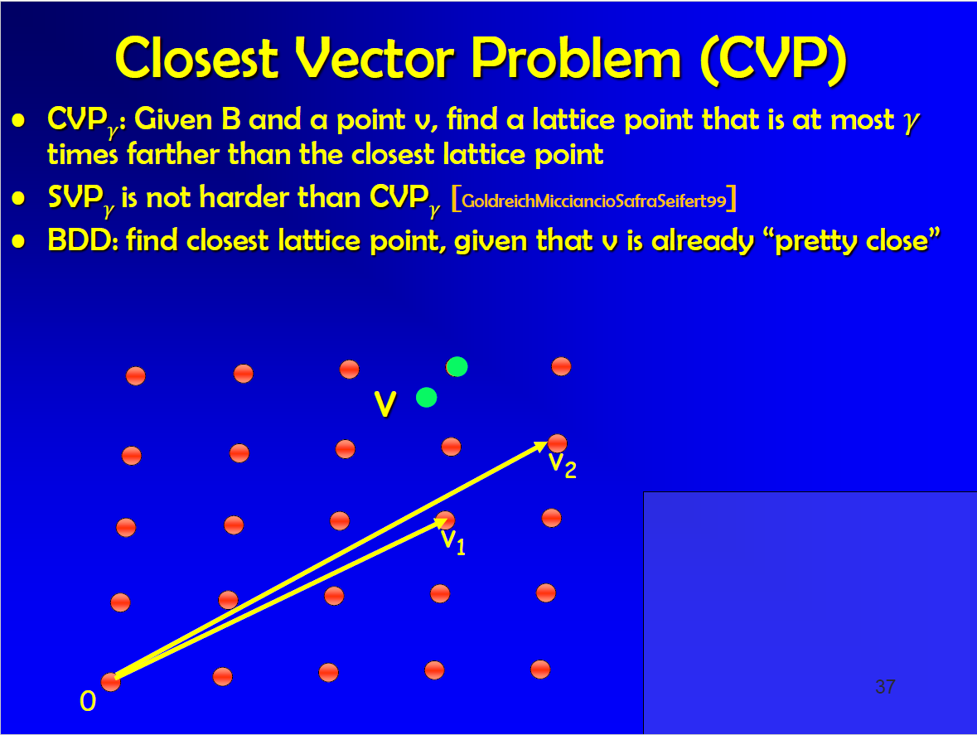

Slide 12
格约化
在格中总有线性无关向量组可以达到所有的逐次最小值。格约化的目的是利用已有的一组基找另一组“更好”的基，这组基满足：
⑴ 该基中的向量比原有的基中的向量更短，或者该基中有向量的范数。
⑵ 该基中的向量两两正交或者相对正交（即该基中任意两个向量的内积与它们的长度之积的比率特别小，接近于零）。
一组约化的基可以帮助解决SVP和CVP。目前最有名的格约化算法为A. K. Lenstra, H. W. Lenstra Jr和L. Lovász提出的LLL算法，见文献[9]。

Slide 13
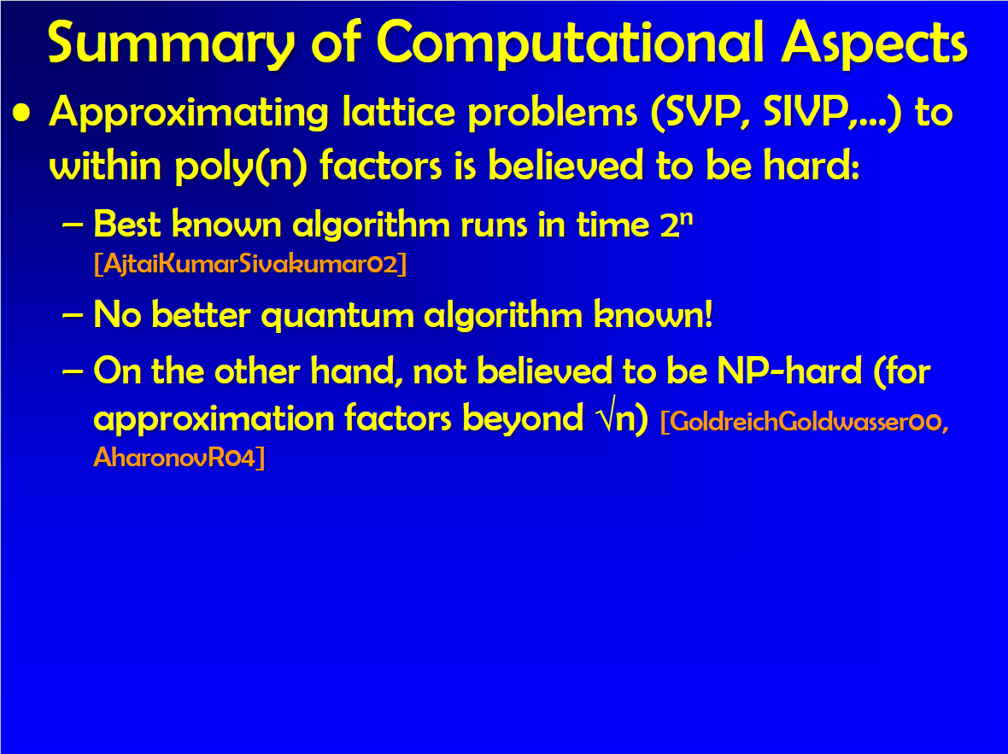

Slide 14
Outline
Introduction
Scheme
Parameter selection
Security analysis
Practical implementations of NTRU
Conclusion

Slide 15
Introduction
The encryption produce uses a mixing system based on polynomial algebra and reduction modulo two numbers p and q.
The decryption produce uses an unmixing system whose validity depends on elementary probability theory.

Slide 16
Introduction
The security of NTRU
  The interaction of the polynomial mixing system with the independence of reduction modulo p and q.
  Fact that for most lattices, it is very difficult to find extremely short vectors.

Slide 17
Outline
Introduction
Scheme
Parameter selection
Security analysis
Practical implementations of NTRU
Conclusion

Slide 18
Notation
An NTRU cryptosystem depends on
  3 integer parameters (N, p, q)
    p and q need not be prime
    gcd(p, q) = 1
    q will always be considerably larger then p
  4 sets L_{f}, L_{g}, L_{φ}, L_{m} of polynomial of degree N-1 integer coefficients.

Slide 19
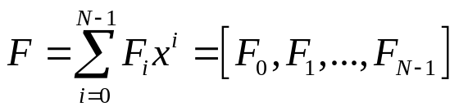
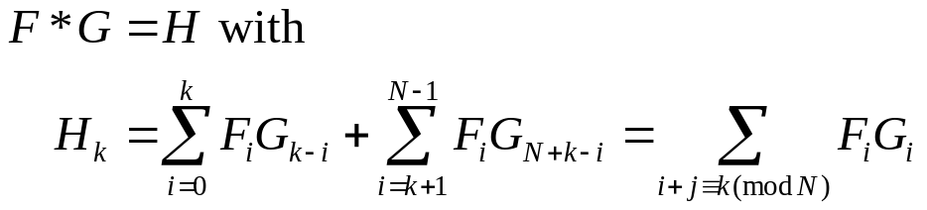
Notation
An NTRU cryptosystem depends on
  Work in the ring R = Z[X] / (X^{N} - 1)
  F ∈ R will be written as a poly or a vector
  * to denote multiplication in R as a cyclic convolution product
  Do a multiplication modulo q, mean to reduce the coefficiens modulo q.

Slide 20
Scheme – Key Generation
Random chooses 2 polynomials f, g ∈ L_{g}
  f must satisfy the additional requirement that it have inverses modulo q and modulo p.
  Denote these inverses by F_{q} and F_{p}, that is
    F_{q} * f ≡ 1 mod q and F_{p} * f ≡1 mod p
Public key h ≡ F_{q} * g mod q
Secret key f
Store F_{p}

Slide 21
Scheme – Encryption
A message m from the set of plaintext L_{m}
Random choose a polynomial φ∈L_{φ}
Compute e ≡ pφ * h + m mod q

Slide 22

Scheme – Decryption
First compute a ≡ f * e mod q
  The coefficients of a in [-q/2 , q/2]
Recovers the message by computing F_{p} * a mod p

Slide 23
Outline
Introduction
Scheme
Parameter selection
Security analysis
Practical implementations of NTRU
Conclusion

Slide 24
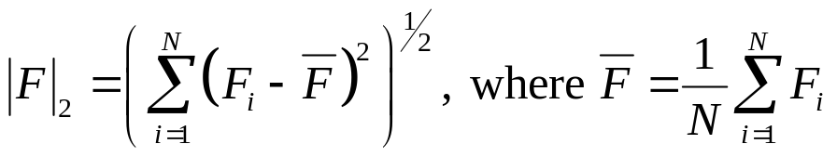
Notation and a norm estimate
The width of an element F ∈ R to be
  |F|∞ = max{F_{i}} – min{F_{i}}
2 norm on R by
Proposition
  For any ε> 0 there are constants γ₁, γ₂ > 0, depending on ε and N, s.t. for randomly chosen polynomials F, G ∈ R, the probability is greater then 1 – ε that they satisfy γ₁|F|₂|G|₂ < |F * G|∞ < γ₂|F|₂|G|₂
If the ratioγ₂ / γ₁ were very large for smallε’s.

Slide 25
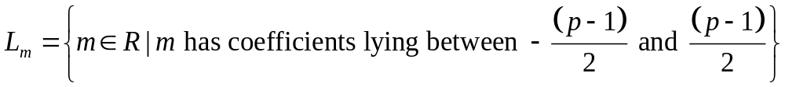
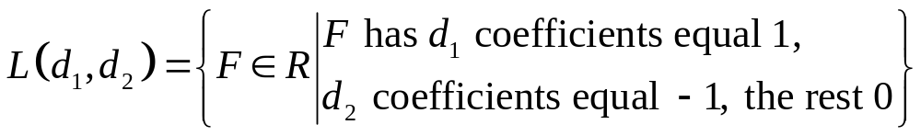
Sample space
The space of message L_{m} consists of all polynomials modulo p. Assuming p is odd,
To describe the other sample spaces, use the sets of the form

Slide 26
Sample space
Choose 3 positive integers d_{f}, d_{g}, d and set
L_{f} = (d_{f}, d_{f} - 1), L_{g} = (d_{g}, d_{g}), L_{φ}=(d, d)
  Don’t set L_{f} = (d_{f}, d_{f}) is because we want f to be invertible.
  |f|₂ = (2d_{f} – 1 – N⁻¹)^{½} , |g|₂ = (2d_{g})^{½}, |φ|2 = (2d)^{½}

Slide 27
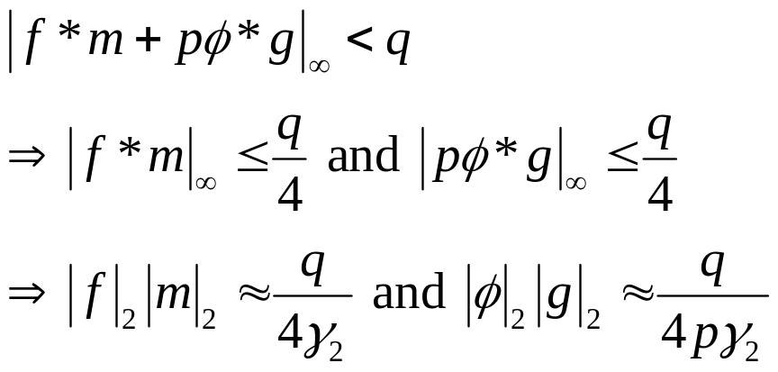
A decryption criterion
For a γ₂ corresponding to a small value for ε

Slide 28
Outline
Introduction
Scheme
Parameter selection
Security analysis
Practical implementations of NTRU
Conclusion

Slide 29
Attacks
Brute force attack
Meet-in-the-middle attack
Multiple transmission attack
Lattice based attack

Slide 30
Lattice based attacks
This section is to give a brief analysis of the known lattice attacks on both the public key h and the message m.
The goal of lattice reduction is to find one or more “small” vectors in a given lattice.
The LLL algorithm (Lenstra-Lenstra-Lovasz) will find the smallest vector provided that the smallest vector is not too much smaller than the expected length of the smallest vector.

Slide 31
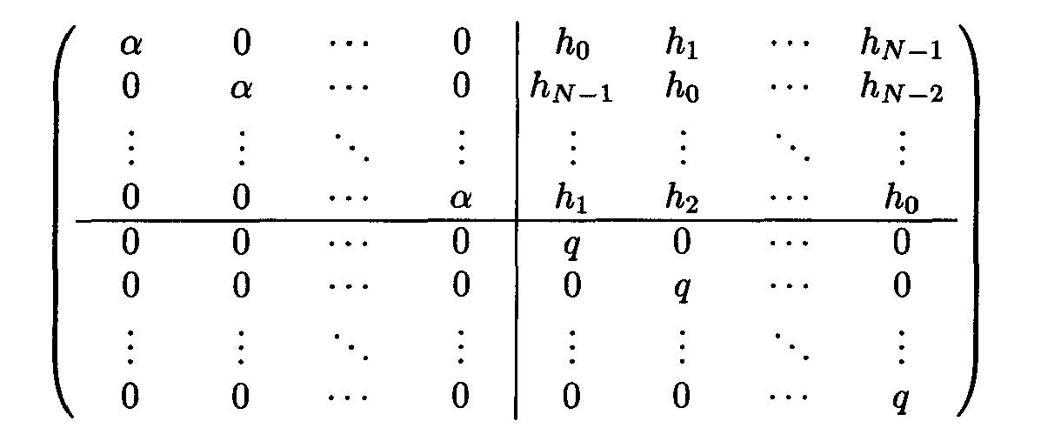
Lattice attack on an NTRU private key
L =
2N × 2N
Let L be the lattice generated by the rows of this matrix.
det(L) = q^{N}α^{N}

Slide 32
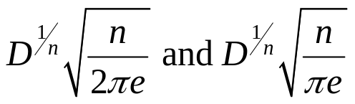
Lattice attack on an NTRU private key
Public key h = g * f⁻¹
The lattice L will contain the vector τ=(αf, g)
  The 2N vector consisting of the N coefficients of f multiplied by α, followed by the N coefficients of g.
By the Gaussian heuristic
  The expected size of the smallest vector in a random lattice of dimension n and determinant D lies between

Slide 33
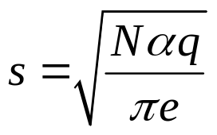
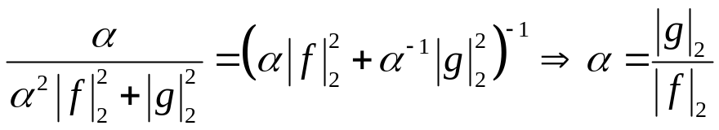
Lattice attack on an NTRU private key
In this case, n = 2N, D = q^{N}α^{N}
  The expected smallest length is larger than
  If the attacker chooses α to maximize the ratio
  s / |τ|₂, the lattice reduction algorithm will have the best chance of locating τ, or another vector whose length is close to τ.
  An attacker should choose α so as to maximize

Slide 34
Lattice attack on an NTRU private key
A constant c_{h} by setting |τ|₂ = c_{h}s
  c_{h} is the ratio of the length of the target vector to the length of the expected shortest vector.
  Smaller c_{h}, the easier to find the target vector.
  If c_{h} is close to 1, then L will resemble a random lattice.

Slide 35
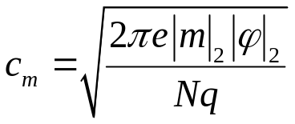
Lattice attack on an NTRU message
A lattice attack may also be directed against an individual message m.
The target vector will have the form (αm, φ)
α= |φ|₂ / |m|₂
  c_{m} gives a measure of the vulnerability of an individual message to a lattice attack.
  If c_{m} is small, an encrypted message is most vulnerable.

Slide 36
Lattice attack on an NTRU message
In order to make the attacks on h and m equal difficult, we want to take c_{m} ≒ c_{h}.
For p = 3, an average message m will consist of N/3 each of 1, 0, and -1.

Slide 37
Outline
Introduction
Scheme
Parameter selection
Security analysis
Practical implementations of NTRU
Conclusion

Slide 38
Moderate Security
(N, p, q) = (107, 3, 64)
L_{f} = (15, 14), L_{g} = (12, 12), L_{φ}=(5, 5)
Secret key = 340-bit
Public key = 642-bit
Key security = 2⁵⁰
Message security = 2^{26.5}
c_{h} = 0.257, c_{m} = 0.258, s = 0.422q

Slide 39
High Security
(N, p, q) = (167, 3, 128)
L_{f} = (61, 60), L_{g} = (20, 20), L_{φ}=(18, 18)
Secret key = 530-bit
Public key = 1169-bit
Key security = 2^{82.9}
Message security = 2^{77.5}
c_{h} = 0.236, c_{m} = 0.225, s = 0.296q

Slide 40
Highest Security
(N, p, q) = (503, 3, 256)
L_{f} = (216, 215), L_{g} = (72, 72), L_{φ}=(55, 55)
Secret key = 1595-bit
Public key = 4024-bit
Key security = 2²⁸⁵
Message security = 2¹⁷⁰
c_{h} = 0.182, c_{m} = 0.160, s = 0.365q

Slide 41
Outline
Introduction
Scheme
Parameter selection
Security analysis
Practical implementations of NTRU
Conclusion

Slide 42
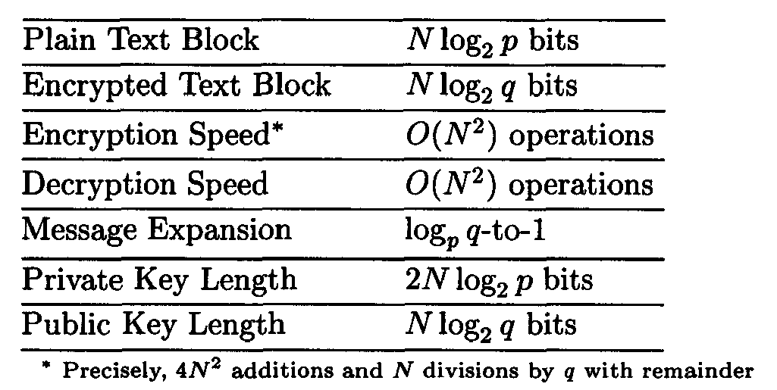
Conclusion

Slide 43
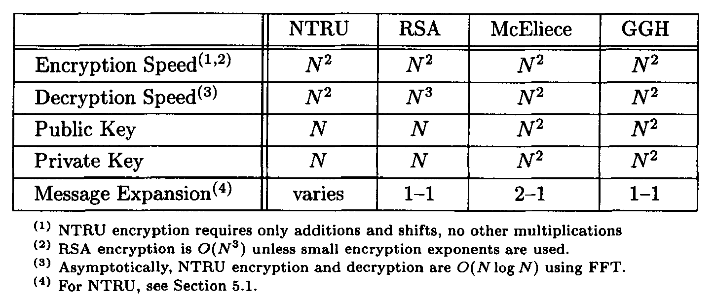
Conclusion

