Slide 1
Module 10: Develop message-based solutions (Azure Service Bus).

Slide 2
Topics
Azure Service Bus
Azure Queue Storage

Slide 3
Lesson 01: Azure Service Bus

Slide 4
What Is Windows Azure Service Bus Relay?
Expose your services to the world without opening the corporate network firewall
Windows Azure Service Bus Relays provides connectivity to on-premises applications from:
Cloud-based applications
Other corporate networks
Mobile devices
Sogar entgegen der NAT-Firewallrichtung←per Relais.
The relay supports multiple messaging patterns:
Unicast(Queue)/Multicast(Themen/Topics) one-way message forwarding
Request-Response socket forwarding
Upgrade to point-to-point socket
TCP-OOB-Data (OOB=Out of Band).: “Vielkanal-Stereo” für TCP.
NAT-freundlich←Der Socket wird von Innen geöffnet (Beispiel Team-Viewer-Clienten verbinden sich alle an ein Reflektoren-Relais von Innen nach Außen).
Relays leverage the WCF programming model with new bindings
Notes:
Ask the students for examples of applications that establish communication between the server back-end and the client, and discuss the challenges.
Make sure that students understand that the Service Bus Relay solves connectivity problems but has a significant impact on performance. Explain that some of the performance impact can be reduced by using point-to-point communication (use the second diagram to explain how this works).
20487B
7: Windows Azure Service Bus

Slide 5

One-Way Messaging
Service Bus
sb://namespace.servicebus.windows.net/a/b/
Backend Naming
Routing Fabric
Route
2
Subscribe
Frontend Nodes
b
c
TCP/SSL 808/828
TCP/SSL 808
TCP/SSL 828
outbound connect one-way net.tcp
4
3
outbound connect bidi
WebSocket (TCP-OOB) socket
outbound connect bidi socket
1
Sender
Receiver
Receiver
Notes:
This slide will help you describe the flow of messages in relayed one-way messaging by using NetOnewayRelayBinding and NetEventRelayBinding. The manual content contains the description of each number. Explain that there are two different one-way bindings, NetOnewayRelayBinding for unicast (single receiver) and NetEventRelayBinding for multicast (multiple receivers).
20487B
7: Windows Azure Service Bus

Slide 6
Comparing cloud messaging options
Requirement | Simple queuing | Eventing and PubSub | Big data streaming | Enterprise messaging
Product | Queue storage MS-Vergleich mit ASB | Event Grid | Event Hubs | Service Bus (Premium-Grundgebühr 6863,778€/Jahr in West US2)
Supported advantages | Communication within an app Individual message Queue semantics / polling buffer Simple and easy to use Pay as you go | Communication between apps / orgs Individual message Push semantics Filtering and routing Pay as you go Billig, schnell, unzuverlässig (stürzt der Client ab, so ist die Nachrichten-instanz verloren) Fan out | Many messages in a Stream (think in MBs) Ease of use and operation Low cost Fan in Strict ordering Works with other tools | Instantaneous consistency Strict ordering Transaktionsunterstützung Java Messaging Service 2.0 im Premium-Abo Non-repudiation and security Geo-replication and availability im Premium-Abo Rich features (such as deduplication and scheduling) WaWi-tauglich:Garantierte (inkl. Transaktion) Auslieferung(falls Dead-Lettering aktiviert wurde)/Reihenfolge
Weaknesses | Ordering of messaging Instantaneous consistency | Ordering of messaging Instantaneous consistency | Server-side cursor Only once | Cost Simplicity
Type | Serverless (Achtung Spectre&Meltdown) | Serverless (Achtung Spectre&Meltdown) | Big data | Enterprise
Notes:
Each of the messaging services that are used in the cloud have distinct use cases.
Storage Queues and Event Grid are both serverless services that are ideal for both simple and scaled-out workloads that don't have serious ordering or consistency requirements. If a workload does have strict requirements around consistency and order, the Service Bus service offers a more expensive and complex alternative.
The Event Hubs service is unique in that it's designed for streaming data that needs to remain consistent across multiple consumers.

Slide 7
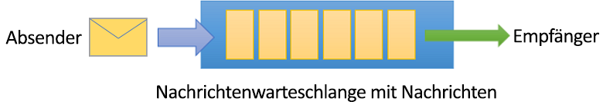
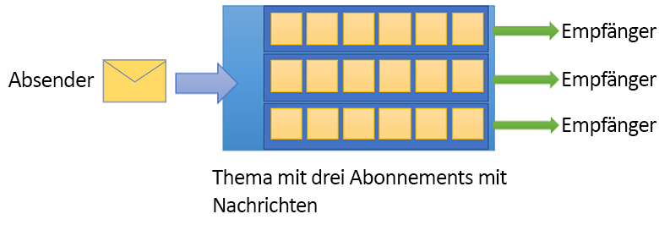
Azure Service Bus
Enables your applications to interact in several different ways
Uses a namespace as a scoping container for all messaging components
The communication mechanisms are:
Queues (genau eine Auslieferung)
Topics (parallel geschaltete Queues)
Notes:
Azure Service Bus is a fully managed enterprise integration message broker. Service Bus is most commonly used to decouple applications and services from each other, and is a reliable and secure platform for asynchronous data and state transfer. Data is transferred between different applications and services by using messages. A message is in binary format, which can contain JSON, XML, or just text.
A namespace is a scoping container for all messaging components. Multiple queues and topics can reside within a single namespace, and namespaces often serve as application containers.
Some common messaging scenarios are:
Messaging: transfer business data, such as sales or purchase orders, journals, or inventory movements.
Decouple applications: improve reliability and scalability of applications and services (client and service do not have to be online at the same time).
Topics and subscriptions: enable 1:n relationships between publishers and subscribers.
Message sessions: implement workflows that require message ordering or message deferral.

Slide 8
Events vs. messaging services→Prüfung
Service | Purpose | Type | When to use
Event Grid (analog zu UDP, ≙AP) | Reactive (Schnell und unzuverlässig, und ausfallsrobust←CAP-Theorem) programming | Event distribution (discrete) | React to status changes
Event Hubs | Big data pipeline | Event streaming (series) | Telemetry and distributed data streaming
Service Bus (analog zu TCP, ≙CP) | High-value enterprise messaging (WaWis,Relays, Garantierte Reihenfolge/Auslieferung, Transaktionen) | Message | Order processing and financial transactions
Notes:
Event
An event is a lightweight notification of a condition or a state change. The publisher of the event has no expectation about how the event is handled. The consumer of the event decides what to do with the notification. Events can be discrete units or part of a series.
Discrete events report state change and are actionable. To take the next step, the consumer only needs to know that something happened. The event data has information about what happened but doesn't have the data that triggered the event. For example, an event notifies consumers that a file was created. It might have general information about the file, but it doesn't have the file itself. Discrete events are ideal for serverless solutions that need to scale.
Series events report a condition and are analyzable. The events are time ordered and interrelated. The consumer needs the sequenced series of events to analyze what happened.
Message
A message is raw data produced by a service to be consumed or stored elsewhere. The message contains the data that triggered the message pipeline. The publisher of the message has an expectation about how the consumer handles the message. A contract exists between the two sides. For example, the publisher sends a message with the raw data, and expects the consumer to create a file from that data and send a response when the work is done.

Slide 9

Queues
Messages are sent to and received from queues
Enables you to store messages until the receiving application is available to receive and process them
Supports a brokered messaging communication model
A general-purpose technology that can be used for a wide variety of scenarios
Genau eine Auslieferung
Sender
Receiver
Message queue with messages
Notes:
Queues offer first in, first out (FIFO) message delivery to one or more competing consumers. That is, receivers typically receive and process messages in the order in which they were added to the queue, and only one message consumer receives and processes each message. A key benefit of using queues is to achieve temporal decoupling of application components. In other words, the producers (senders) and consumers (receivers) do not have to be sending and receiving messages at the same time, because messages are stored durably in the queue. Furthermore, the producer does not have to wait for a reply from the consumer in order to continue to process and send messages.
A related benefit is load leveling, which enables producers and consumers to send and receive messages at different rates. In many applications, the system load varies over time; however, the processing time required for each unit of work is typically constant. Intermediating message producers and consumers with a queue means that the consuming application only has to be provisioned to be able to handle average load instead of peak load. The depth of the queue grows and contracts as the incoming load varies. This capability directly saves money with regard to the amount of infrastructure required to service the application load. As the load increases, more worker processes can be added to read from the queue. Each message is processed by only one of the worker processes. Furthermore, this pull-based load balancing allows for optimum use of the worker computers even if the worker computers differ with regard to processing power, because they pull messages at their own maximum rate. This pattern is often termed the competing consumer pattern.
Using queues to intermediate between message producers and consumers provides an inherent loose coupling between the components. Because producers and consumers are not aware of each other, a consumer can be upgraded without having any effect on the producer.

Slide 10

Queue-based load leveling
Tasks
Ein Service
only 1 consumer.
Message queue
Requests received at a variable rate
Messages processed at a more consistent rate
Notes:
Use a queue that acts as a buffer between a task and a service it invokes, to smooth intermittent heavy loads that can cause the service to fail or the task to time out. This can help to minimize the impact of peaks in demand on availability and responsiveness for both the task and the service.
Refactor the solution and introduce a queue between the task and the service. The task and the service run asynchronously. The task posts a message containing the data required by the service to a queue. The queue acts as a buffer, storing the message until it's retrieved by the service. The service retrieves the messages from the queue and processes them. Requests from a number of tasks, which can be generated at a highly variable rate, can be passed to the service through the same message queue. This figure shows using a queue to level the load on a service.

Slide 11
Topics and subscriptions (streng lokal-deterministisch)
Implements publish/subscribe (pub-sub) model
Receivers subscribe to a topic, and they can even filter down by interest
A sender publishes messages to the topic
Asynchronously, receivers get their own copy of the message
Subscriptions are independent, which allows for many independent “taps” into a message stream
→ermöglicht asynchrones (unterschiedlich schnelles) Arbeiten.
Receiver
Durchaus mehrere Sender
Receiver
Receiver
Topic with three subscriptions
with messages
Notes:
In contrast to queues, in which each message is processed by a single consumer, topics and subscriptions provide a one-to-many form of communication, in a publish/subscribe pattern. Useful for scaling to large numbers of recipients, each published message is made available to each subscription registered with the topic. Messages are sent to a topic and delivered to one or more associated subscriptions, depending on filter rules that can be set on a per-subscription basis. The subscriptions can use additional filters to restrict the messages that they want to receive. Messages are sent to a topic in the same way they are sent to a queue, but messages are not received from the topic directly. Instead, they are received from subscriptions. A topic subscription resembles a virtual queue that receives copies of the messages that are sent to the topic. Messages are received from a subscription identically to the way they are received from a queue.
By way of comparison, the message-sending functionality of a queue maps directly to a topic and its message-receiving functionality maps to a subscription. Among other things, this feature means that subscriptions support the same patterns described earlier in this section with regard to queues: competing consumer, temporal decoupling, load leveling, and load balancing.

Slide 12
Messages, payloads, and serialization
Messages carry multiple things
Metadata about the message itself (in key-value pairs)
Predefined Broker properties
The message binary payload
Länge
Bis zu ¼ MB (1MB bei Premium), bei
Bei mehr bitte nur die blob.core.windows.net-Links angeben und damit bis zu 8TB lange Nachrichten verpacken.
Message payload is not visible to Service Bus at any point
Serializes as opaque, binary content
Can be deserialized by using client SDK libraries
Gives you the flexibility to explicitly define how you want to serialize content
Notes:
Messages carry a payload and metadata, in the form of key-value pair properties, describing the payload and giving handling instructions to Service Bus and applications. Occasionally, that metadata alone is sufficient to carry the information that the sender wants to communicate to receivers, and the payload remains empty.
The object model of the official Service Bus clients for .NET and Java reflect the abstract Service Bus message structure, which is mapped to and from the wire protocols Service Bus supports.
A Service Bus message consists of a binary payload section that Service Bus never handles in any form on the service side, and two sets of properties. The broker properties are predefined by the system. These predefined properties either control message-level functionality inside the broker or map to common and standardized metadata items. The user properties are a collection of key-value pairs that can be defined and set by the application.
Payload serialization
When in transit or stored inside of Service Bus, the payload is always an opaque, binary block. The ContentType property enables applications to describe the payload, with the suggested format for the property values being a MIME content-type description according to IETF RFC2045; for example, application/json;charset=utf-8.
Unlike the Java or .NET Standard variants, the .NET Framework version of the Service Bus API supports creating BrokeredMessage instances by passing arbitrary .NET objects into the constructor.
When using the legacy Simple Network Management Protocol (SBMP), those objects are then serialized with the default binary serializer, or with a serializer that is externally supplied. When using the Advanced Message Queuing Protocol (AMQP), the object is serialized into an AMQP object. The receiver can retrieve those objects with the GetBody() method, supplying the expected type. With AMQP, the objects are serialized into an AMQP graph of ArrayList and IDictionary<string,object> objects, and any AMQP client can decode them.
While this hidden serialization magic is convenient, applications should take explicit control of object serialization and turn their object graphs into streams before including them into a message, and do the reverse on the receiver side. This yields interoperable results. It should also be noted that while AMQP has a powerful binary encoding model, it is tied to the AMQP messaging ecosystem and HTTP clients will have trouble decoding such payloads.

Slide 13
Demonstration: Using .NET to send and receive messages from a Service Bus queue
S. 285.

Slide 14
Lesson 02: Azure Queue Storage

Slide 15
Azure Queue storage vs Azure Service Bus queues (auch im Preis ASQ vs ASB-Q).
Service for storing messages in an Azure Storage account
Accessed using HTTP or HTTPS
Scalable to millions of messages
Common uses of Queue storage include:
Creating a backlog of work to process asynchronously
Passing messages from an Azure web role to an Azure worker role
Notes:
Azure Queue storage is a service for storing large numbers of messages that can be accessed from anywhere in the world via authenticated calls using HTTP or HTTPS. A single queue message can be up to 64 kilobytes (KB) in size, and a queue can contain millions of messages, up to the total capacity limit of a storage account.

Slide 16



Components
URL format
https://<storage-account>.queue.core.windows.net/<queue>
Storage account
Queue
Message
A queue message can be up to 64 KB in size.
https://az204speicher.queue.core.windows.net/intend
Storage account
Queue
Image-to-download
myaccount
Image-to-resize
Queue service components
Notes:
The Queue service contains the following components:
URL format: Queues are addressable by using the following URL format: https://<storage account>.queue.core.windows.net/<queue> The following URL addresses a queue in the diagram: https://myaccount.queue.core.windows.net/images-to-download
Storage account: All access to Azure Storage is done through a storage account.
Queue: A queue contains a set of messages. All messages must be in a queue. Note that the queue name must be all lowercase.
Message: A message, in any format, of up to 64 KB. The maximum time that a message can remain in the queue is seven days.

Slide 17
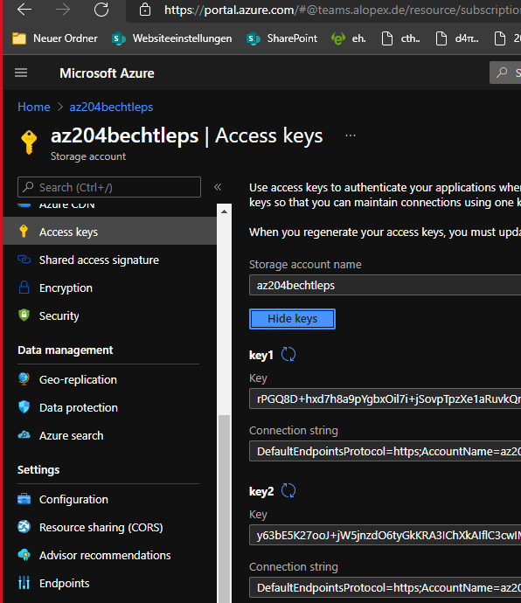
Code examples
// connection string in application’s configuration file
<add key="StorageConnectionString" value="DefaultEndpointsProtocol=https;AccountName=storagesample;AccountKey=GMuzNHjlB3S9itqZJHHCnRkrokLkcSyW7yK9BRbGp0ENePunLPwBgpxV1Z/pVo9zpem/2xSHXkMqTHHLcx8XRA==" />
// create instance of CloudStorageAccount class
CloudStorageAccount account = CloudStorageAccount.Parse("StorageConnectionString");
// create queue client
CloudQueueClient queueClient = account.CreateCloudQueueClient();
// retrieve reference to queue
CloudQueue queue = queueClient.GetQueueReference("myqueue");
// Create the queue if it doesn't already exist
queue.CreateIfNotExists();
Notes:
The Azure Storage Client Library for .NET supports using a storage connection string to configure endpoints and credentials for accessing storage services. The best way to maintain your storage connection string is in a configuration file.
To configure your connection string, open the application’s configuration file in Microsoft Visual Studio and add a new element to the <appSettings> section.
The CloudQueueClient class enables you to retrieve queues stored in Queue storage.

Slide 18
Code examples – create and get messages
// Create a message and add it to the queue.
CloudQueueMessage message = new CloudQueueMessage("Hello, World");
queue.AddMessage(message);
// Peek at the next message
CloudQueueMessage peekedMessage = queue.PeekMessage(); //→Lesen aber kein Löschen.
// Fetch the queue attributes.
queue.FetchAttributes();
// Retrieve the cached approximate message count.
int? cachedMessageCount = queue.ApproximateMessageCount;
Notes:
To insert a message into an existing queue, first create a new CloudQueueMessage. Next, call the AddMessage method. A CloudQueueMessage can be created from either a string (in UTF-8 format) or a byte array.
You can peek at the message in the front of a queue without removing it from the queue by calling the PeekMessage method.
You can get an estimate of the number of messages in a queue. The FetchAttributes method asks the Queue service to retrieve the queue attributes, including the message count. The ApproximateMessageCount property returns the last value retrieved by the FetchAttributes method, without calling the Queue service.

Slide 19
Code examples – retrieve and change message (magic-of-transactionscope einschießlich MSDTC-Support: gsv msdtc|fl –property *
// Get the next message
// using (TransactionScope scope = new TransactionScope()) //Allerdings wird nur eine ASB-Queue auch wirklich rollback/commit-Aufrufe in diesen scope eintragen.
TransactionScope scope = new TransactionScope()
try{//Wie in Java per try(var a=new kkk()){} , wobei kkk AutoClosable implementieren muß.
{
CloudQueueMessage retrievedMessage = queue.GetMessage(); //Process the message in less than 30 seconds, and then delete the message
queue.DeleteMessage(retrievedMessage); // Get the message from the queue and update the message contents.
CloudQueueMessage message = queue.GetMessage(); //→Lesen und Löschen (aber per scope transaktionsgeschützt).
message.SetMessageContent("Updated contents.");
queue.UpdateMessage( message,
TimeSpan.FromSeconds(60.0), // Make it invisible for another 60 seconds.
MessageUpdateFields.Content | MessageUpdateFields.Visibility );
scope .Commit ();
}
finally{if(scope !=null){scope .Rollback(); scope .Dispose();}} //Wie in Java
Notes:
Your code de-queues a message from a queue in two steps. When you call GetMessage, you get the next message in a queue. A message returned from GetMessagebecomes invisible to any other code reading messages from this queue. By default, this message stays invisible for 30 seconds. To finish removing the message from the queue, you must also call DeleteMessage. This two-step process of removing a message assures that if your code fails to process a message due to hardware or software failure, another instance of your code can get the same message and try again. Your code calls DeleteMessage right after the message has been processed.
You can change the contents of a message in-place in the queue. If the message represents a work task, you could use this feature to update the status of the work task. The following code updates the queue message with new contents, and sets the visibility timeout to extend another 60 seconds. This saves the state of work associated with the message, and gives the client another minute to continue working on the message. You could use this technique to track multi-step workflows on queue messages, without having to start over from the beginning if a processing step fails due to hardware or software failure. Typically, you would keep a retry count as well, and if the message is retried more than n times, you would delete it. This protects against a message that triggers an application error each time it is processed.

Slide 20

Lab: Asynchronously processing messages by using Azure Storage queues
Notes:
This lab is scheduled to take 45 minutes.

Slide 21

Lab sign-in information
Duration
Lab 10: Asynchronously processing messages by using Azure Storage queues
http://aka.ms/az204labs
AZ204-SEA-DEV
Username: Admin
Password: Pa55w.rd
Notes:
Students will also have access to the following scenario description in their lab guide:
You're studying various ways to communicate between isolated service components in Microsoft Azure, and you have decided to evaluate the Azure Storage service and its Queue service offering.
As part of this evaluation, you'll build a prototype application in .NET that can send and receive messages so that you can measure the complexity involved in using this service.
To help you with your evaluation, you've also decided to use Azure Storage Explorer as the queue message producer/consumer throughout your tests.

