Slide 1
COVID-19 Transmission Dynamics modelling
Prepared by: Egor Udalov, J4234c

Slide 2
Outline
Task statement
Dataset overview
Mathematical model overview
Improved model overview
Optimization process configuration
Results
Conclusions

Slide 3
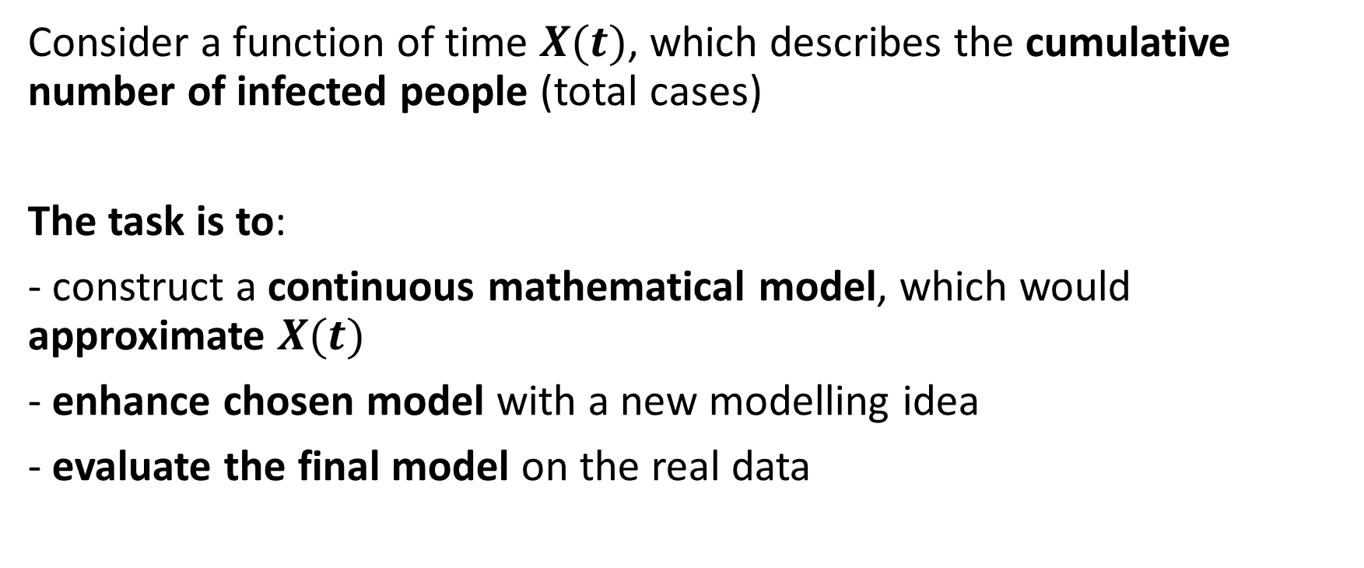
Task Statement
Consider a function of time $X(t)$, which describes the cumulative number of infected people (total cases)
The task is to:
- construct a continuous mathematical model, which would approximate $X(t)$
- enhance chosen model with a new modelling idea
- evaluate the final model on the real data

Slide 4
Dataset overview
Source: https://covid-19.nyc3.digitaloceanspaces.com/
Short description: data contains up-to-date info for all countries about different metrics related to COVID-19
Selected countries: Italy, Germany, Russia, United Kingdom
Field | Description
location | Name of the country
date | Date in YY-MM-DD format
total_cases | Cumulative number of infected people
reproduction_rate | The number of additional infections by an infected person before it recovers (at the corresponding day)
Table. List of selected fields from original dataset

Slide 5
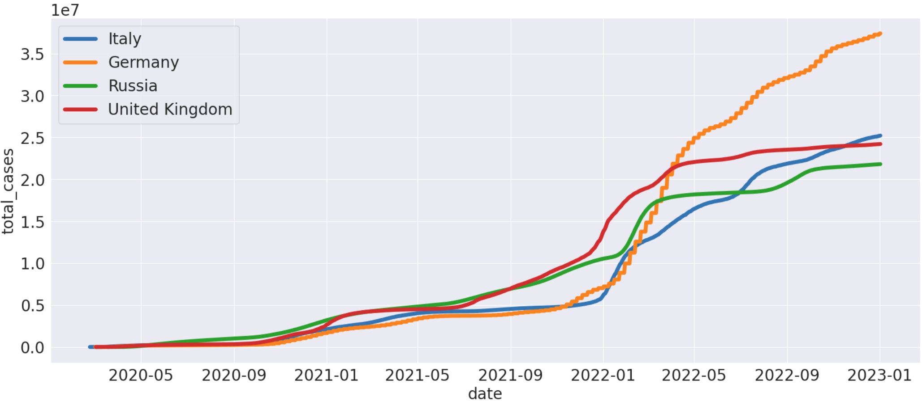
Dataset overview
Figure. Dynamics of the total cases (cumulative sum of the number infected people)

Slide 6
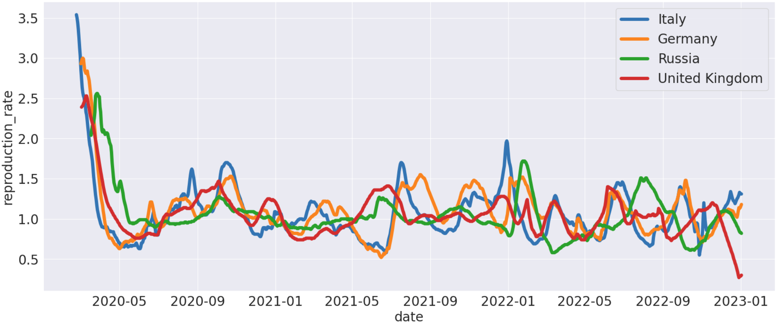
Dataset overview
Figure. Dynamics of the reproduction rate

Slide 7
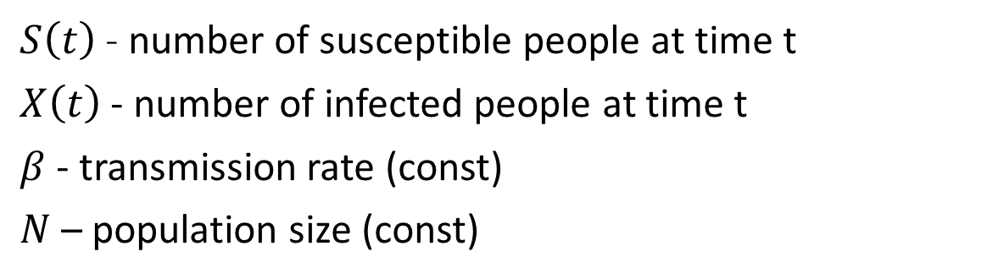
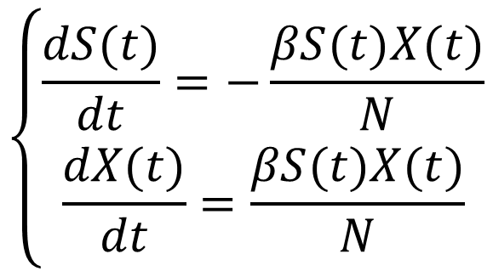
Mathematical model overview
Model name: Susceptible-Infected model (SI)
$$\left\{\begin{aligned}\frac{dS(t)}{dt}=−\#\#\#\frac{βS(t)X(t)}{N} \\ \frac{dX(t)}{dt}=\frac{βS(t)X(t)}{N}\end{aligned}\right.$$
$S\left(t\right)$ - number of susceptible people at time t
$X\left(t\right)$ - number of infected people at time t
$β$ - transmission rate (const)
$N$ – population size (const)

Slide 8
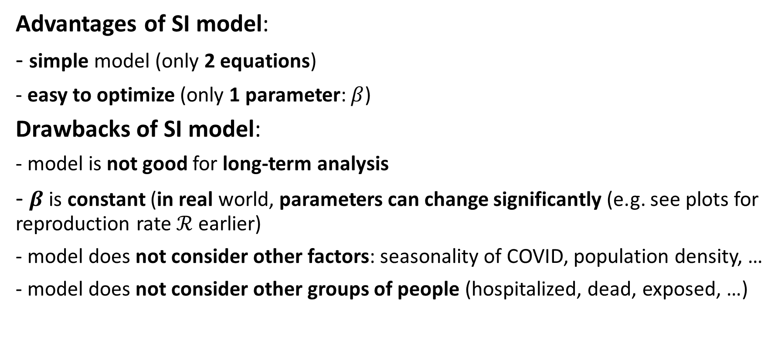
Mathematical model overview
Advantages of SI model:
- simple model (only 2 equations)
- easy to optimize (only 1 parameter: $β$)
Drawbacks of SI model:
- model is not good for long-term analysis
- $β$ is constant (in real world, parameters can change significantly (e.g. see plots for reproduction rate $ℛ$ earlier)
- model does not consider other factors: seasonality of COVID, population density, …
- model does not consider other groups of people (hospitalized, dead, exposed, …)

Slide 9
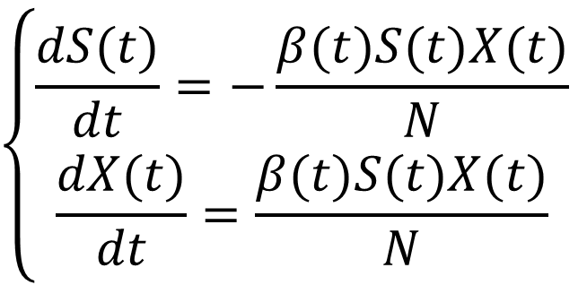
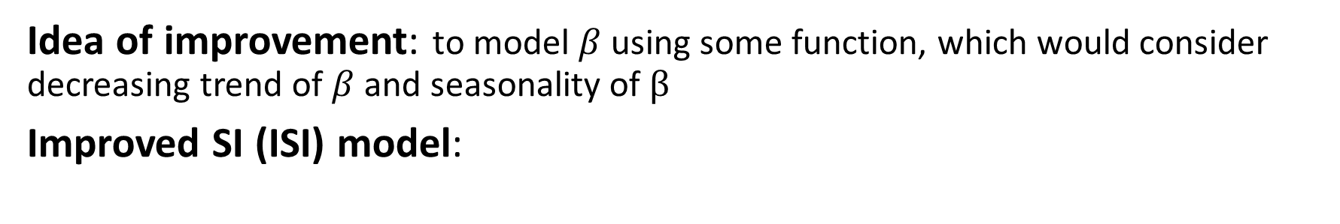
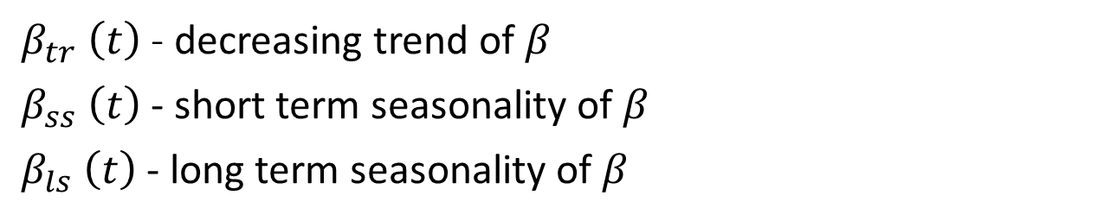
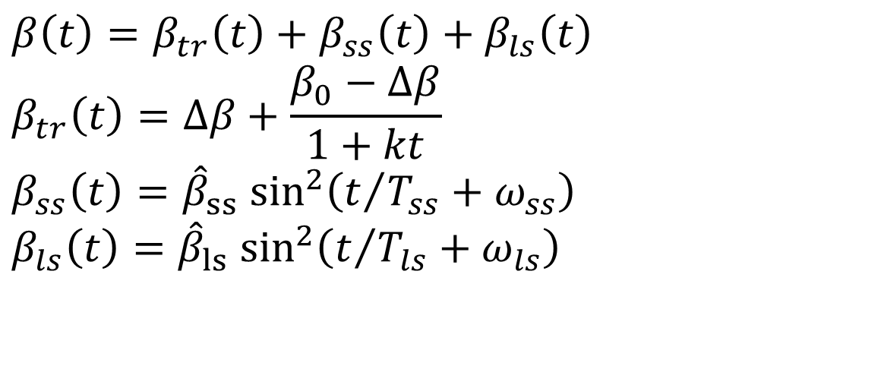
Improved model overview
Idea of improvement: to model $β$ using some function, which would consider decreasing trend of $β$ and seasonality of $β$
Improved SI (ISI) model:
$$β\left(t\right)=β_{tr}\left(t\right)+β_{ss}\left(t\right)+β_{ls}\left(t\right)$$
$$β_{tr}\left(t\right)=Δβ+\frac{β_{0}−Δβ}{1+kt}$$
$$β_{ss}\left(t\right)={\hat{β}}_{ss} \sin^{2}\left(t/{T_{ss}}+ω_{ss}\right)$$
$$β_{ls}\left(t\right)={\hat{β}}_{ls} \sin^{2}\left(t/{T_{ls}}+ω_{ls}\right)$$
$$\left\{\begin{aligned}\frac{dS(t)}{dt}=−\#\#\#\frac{β(t)S(t)X(t)}{N} \\ \frac{dX(t)}{dt}=\frac{β(t)S(t)X(t)}{N}\end{aligned}\right.$$
$β_{tr} \left(t\right)$ - decreasing trend of $β$
$β_{ss} \left(t\right)$ - short term seasonality of $β$
$β_{ls} \left(t\right)$- long term seasonality of $β$

Slide 10
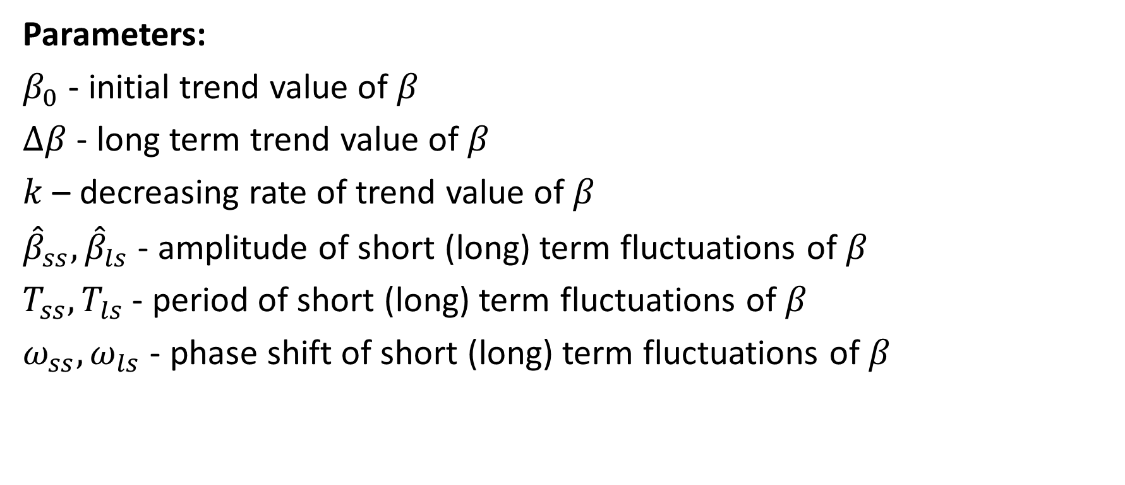
Improved model overview
Parameters:
$β_{0}$ - initial trend value of $β$
$Δβ$ - long term trend value of $β$
$k$ – decreasing rate of trend value of $β$
${\hat{β}}_{ss},{\hat{β}}_{ls}$ - amplitude of short (long) term fluctuations of $β$
$T_{ss},T_{ls}$ - period of short (long) term fluctuations of $β$
$ω_{ss},ω_{ls}$ - phase shift of short (long) term fluctuations of $β$
Number of parameters: 9

Slide 11
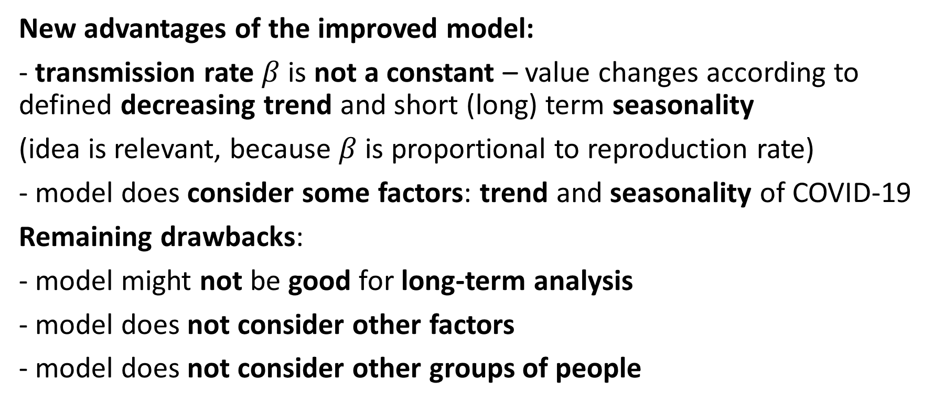
Improved model overview
New advantages of the improved model:
- transmission rate $β$ is not a constant – value changes according to defined decreasing trend and short (long) term seasonality
(idea is relevant, because $β$ is proportional to reproduction rate)
- model does consider some factors: trend and seasonality of COVID-19
Remaining drawbacks:
- model might not be good for long-term analysis
- model does not consider other factors
- model does not consider other groups of people

Slide 12
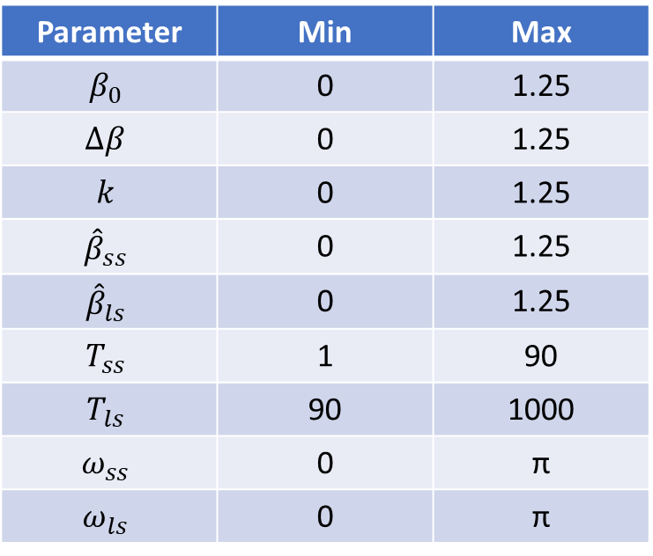
Optimization process configuration
Optimization method: Nelder-Mead method with constraints
Initialization of parameters: sample from uniform distribution
Number of runs: 1000
Train set ratio: 0.8
Parameters are optimized on the train set (first 80% of the time series)
Best parameters - according to the metric on the whole set
Parameter | Min | Max
$$β_{0}$$ | 0 | 1.25
$$Δβ$$ | 0 | 1.25
$$k$$ | 0 | 1.25
$${\hat{β}}_{ss}$$ | 0 | 1.25
$${\hat{β}}_{ls}$$ | 0 | 1.25
$$T_{ss}$$ | 1 | 90
$$T_{ls}$$ | 90 | 1000
$$ω_{ss}$$ | 0 | π
$$ω_{ls}$$ | 0 | π
Table. Parameters’ constraints

Slide 13
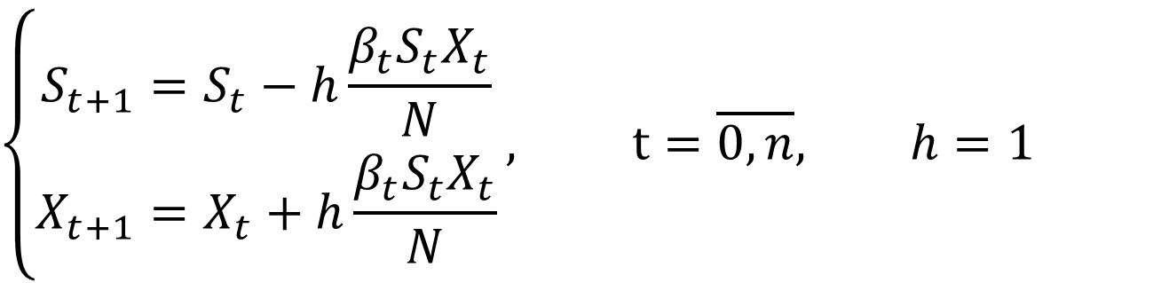
Optimization process configuration
Metric: MAPE
Approximation of ISI model: 1-order
$$\left\{\begin{aligned}S_{t+1}=S_{t}−h\frac{β_{t}S_{t}X_{t}}{N} \\ X_{t+1}=X_{t}+h\frac{β_{t}S_{t}X_{t}}{N}\end{aligned}\right., t=\overline{0,n}, h=1$$
Initial conditions:
$$S_{0}=N, X_{0}=X_{init}$$

Slide 14
Results
Model | Location | MAPE (train) | MAPE (val)
SI | Italy | 0.994 | 0.995
 | Germany | 0.986 | 0.989
 | Russia | 0.992 | 0.994
 | United Kingdom | 0.992 | 0.994
ISI | Italy | 0.343 | 0.276
 | Germany | 0.312 | 0.261
 | Russia | 0.237 | 0.240
 | United Kingdom | 0.285 | 0.231
Table. Results for the best sets of parameters

Slide 15
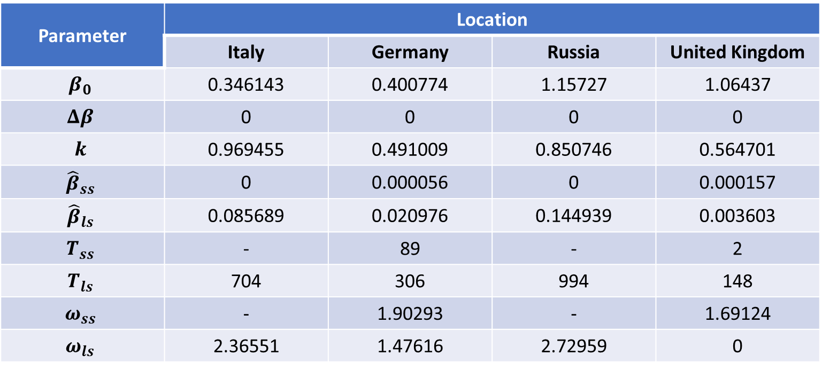
Results
Parameter | Location
Parameter | Italy | Germany | Russia | United Kingdom
$$β_{0}$$ | 0.346143 | 0.400774 | 1.15727 | 1.06437
$$Δβ$$ | 0 | 0 | 0 | 0
$$k$$ | 0.969455 | 0.491009 | 0.850746 | 0.564701
$${\hat{β}}_{ss}$$ | 0 | 0.000056 | 0 | 0.000157
$${\hat{β}}_{ls}$$ | 0.085689 | 0.020976 | 0.144939 | 0.003603
$$T_{ss}$$ | - | 89 | - | 2
$$T_{ls}$$ | 704 | 306 | 994 | 148
$$ω_{ss}$$ | - | 1.90293 | - | 1.69124
$$ω_{ls}$$ | 2.36551 | 1.47616 | 2.72959 | 0
Table. Best sets of parameters for ISI model

Slide 16
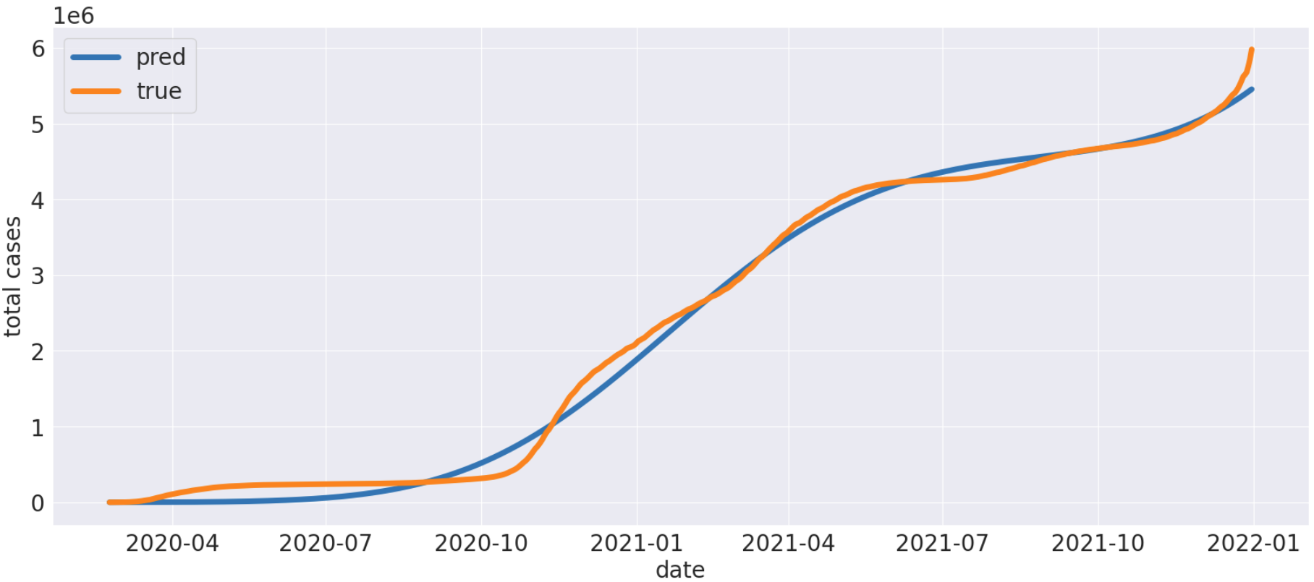
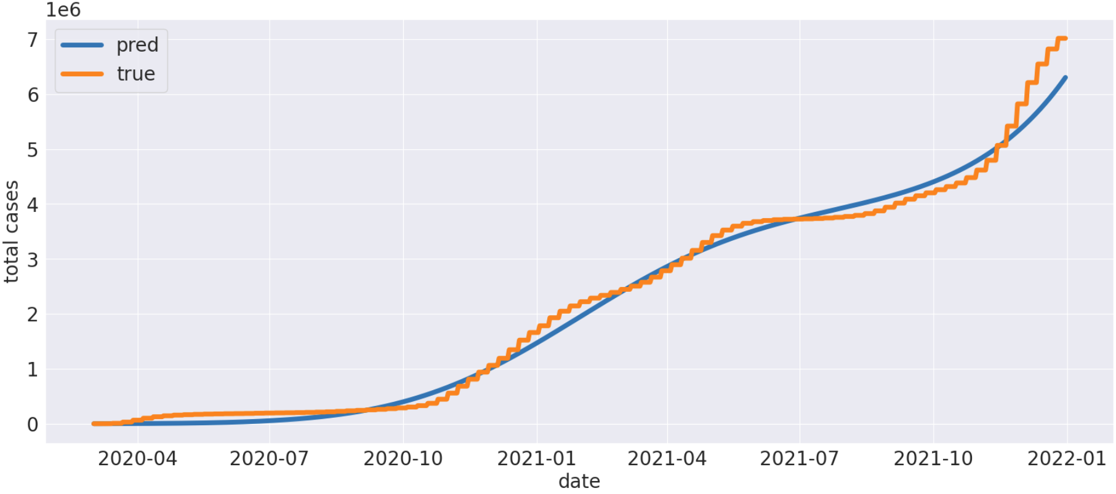
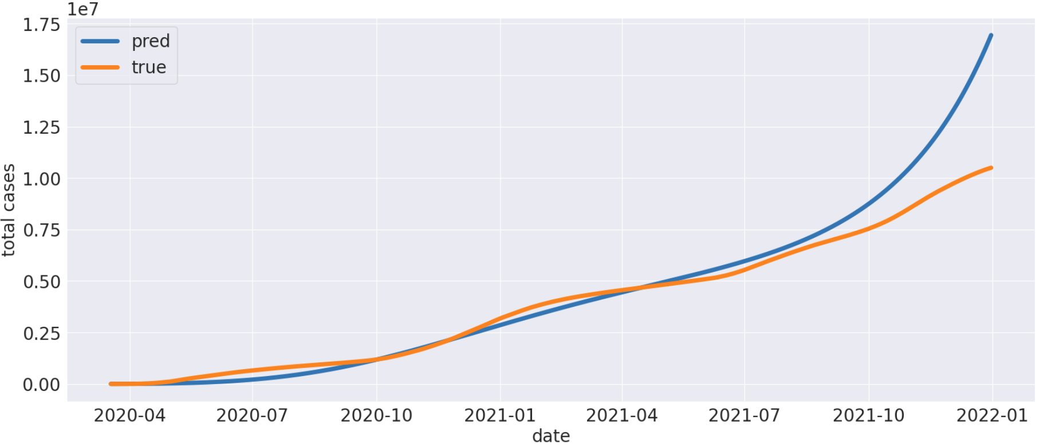
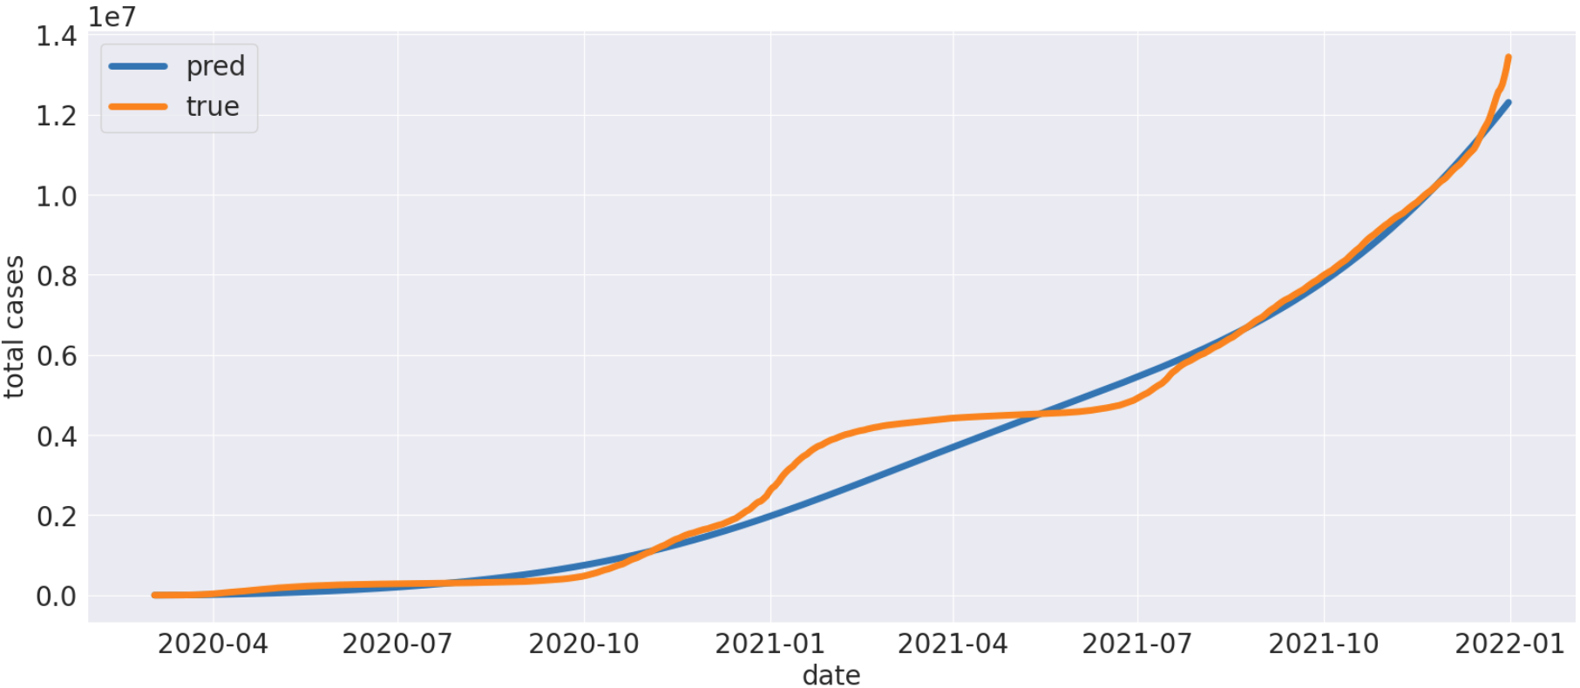
Results
Figure. Total cases dynamics for Italy
Figure. Total cases dynamics for Germany
Figure. Total cases dynamics for Russia
Figure. Total cases dynamics for UK

Slide 17
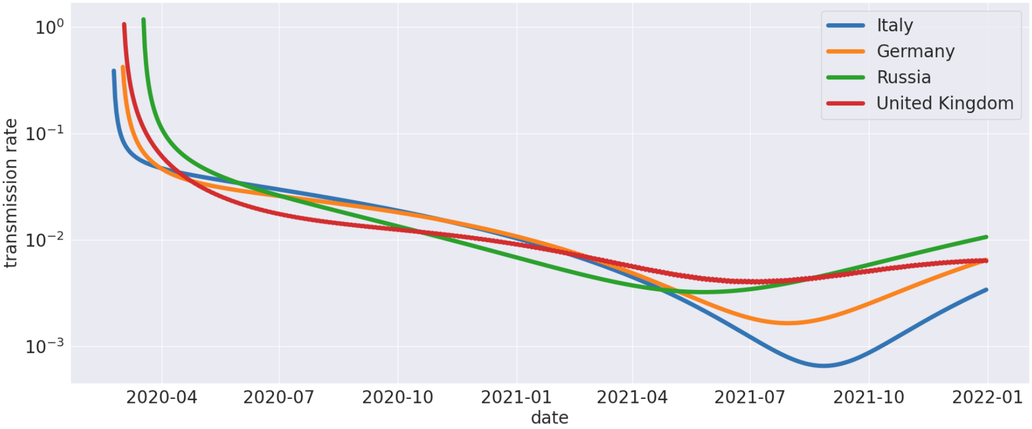
Results
Figure. Transmission rate dynamics

Slide 18
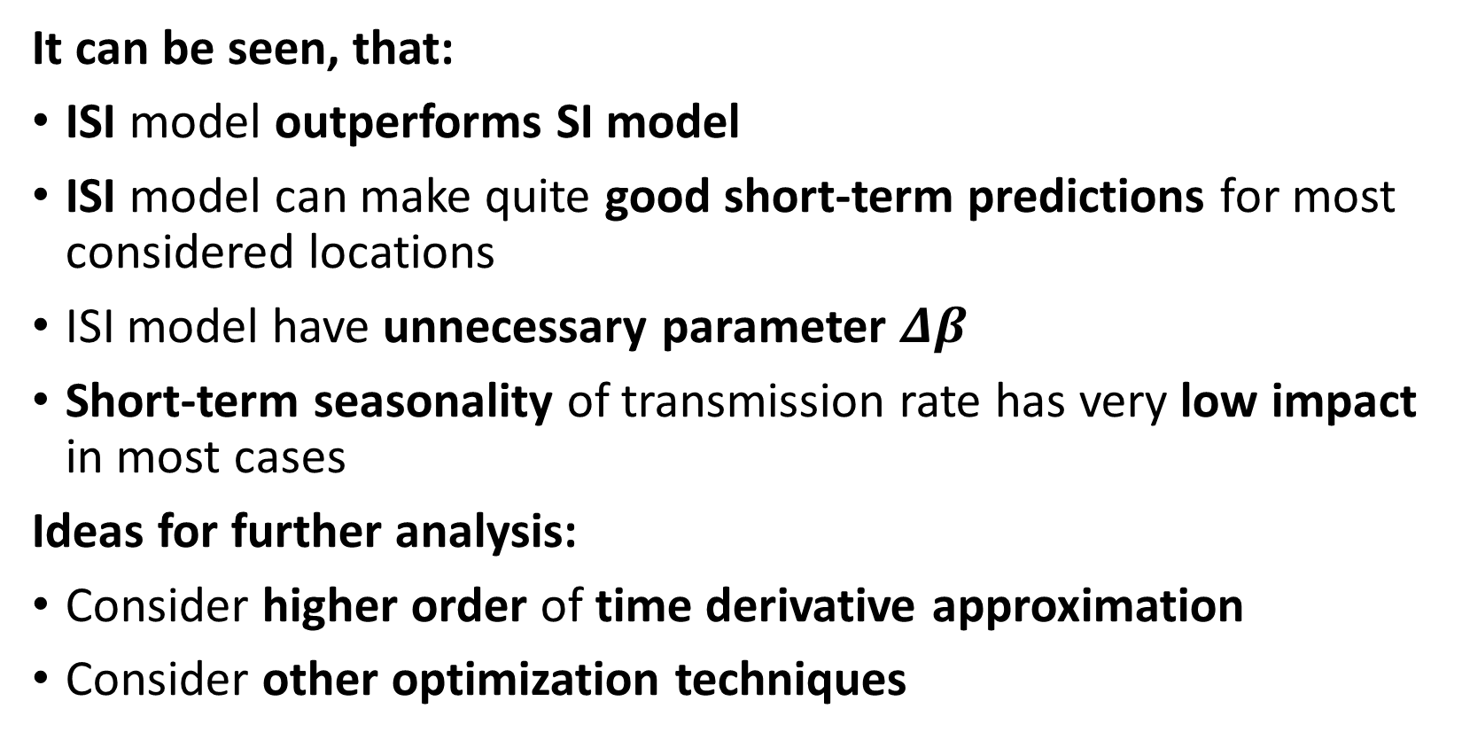
Conclusions
It can be seen, that:
ISI model outperforms SI model
ISI model can make quite good short-term predictions for most considered locations
ISI model have unnecessary parameter $Δβ$
Short-term seasonality of transmission rate has very low impact in most cases
Ideas for further analysis:
Consider higher order of time derivative approximation
Consider other optimization techniques

Slide 19
Thanks for your attention!
Link to code: https://github.com/GitHub-User228/ContinuousMathematicalModelling

