Slide 1




TelCo Customer churn
Classification Model
By
Chamila C. Dharmawardhana

Slide 2
Project objectives
TelCo desires to have a data driven customer churn prediction model to facilitate future marketing decision.
What is the current customer churn distribution ?
What is the best classification method to model customer churn ?
What features prompt customer churn ?
Recommendations for the marketing team to retain customers

Slide 3
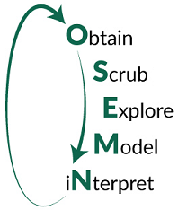
Methodology
Obtain : get data, evaluate requirements and formulate set of specific questions, the project can likely answer.
Scrub: Process and clean data. Remove outliers.
Explore: analyze and visualize data as much as possible to illuminate the
questions.
Model: pic a suitable ML model and fit the data. Validate the model and test for
accuracy.
Logistic regression
SVM
Random Forrest
XGBoost
iNterpret: more data analysis and visualization and interpret the model in order to answer the questions in the first section.

Slide 4
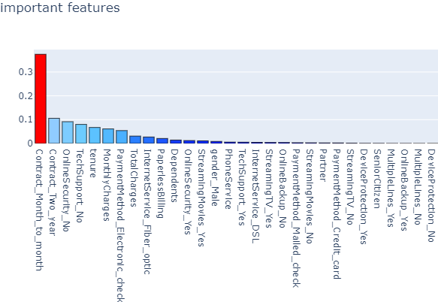
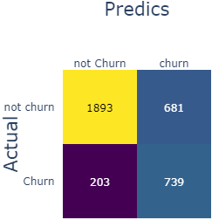

Best Model is Random Forest

Slide 5
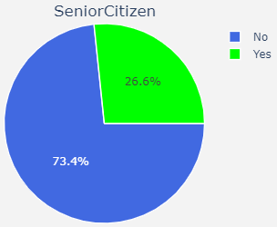
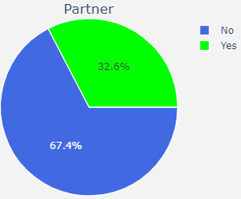
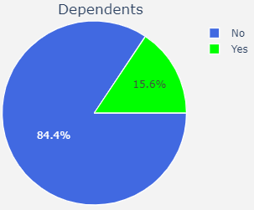
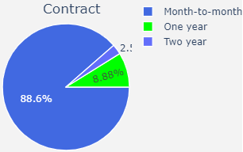
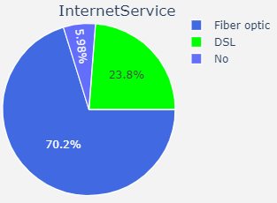
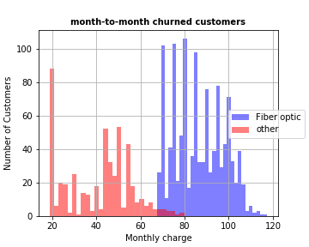
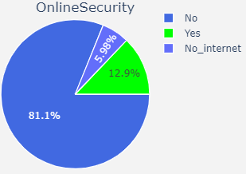
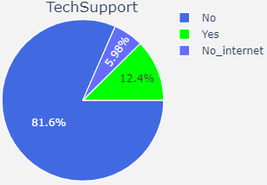
Contract
Young
single

Slide 6
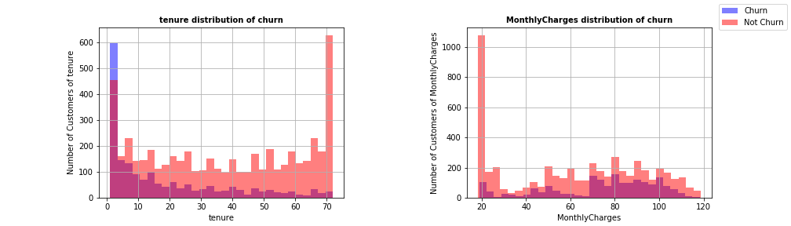
Tenure and monthly charge

Slide 7
Conclusion and recommendations
Random Forrest was the best model for Churn dataset
Top important features: Contract, Online Security, Tech Support, tenure, Monthly Charges and Payment Method
Month-to-month contracts are the most vulnerable. These are mostly young and single customers. Most have expensive Fiber_optics service.
Recommendations:
Target demography = young; Target technology = Fiber Optics
Provide services (for young) such as internet security, device protection, tech support at an economical price tide to two-year contract.
Mind the quality and the price of the Fiber Optics services
Provide easy and cheap DSL options for customers unsatisfied with Fiberoptics

Slide 8
Future work
More thorough dataset with many other important features such as income, locality, demography, educational background….etc.
Many other bagging and boosting methods as well as Neural Network methods could be tried if time permits.
Obtain data for several regions of the country to produce statistically significant conclusions.

Slide 9

Acknowledgement
Amber Yandow
Dara Paoletti
Khulood and Maria
Thank you

Slide 10
Extra slides

