Slide 1






What would you like to watch?
“A Data Science perspective”
By
Chamila C. Dharmawardhana

Slide 2
What are the key question ?
Selecting a genre based on box office success and customer ratings ?
What are the appropriate move runtime for different genres and how it affects the box office earnings ?
What is the best season to release the movies?
What genres works best for different seasons ?

Slide 3
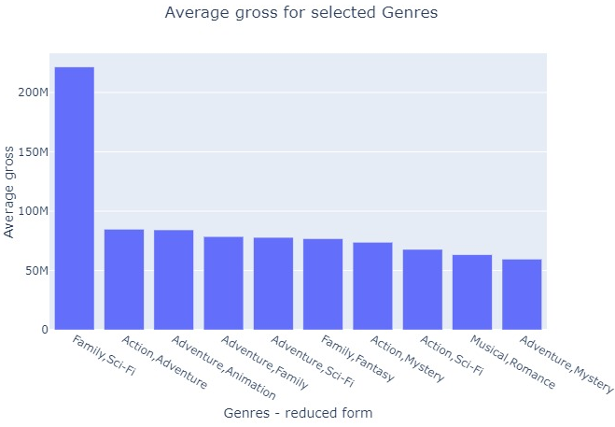
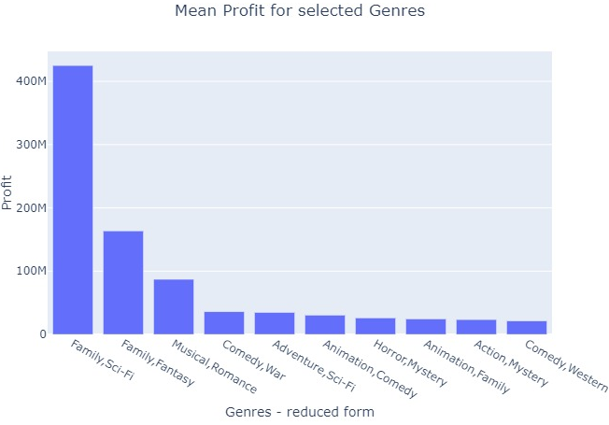
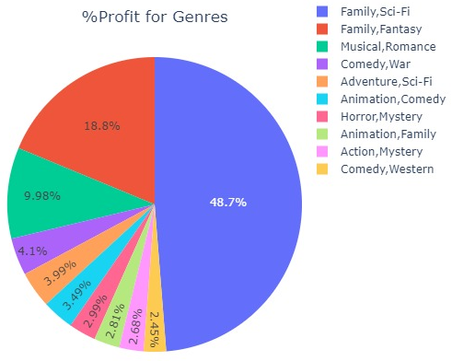
What are the most popular genres – gross and profit

Slide 4
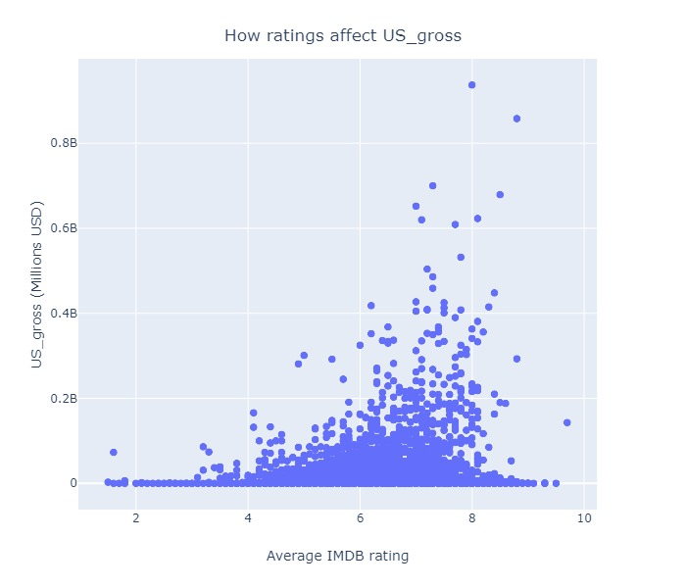
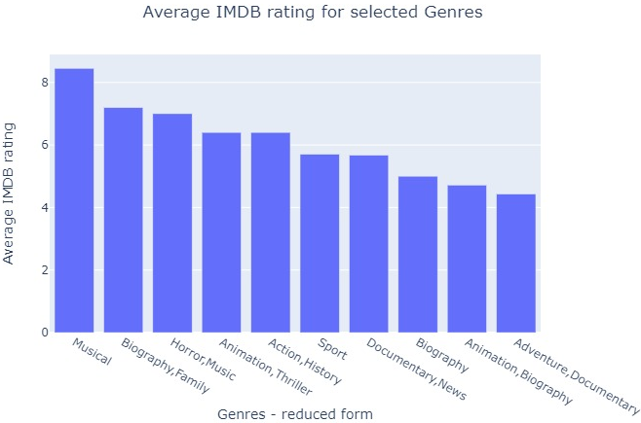
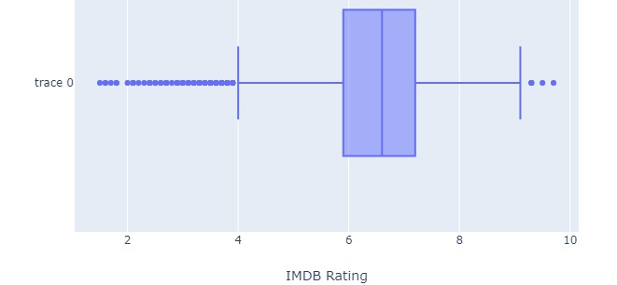
What are the most popular genres – IMDB rating
No obvious trends. Generally most movies has 6 -7.5 rating
This discrepancy is due to lack of rating data. The ratings of most of the highest gross movies were not included in the dataset.

Slide 5
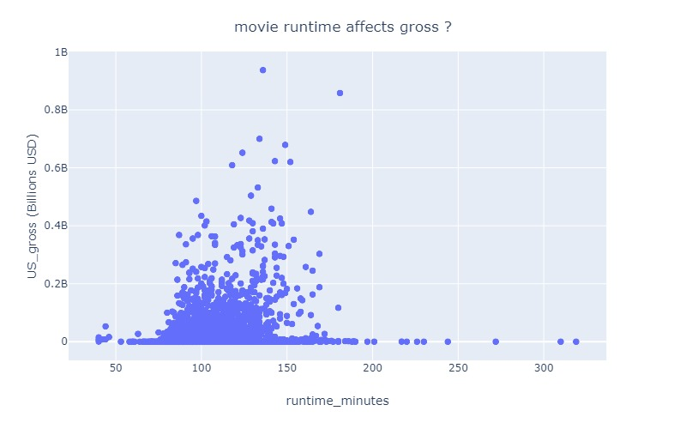
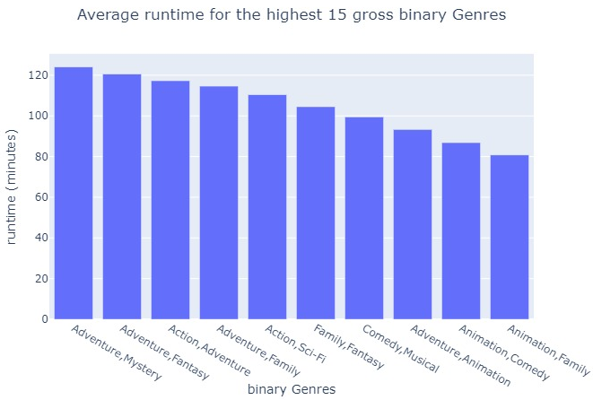
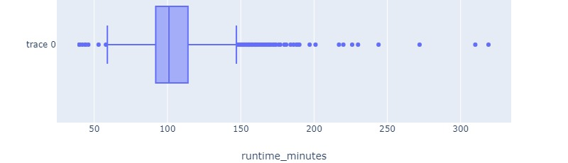
Movie runtime analysis
lack of runtime data affects the trend

Slide 6
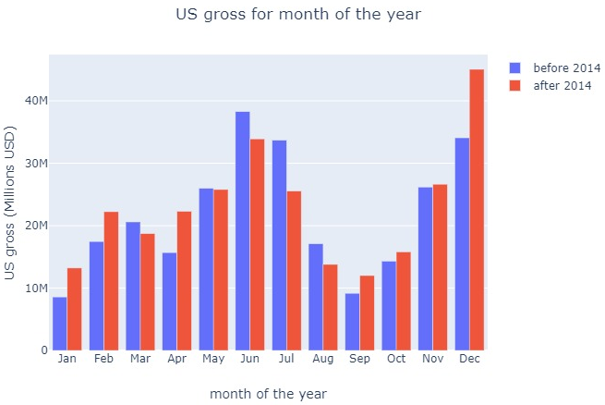
What month to release the movie ?
Summer
Christmas

Slide 7
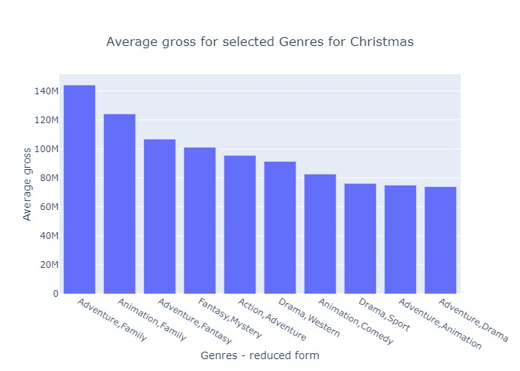
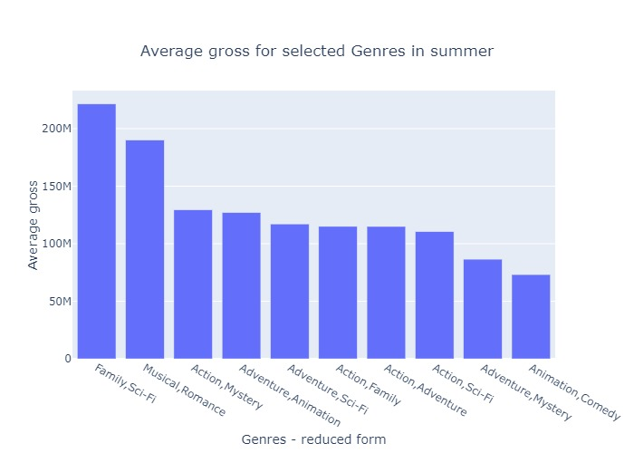
Most successful genres for summer and Christmas
“Family, Sci-Fi” movies do better in the summer months and “Adventure, Family” movies do better in Christmas

Slide 8
Recommendations
Family-SciFi or Action-Adventure genres tend to do better in the box office
Movie length should be generally 90 – 120 mins
Highest revenue is achieved for December released movies. Family-SciFi for summer and Family-Adventure for Christmas

Slide 9
Study limitations and Future directions
Limitations of present study:
Lack of clean and consistent data. Missing values were significant and affected the analysis and outcome significantly
Biased features such as IMDB rating
Limited time
Future directions of the study:
Use web scraping and effective API to gather complete set of data
New features may be found with further research
Finding a consistent way to properly assign single genres to movies

