Slide 1


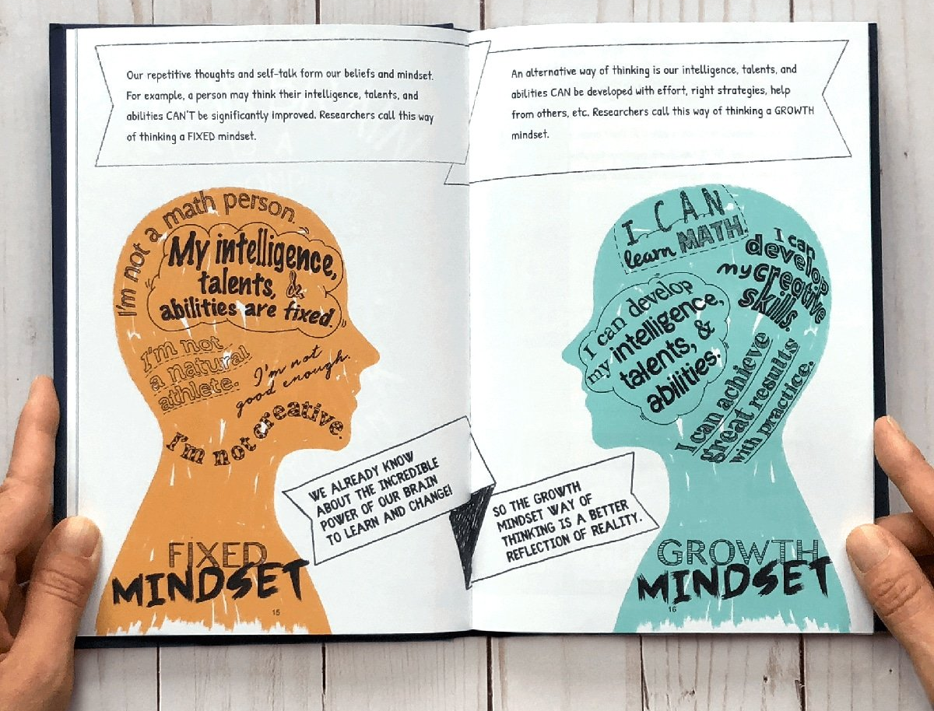
EmoJ– A Journal of emotional state
J
Chamila Dharmawardhana, PhD
Capstone project
Flatiron School
Data Science
07/28/2020

Slide 2
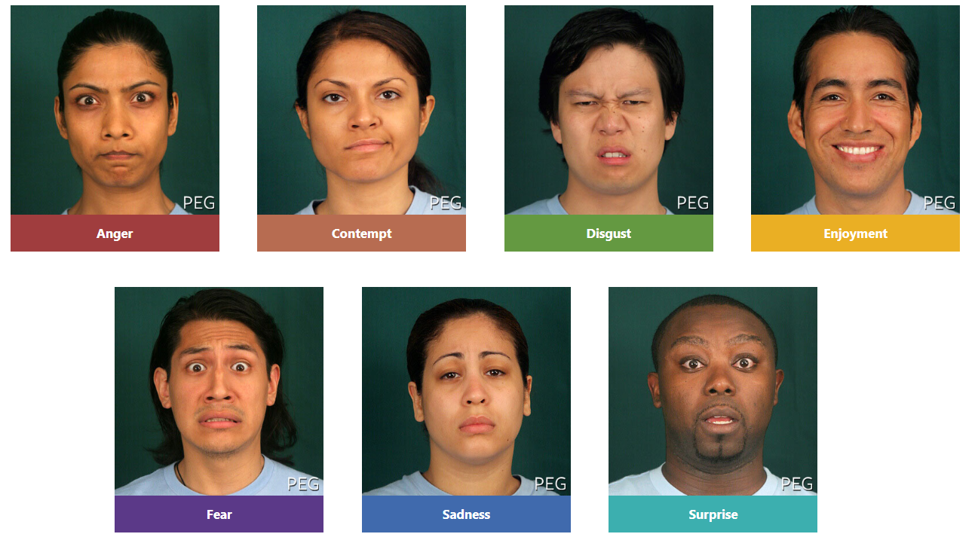
Human Facial Expressions
Human emotion is most vividly understood by facial expression. Dr. Paul Ekman’s shows there are 7 universal facial expression of emotion.
A personal journal is not only a record of events it’s a record of the person.
What if we can record images, translated to a record of emotions to record our emotional state in our daily life ?

Slide 3


The Challenge & Objective
Obtain diverse and large enough image dataset that is well labelled
Build a CNN model that can continuously improve with usage
Build a web app that is both efficient and attractive to the user
Develop meaningful analysis for the gathered data and useful reporting to the user

Slide 4
Strategy
The overall strategy is a three-stage process within ROSEMED method
Stage-1
FER2013 dataset
(FER model)
Stage-2
Scraped dataset
(FIW model)
Stage-3
user dataset
(continuous model)
Incorporate model
A web app

Slide 5
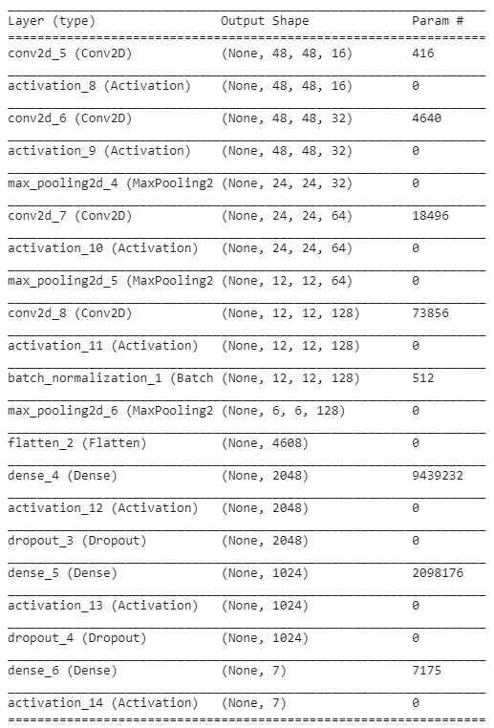
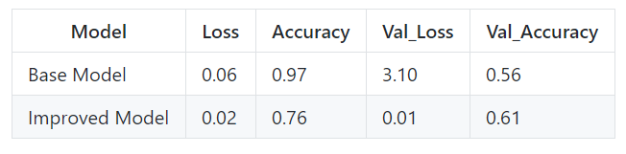
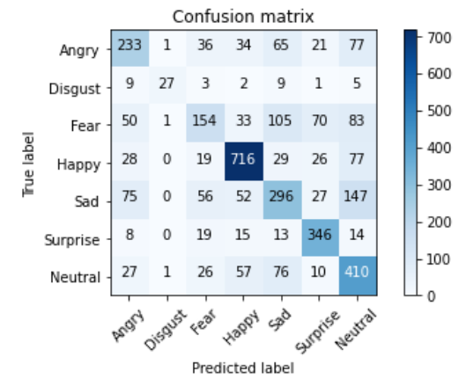
The Model

Slide 6
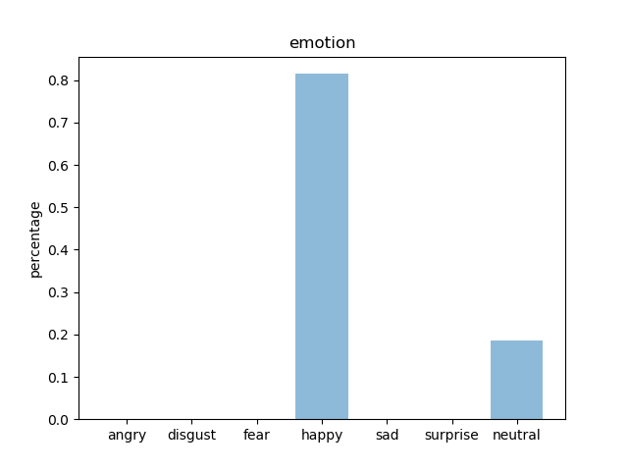

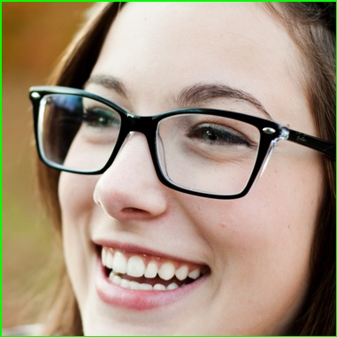







Results

Slide 7
Conclusion

Slide 8
Recomendations

Slide 9
Future work

Slide 10

Thank You
Amber Yandow
Ben Jacobson
Dara Paoletti
Vidya Menon
Jesse Neumann
Any Questions

Slide 11
FER 2013 dataset (Kaggel)
 | Train | Validation | scraped
angry | 3993 | 960 | 498
disgust | 436 | 111 | 402
fear | 4103 | 1018 | 496
happy | 7164 | 1825 | 499
neutral | 4982 | 1216 | 497
sad | 4938 | 1139 | 495
surprise | 3205 | 797 | 495
Total | 28821 | 7066 | 3382
Kaggel dataset has a total of 35887 images
Web scraped has a total of 3382

