Slide 1


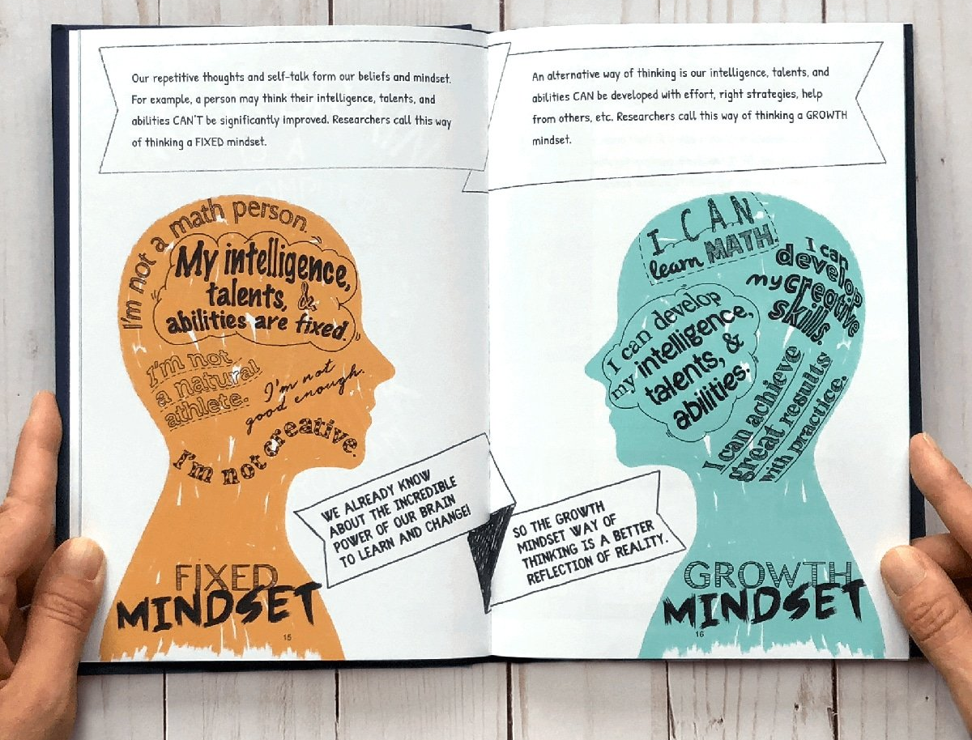
EmoJ– A Journal of emotions
J
Chamila Dharmawardhana, PhD
Capstone project
Flatiron School
Data Science
07/28/2020

Slide 2
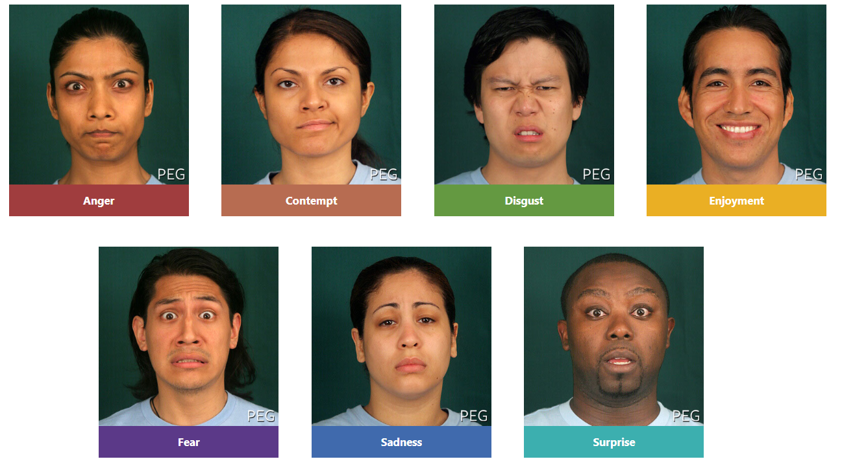
Human Facial Expressions
Human emotion is most vividly understood by facial expression. Dr. Paul Ekman’s shows there are 7 universal facial expression of emotion.
A personal journal is not only a record of events it’s a record of the person.
What if we can record images, translated to a record of emotions to record our emotional state in our daily life ?

Slide 3


The Challenge & Objective
Obtain diverse and large enough image dataset that is well labelled
Build a CNN model that can continuously improve with usage
Build a web app that is both efficient and attractive to the user
Develop meaningful analysis for the gathered data and useful reporting to the user

Slide 4
Strategy
The overall strategy is a three-stage process within ROSEMED method
Stage-1
FER2013 dataset
(FER model)
Stage-2
Scraped dataset
(FIW model)
Stage-3
user dataset
(continuous model)
Incorporate model
A web app

Slide 5
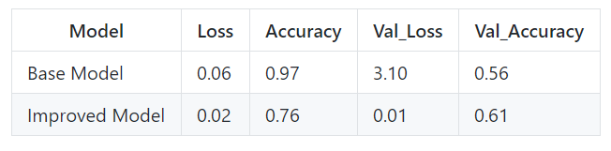
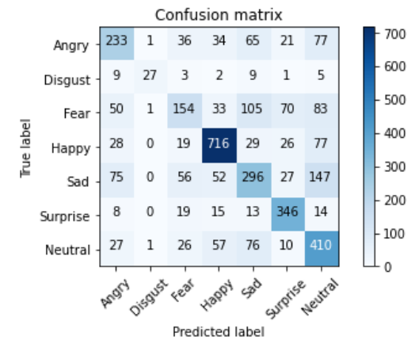
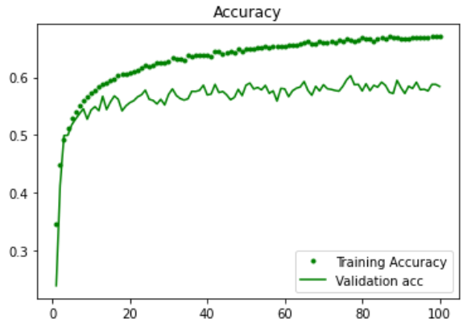
The Model

Slide 6
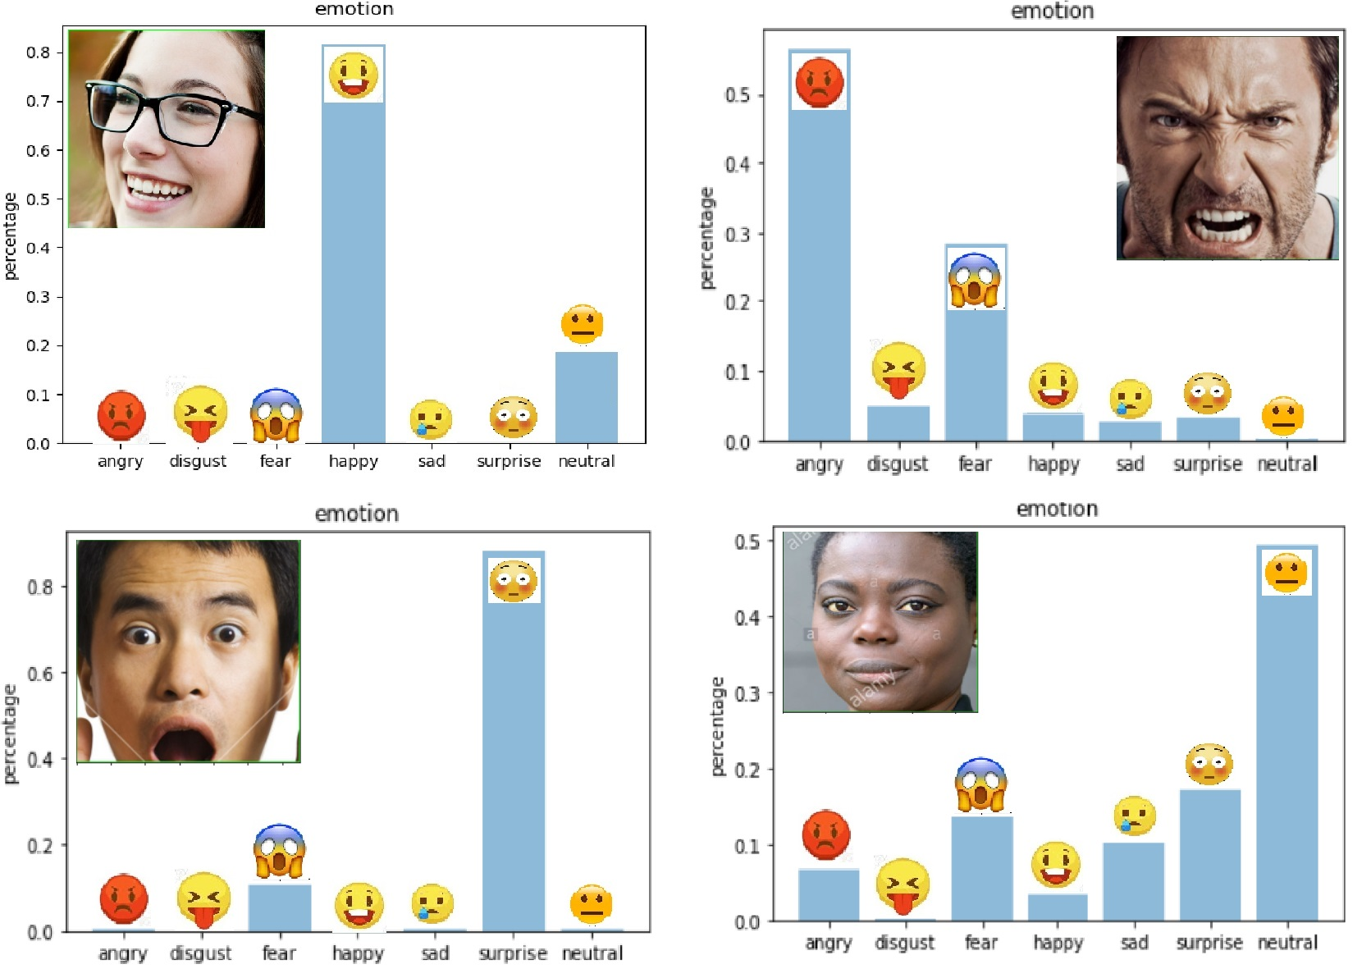
Results

Slide 7
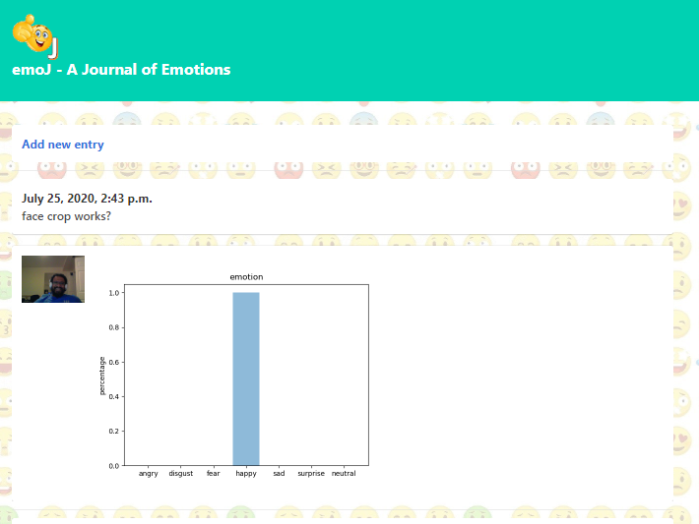
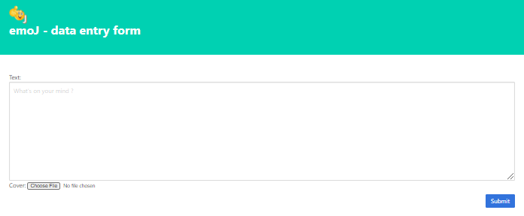
Django web app:

Slide 8
Conclusion
Present a deep NN approach for the detection of human emotion
Improved model has a 76% training and 61% validation accuracy
Web scraped images proved to decrease the model accuracy
With a very small set of images from a single user can quickly build a model that is well optimized for that each user
For the purpose of a journal app the models constructed here suffice

Slide 9
Recommendations
The model is demonstrated to work as a web app
User must input at least 10 images per emotion to get a baseline model
The app will be built to continuously feed new images and labels from the user
could possible be an asset to psychiatrists, psychotherapist as well as general physicians

Slide 10
Future work
Implement authentication and DB for each user
Add automatic re-training of the model on server side for each user
add capability for users to update labels
deploy the Django webapp
develop and deploy Android and IOS apps

Slide 11

Thank You
Amber Yandow
Ben Jacobson
Dara Paoletti
Vidya Menon
Jesse Neumann
Any Questions

Slide 12
Appendix: Datasets
Source | Size
Kaggle dataset | 35888
Google images | 3136
User (me) | 77
Extended Cohn-Kanade Dataset - CK+
Japanese Female Facial Expressions (JAFFE)
MMI Database
AffectNet: A Database for Facial Expression, Valence, and Arousal Computing in the Wild

