Slide 1
BATTLE OF NEIGHBOURHOODS
Aishwarya G

Slide 2
TABLE OF CONTENTS
01
02
INTRODUCTION
DATA
03
04
APPROACH AND ANALYSIS
CONCLUSION

Slide 3
INTRODUCTION
New York City or New York is United State’s most populous city with a population of 8,336,817 spread over 302.6 square miles. New York is also referred to as the financial, cultural and media capital of the world.
New York city demographically is ethnically diverse metropolis and as many as 800 languages are spoken in New York. New York is home to over 3.2 million legal immigrants. Over the past decade, New York city has exponentially grown when compared to its region.
New York city is composed of five boroughs- Brooklyn, Manhattan, Queens, the Bronx and Staten Island.
New York’s food culture influenced by the city’s immigrant history has a wide array of international cuisine hosting world’s finest 1000 restaurants of the world.
With such diverse and rich dining options, the project is aimed at the Indian restaurants in NYC.

Slide 4
DATA INVOLVED
As discussed, New York has a very diverse ethnic population and its food is influenced by the immigrant’s history i.e. you would have Lebanese, Chinese, Indian. Caribbean, Mexican etc. cuisine restaurants.
To perform the above-mentioned analysis, we would need:
List of Boroughs and Neighbourhood for NYC along with the longitude and latitude details
Data source: https://cocl.us/new_york_dataset
Description:
Use of FourSquare API to find out the venues of the Indian restaurants in every neighbourhood of New York City.
Data Source: FourSquare API
Description: Using FourSquare APIs we will get the venues in each neighbourhood which will be further filtered.
Folium for mapping purposes and visualization

Slide 5
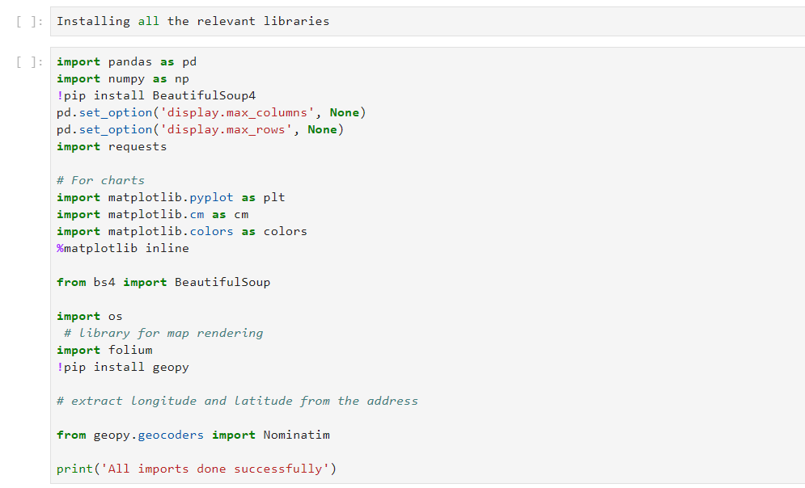
APPROACH AND ANALYSIS
Import all the necessary libraries for getting geographic locations, to create charts, dataframes etc.

Slide 6
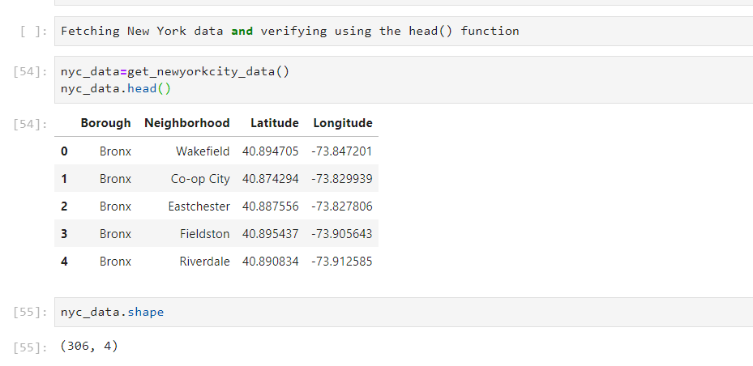
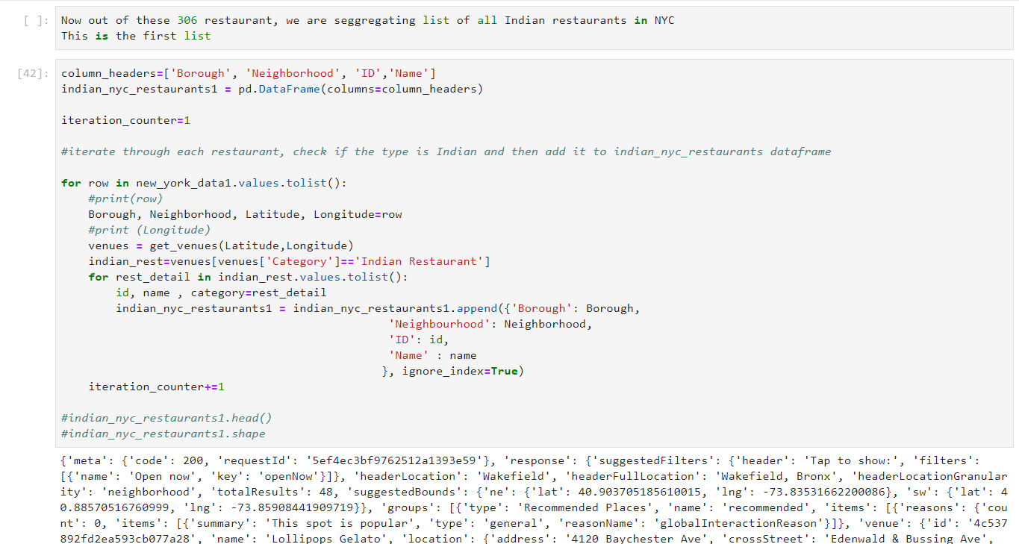
APPROACH AND ANALYSIS
Using FourSquare API, get venues from each neighbourhood in NYC
Out of all the venues pulled by FourSquare API call, segregate the Indian restaurants

Slide 7
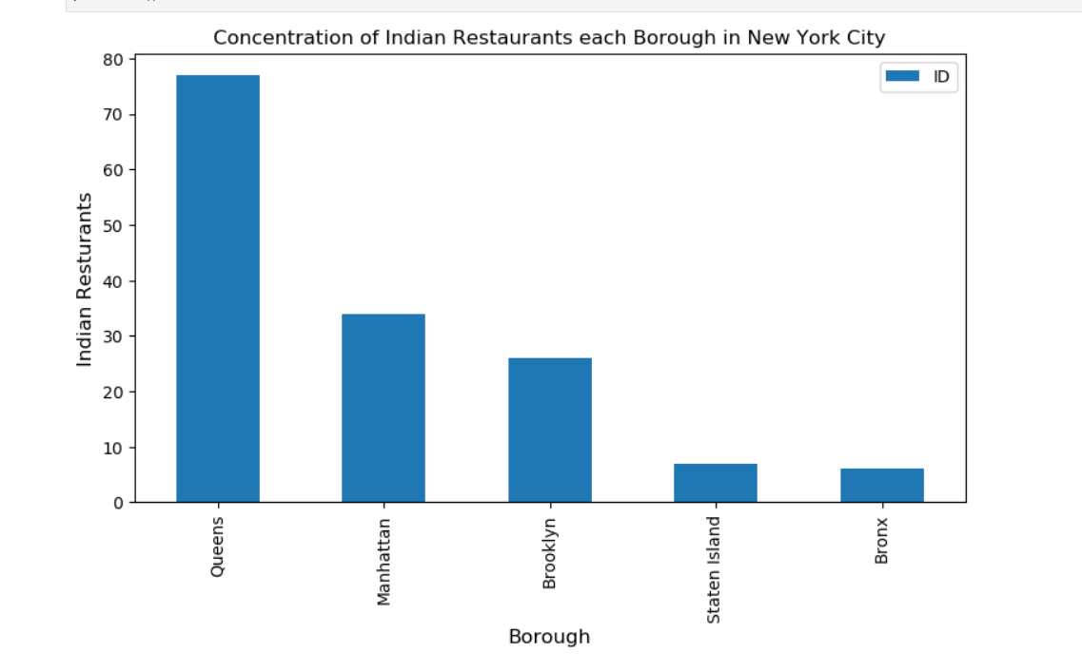
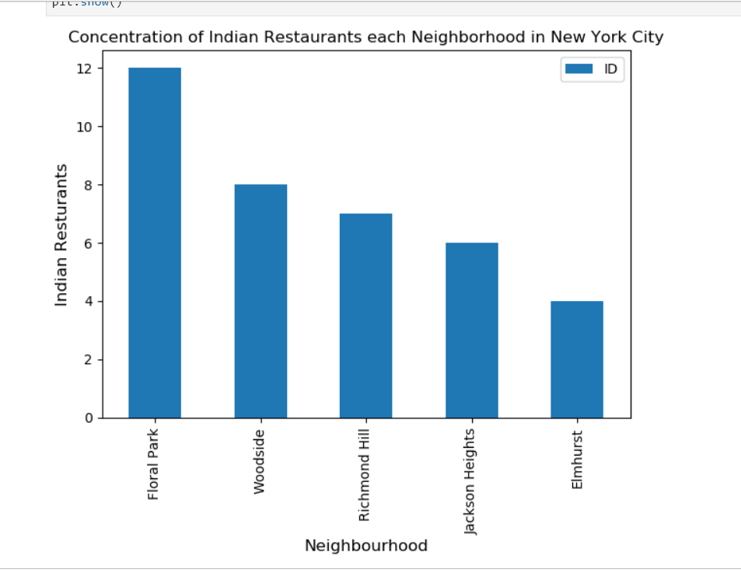
APPROACH AND ANALYSIS
Concentration of Indian restaurants in each Borough
Concentration of Indian restaurants in each Neighborhood

Slide 8
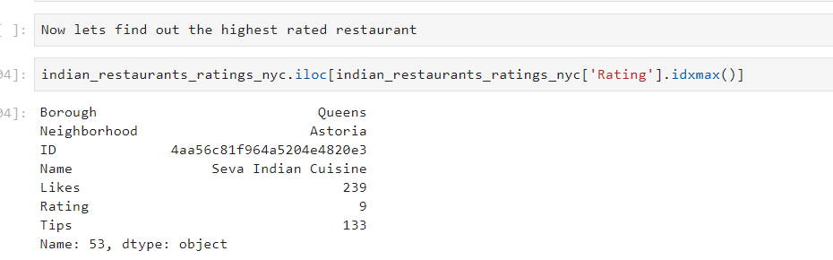
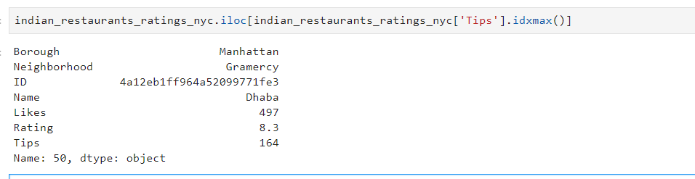
APPROACH AND ANALYSIS
Indian restaurant with the highest rating
Indian restaurant with the highest tips

Slide 9
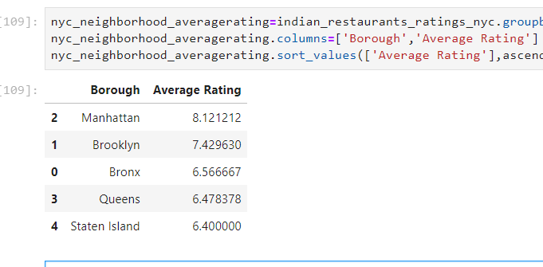
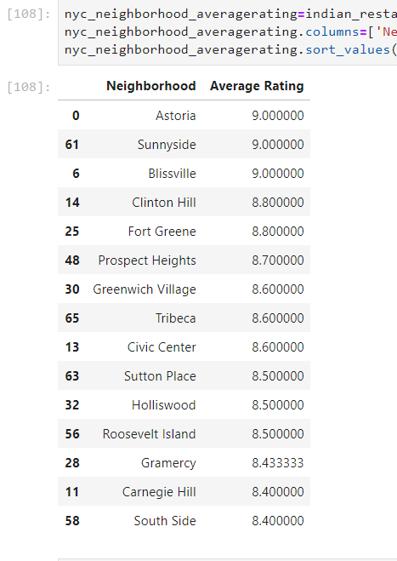
APPROACH AND ANALYSIS
Average rating per Borough
Average rating per Neighborhood

Slide 10
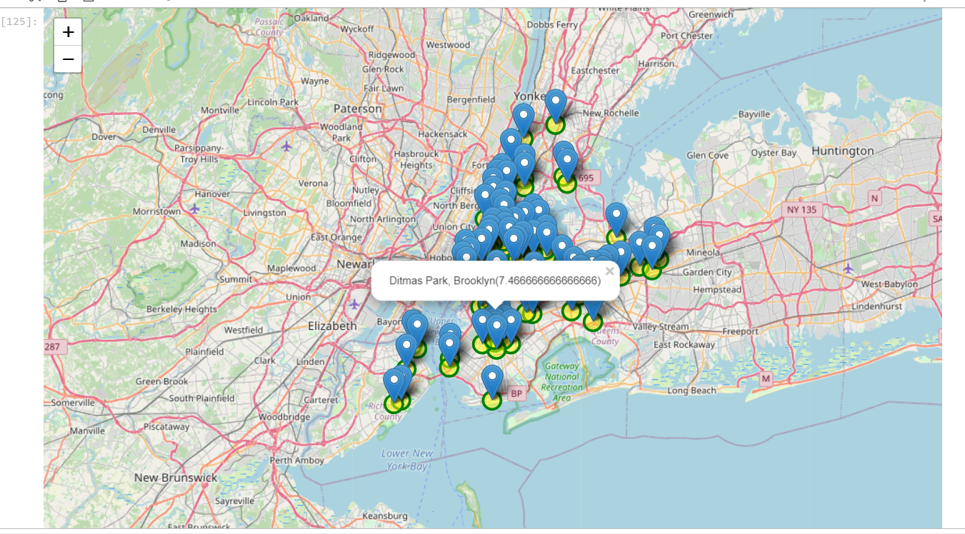
APPROACH AND ANALYSIS
Visualization of all Indian restaurants

Slide 11
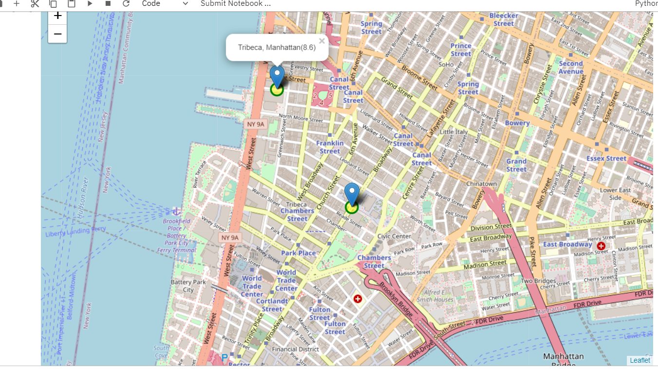
APPROACH AND ANALYSIS
Visualization of all Indian restaurants with average ratings 8.0 and above

Slide 12
Conclusions
There are around 360 restaurants in NYC out of which majority are clustered in Queens, followed by Manhattan.
Neighbourhood wise, Floral Park and Woodside are the most populated regions
Although Queens has the maximum no. of restaurants, the likes for Manhattan are much higher.
The best neighbourhood to eat in is Astoria but Manhattan’s Tamarind Tribecca and Dhaba are the best restaurants as per like and tips received
Staten Island and Bronx borough have food of average quality.
Astoria, Blissvile and SunnySide are the best neighbourhoods to dine in for Indian cuisine.

