Slide 1
Numerical Analysis
Final Project
Jan Kretschmann

Slide 2
Comparing Interpolation Methods
Description and Example Data Set
Interpolating Known Functions
Comparing Errors
Conclusion

Slide 3
Methods of Interpolation
Linear Interpolation
Lagrange Interpolation
Neville’s Method
Divided Differences
Cubic Splines
Example Data Set
x | 0 | 3 | 5 | 8 | 13
y | 75 | 77 | 80 | 74 | 72

Slide 4
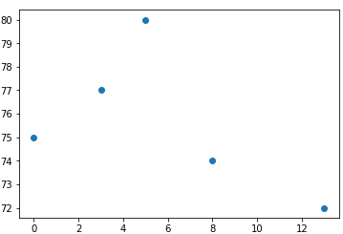
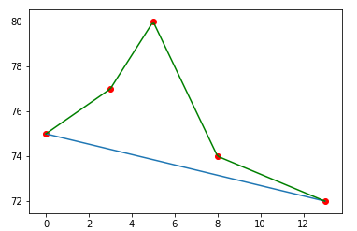

Linear Interpolation
Straight Line through 2 points
$y=mx+b$
Piecewise vs Non-Piecewise

Slide 5
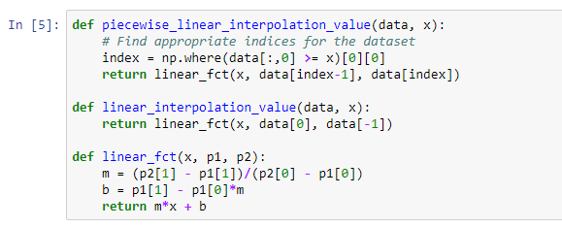
Linear Interpolation

Slide 6
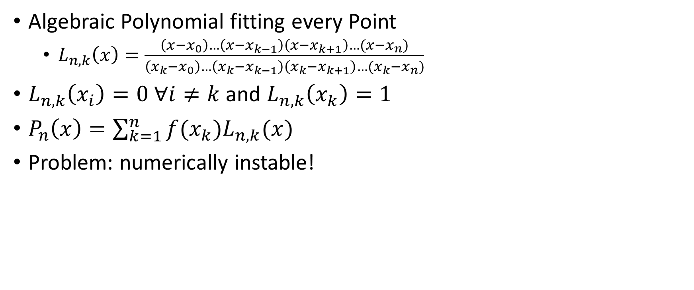
Lagrange Interpolation
Algebraic Polynomial fitting every Point
$L_{n,k}\left(x\right)=\frac{\left(x−x_{0}\right)…\left(x−x_{k−1}\right)\left(x−x_{k+1}\right)…(x−x_{n})}{\left(x_{k}−x_{0}\right)…\left(x_{k}−x_{k−1}\right)\left(x_{k}−x_{k+1}\right)…(x_{k}−x_{n})}$
$L_{n,k}\left(x_{i}\right)=0 ∀i≠k$ and $L_{n,k}\left(x_{k}\right)=1$
$P_{n}\left(x\right)=\sum_{k=1}^{n}{f(x_{k})L_{n,k}(x)}$
Problem: numerically instable!

Slide 7
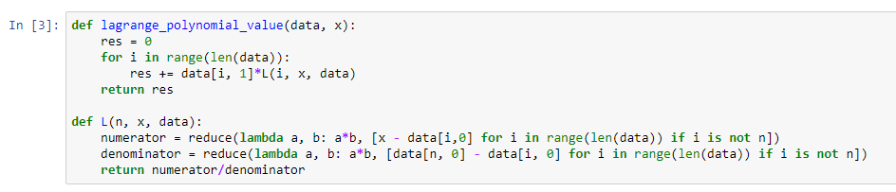
Lagrange Interpolation

Slide 8
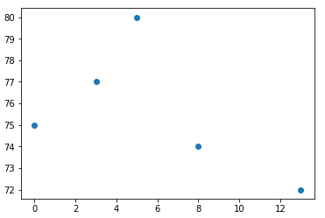
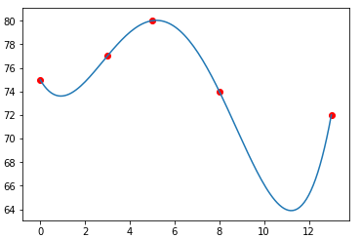
Lagrange Interpolation

Slide 9

Divided Differences (Newton)
Successively generated Polynomial
$P_{n}\left(x\right)=f\left[x_{0}\right]+f\left[x_{0},x_{1}\right]\left(x−x_{0}\right)+f\left[x_{0},…,x_{k}\right]\left(x−x_{0}\right)…(x−x_{k})$
With $f\left[x_{i},x_{i+1}\right]=\frac{f\left(x_{i+1}\right)−f(x_{i})}{x_{i+1}−x_{i}}$ and $f\left[x_{i},x_{i+1},x_{i+2}\right]=\frac{f[x_{i+1},x_{i+2}]−f[x_{i},x_{i+1}]}{x_{i+2}−x_{i}}$
“Divided Differences“ as coefficients

Slide 10
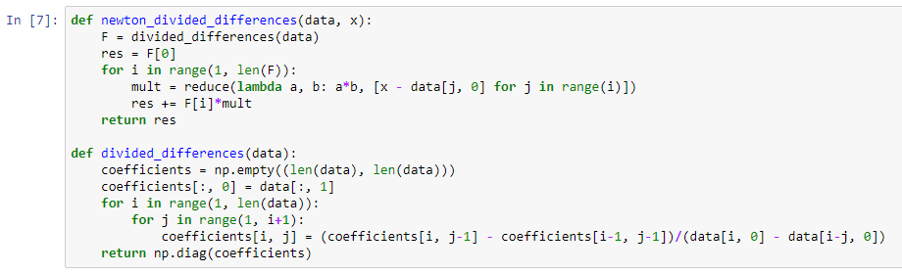
Divided Differences

Slide 11
Divided Differences

Slide 12

Neville’s Method
Iterative Generation of Interpolation Polynomial
$P\left(x\right)=\frac{\left(x−x_{j}\right)P_{0,1,…,j−1,j+1,…k}\left(x\right)−(x−x_{i})P_{0. 1. …i−1, i+1, …, k}(x)}{x_{i}−x_{j}}$
Easiest to implement

Slide 13
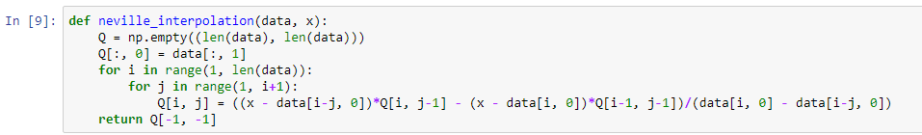
Neville‘s Method

Slide 14
Neville’s Method

Slide 15

Cubic Splines
Piecewise defined => non algbebraic
Cubic Function for each interval $\left[x_{i},x_{i+1}\right]$
Numerically Stable
Most complex implementation

Slide 16
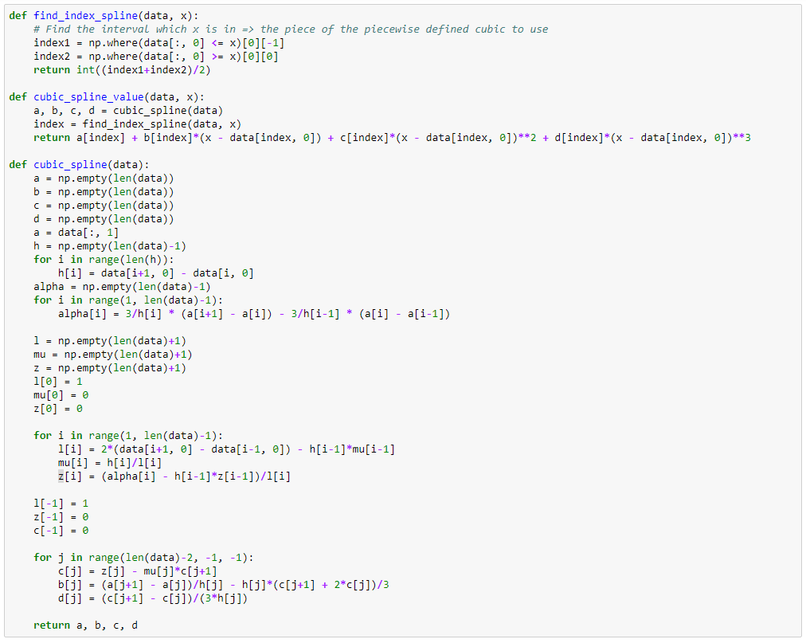

Slide 17
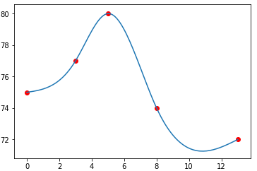
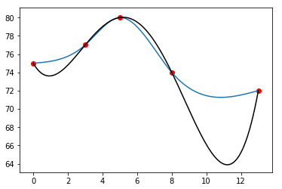
Cubic Splines

Slide 18

Interpolating Known Functions
Examining Interpolation Methods on
$f\left(x\right)=e^{x}$
$f\left(x\right)=sin⁡(x)$
$f\left(x\right)=x$
$f\left(x\right)=x^{4}$

Slide 19
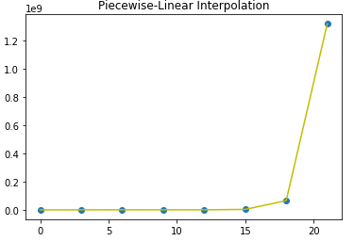
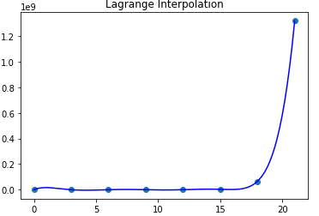
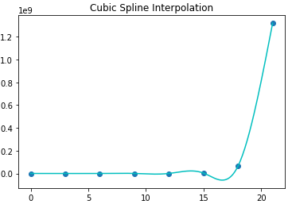

Interpolating Known Functions
$f\left(x\right)=e^{x}$

Slide 20
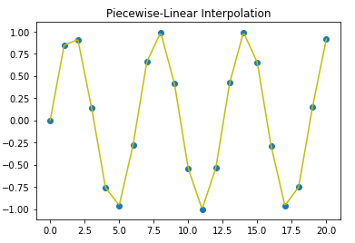
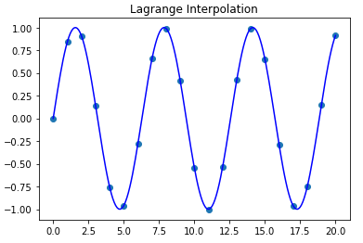
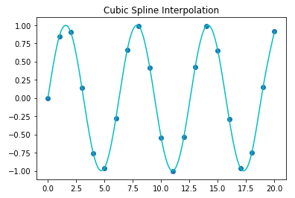

Interpolating Known Functions
$f\left(x\right)=sin⁡(x)$

Slide 21
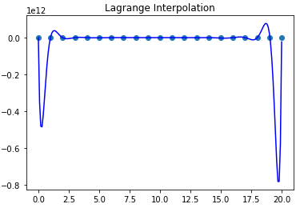
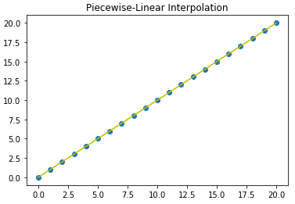
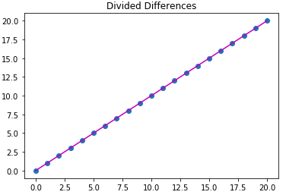
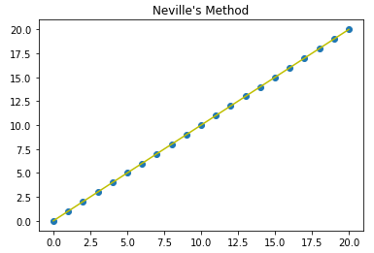
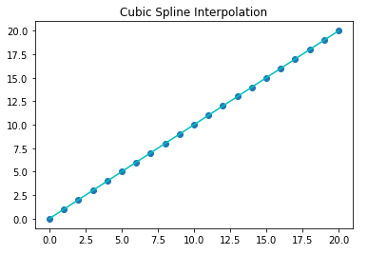

Interpolating Known Functions
$f\left(x\right)=x$

Slide 22
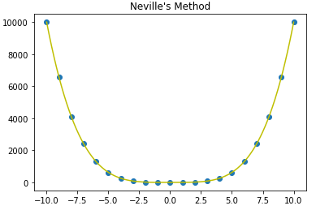
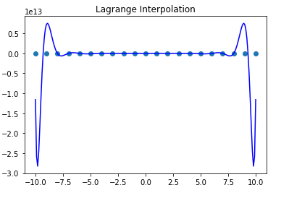
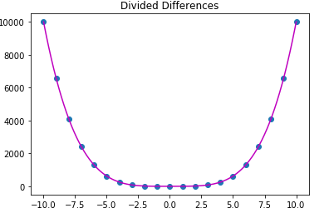
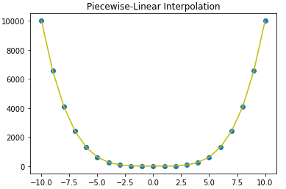
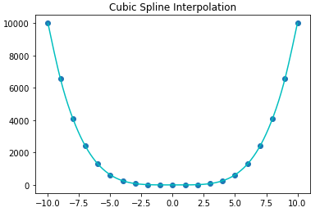

Interpolating Known Functions
$f\left(x\right)=x^{4}$

Slide 23
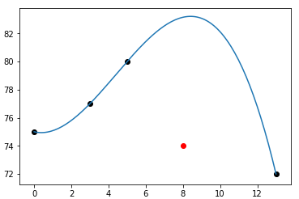
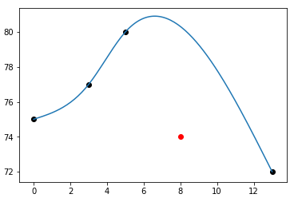



Comparing Errors
Large roundoff error => Instability
For unknown $f$: Cross Validation
Lagrange Interpolation without $(8, 74)$
Cubic Spline Interpolation without $(8, 74)$

Slide 24
Comparing Errors
Method | Total Error
Linear (PW) | 8.2
Lagrange | 17.39
Newton | 17.39
Neville | 17.39
Spline | 12.98
Cross Validation Results
Piecewise Linear Interpolation works best in this example
But: not always!

Slide 25
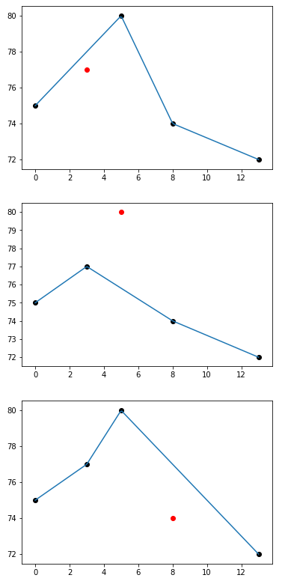
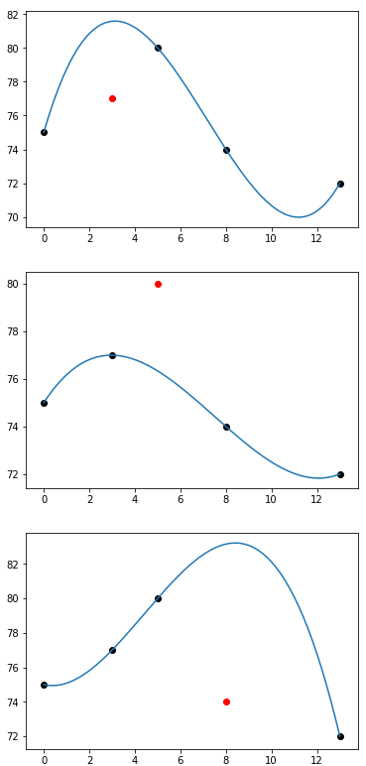
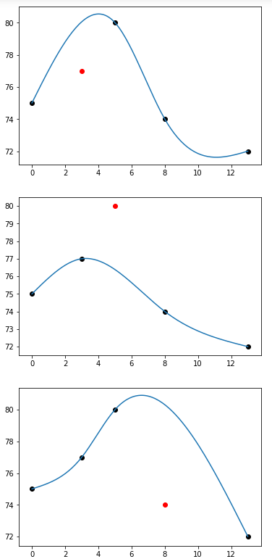

Slide 26

Errors for Known Functions
Comparing interpolated value to actual value
Example: $f\left(x\right)=\sin\left(x\right)$
Lagrange/Newton/Neville has lowest error
Method | Error
Linear (PW) | 1.5349
Lagrange | 0.0021
Newton | 0.0021
Neville | 0.0021
Spline | 0.0969

Slide 27
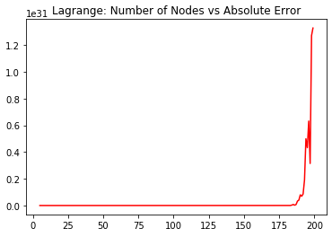
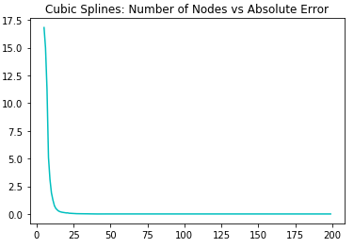
Stability
Lagrange instable → so what? Increase number of nodes to see!

Slide 28

Conclusion
No Method is always the best
Lagrange unstable for large $n$

