Slide 1
A
A
North
South
B’
B
B’
B
Rotor
A’
A’
A
A
B’
B
B’
B
A’
A’

Slide 2
A
A
North
South
B’
B
B’
B
Rotor
A’
A’
A
A
B’
B
B’
B
A’
A’

Slide 3
A
A
A
A
B’
B
B’
B
B’
B
B’
B
A’
A’
A’
A’
A
A
A
A
B’
B
B’
B
B’
B
B’
B
A’
A’
A’
A’
North
South
Rotor

Slide 4
Sin Wave
A
+
Phase A Current
0
B’
B
-
+
A’
Phase B Current
0
-

Slide 5


Static Torque
Holding Torque
0
$$θ_{m}$$
$$θ$$
Displacement from an Equilibrium position

Slide 6
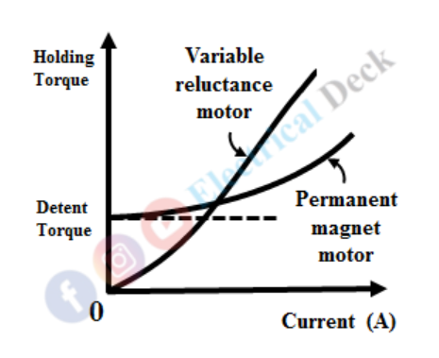

Holding Torque
Detent Torque
0
$Current$ (A)

Slide 7
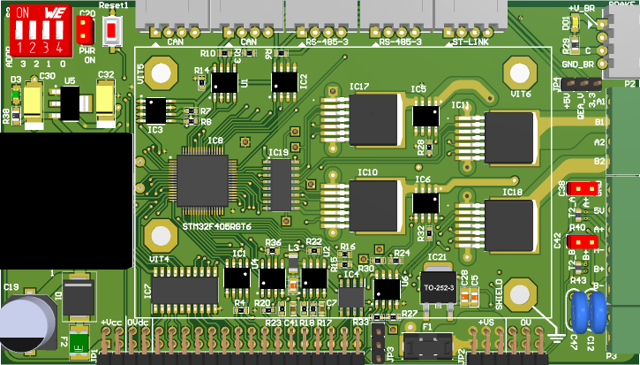

Slide 8
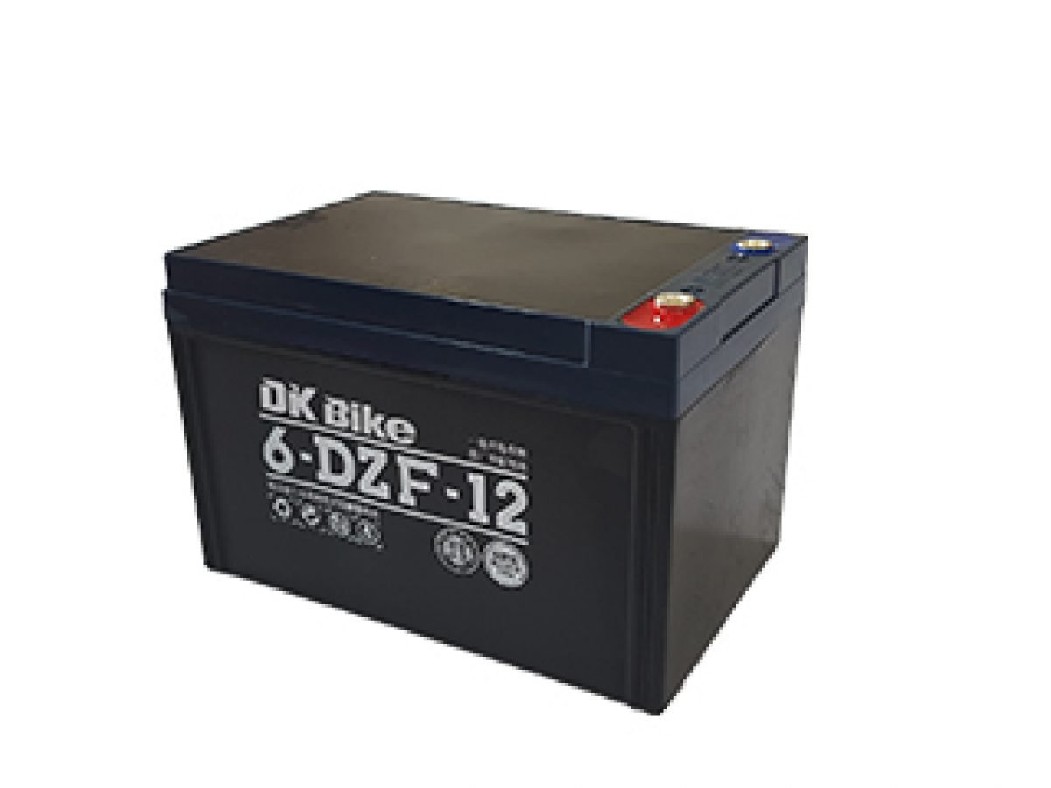
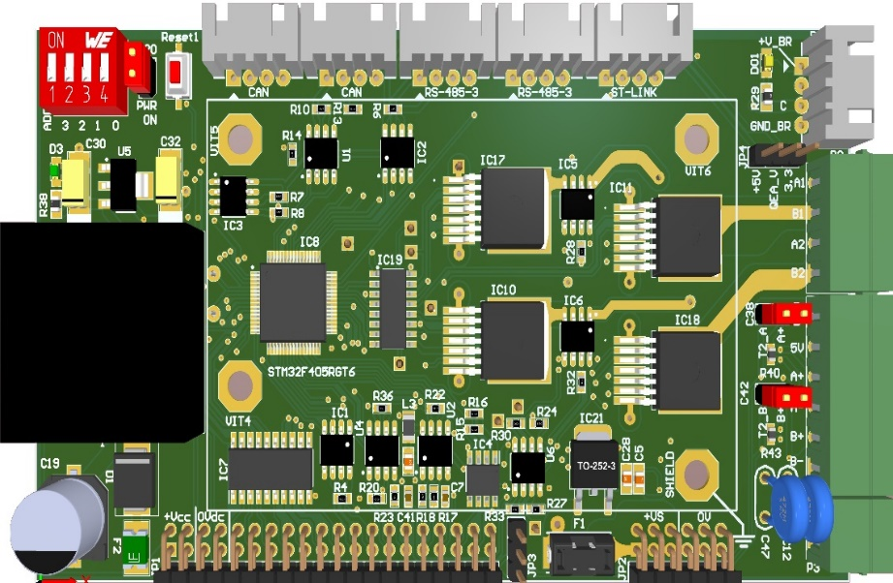
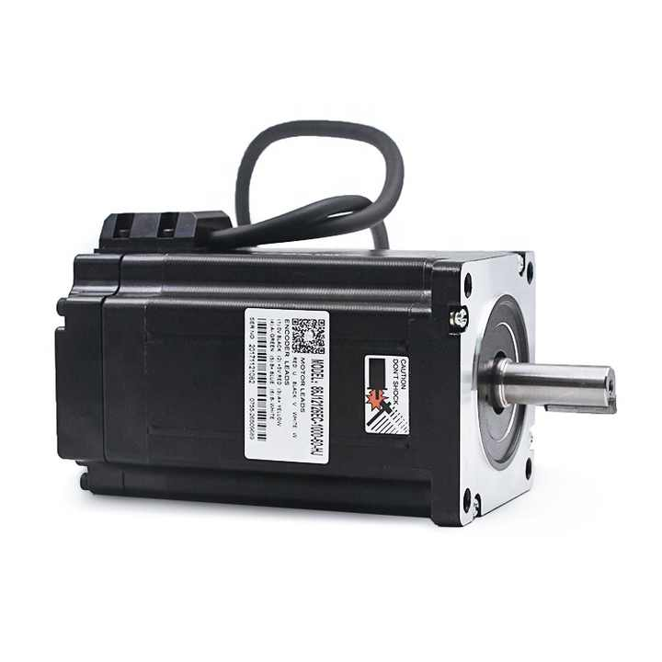
Mạch điều khiển động cơ
Pin acqui
A+
A-
B+
B-
EGND
5V
EA+
EA-
EB+
EB-
24 Vdc
0 Vdc
Hybrid Step Motor

Slide 9

Khối Vi Điều Khiển
RS-485
St-Link V2
Khối đo dòng
Khối nguồn
Đầu ra điện áp động cơ
Cầu đấu Encoder tương đối
Đầu vào ra Analog, I2C,...
Cầu chì phía mạch lực
Khối Driver

Slide 10
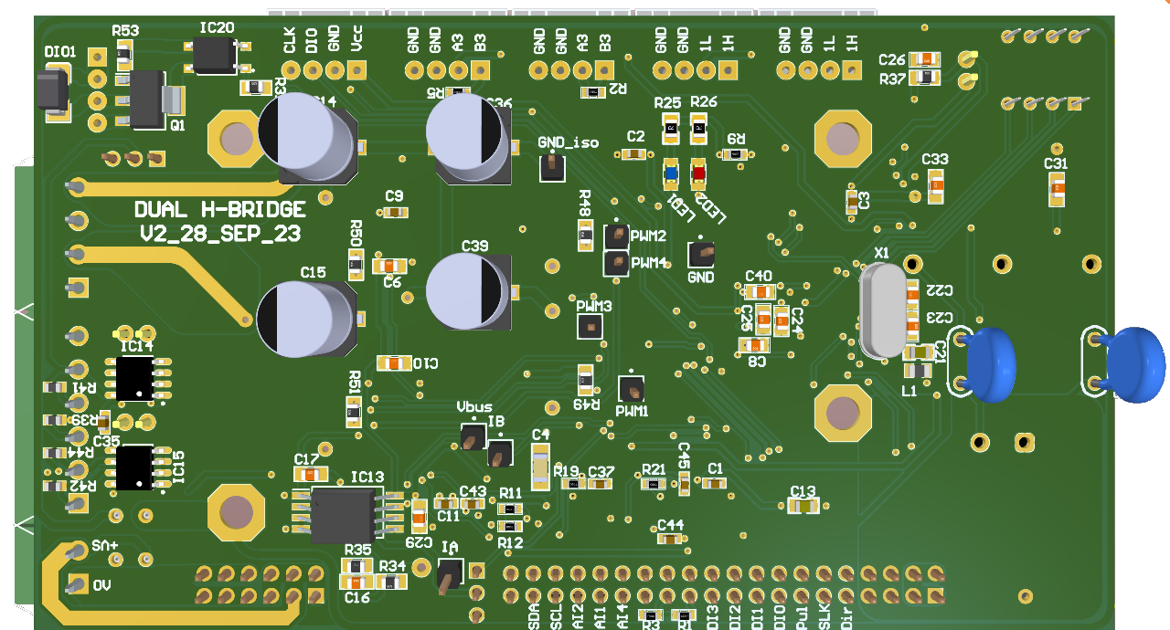
Test Points
Khối Led cảnh báo
Thạch anh ngoại
Khối Encoder
Khối đo áp

Slide 11
Vdc
a
b
c
d
A+
A-
B+
B-
a
b
c
d
GND

Slide 12
In its simplest form, a step motor consists of a permanent magnet which rotates (the rotor), surrounded by equally spaced windings which are fixed (the stator). Current flow in each winding produces a magnetic field vector, which sums with the field from the other winding. By controlling currents in each winding, a magnetic field of arbitrary direction and magnitude can be produced by the stator. Torque is then produced by the attraction or repulsion between this net stator field and the magnetic field of the rotor.
In field oriented control, the motor input currents are adjusted to set a specific angle between the fluxes produced in the rotor and stator windings. The key to field oriented control is the knowledge of the rotor flux position angle with respect to the stator. The angle between the stator and rotor flux is computed from shaft position. For any position
of the rotor, there is an optimal direction of the net stator field, which maximizes torque; there is also a direction which will produce no torque. If the permanent magnet rotor is in the same direction as the field produces the net stator field, no torque is produced. The fields interact to produce a force, but because the force is in line with the axis of rotation of the rotor, it only serves to compress the motor bearings, not to cause rotation. On the other hand, if the stator field is orthogonal to the field produced by the rotor, the magnetic forces work to turn the rotor and torque is maximized. A stator field with arbitrary direction and magnitude can be decomposed into components parallel and orthogonal to the rotor field. In this case, only the orthogonal (quadrature) component produces torque, while the parallel component produces useless compression forces. For the purpose of control system modeling and analysis, it is convenient to work in terms of winding currents rather than stator magnetic field. This is because motor currents are easily measured externally while fields (flux) are not.
In a step motor, the stator field is produced by current flow in two equally spaced stator windings. These two components sum to produce the net magnetic field of the stator. In order to model the field produced by the stator windings in terms of winding current, ‘current space vectors’ are used. The current space vector for a given winding
has the direction of the field produced by that winding and a magnitude proportional to the current through the winding. This will represent the total stator field as a current space vector that is the vector sum of two current space vector components, one for each of the stator windings.

Slide 13
The stator current space vector can be broken into orthogonal components in parallel with, and perpendicular to, the axis of the rotor magnet. The quadrature current component produces a field at right angles to the rotor magnet and therefore results in torque, while the direct current component produces a field that is aligned with the rotor magnet and therefore produces no torque. Winding currents will be adjusted so as to produce a current space vector that lies exclusively in the quadrature direction. Torque will then be proportional to the magnitude of the current space vector.
In order to efficiently produce constant smooth torque, the stator space vector should ideally be constant in magnitude and should turn with the rotor so as to always be in the quadrature direction, irrespective of the rotor angle and speed. While the stator current space vector may be constant in magnitude and direction if viewed form the rotating frame of reference of the rotor, from the fixed frame of the stator the current space vector describes a circle as the motor turns. Because the current space vector is produced by the vector sum of components from each of the motor windings, the motor winding currents should ideally be two sinusoids, phase shifted 90 0 from the each other. If winding A and B currents are sine waves phased 90 0 with respect to each other, then the resulting stator magnetic field vector will rotate at the sinusoidal frequency.

Slide 14
Despite recent performance improvements in step motor modeling and control algorithms, open-loop control still falls significantly short of achieving maximum motor performance. Step motors, which are often used in industrial applications, can exhibit stepping resonance and skipped steps. Field oriented control can eliminate resonance anomalies and skipped steps. The maximum theoretical performance from the step motor can be derived by driving a step motor with field oriented control rather than stepping. In field oriented control, the motor input currents are adjusted to set a specific angle between the stator magnetic field and rotor magnetic field. From basic motor theory, when the stator magnetic field vector is maintained at a phase angle of 90 0 ahead of the rotor magnetic field, maximum torque is produced. The torque varies with the sine of this torque angle between the stator and rotor magnetic field vectors. By sensing rotor position, the phase of the rotor magnetic field can be determined and the current excitation kept 90 0 ahead of it. At this optimal torque angle, maximum torque is available (for given power supply voltage) under steady-state and transient operation. This approach is not widespread because electronic components historically have constrained drives to simple schemes such as stepping, and the full dynamic theory of electric machines was not worked out until the 1980’s. The resulting performance advantages of field oriented control over stepping compensate for the additional circuit cost and complexity.

Slide 15








cos
$$\hat{ω}$$
$${\hat{emf}}_{a}$$
x
$$−$$
$$Δe$$
$$\frac{1}{s}$$
$$\hat{θ}$$
PI
$$−$$
$${\hat{emf}}_{b}$$
x
sin

Slide 16
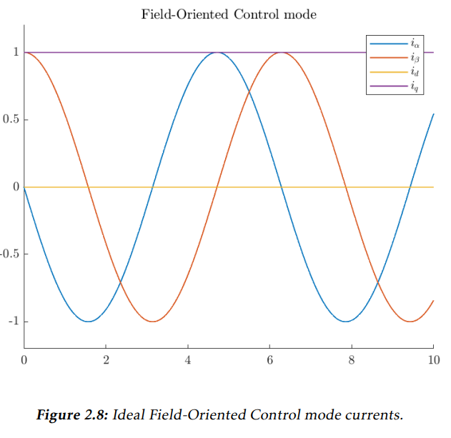




Holding Torque
$$i_{α}$$
$$i_{β}$$
$$i_{d}$$
$$i_{q}$$
0

Slide 17
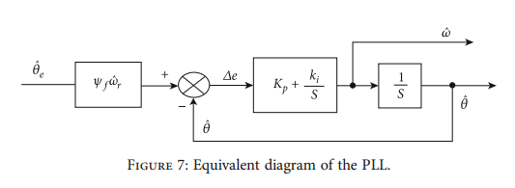










$${\hat{θ}}_{e}$$
+
$$\hat{ω}$$
PI
_
$$\hat{θ}$$
$$\frac{1}{s}$$
$${\hat{θ}}_{e}$$
+
$$Δe$$
$$\hat{ω}$$
$$\frac{1}{s}$$
$$\hat{θ}$$
PI
_
$$θ^{∗}$$
+
$$\hat{ω}$$
PI
_
$$\hat{θ}$$
$$\frac{1}{s}$$

Slide 18











$$T_{s}$$
$$T_{s}$$
PWMa
PWMa
PWMb
PWMb
PWMc
PWMc
PWMd
$T_{0}$/4
$T_{1}$/2
$T_{2}$/2
$T_{0}$/4
PWMd
$T_{0}$/4
$T_{1}$/2
$T_{2}$/2
$T_{0}$/4
$T_{0}$/4
$T_{2}$/2
$T_{1}$/2
$T_{0}$/4
$T_{0}$/4
$T_{2}$/2
$T_{1}$/2
$T_{0}$/4
Sector I
Sector II
$$T_{s}$$
$$T_{s}$$
PWMa
PWMa
PWMb
PWMb
PWMc
PWMc
PWMd
$T_{0}$/4
$T_{1}$/2
$T_{2}$/2
$T_{0}$/4
PWMd
$T_{0}$/4
$T_{1}$/2
$T_{2}$/2
$T_{0}$/4
$T_{0}$/4
$T_{2}$/2
$T_{1}$/2
$T_{0}$/4
$T_{0}$/4
$T_{2}$/2
$T_{1}$/2
$T_{0}$/4
Sector III
Sector IV

Slide 19
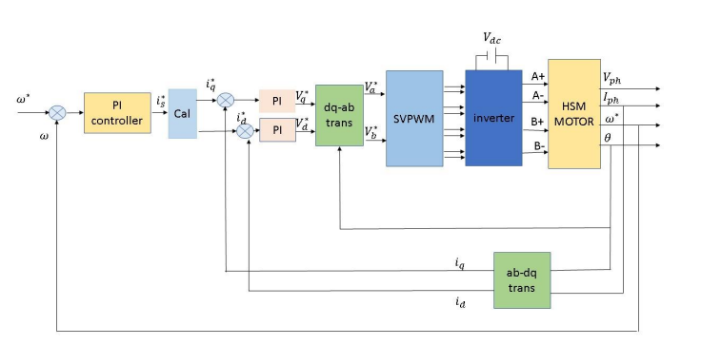



























$$i_{q}^{∗}$$
$$+$$
PI
$$V_{q}^{∗}$$
$$dq$$
$$V_{α}^{∗}$$
$A$+
$$V_{ph}$$
$$ω^{∗}$$
$$+$$
PI
Controller
$$i_{s}^{∗}$$
$$−$$
$A$-
Hybrid
Step
Motor
$$I_{ph}$$
Cal
Inverter
$B$+
$$ω$$
$$−$$
$$i_{d}^{∗}$$
$$+$$
PI
$$V_{d}^{∗}$$
$$αβ$$
$$V_{β}^{∗}$$
$B$-
$$θ$$
$$ω$$
$$−$$
$$i_{d}$$
$$αβ$$
$$i_{q}$$
$$dq$$

Slide 20
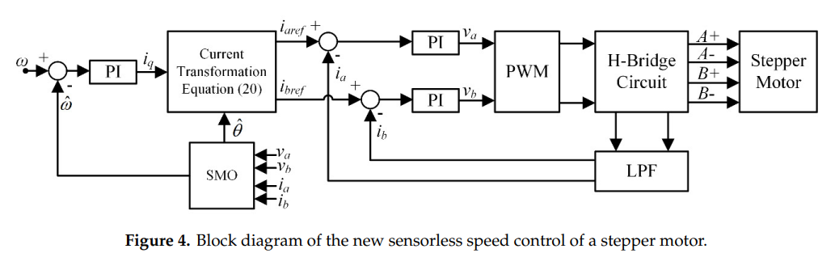






















$$i_{q}^{∗}$$
$$+$$
PI
$$V_{q}^{∗}$$
$$dq$$
$$V_{α}^{∗}$$
$A$+
$$V_{ph}$$
$$ω^{∗}$$
$$+$$
$$i_{s}^{∗}$$
Phép tính dòng
$$+$$
$A$-
$$I_{ph}$$
PI
$$−$$
$$+$$
Điều chế SVPWM
Mạch Cầu H kép
Động cơ bước lai
$$ω$$
$$i_{d}^{∗}$$
$$+$$
$$V_{d}^{∗}$$
$$V_{β}^{∗}$$
$B$+
$$θ$$
$$−$$
PI
$$+$$
$$αβ$$
$B$-
$$ω$$
$$−$$
$$+$$
$$\hat{{emf}_{q}}$$
$$\hat{{emf}_{d}}$$
Ước lượng EMF
$$i_{d}$$
$$αβ$$
$$i_{q}$$
$$dq$$

Slide 21
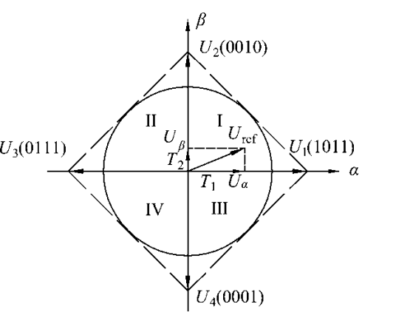















$$β$$
$$U_{2}(0010)$$
$$II$$
$$I$$
$$U_{β}$$
$$U_{ref}$$
$$U_{3}(0111)$$
$$T_{2}$$
$$U_{1}(1011)$$
$$T_{1}$$
$$α$$
$$U_{α}$$
$$III$$
$I$V
$$U_{4}(0001)$$

Slide 22
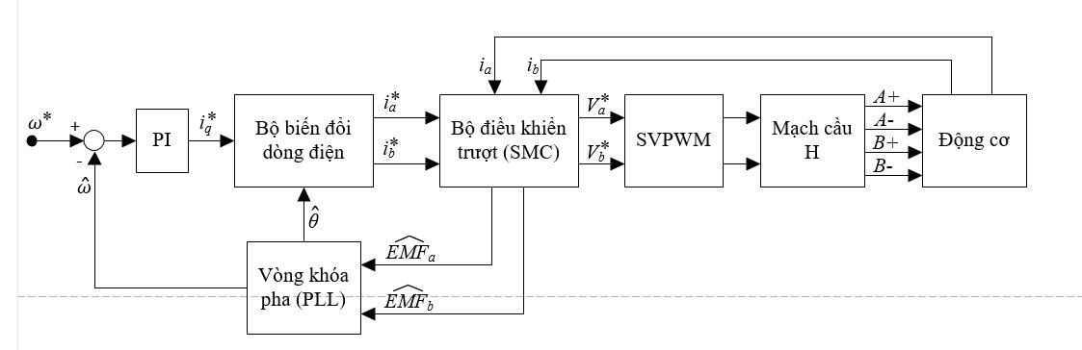













$$i_{a}^{∗}$$
$$V_{α}^{∗}$$
$A$+
$$ω^{∗}$$
$$+$$
$$i_{q}^{∗}$$
Bộ biến đổi dòng điện
Bộ điều khiển trượt (SMC)
Điều chế SVPWM
Mạch Cầu H kép
$A$-
Động cơ bước lai
PI
$$i_{b}^{∗}$$
$B$+
$$−$$
$$V_{β}^{∗}$$
$B$-
$$\hat{ω}$$
$$\hat{θ}$$
$$i_{a}$$
$${\hat{emf}}_{a}$$
$$i_{b}$$
Vòng khóa pha (PLL)
$${\hat{emf}}_{b}$$

Slide 23













$$x^{∗}$$
$$x$$
$$+$$
$R\left(p\right)$
$S_{0}\left(p\right)$
$$−$$
$Hệ$ thống theo chuẩn tối ưu module
$R\left(s\right)$
$S_{0}\left(s\right)$
$$ω^{∗}$$
$$\frac{1}{T_{D}s+1}$$
$$\frac{K_{m}}{s.J+B}$$
$$ω$$
$$+$$
PI
$$−$$
$Cấu$ trúc PI cho mạch vòng tốc độ

Slide 24
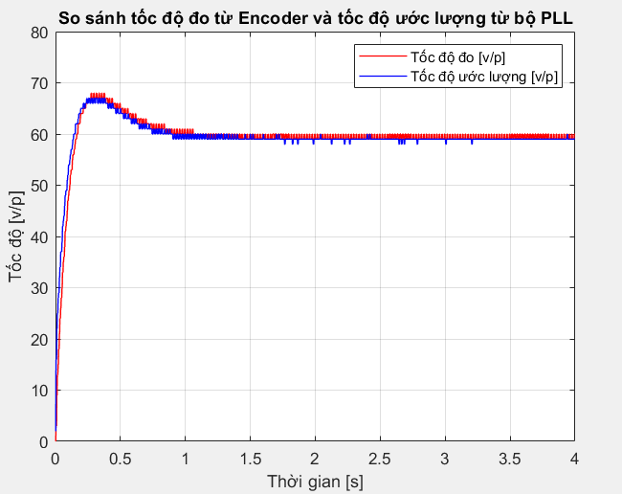
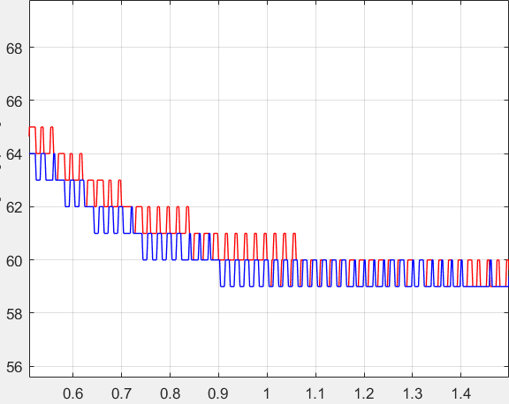

Slide 25
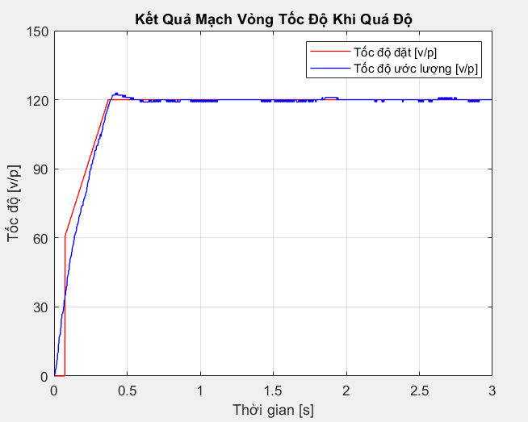
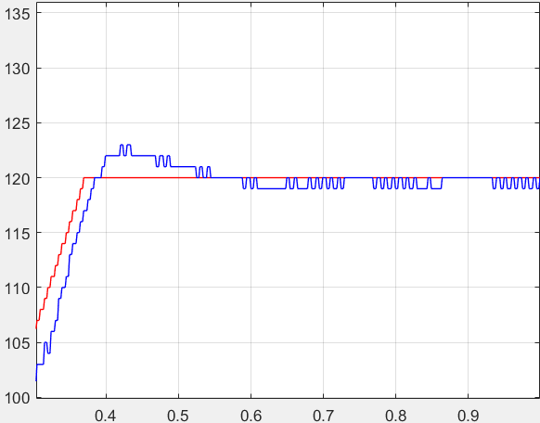

Slide 26
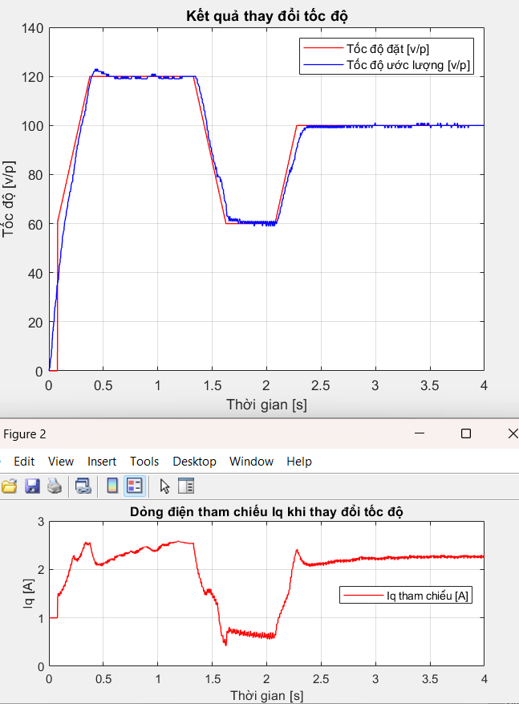

Slide 27
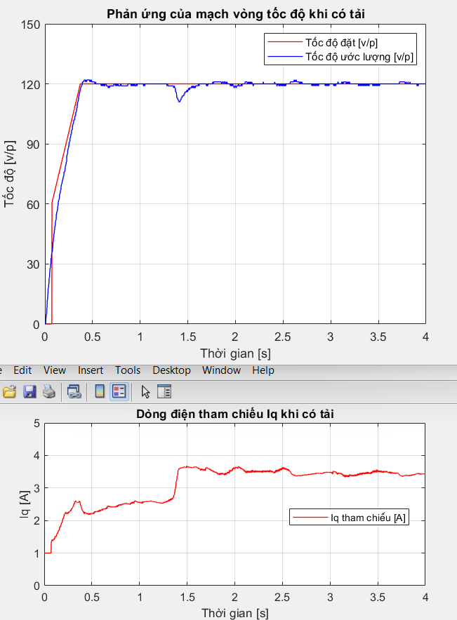
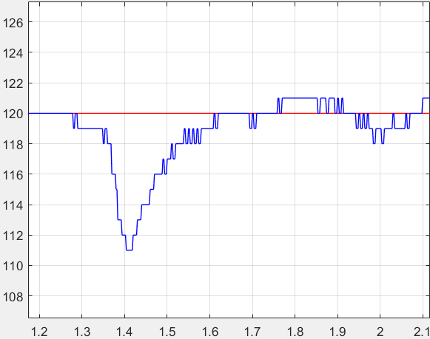

Slide 28
A
A
A
A
B’
B
B’
B
B’
B
B’
B
A’
A’
A’
A’

Slide 29
A
A
A
A
B’
B
B’
B
B’
B
B’
B
A’
A’
A’
A’
Cực nam
Cực bắc
Rotor

