Slide 1
Network Configuration Documentation
Project: Router DHCP, VLAN, OSPF, and VLSM Setup
Prepared By: PULMANO, JOHN MARK LILIO Date: May 28, 2002

Slide 2
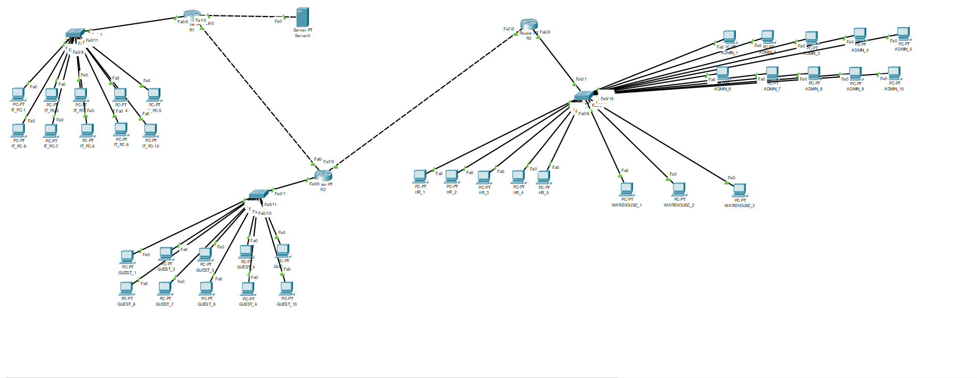

Slide 4
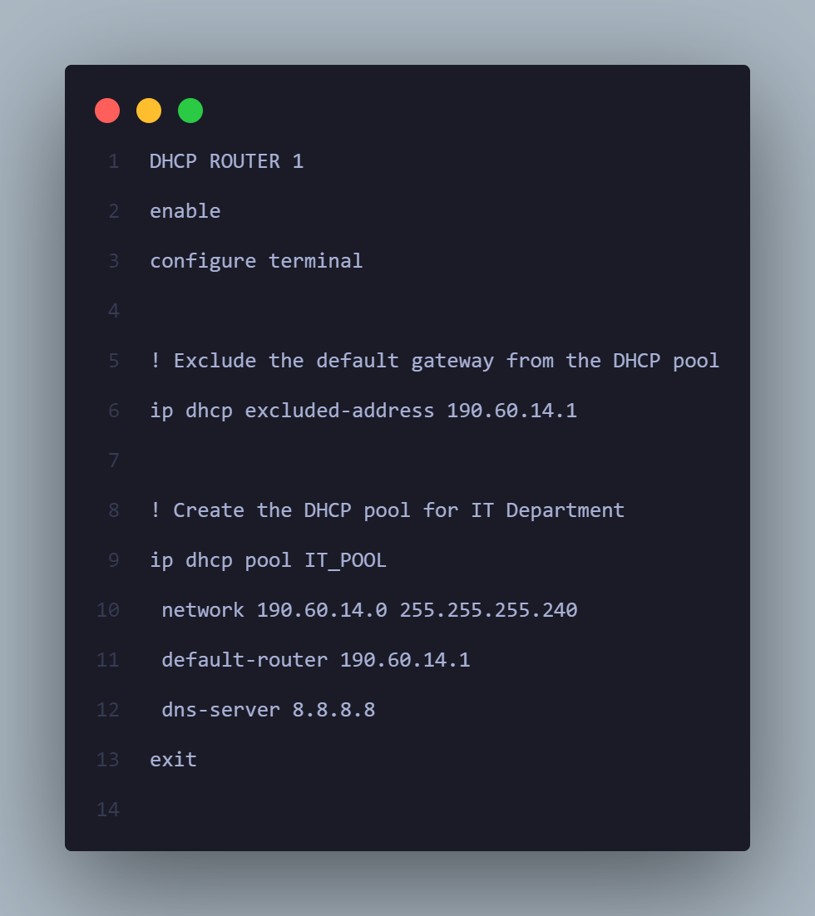
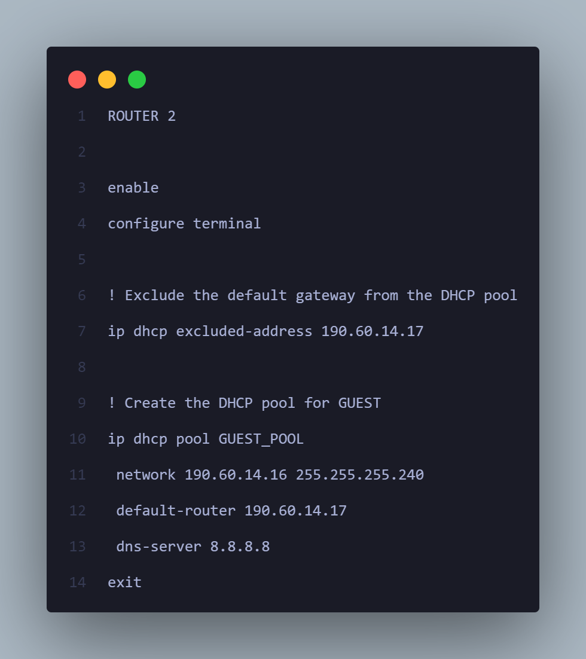
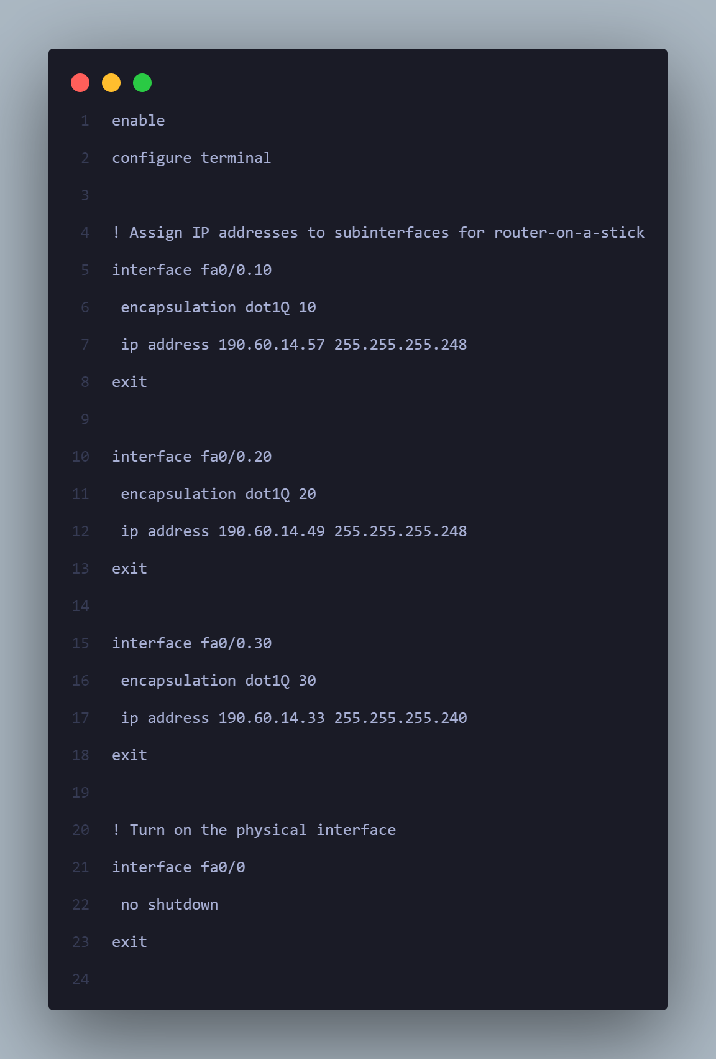

Slide 5

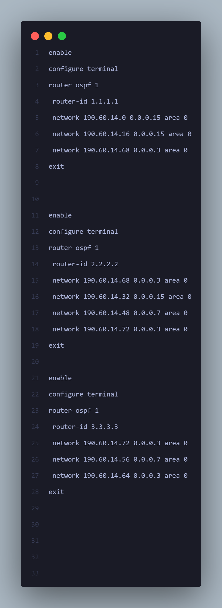

Slide 6
