Slide 1

DSC 530 - Data Exploration and Analysis Final Project
Name: Zicheng (Chance) Xu
Date: 8/5/2024

Slide 2
Statistical Question/Hypothesis
Is it more likely to have severe car accidents during the night than during the day?

Slide 3
Dataset and Variables
Dataset: US Accidents (2016 - 2023)
Countrywide car accident dataset covering 49 states of the USA from Feb 2016 – Mar 2023
Trimmed down to only Miami, FL car accidents to control for location (186,760 observations)
Key Variables
Astronomical_Twilight: Day or Night based on astronomical twilight
Severity: Severity of the accident, with a number between 1(short delay because of the accident) and 4(long delay)
Distance(mi): The length of the road extent affected by the accident in miles
Temperature(F): The temperature during the accident(in Fahrenheit)
Visibility(mi): The visibility during the accident(in miles)
Humidity(%): The humidity during the accident(in percentage)

Slide 4
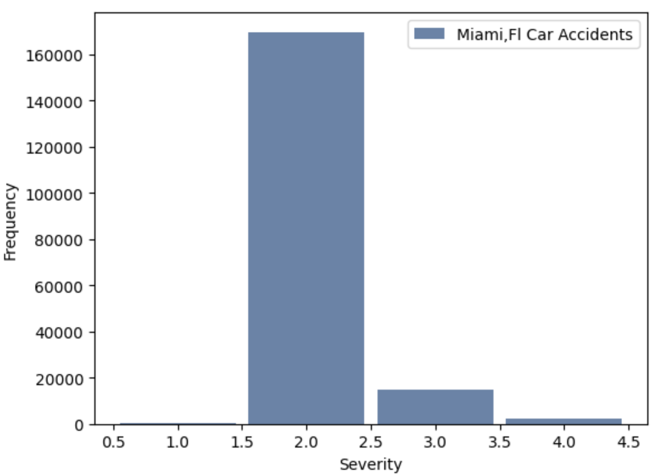
Histogram - Severity
Most of the accidents graded around level 2
Level 1 had the least amount followed by level 4
It makes sense to have such outliers as severe car accidents are rare in real life, and most car accident result in the delay of the traffic. We should keep them

Slide 5
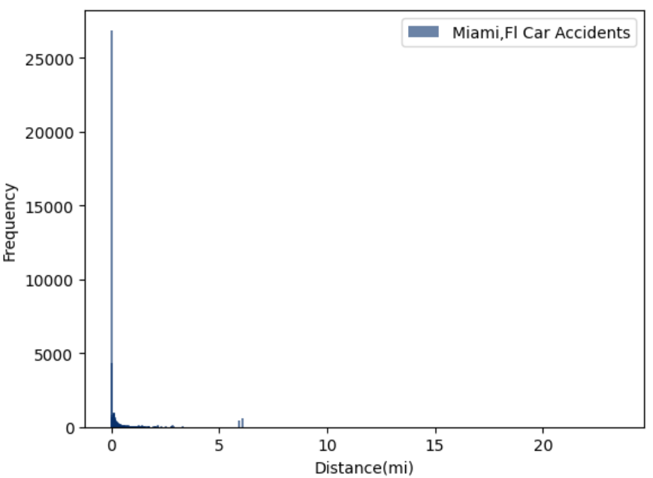
Histogram - Distance(mi)
There are a more than 25000 records have distance of 0 miles, meaning not affecting the road at all
Since we don't have insights into the cause of the outliers, and 23 miles(max value of the variable) of road affect could be completely blocking the road, or part of the road, as some roads are way longer than 23 miles, such as U.S.Route 20, which extends to 3,365 miles, I will leave the outliers untouched

Slide 6
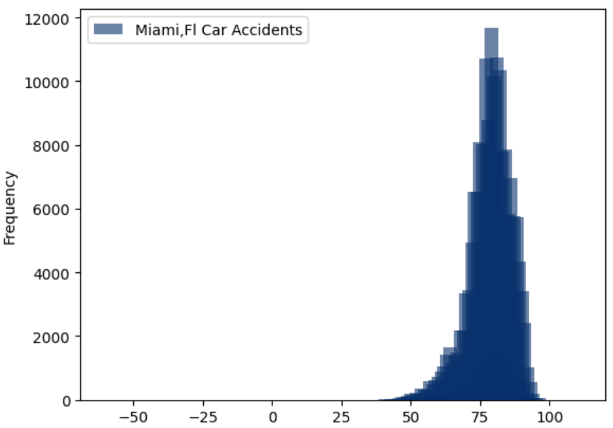
Histogram - Temperature(F)
The obvious outliers are the records when the Fahrenheit temperature are negative, with a few as extreme as around -50
As they are very rare in the data (invisible from the histogram but are there as the x axis is auto adjusted for them), we can remove them regardless of the cause of them being outliers

Slide 7
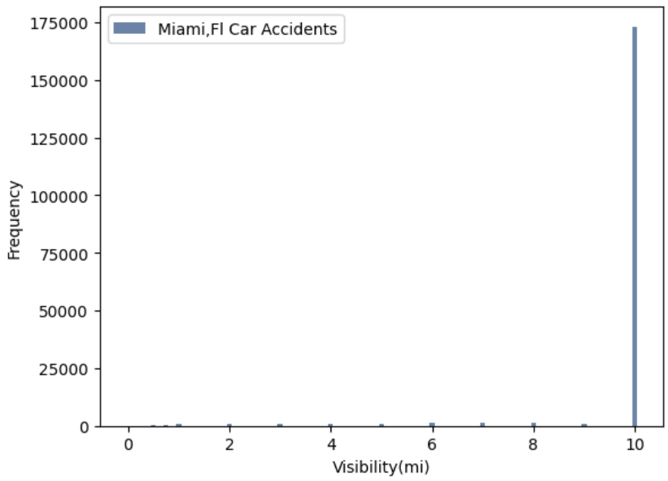
Histogram - Visibility(mi)
Most of the values are around 10 miles
Since we don't have insights into the cause of the outliers, and the lower valued outliers could well mean abnormal situations such as tropical storm, we will keep the values untouched

Slide 8
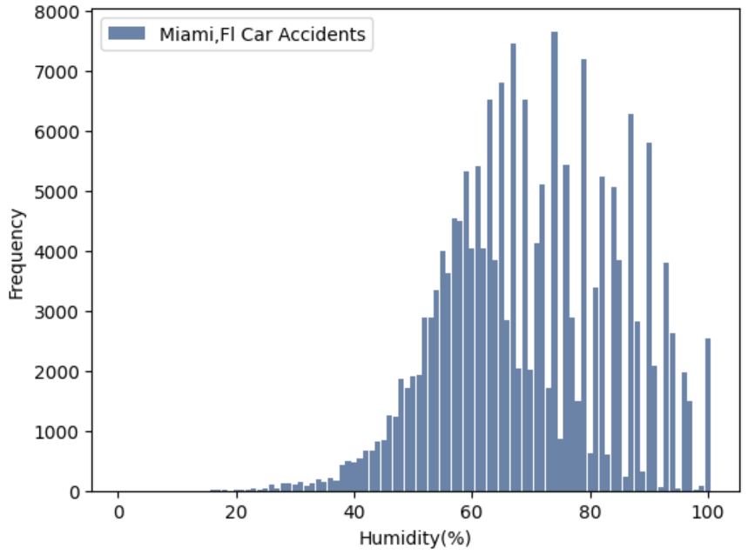
Histogram - Humidity(%)
The plot looks normal if we were to take out the spikes that we see about 60% to 100%, with the data normal around 60%
However, because of the spikes, the data is not normal
There are records with humidity less than 40%, which does not make sense according to World Population Review, that shows even the driest place in the US, Nevada, has an average humidity of 38.3%, let alone Florida is at the humid subtropical climate zone
Since there about about 0.31 percent of all current Miami records have humidity less than 30%, let's remove them for data sanity

Slide 9
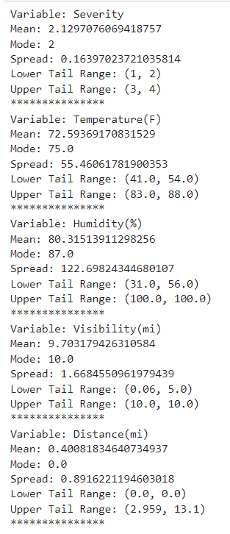
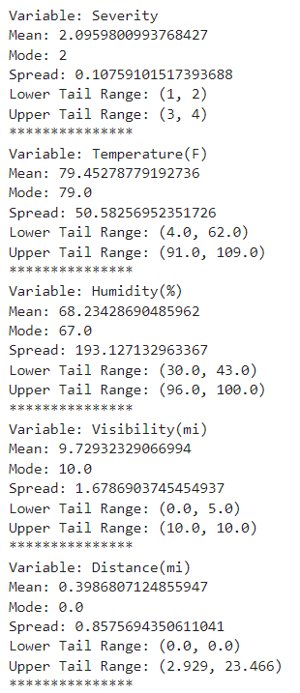
Descriptive Statistics
Distribution: Night – 25,411 records; Day – 158,387 records
Night
Day

Slide 10
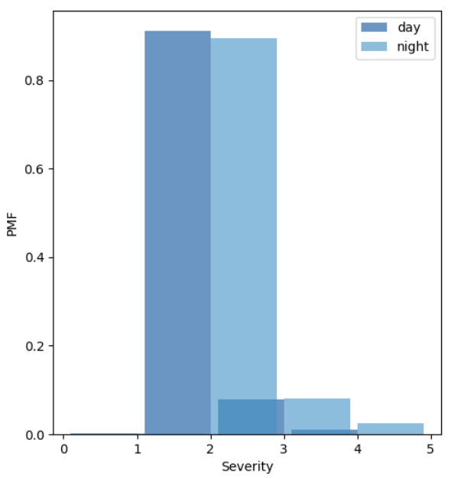
PMF Analysis - Severity
According to the graph, night accidents seem to be less likely than day accidents to have severity level of 2, and more likely to have severity level of 3 and 4

Slide 11
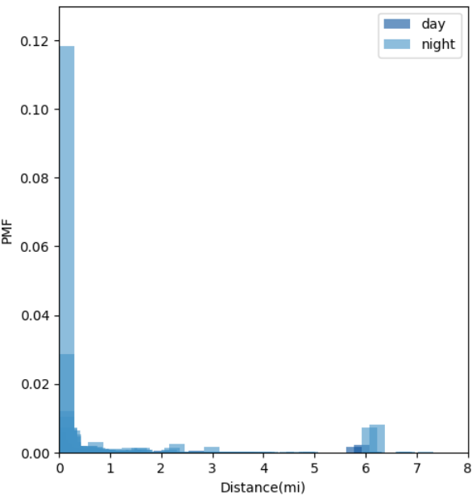
PMF Analysis - Distance(mi)
Although it's hard to visualize the PMF chart of Distance(mi), we can still see that night accidents seem to be more likely to have larger distance impact

Slide 12
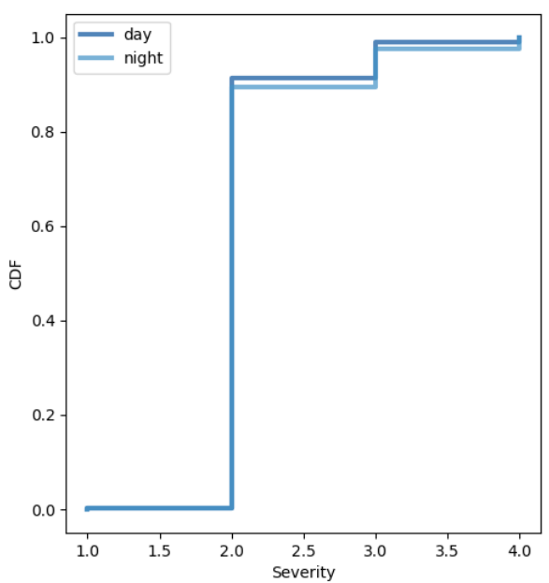
CDF Analysis - Severity
This graph provides visual representation that the most common value for both day and night is level 2 of severity, and it does look like the change of severity happens earlier for night for both severity 3 and 4, indicating accidents that happened during night tend to be more severe

Slide 13
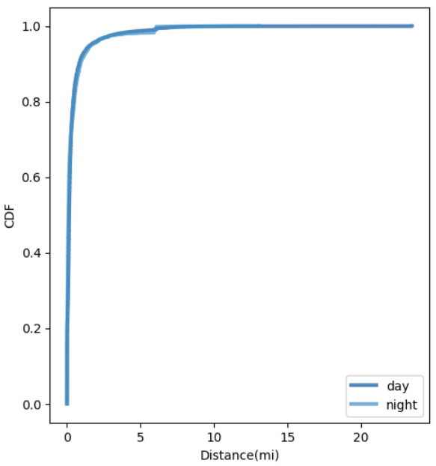
CDF Analysis - Distance(mi)
The plot shows the night accidents have slightly longer impact distance especially as the CDF gets larger

Slide 14
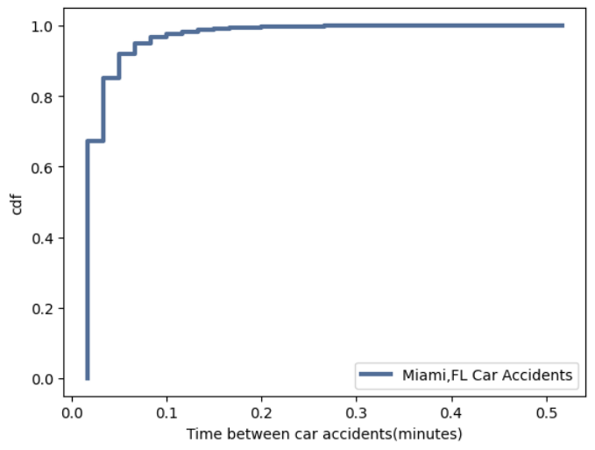
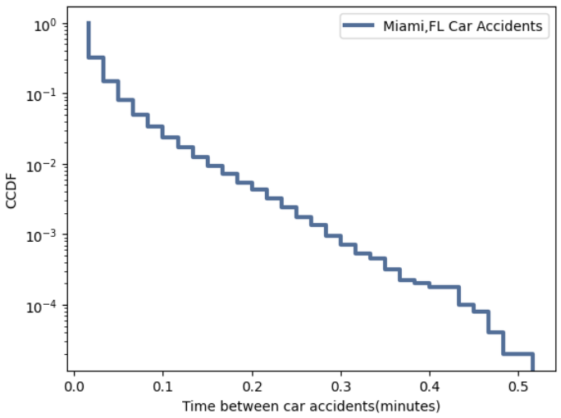
Analytical Distribution
The CDF graph on the left looks like an exponential distribution with relatively large λ
The graph on the right looks like a straight-line trended steps. Exponential distribution model will work good for time between car accidents for our database

Slide 15
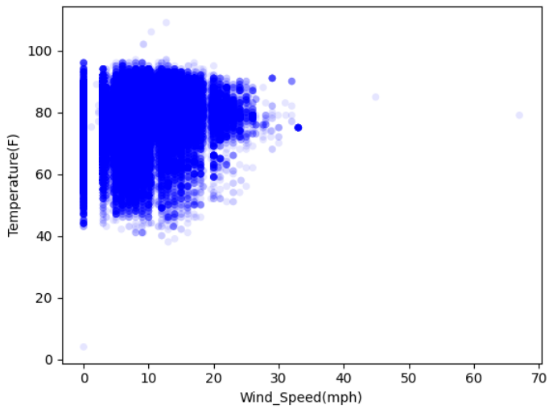
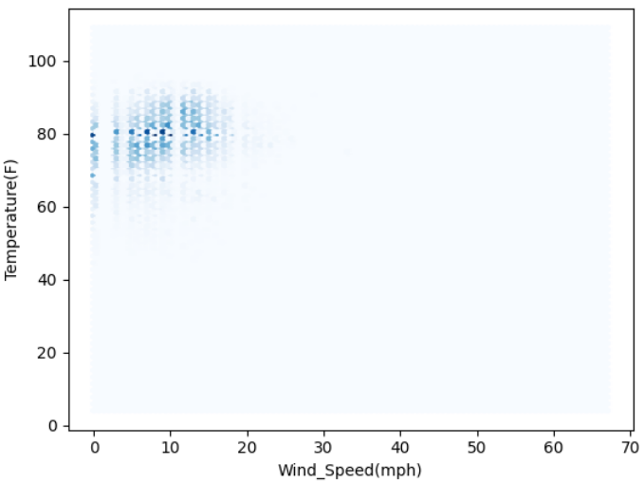
Scatter Plot – Wind Speed vs Temperature
There's no non-linear relationship in this plot as there's no non-straight-line pattern in this graph
There's no clear indication that high wind speed tend to have low temperature for the Miami, FL car accidents data. Quite the opposite, the scatter plot shows that high wind speed tend to have higher temperature
At the low wind speed, however, there's wide spread of temperature, indicating the relationship is weak
HexBin plot: it's clear the majority of the data is around 80 degrees, regardless of the wind speed, which makes sense as Miami,FL is around that heat year around, and the positive relationship between the higher wind speed and high temperature is less clear

Slide 16
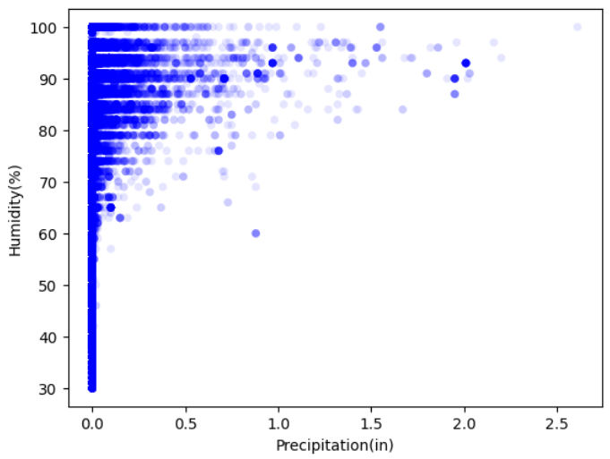
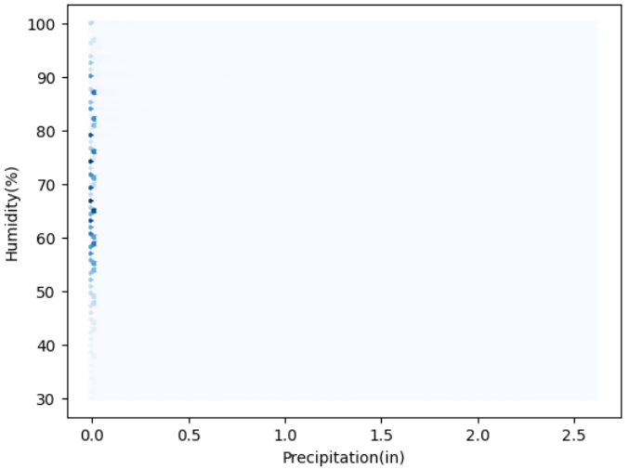
Scatter Plot –Precipitation vs Humidity
There's no non-linear relationship in this plot as there's no non-straight-line pattern in this graph
There's no clear linear relationship between precipitation and humidity in the Miami, FL car accidents data
However, we can tell that as precipitation increases, humidity tends to increase for some of the outliers
HexBin plot: the humidity has precipitation have no major correlation in our Miami, FL car accidents dataset.

Slide 17
Hypothesis Test - ChiSquared
Since the Severity is categorical, we use chi-squared statistic
Model: Stacked Day and Night car accidents data in Miami, FL, shuffled to make simulated sampling with the same number of observations as the total Miami, FL accidents
Observed: Based on the frequency of severity levels of the Day and Night data for each iteration
Expected: Based on the frequency of the original dataset of the Day and Night data
Iterations: 1000
Results: P-Value of 0
Summary: There is statistically significant association between the time of day (day or night) and the severity of car accidents
While the chi-squared test indicate a relationship between time of day and accident severity, it does not directly measure the likelihood of accident occurring at night versus during the day. Therefore, let's also do a one-sided test of the mean of the Distance(mi).

Slide 18
Hypothesis Test – One-sided Mean Diff Test
Test Statistic: Mean of Night Distance(mi) – Mean of Day Distance(mi)
Model: Stacked Day and Night car accidents data in Miami, FL, shuffled to make simulated sampling with the same number of observations as the total Miami, FL accidents
Iterations: 1000
Results: P-Value of 0
Summary: The p value of is still below 0.05, which confirms our hypothesis that it's more likely to have severe car accidents during the night than during the day.

Slide 19
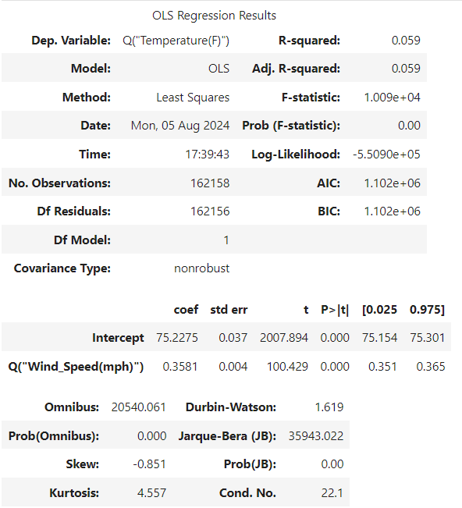
Regression Analysis
Response Variable: Temperature(F)
Predictor Variable: Wind_Speed(mph)
Model: Simple Linear Regression
Results Summary: As we can see the R squared and adjusted R squared are both 0.059, meaning a very small percentage of the variability in the Temperature(F) is explained by the Wind_Speed(mph). However, the p value of 0.000 for both the intercept and the predictor variable indicate they are statitically significant. When wind speed is 0 mph, the expected temperature is 75.2F. The p value of 0 provides evidence against the null hypothesis that the coefficient of wind speed is 0 mph. When wind speed increases or decreases by 1 mph, the temperature is expected to increase or decrease by 0.36F

