Slide 1

小游戏
QT6 C++ 开发教程
第15章

Slide 2
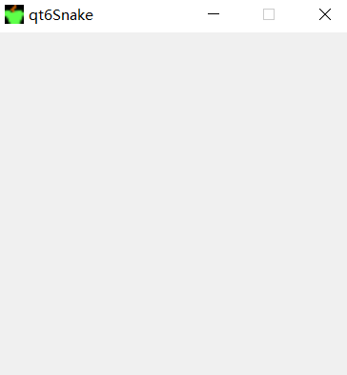
贪吃蛇
玩家控制一条蛇。目标是吃尽可能多的苹果。每次蛇吃苹果，它的身体就会生长。蛇必须避开墙壁和自己的身体。
框架搭建
#ifndef SNAKE_H
#define SNAKE_H #include <QMainWindow> class snake : public QMainWindow {
Q_OBJECT
public:
snake(QWidget *parent = nullptr);
~snake();
enum moveDirection{ left,right,up,down };
protected:
void paintEvent(QPaintEvent *);
void timerEvent(QTimerEvent *);
void keyPressEvent(QKeyEvent *);
private:
QImage dot; //身体的一节
QImage head;
QImage apple;
moveDirection heading;
static const int B_WIDTH = 300;
static const int B_HEIGHT = 300;
static const int DOT_SIZE = 10; //身体一节的大小，10*10
static const int ALL_DOTS = B_WIDTH*B_HEIGHT/(DOT_SIZE*DOT_SIZE);//900 void initGame();
};
#endif // SNAKE_H
#include "snake.h" snake::snake(QWidget *parent) : QMainWindow(parent) {
setFixedSize(B_WIDTH, B_HEIGHT);
dot.load("../images/dot.png");
head.load("../images/head.png");
apple.load("../images/apple.png");
initGame();
}

Slide 3
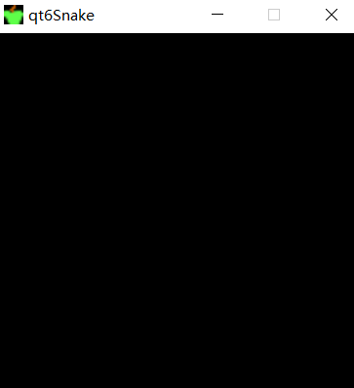
初始化
#ifndef SNAKE_H
#define SNAKE_H #include <QMainWindow> class snake : public QMainWindow {
…
private:
int timerId;
int length_snake;
int apple_x;
int apple_y;
bool game_playing; int x[ALL_DOTS];
int y[ALL_DOTS]; void initGame();
void locateApple();
};
#endif // SNAKE_H
void SnakeWidget::initGame() {
setStyleSheet("background-color:black;");
heading=right;
length_snake = 3;
game_playing = true;
for (int z = 0; z < length_snake; z++) {
x[z] = 50 - z * 10;
y[z] = 50;
} locateApple(); timerId = startTimer(DELAY);
}
void snake::locateApple() {
QTime time = QTime::currentTime();
srand((uint) time.msec()); int r = rand() % B_WIDTH/DOT_SIZE;
apple_x = (r * DOT_SIZE); r = rand() % B_WIDTH/DOT_SIZE;
apple_y = (r * DOT_SIZE);
}

Slide 4
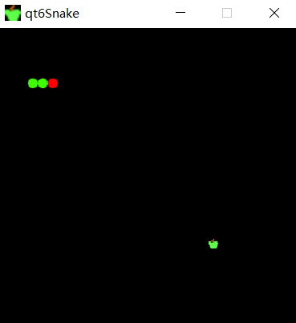
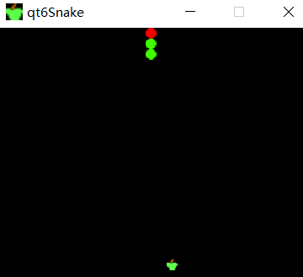
void snake::paintEvent(QPaintEvent *e) {
Q_UNUSED(e); QPainter qp(this); if (game_playing) {
qp.drawImage(apple_x, apple_y, apple); for (int z = 0; z < length_snake; z++) {
if (z == 0) { qp.drawImage(x[z], y[z], head);
else { qp.drawImage(x[z], y[z], dot); } }
}
} else { gameOver(qp); }
}
绘制
void checkApple();
void checkCollision();
void move();
void gameOver(QPainter &);
头文件新增
void snake::timerEvent(QTimerEvent *e) {
Q_UNUSED(e); if (game_playing) {
checkApple();
checkCollision();
move();
} repaint();
}
void snake::move() {
for (int z = length_snake; z > 0; z--) {
x[z] = x[(z - 1)];
y[z] = y[(z - 1)];
} switch (heading) {
case left: x[0] -= DOT_SIZE;break;
case right: x[0] += DOT_SIZE;break;
case up: y[0] -= DOT_SIZE;break;
case down: y[0] += DOT_SIZE;break;
default: break;
}
}
void snake::keyPressEvent(QKeyEvent *e) {
int key = e->key(); switch (key) {
case Qt::Key_Left: if(heading!=right) heading=left;break;
case Qt::Key_Right: if(heading!=left) heading=right;break;
case Qt::Key_Up: if(heading!=down) heading=up;break;
case Qt::Key_Down: if(heading!=up) heading=down;break;
default: break; } if (key == Qt::Key_Space && !game_playing) { initGame(); }
QWidget::keyPressEvent(e);
}
移动

Slide 5
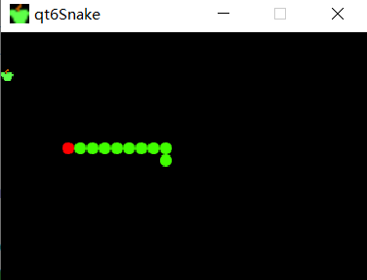
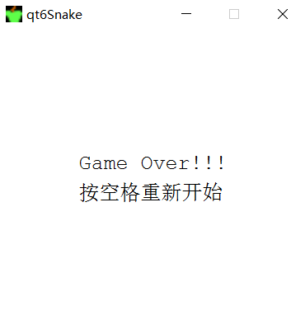
吃苹果
void snake::checkApple() {
if ((x[0] == apple_x) && (y[0] == apple_y)) { length_snake++;
locateApple();
}
}
碰撞检测
void snake::checkCollision() {
if(length_snake>4)//大于4才可能咬到自己
for (int z = length_snake; z > 0; z--) {
if ((x[0] == x[z]) && (y[0] == y[z])) { game_playing = false; }
}
if (y[0] >= B_HEIGHT||y[0] < 0||x[0] >= B_WIDTH||x[0] < 0) { game_playing = false; }
if(!game_playing) { killTimer(timerId); }
}
游戏结束
void snake::gameOver(QPainter &qp) {
setStyleSheet("background-color:white;");
QString message = "Game Over!!!";
QFont font("Courier", 15);
QFontMetrics fm(font);
int textWidth = fm.horizontalAdvance(message); qp.setFont(font);
int h = height();
int w = width(); qp.translate(QPoint(w/2, h/2));
qp.drawText(-textWidth/2, -15, message);
qp.drawText(-textWidth/2, 15, "按空格重新开始");
}

Slide 6
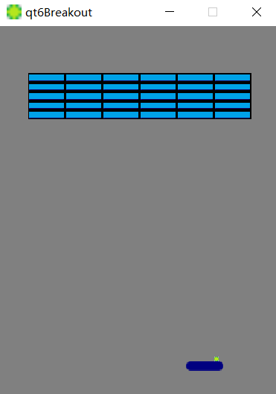
打砖块
在这个游戏中，玩家移动一个球拍并弹起一个球。目的是摧毁顶部的砖块。
paddleLPos
根据小球与球拍或砖块的撞击位置确定回弹方向
小球与上、左、右墙壁碰撞后会改变方向
小球与砖块碰撞，砖块被销毁
小球从底部掉落游戏结束
BaseItem
public继承关系：is-a
Ball
Paddle
Brick
聚合关系:has-a
QWidget
Breakout

Slide 7
#ifndef BASEITEM_H
#define BASEITEM_H
#include <QObject>
#include <QRect>
#include <QImage> class BaseItem : public QObject {
//Q_OBJECT
public:
QRect getRect();
QImage & getImage();
protected:
QImage image;
QRect rect;
explicit BaseItem(QObject *parent = nullptr);
virtual ~BaseItem();
}; #endif // BASEITEM_H
材料准备工作
QRect BaseItem::getRect() { return rect; } QImage &BaseItem::getImage() { return image; }
BaseItem::~BaseItem() {
//qInfo()<<this->objectName()<<"destroyed"<<Qt::endl;
}
BaseItem
Ball
Paddle
Brick
#ifndef BALL_H
#define BALL_H #include "baseitem.h" class Ball:public BaseItem {
public:
explicit Ball(QObject *parent = nullptr);
public:
void resetState();
void autoMove();
void setXDir(int);
void setYDir(int);
int getXDir();
int getYDir();
private:
int xdir;
int ydir;
static const int INITIAL_X = 230;
static const int INITIAL_Y = 355;
static const int RIGHT_EDGE = 300;
}; #endif // BALL_H
#include "ball.h"
Ball::Ball(QObject *parent):BaseItem{parent}
{
xdir = 1; ydir = -1; image.load("../images/ball.png"); rect = image.rect();
resetState();
//this->setObjectName("Ball");
}
void Ball::resetState() {
rect.moveTo(INITIAL_X, INITIAL_Y);
}
void Ball::autoMove() {
rect.translate(xdir, ydir); if (rect.left() == 0) { xdir = 1; } if (rect.right() == RIGHT_EDGE) { xdir = -1; } if (rect.top() == 0) { ydir = 1; }
}
void Ball::setXDir(int x) { xdir = x; } void Ball::setYDir(int y) { ydir = y; } int Ball::getXDir() { return xdir; } int Ball::getYDir() { return ydir; }

Slide 8
#ifndef PADDLE_H
#define PADDLE_H
#include "baseitem.h"
class Paddle:public BaseItem {
public:
Paddle(QObject *parent = nullptr);
void resetState();
void move();
void setDx(int);
private:
int dx;
static const int INITIAL_X = 200;
static const int INITIAL_Y = 360;
static const int RIGHT_EDGE = 300;
}; #endif // PADDLE_H
#include "paddle.h"
Paddle::Paddle(QObject *parent)
:BaseItem{parent}
{
image.load("../images/paddle.png"); rect = image.rect();
resetState();
}
void Paddle::resetState() {
rect.moveTo(INITIAL_X, INITIAL_Y);
}
void Paddle::move() {
int x = rect.x() + dx;
int y = rect.top();
if((x>0)&&(x<RIGHT_EDGE-getRect().width())) rect.moveTo(x, y);
}
void Paddle::setDx(int x) { dx = x; }
BaseItem
Ball
Paddle
Brick
#ifndef BRICK_H
#define BRICK_H
#include "baseitem.h"
class Brick:public BaseItem {
public:
Brick(int, int, QObject *parent = nullptr); bool isDestroyed();
void setDestroyed(bool);
private:
bool destroyed;
}; #endif // BRICK_H
#include "brick.h"
#include <QDebug>
Brick::Brick(int x, int y, QObject *parent)
:BaseItem{parent}
{
image.load("../images/brick.png");
destroyed = false;
rect = image.rect();
rect.translate(x, y);
}
bool Brick::isDestroyed() { return destroyed; }
void Brick::setDestroyed(bool b) { destroyed=b; }

Slide 9

#ifndef BREAKOUT_H
#define BREAKOUT_H #include <QMainWindow>
#include "ball.h"
#include "brick.h"
#include "paddle.h"
class Breakout : public QMainWindow
{
public:
Breakout(QWidget *parent = 0);
protected:
void paintEvent(QPaintEvent *);
void timerEvent(QTimerEvent *);
void keyPressEvent(QKeyEvent *);
void keyReleaseEvent(QKeyEvent *);
void finishGame(QPainter *, QString); void startGame();
void pauseGame();
void stopGame();
void victory();
void checkCollision();
private:
int timerId;
static const int N_OF_BRICKS = 30;
static const int DELAY = 10;
static const int BOTTOM_EDGE = 400;
Ball * ball;
Paddle * paddle;
Brick * bricks[N_OF_BRICKS];
bool gameOver;
bool gameWon;
bool gameStarted;
bool paused;
unsigned brokenBricks;
};
#endif // BREAKOUT_H
框架搭建
Breakout::Breakout(QWidget *parent)
: QMainWindow(parent)
{
setStyleSheet("background-color:gray;"); setFixedSize(300,400); setWindowIcon(QIcon("../images/ball.png")); gameOver = false;
gameWon = false;
paused = false;
gameStarted = false; ball=new Ball(this);
paddle=new Paddle(this);
const int paddle_W=paddle->getRect().width();
const int paddle_H=paddle->getRect().height();
for (int i=0,k=0; i<5; i++) {
for (int j=0; j<6; j++) {
bricks[k++]=new Brick(j*paddle_W+30,i*paddle_H+50,this);
}
}
}
BaseItem
public继承关系：is-a
Ball
Paddle
Brick
聚合关系:has-a
Breakout

Slide 10
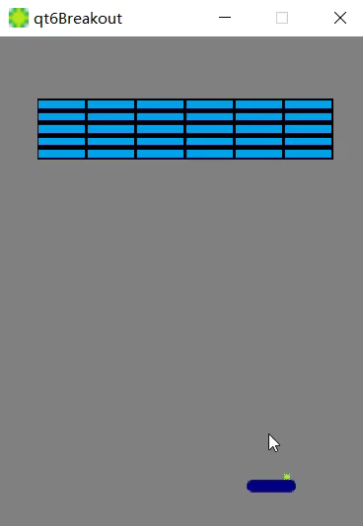
void Breakout::paintEvent(QPaintEvent *e)
{
Q_UNUSED(e); QPainter painter(this); if (gameOver) {
finishGame(&painter, "Game lost");
} else if(gameWon) {
finishGame(&painter, "Victory");
}else {
//绘制ball,paddle
painter.drawImage(ball->getRect(), ball->getImage());
painter.drawImage(paddle->getRect(), paddle->getImage());
//绘制bricks
for (int i=0; i<N_OF_BRICKS; i++) {
if (!bricks[i]->isDestroyed()) {
painter.drawImage(bricks[i]->getRect(), bricks[i]->getImage());
}
}
}
}
绘制
void Breakout::timerEvent(QTimerEvent *e)
{
Q_UNUSED(e); ball->autoMove();
paddle->move(); checkCollision();
repaint();
}
移动
void Breakout::keyPressEvent(QKeyEvent *e)
{
switch (e->key()) {
case Qt::Key_Left:paddle->setDx(-1);break;
case Qt::Key_Right:paddle->setDx(1);break;
case Qt::Key_P:pauseGame();break;
case Qt::Key_Space:startGame();break;
case Qt::Key_Escape:qApp->exit();break; default: QWidget::keyPressEvent(e);
}
}
void Breakout::startGame()
{
if (!gameStarted) {
setStyleSheet("background-color:gray;");
ball->resetState();
paddle->resetState();
for (int i=0; i<N_OF_BRICKS; i++) {
bricks[i]->setDestroyed(false);
} gameOver = false;
gameWon = false;
gameStarted = true;
timerId = startTimer(DELAY);
brokenBricks=0;
}
}
void Breakout::keyReleaseEvent(QKeyEvent *e)
{
switch (e->key()) {
case Qt::Key_Left:
case Qt::Key_Right:paddle->setDx(0);break;
}
}

Slide 11
void Breakout::checkCollision()
{
if (ball->getRect().bottom() > BOTTOM_EDGE) {
stopGame();
return;
}
checkPaddleCollision();
checkBricksCollision();
if(brokenBricks>=N_OF_BRICKS) victory();
}
碰撞检测
void Breakout::stopGame() {
killTimer(timerId);
gameOver = true;
gameStarted = false;
}
void Breakout::victory() {
killTimer(timerId);
gameWon = true;
gameStarted = false;
}
void Breakout::pauseGame() {
if (paused) {
timerId = startTimer(DELAY);
paused = false;
} else {
paused = true;
killTimer(timerId);
}
}
void Breakout::checkBricksCollision() {
for (int i=0; i<N_OF_BRICKS; i++) {
if (bricks[i]->isDestroyed()) continue;
if ((ball->getRect()).intersects(bricks[i]->getRect())) {
int ballLeft = ball->getRect().left();
int ballHeight = ball->getRect().height();
int ballWidth = ball->getRect().width();
int ballTop = ball->getRect().top(); QPoint pointRight(ballLeft + ballWidth, ballTop);
QPoint pointLeft(ballLeft, ballTop);
QPoint pointTop(ballLeft, ballTop);
QPoint pointBottom(ballLeft, ballTop + ballHeight);
//砖块碰到了球的最右侧，球往左弹 ，碰到了球的最左侧，球往右弹
if(bricks[i]->getRect().contains(pointRight)) { ball->setXDir(-1); }
else if(bricks[i]->getRect().contains(pointLeft)) { ball->setXDir(1); }
//砖块碰到了球的最上端，球往下弹 ，碰到了球的最下端，球往上弹
if(bricks[i]->getRect().contains(pointTop)) { ball->setYDir(1); }
else if(bricks[i]->getRect().contains(pointBottom)) { ball->setYDir(-1); }
bricks[i]->setDestroyed(true);
++brokenBricks;
}
}
}

Slide 12
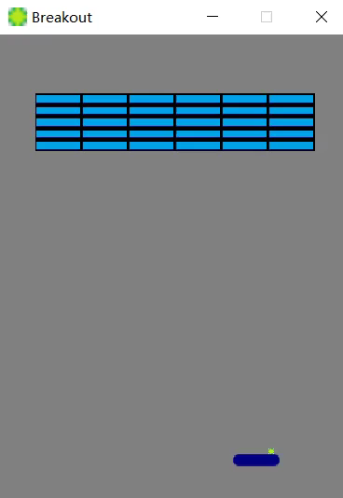
void Breakout::checkPaddleCollision() {
if ((ball->getRect()).intersects(paddle->getRect())) {
int paddleLPos = paddle->getRect().left();
int ballLPos = ball->getRect().left();
int oneFifthPaddle= paddle->getRect().width()/5;
int twoFifthPaddlePos = paddleLPos+2*oneFifthPaddle;
int threeFifthPaddlePos = paddleLPos+3*oneFifthPaddle;
if (ballLPos < twoFifthPaddlePos) { ball->setXDir(-1); } if (ballLPos >= twoFifthPaddlePos && ballLPos < threeFifthPaddlePos) { ball->setXDir(0); } if (ballLPos >= threeFifthPaddlePos ) { ball->setXDir(1); }
ball->setYDir(-1); //球拍总是让球向上运动
}
}
碰撞检测
paddleLPos

