Slide 1

容器
QT6 C++ 开发教程
第3章

Slide 2
容器
数据结构与算法
C++ 标准库：容器
Qt里的容器
我们将学习以下容器：QList、QSet和QMap。
有两种容器：顺序容器和关联容器。
顺序（sequence）容器一个接一个地存储项
QList、QVector(在qt6中，QVector是QList别名)
而关联容器存储键值对。
QSet、QMap
#include <QList> int main(void)
{
QList<int> vals = {1, 2, 3, 4, 5}; qDebug() << ”vector容器大小是：” << vals.size(); qDebug() << ”第一个元素是： " << vals.first();
qDebug() << ”最后一个元素是： " << vals.last(); vals.append(6);
vals.prepend(0); qDebug() << "Elements: ";
for (int val : vals)
qDebug() << val ;
}
QList
vector容器大小是：5
第一个元素是： 1
最后一个元素是： 5
Elements:
0
1
2
3
4
5
6
#include <QList>
#include <QLocale>
#include <QCollator>
#include <algorithm>
int main(void)
{
QList<QString> authors = {"张三", "李四", "王五"}; for (int i=0; i < authors.size(); ++i)
qDebug() << authors.at(i);
authors << "莫言" << "刘慈欣";
qDebug() << "***********************"; QLocale cn(QLocale::Chinese);
QCollator collator(cn);
std::sort(authors.begin(), authors.end(), collator);
qDebug() << "按拼音排序:";
for (QString &author : authors)
qDebug() << author;
}
张三
李四
王五
***********************
Sorted:
李四
刘慈欣
莫言
王五
张三

Slide 3
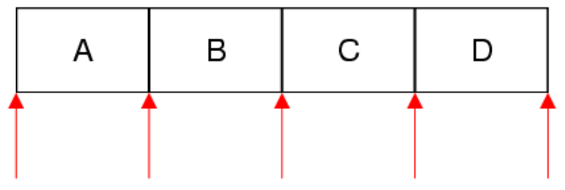
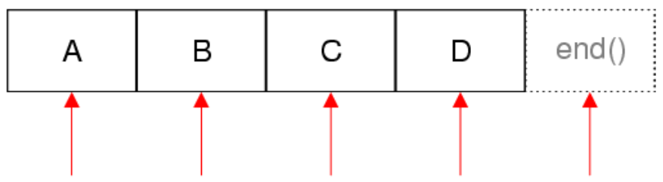
QStringListIterator为QStringList提供了Java风格的const迭代器。
QStringList
#include <QList>
int main(void)
{
QString string = "coin, book, cup, pencil, clock, bookmark";
QStringList items = string.split(",");
QStringListIterator it(items); while (it.hasNext())
qDebug() << it.next().trimmed() ;
}
coin
book
cup
pencil
clock
bookmark
QStringList::Iterator it=items.begin();
while (it!=items.end())
qDebug() << (*it++).trimmed() ;
QSet
#include <QTextStream>
#include <QSet>
#include <QList>
#include <algorithm>
using namespace Qt;
int main(void) {
QTextStream out(stdout); QSet<QString> cols1 = {"yellow", "red", "blue"};
QSet<QString> cols2 = {"blue", "pink", "orange"}; out << "There are " << cols1.size() << " values in the set" << endl; cols1.insert("brown"); out << "There are " << cols1.size() << " values in the set" << endl; cols1.unite(cols2); out << "There are " << cols1.size() << " values in the set" << endl; for (const QString &val : cols1)
out << val << endl;
//QList<QString> lcols=cols1.values(); QList<QString> lcols(cols1.begin(),cols1.end());
std::sort(lcols.begin(), lcols.end()); out << "*********************" << endl;
out << "Sorted:" << endl; for (const QString &val : lcols)
out << val << endl;
}
提供具有快速查找功能的单值集。
不支持排序。values方法返回一个QList，其中包含QSet中的元素。
unite方法执行两个集合的并集。
There are 3 values in the set
There are 4 values in the set
There are 6 values in the set
orange
yellow
brown
red
pink
blue
*********************
Sorted:
blue
brown
orange
pink
red
yellow

Slide 4
QMap
#include <QTextStream>
#include <QMap>
using namespace Qt; int main(void)
{
QTextStream out(stdout); QMap<QString, int> items = { {"coins", 5}, {"books", 3} }; items.insert("bottles", 7);
//QList<int> values = items.values(); QList<int> values(items.cbegin(),items.cend());
out << "Values:" << endl; for (int val : values)
out << val << endl;
//QList<QString> keys = items.keys();
QList<QString> keys(items.keyBegin(),items.keyEnd()); out << "Keys:" << endl;
for (const QString &key : keys)
out << key << endl;
QMapIterator<QString, int> it(items); out << "Pairs:" << endl; while (it.hasNext()) {
it.next();
out << it.key() << ": " << it.value() << endl;
}
}
Values:
3
7
5
Keys:
books
bottles
coins
Pairs:
books: 3
bottles: 7
coins: 5
QMapIterator是QMap的Java风格迭代器。
next()：返回下一项并将迭代器前进一个位置。

Slide 5
自定义类型排序
#include <QTextStream>
using namespace Qt;
class Book { public:
Book(QString, QString);
QString getAuthor() const;
QString getTitle() const;
private:
QString author;
QString title;
};
Book::Book(QString auth, QString tit) {
author = auth;
title = tit;
}
QString Book::getAuthor() const { return author; }
QString Book::getTitle() const { return title; }
bool compareByTitle(const Book &b1, const Book &b2) { return b1.getTitle() < b2.getTitle();
}
int main(void)
{
QTextStream out(stdout); QList<Book> books = {
Book("Jack London", "The Call of the Wild"),
Book("Leo Tolstoy", "War and Peace"),
Book("Gustave Flaubert", "Sentimental education"),
Book("Guy de Maupassant", "Une vie"),
Book("William Shakespeare", "Hamlet")
}; std::sort(books.begin(), books.end(), compareByTitle); for (const Book& book : books)
out << book.getAuthor() << ": " << book.getTitle() << endl;
}
William Shakespeare: Hamlet
Gustave Flaubert: Sentimental education
Jack London: The Call of the Wild
Guy de Maupassant: Une vie
Leo Tolstoy: War and Peace

