Slide 1


GA-DSI-18 Project 1
2017 & 2018
SAT & ACT Data Analysis
Katherine
Rebecca
Joseph
Jeffrey

Slide 2
What is the problem?
The new format for the SAT was released in March 2016. The College Board - the organization that administers the SAT and tracks statewide participation would like to look for ways to improve SAT participation rate.
Use a combination of analysis techniques into the provided data and outside research to give recommendations on:
“How the College Board might work to increase the
participation rate in a state of our choice.”

Slide 3
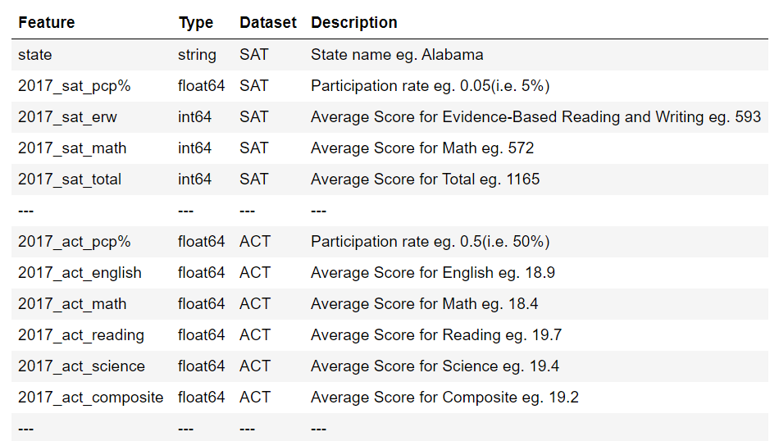
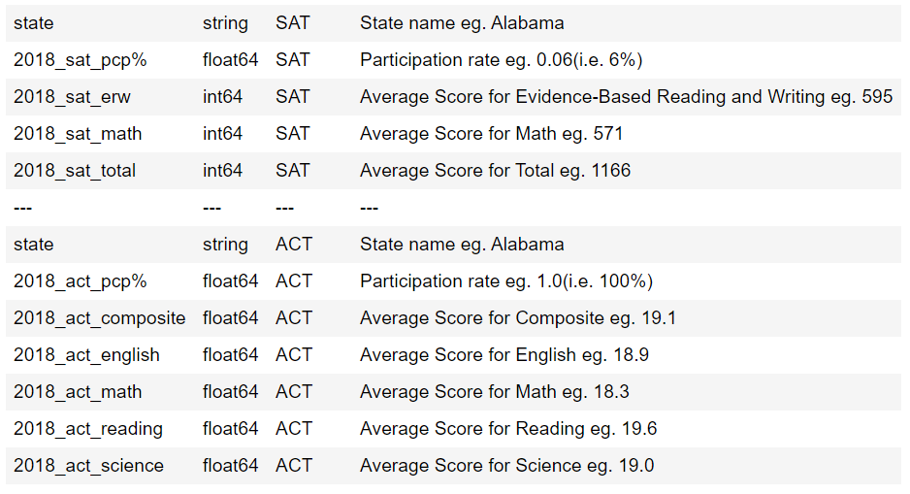
Data Dictionary
2018 data
2017 data

Slide 4
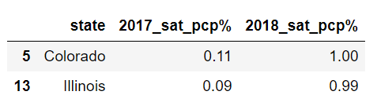
Key findings
Participation Rate
states with 100% participation on a given test with a rate change year-to-year
Colorado and Illinois stood out from the list with the biggest increase for SAT participation

Slide 5
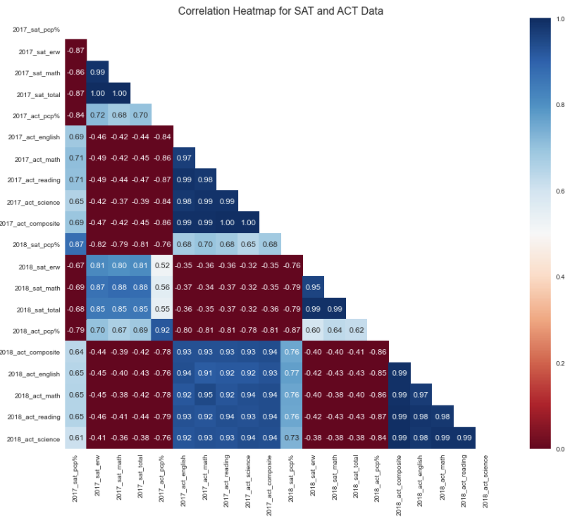
Key findings
We observed the following points:
Mean scores on a given test are highly negatively correlated with participation rate on that test (r ~ -0.8). This directly indicates the observation of higher scores on SAT had lower SAT participation rate and higher ACT participation rate had lower ACT scores). (Yellow box)
SAT participation rate was negatively correlated with ACT participation rate. (Red box)
Notes:
Using heatmap to look at Correlation between some data

Slide 6
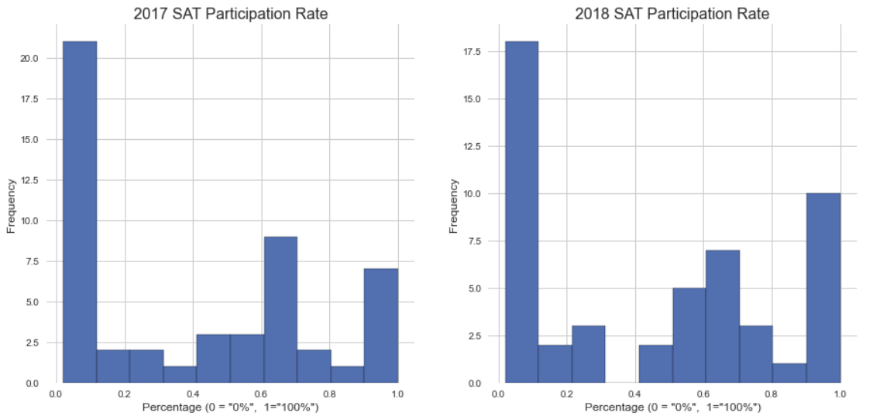
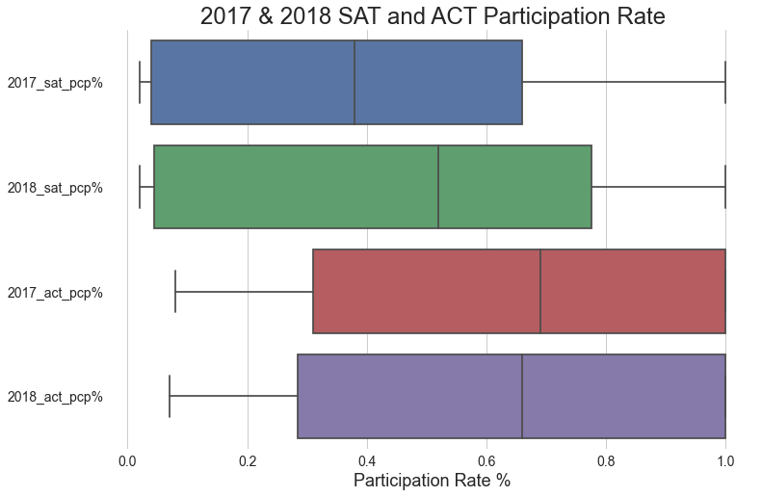
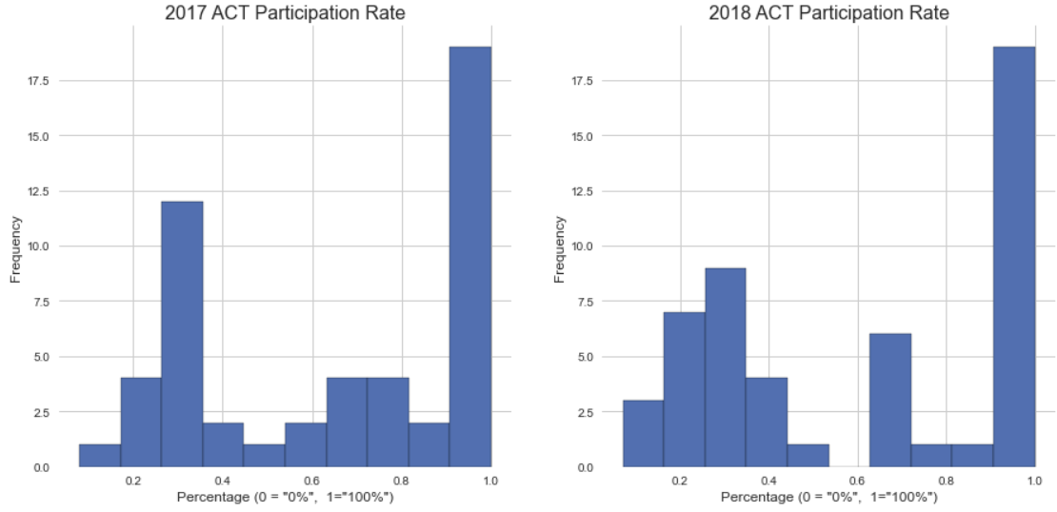
Key findings
SAT and ACT Participation Rate, we observed the distribution of ACT Participation Rate across the 50 states is centered significantly higher than that of the SAT. This can also mean that across the 50 states, ACT is preferred over SAT.
Notes:
participation SAT lower than in ACT accross all the states. IQR more towards the left for SAT, IQR more toward the right for ACT. The histogram shows in more detail that the peak for both 2017 and 2018, SAT peak is at 0 to 10%. Whereas ACT is at the 90 to 100.

Slide 7
Key findings
(a) Participation rate had a huge impact on state average SAT/ACT scores.
Relationships between populations sizes & rates:
Low participation states have lesser people taking the tests. However, these people are usually the ones who need to pass the tests and put in more effort to get better scores. This resulted in bias and artificially higher scores.
High participation state have more people taking the tests. However, these include the good performers and the bad performers. This also resulted in bias and artificially lower scores.

Slide 8
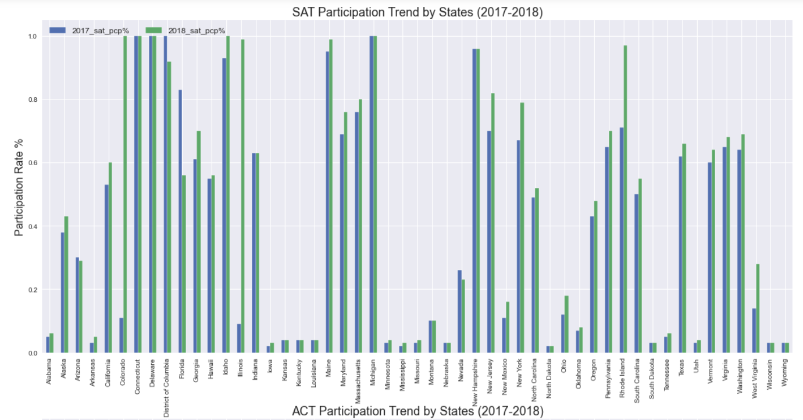
Key findings
(b) Identifying States of interest
Using simple bar charts in Python to plot the 2017/2018 SAT/ACT Participation Rates, we were able to easily identify the following states of interest:
From the SAT chart, Colorado, Illinois who had significant increase in 2018 SAT participation rate as compared to 2017.
Tennessee had perpetual low SAT Participation Rate but highest ACT PArticipation Rate

Slide 9
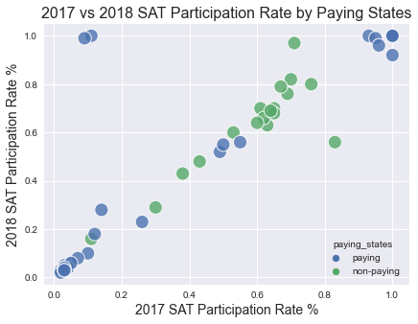
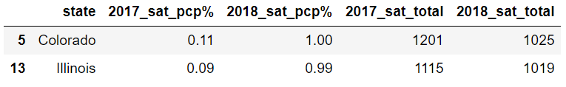

Key findings
(c) Outside Research
Investigating Colorado and Illinois had significant increase in 2018 SAT participation rate as compared to 2017
According to various articles found online, both states implemented mandatory SAT testing as well as the allowing contracts with the ACT to expire.
Since the participation rate increase was significant, there may be an impact to these states' SAT and ACT scores. To investigate the correlation of this impact, we used scatter plots and we saw that there was a high correlation between SAT Total score in 2017 and 2018 for each state. There were a few exceptions where we see that states have dropped off from 2017 to 2018.
Investigating Tennessee perpetual low SAT participation rate
State required either tests SAT/ACT, Not paid by the state
100% ACT participation in both years

Slide 10
Conclusion and recommendations
The ACT and SAT participation distributions roughly mirror each other, with states tending to prefer one test or the other based on bias of whether SAT or ACT is required in that state and whether the state is paying for the tests or not.
ACT and SAT scores are inversely correlated with their respective participation rates. This is likely due to selection bias, as low participation means those who are participating tend to be higher achieving, and high participation means diluted quality of performance.
It is recommended that the College Board takes into consideration household income data especially for states with low participation rate and is currently a non-paying state. The analysis had shown a correlation in this aspect that makes it worth further investigation.
The analysis had yielded a list of states with low participation rate and is currently a non-paying state, of which the College Board could work with to share and implement support and fiscal policies that were put in place in states with high participation rate. In particular, our analysis specifically identified Tennessee as a potential working target.

Slide 11
Thank you

