Slide 1
MACHINE LEARNING - KISHOR DESAI
Making the Machines to Learn is called as Machine Learning.
There are 3 types of Machine Learning:
Supervised Learning
Unsupervised Learning
Reinforcement Learning

Slide 2
DIFFERENT TYPES OF MACHINE LEARNING
Supervised Learning – Means learn from someone. The Machine is trained by a person/program
Unsupervised Learning – Means learn on own. The Machine gets trained on its own.
Reinforcement Learning – Reinforcement learning involves Rewards and Penalties. Rewards when the work is done right and penalty when the work is not done right.

Slide 3
TYPES OF ANALYTICS
Descriptive Analytics
Prescriptive Analytics
Diagnostic Analytics
Predictive Analytics – Machine Learning comes under Predictive Analysis. Using the past data, we predict the future outcome in Machine Learning.

Slide 4
CONVENTIONAL PROGRAMMING VS MACHINE LEARNING
In conventional programming, we write the program/code which has the equation. We give input to our program and get the output from the program.
In Machine Learning, we give both input and output data to the program, in turn we get the equation/relation between the input and output, which can be used to predict the output in future using the input data provided.

Slide 5
PARTS OF MACHINE LEARNING
Features – Features is/are the input data that we give to the Machine Learning Algorithm. Features help us to build the relation/equation.
Labels – Labels is/are the output data that we give to the Machine Learning Algorithm. Labels are necessary to build the relation/equation
Model – Model is the equation/relation between the Features and Labels generated by the Machine Learning Algorithm.

Slide 6
MACHINE LEARNING ALGORITHMS
Machine Learning Algorithms are the programs which take the Features and Labels data and give us the relation/equation between the Features and Labels.
There are mainly two types of Machine Learning Algorithms, they are:
Regression Algorithms
Classifier Algorithms
Regression Algorithms are used when the data is continuous, i.e., for continuous-data prediction.
Classifier Algorithms are used to take decisions(based on Boolean Values-True or False, 1 or 0, etc)

Slide 7
MACHINE LEARNING ALGORITHMS
Regression Algorithm – Linear Regression – Linear Regression is used when the features and labels are linearly related.
Eg: x : 1 2 3 4 5 6
y : 4 7 10 13 16 19
In this example, we see that y is related to x by the equation y=3x+1, indicating the linearity of the relation.
Regression Algorithm can be used for any data where inputs and outputs are related by the function y=mx+c, where power of x always is 1

Slide 8
MACHINE LEARNING ALGORITHMS
Classification Algorithm – Classification Algorithms are used whenever there is a need to take a decision based on input values.
Eg: Marks : 20 30 35 40 60 80
Pass/Fail : F F P P P P
In this example, we see that the Student will be declared Pass if he scores 35 or above marks, and will be declared Fail if he scores less than 35
Classifier Algorithms can be used whenever there is a need to take a decision based on the input(features) values

Slide 9
TYPES OF CLASSIFICATION ALGORITHMS
Logistic Regression
Decision Tree
Random Forest
Support Vector Machine(SVM)
K Nearest Neighbors(KNN)
Naive Bayes

Slide 10
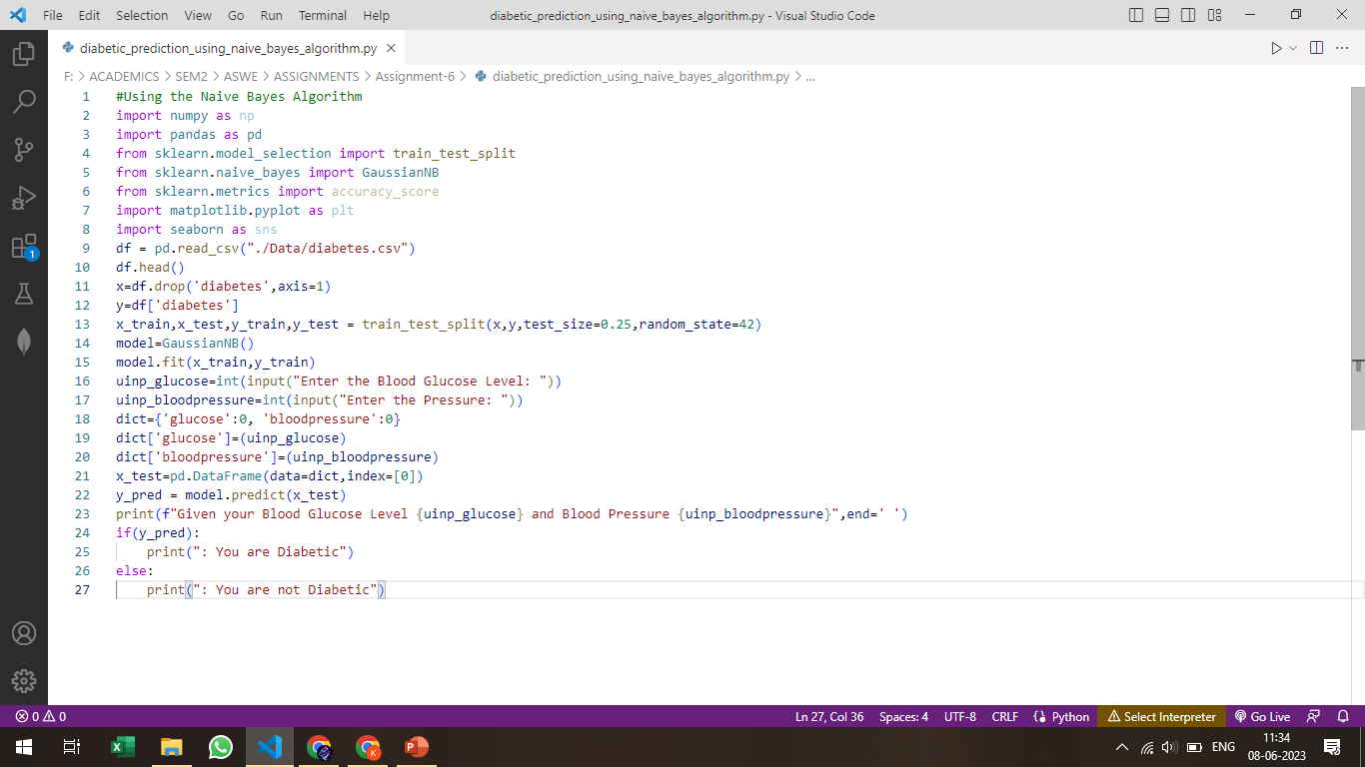
MACHINE LEARING CODE IN PYTHON (USING NAIVE BAYES ALGORITHM)

Slide 11
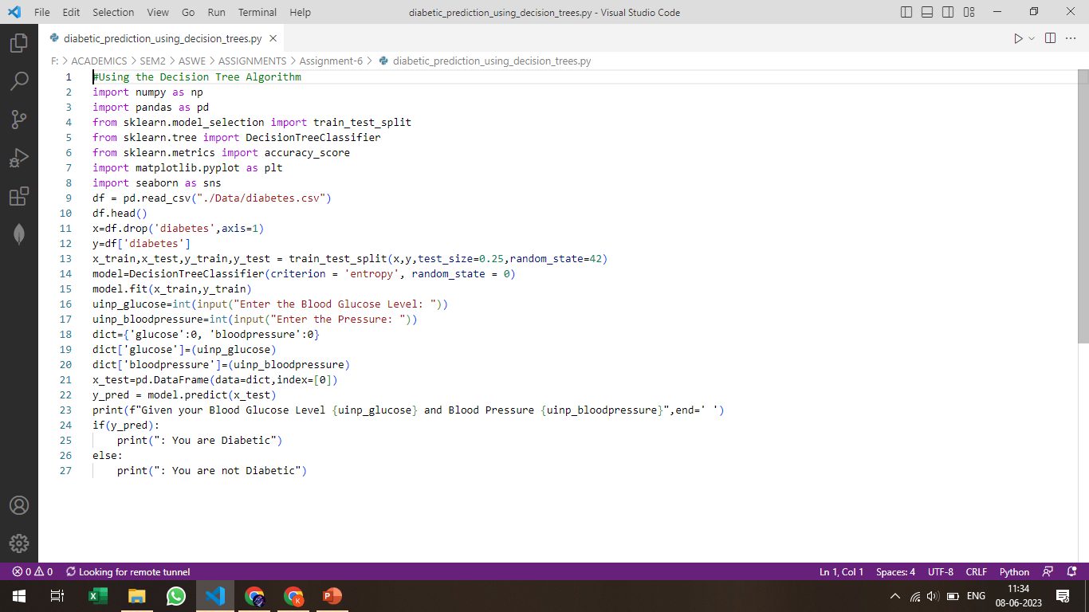
MACHINE LEARING CODE IN PYTHON (USING DECISION TREES ALGORITHM)

Slide 12
MACHINE LEARING CODE IN PYTHON
All other Machine Learning Algorithms have been executed in the file “all_algorithms.ipynb”attached alongside this PPT in Google Classroom.

