Slide 1
FINTECH MINOR - GENAI - MINI PROJECT
TITLE : CODE ANALYSIS USING GEMINI MODEL
NAME : KISHOR DESAI
USN : 1RVU22BSC044

Slide 2
PROJECT DETAILS:
Description : Analyzing Code from GitHub Repositories, generating detailed report about Errors and Bugs, including the corrected code.
Steps:
1) User Input for GitHub Repository URL
2) Recursively extracting files from the Repository
3) Providing extracted files to Generative API for error identification and report generation
4) Saving generated reports in local directory.

Slide 3
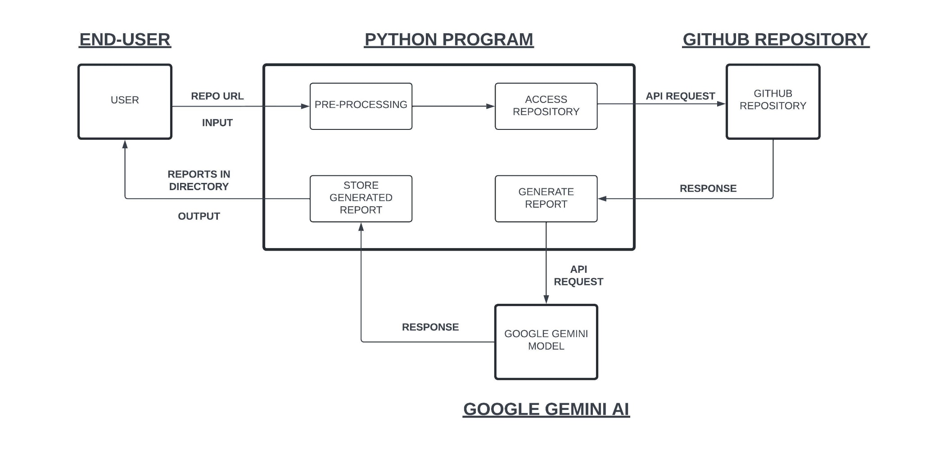
SOFTWARE ARCHITECTURE:

Slide 4
COMPONENTS USED:
Programming Language: Python
Modules Used:
1) PyGitHub – for accessing files from Repository
2) Google Gemini API – For Error and Bug identification, and Report Generation.
3) OS Module – To Store Files in Local Directory.
Resources Referred:
1) https://pygithub.readthedocs.io/en/stable/
2) https://ai.google.dev/gemini-api/docs/get-started/python

Slide 5
LINKS:
GitHub : https://github.com/GitKDCollege/Code_Analyser
Google Drive : https://drive.google.com/drive/folders/11b_hwgMw6yhHHOuR-8ZsAedHRqt_jc1z?usp=sharing
THANK YOU

