Slide 1
第2周组会
虚拟现实头眼协同对象操纵方法设计与实现
刘兆薰
Feb 27, 2023

Slide 2
组会内容
Baseline
User Study
对象旋转方程

Slide 3
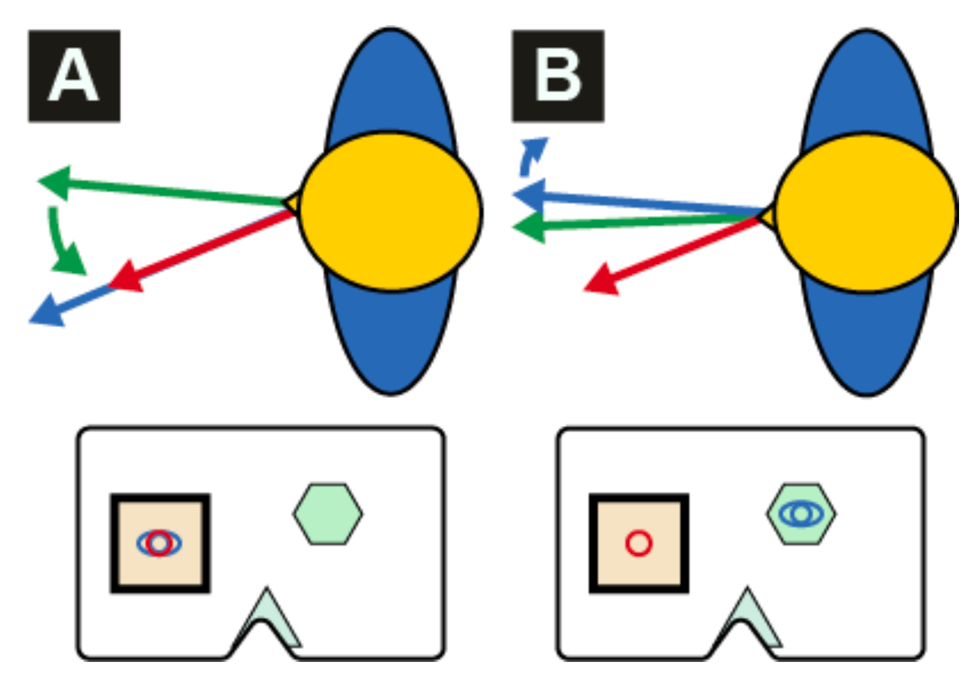
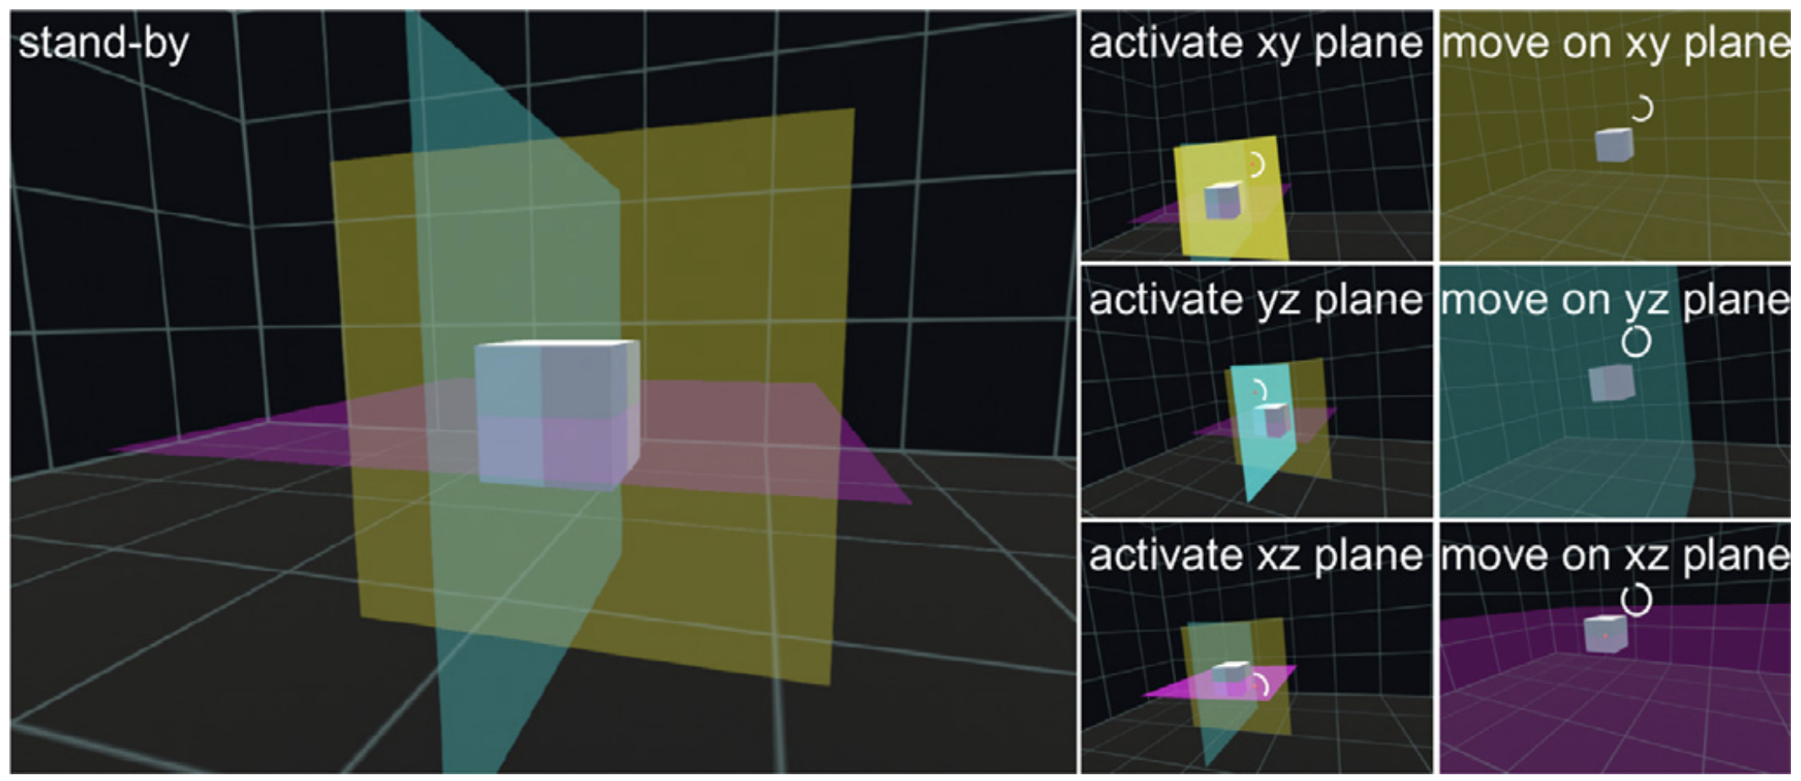
Baseline
Sidenmark, UIST, 2019
Liu, Computer & Graphics, 2020

Slide 4
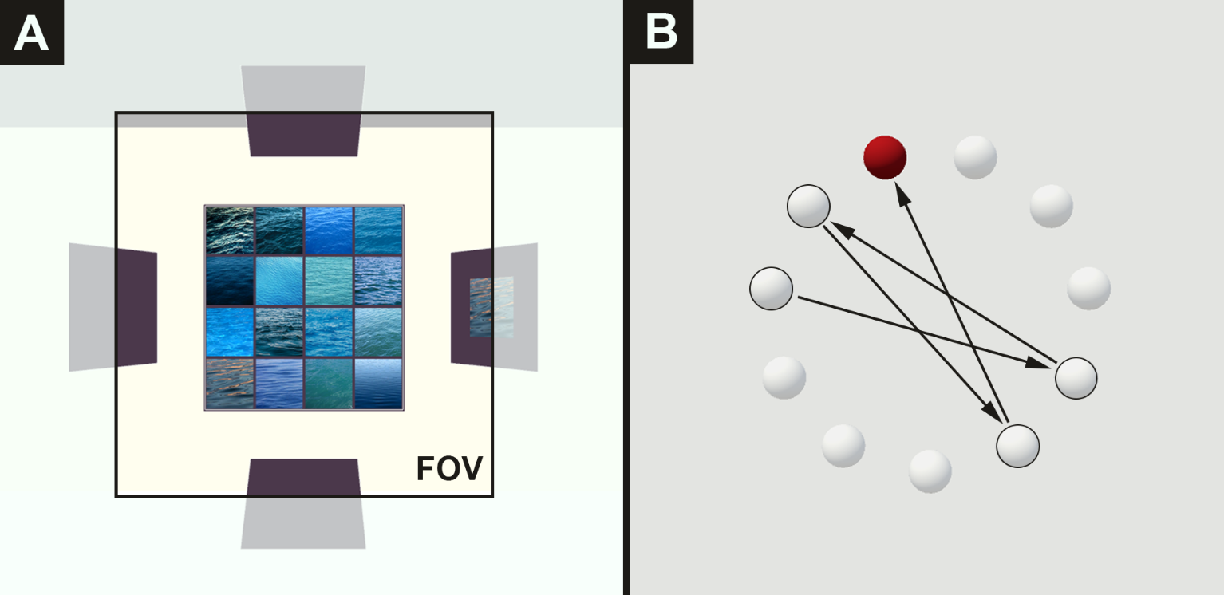
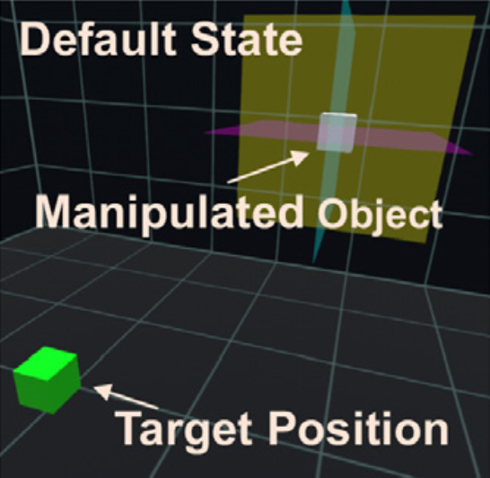



User study
对象选择 (复用Eye & Head)
对象操纵 (复用OrthoGaze + 自行设计)

Slide 5

对象旋转方程
Function HeadBasedRotation():
float rotationSpeed = 1.0f;
float xAxisRotation = INPUT_DEVICE.GetAxis(“x”) * rotationSpeed;
float yAxisRotation = INPUT_DEVICE.GetAxis(“y”) * rotationSpeed;
OBJECT.transform.Rotate(Vector3.down, xAxisRotation);
OBJECT.transform.Rotate(Vector3.right, yAxisRotation);

