Slide 1
OASIS
Tom Shuman
@GitMeOutaHere on GitHub

Slide 2
Description
The USDA runs a programs nationally that provides food to at risk children. The program that allows meals while school is not in session for the summer is SFSP.
OASIS is a mobile application that allows users to access a listing of the ten nearest SFSP meal sites to their current location.

Slide 3
Features
Users can access the information for the ten closest meal sites to their current location from anywhere in the United States
Users will be notified of the most recent site database update
User can choose to manually enter an address to search for sites

Slide 4
Planning - User Stories
Users are able to view the locations in map or list view
Users are able to view the hours of operation and meal service peramaeters by selecting a location
Users are able to request directions for the fastest route to desired location by walking, driving or public transportation

Slide 5
Planning - DB and Models
Model classes / tables
Authorized Meal Site
Address
Meals Served (e.g. “Breakfast”, “AM Snack”, “Lunch” “PM Snack”, or “Dinner”
Hours of operations

Slide 6
Technology Stack
Java
XML
Android Studio
MySql

Slide 7
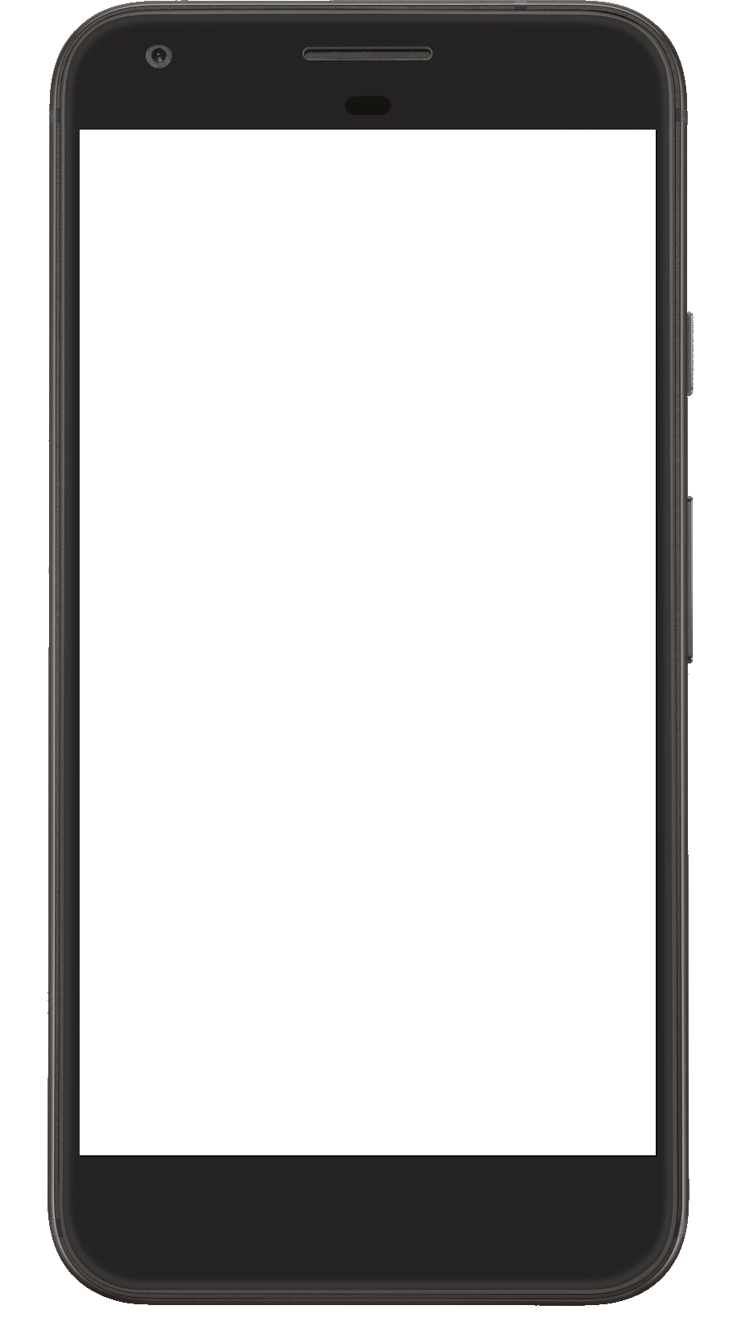
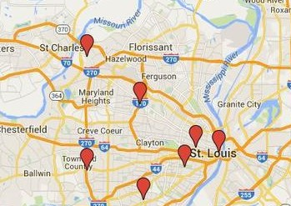
Demo
Meal Sites
OASIS
Address 1
Navigate The Food Desert
Current Location
Address 2
Press the “USE CURRENT LOCATION” button to see the ten Summer Food Program (SFSP) sites closest to your current location.
City
State
1. The Freedom School .5m
2. Harambee 1.1m
3. Firm Foundation 1.4m
4. Workday 2.1m
5. Extreme Faith 2.2m
6. CFNA 2.3m
7. Heeman Park 2.7m
8. Blackburn Park 3.1m
Enter address
Press the “ENTER ADDRESS” button to enter the address to see the ten Summer Food program sites closest to that address
Zip
Search Address

Slide 8
What’s Next
Add an option that allows users to search for food pantries
Add a background image to the banner view
Learn how to integrate Google Firebase for analytics and advertising
Notes:
Be specific! If you mention another feature describe why that features is necessary, or what problem it solves. If you mention changing the UI mention specific technologies, or libraries you will use to do that. If you mention a technology, or feature you don’t know yet tell them how you plan on learning it.

