Slide 1


Slide 2
knowledge
cybol
control software
cyboi
operating system
hardware
computer

Slide 3
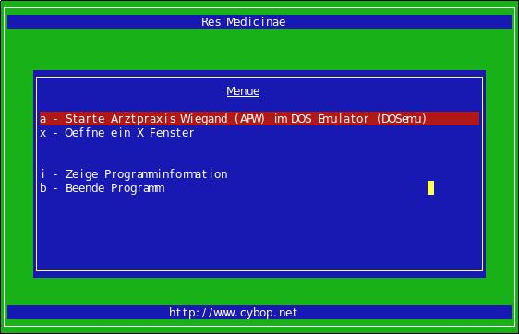

Slide 4
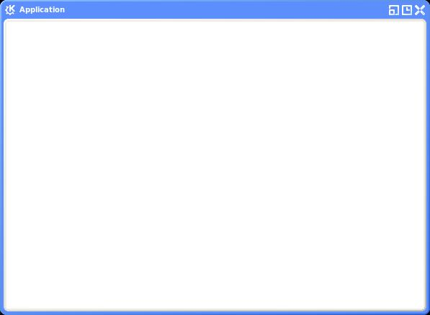

Slide 5
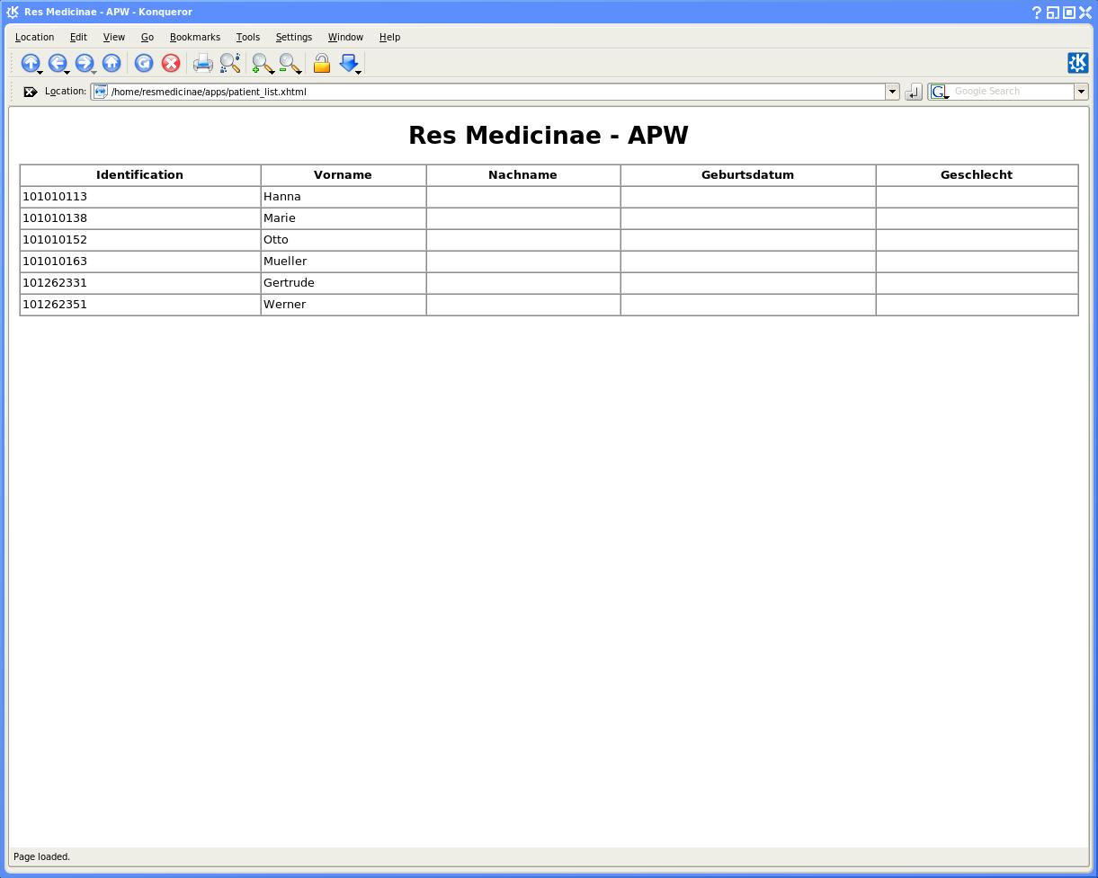

Slide 6
procedure(int** flag) {
while (1) {
if (**flag) {
break;
}
create_rows(flag);
}
}
operation
break
model
<model>
<part name="creat_table_body" channel="inline" abstraction="operation" model="loop">
<property name="break" channel="inline" abstraction="knowledge" model="domain.flag"/>
<property name="model" channel="inline" abstraction="knowledge" model="logic.create_rows"/>
</part>
</model>

Slide 7
procedure(int** index, int** count) {
if (**index >= **count) {
true_model();
} else {
false_model();
}
}
procedure(int** index, int** count, int** flag) {
if (**index >= **count) {
**flag = 1;
}
if (**flag) {
true_model();
} else {
false_model();
}
}
<model>
<part name="comparison" channel="inline" abstraction="operation" model="compare">
<property name="operand_1" channel="inline" abstraction="knowledge" model="domain.index"/>
<property name="operand_2" channel="inline" abstraction="knowledge" model="domain.count"/>
<property name="operator" channel="inline" abstraction="string" model="greater_or_equal"/>
<property name="result" channel="inline" abstraction="knowledge" model="domain.flag"/>
</part>
</model>
<model>
<part name="if-then-example" channel="inline" abstraction="operation" model="branch">
<property name="criterion" channel="inline" abstraction="knowledge" model="domain.flag"/>
<property name="true" channel="inline" abstraction="knowledge" model="domain.true_model"/>
<property name="false" channel="inline" abstraction="knowledge" model="domain.false_model"/>
</part>
</model>

Slide 8
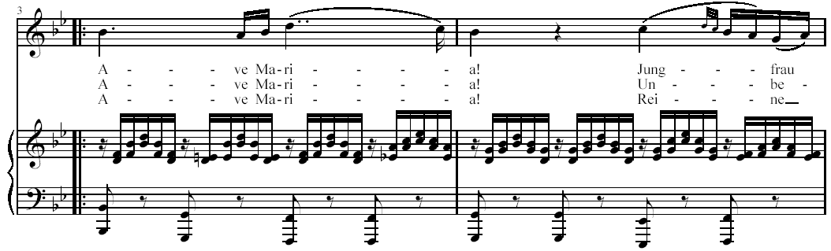

Slide 9
container
collection
map
tree
array
hash map
vector
hash table
stack
set
list

Slide 10
menu_bar
file_item
edit_item
view_item
help_item
tool_bar
dialog
file_open_icon
title
file_save_icon
menu_bar
cut_icon
tool_bar
copy_icon
panel
panel
paste_icon
status_bar
instruction_label
zoom_icon
tab_pages
button
button
label
glyph
status_bar
status_panel
insert_overwrite_panel

Slide 11
dialogue
title
file_item
edit_item
...
menu_bar
tool_bar
panel
button
label
glyph
status_bar

Slide 12
logic
domain
administrative
clinical
user_interface
tui
gui
wui

Slide 13
patient_user
wui
id
person_identification
nurse_user
gui
ehr_manager
image
image_storage
doctor_user
tui
document
hospital_system

Slide 14
dialogue
&
name
channel
abstraction
model
inline
string
Res Medicine
title
file
cybol
/resmedicinae/gui/menu_bar.cybol
+
menu_bar
file
cybol
/resmedicinae/gui/tool_bar.cybol
file
cybol
/resmedicinae/gui/panel.cybol
+
tool_bar
file
cybol
/resmedicinae/gui/status_bar.cybol
&
panel
&
button
whole-part relation
label
-
status_bar
-
size
meta information
minimum
&
colour

