Slide 1


Slide 2




  passive
  software
  hardware
  active

Slide 3
practice
structure for states and logic
theory
physical dimensions
double-hierarchy knowledge
human thinking
universal translator pattern
human communication
system-knowledge separation
body and mind
top-level container
hierarchical universe
monolithic java application
Notes:
Trotz aller wissenschaftlichen Methodik ist Forschung meist eine Reise ins Ungewisse. So folgte auch meine Arbeit keinem linearen Weg, sondern vielmehr einem Zick-Zack-Kurs zwischen Theorie und Praxis, den ich als "Konstruktive Entwicklung" bezeichnen moechte.
Am Beginn stand der Wunsch, eine Software-Anwendung fuer den Bereich der Medizin zu entwickeln …
Dies ging gut – bis zu einem Punkt, an dem die Komplexität der Software nur noch schwer beherrschbar und neue Ideen gefragt waren.
Im Verlauf der Arbeit wurden verschiedenste Loesungen entwickelt, weswegen es sich schwierig gestaltet, ein durchgaengiges Beispiel zu liefern.

Slide 4
traditional
programming
traditional
programming
structure
procedure
class
inheritance
structure
procedure
class
inheritance
cybop
+/-
+/-
statics & dynamics
knowledge schema
state & logic
scientific
disciplines
scientific
disciplines
new
concept
ideas
new
concept
ideas

Slide 5
basics
contribution
proof
completion
software
engineering
process
statics
&
dynamics
cybol
review
physical
architecture
knowledge
schema
cyboi
summary
&
future
logical
architecture
state
&
logic
res medicinae
appendices
extended
motivation

Slide 6
analysis
design
implementation
test

Slide 7
analysis
acceptance
architecture
integration
design
unit
develop
downhill
implementation
test
uphill

Slide 8
integration
requirements
test
analysis
implementation
design

Slide 9
extreme programming
iteration
development
collective code ownership
communication
simplicity
4 values
feedback
courage

Slide 10
agile methodology manifesto
individuals and interaction over processes and tools
working software over comprehensive documentation
customer collaboration over contract negotiation
responding to change over following a plan
while there is value in the items on the right,
those on the left are valued more

Slide 11
software engineering process
analysis
design
implementation
requirements
document
feature
model
architecture
diagrams
source
code
1a
1b
2
1

Slide 12
conceptual view
module view
execution view
code view

Slide 13
logical
view
development
view
user view
scenarios
process
view
physical
view

Slide 14
application
server
jdbc
database
server

Slide 15
presentation
client
rmi
application
server
jdbc
database
server

Slide 16
web
browser
http
web
server
presentation
client
socket
rmi
application
server
jdbc
database
server

Slide 17
web
browser
http
web
server
presentation
client
socket
rmi
application
server
jms
jdbc
local
process
database
server

Slide 18
web
browser
http
web
server
presentation
client
socket
rmi
mouse
gui
human
user
application
server
jms
jdbc
local
process
database
server

Slide 19
web
browser
http
web
server
presentation
client
socket
rmi
mouse
gui
gnutella
freenet
human
user
application
server
peer
node
jms
jdbc
local
process
database
server

Slide 20
web
browser
http
web
server
presentation
client
socket
rmi
mouse
gui
corba
soap
human
user
application
server
remote
server
jms
jdbc
stream
local
process
database
server
file

Slide 21
web
browser
http
web
server
presentation
client
textual
terminal
socket
rmi
cics
mouse
gui
ibm
ware
human
user
application
server
legacy
host
jms
jdbc
local
local
process
database
server
database
server

Slide 22
  layer
  protocol
  device
7
application
smtp, telnet, ftp, http, dns
gateway
6
presentation
x.226
gateway
5
session
rpc, netbios
gateway
4
transport
tcp, udp, tp4, spx
gateway
3
network
ipv4, ipv6, ipx
router
2
link
ppp, slip, fr
bridge, switch
1
physical
ethernet, token ring, fddi
repeater, hub

Slide 23
unscaled
tier
horizontally scaled tier
vertically scaled tier
processor
processor
processor
processor
processor
processor
memory
memory
memory
i/o
i/o
i/o
i/o
i/o
network

Slide 24






interact
presentation
client
read / write
configure
application
server
read / write
administer
database
server
read / write

Slide 25
presentation
domain logic
system
documentation
laboratory
reporting
billing
administration
imaging
devices
data source

Slide 26
problem oriented language
compiler
translation
assembly language
assembler
translation
operating system machine
operating system
partial interpretation
instruction set architecture
microprogram / microarchitecture
interpretation or direct execution
micro architecture
gate, memory, register
hardware functionality
digital logic
transistor
hardware functionality
analogue device
electron
hardware functionality
solid state physics

Slide 27
operand++
operand++

Slide 28
true
condition
condition
true
false
false
statement
statement

Slide 29
true
condition
condition
statement
(true)
false
statement

Slide 30
class
- attribute : type
+ method(parameter : type) : void

Slide 31
class
- attribute : type
+ set_attribute(attribute : type) : void
+ get_attribute() : type

Slide 32
super_class
- super_attribute : type
+ super_method() : void
sub_class
- sub_attribute : type
+ sub_method() : void

Slide 33
super_class
void method() {
do_something();
}
+ method() : void
sub_class
void method() {
do_something_else();
}
super.method();
+ method() : void

Slide 34
container
collection
map
tree
array
hash map
vector
hash table
stack
set
list

Slide 35
Hashtable
put(Object key, Object value)
ExtendedHashtable
  old
  new
put(Object key, Object value)
  ball,
  balls
  ball,
  balls,
  balls,
  ballss
  super.put(key, value);
  super.put(key + “s”, value);
  copy

Slide 36
paradigm/
language
imperative
declarative/
descriptive
monolithic
procedural
functional/
applicative
logical
structured
unstructured
markup
data
manipulation

Slide 37
Machine Language
Assembler
1950
Fortran
APL
Algol
JOVIAL
Lisp
COBOL
Simula
Basic
CPL
CORAL
Snobol
PL/I
1960
BCPL
ISWIM
MUMPS
Smalltalk
B
Forth
Logo
Pascal
C
sh
Icon
Prolog
1970
Modula
MS Basic
CLU
Scheme
SASL
ML
Ada
Mesa
awk
csh
sed
Rex
B
Cedar
C w Classes
PostScript
Miranda
KRC
1980
Sharp APL
ObjectiveC
C++
Concurrent C
CommonLisp
SML
ObjectPascal
Eiffel
nawk
OO Forth
Object Logo
Oberon
Self
Perl
Tcl/Tk
Haskell
Caml
1990
J
ABC
ANSI C
bash
Clos
Python
Visual Basic
Sather
Oak
NetRexx
A+
Ruby
Cmm
ksh
M
2000
Delphi
PHP
JavaScript
Java
Open M
K
JScript
ECMAScript
Objectv Caml
OO COBOL
C#
Java 2
O Caml

Slide 38
pattern
architectural
design
idiomatic
creational
structural
behavioural

Slide 39
uses
client
layer n
highest abstraction level
provides services
to layer n
layer n - 1
delegates subtasks
to layer n-2
layer n - 2
layer 1
lowest abstraction level

Slide 40
layer
sub_type_1
attribute_1 : int
super_type
sub_type_2
common_attribute : int
attribute_2 : int
sub_type_3
attribute_3 : int

Slide 41
domain model layer
object_2
0 .. *
object_1
object_2
- object_2
- attribute
- object_3
+ method()
object_3
1 .. 5
object_3
object_2_1
object_2_2
+ method_1()
- attribute_1
- attribute
+ method_2()
- attribute_2
+ method()
+ method_3()
+ method()
# method_1()
# method_2()

Slide 42
domain layer
domain_object
<<interface>>
object_finder
- id : long
+ find(id : long)
data mapper layer
object_mapper
+ find(id : long)
# load()
database

Slide 43
domain layer
dto layer
domain_object_1
domain_object_2
data_transfer_object
- attribute_1
- attribute_2
- attribute_1
- attribute_2
assembler layer
assembler
+ assemble()
+ disassemble()

Slide 44
view
controller
model

Slide 45
layer 1 triad
view
controller
child
parent
model
layer 2 triad
view
controller
child
parent
model
layer 3 triad
view
controller
model

Slide 46
calls
service
sends
request
client
adapter
external_server
do_task()
call_service()
receive_request()
create_request()
dispatch_request()
execute_service()
initialises
communication
calls
activates
microkernel
internal_server
execute_mechanism()
receive_request()
init_communication()
execute_service()
find_receiver()
create_handle()
send_message()
call_internal_server()

Slide 47
transmits
message
transmits
message
client_side_proxy
broker
server_side_proxy
pack_data()
main_event_loop()
pack_data()
unpack_data()
update_repository()
unpack_data()
send_request()
register_service()
call_service()
return
acknowledge()
send_response()
find_server()
find_client()
forward_request()
forward_response()
calls
uses api
uses api
calls
calls
client
bridge
server
call_server()
pack_data()
initialise()
start_task()
unpack_data()
enter_main_loop()
use_broker_api
forward_message()
run_service()
transmit_message()
use_broker_api()

Slide 48
filter_2
decode
encode
encode()
decode()
encode
decode
filter_1
filter_3
encode()
encode()
decode()
decode()
encode
decode
input
output
process()
process()

Slide 49
meta meta level
meta level
modifies
meta_object_1
meta_object_2
meta_object_protocol
retrieves
information
modifies
base level
uses
uses
uses
uses
component_1
component_2
user_interface
provides
access to

Slide 50
  runtime dynamics
  design time statics
java virtual machine
meta level
calls native procedures
java.lang.Class
getPackage()
getName()
getSuperclass()
getInterfaces()
getFields()
getMethods()
getConstructors()
getModifiers()
getClasses()
keeps
instances
base level
keeps
instances
java.lang.Object
getClass()

Slide 51
client
invoker
command
execute()
receiver
receiver
concrete_command
action()
state
execute()
receiver.action()

Slide 52
target
client
target
request()
contents
wrapper
contents
request()
specific_request()
contents.specific_request()

Slide 53
part_1
service_1_a()
service_1_b()
calls
service
combines
client
whole
part_2
do_task()
service_a()
service_2_a()
service_b()
service_2_b()
part_n
service_n_a()
service_n_b()

Slide 54
client
component
operation()
add(p : component)
remove(p : component)
get(p : int) : component
children
leaf
composite
operation()
operation()
add(p : component)
remove(p : component)
get(p : int) : component
for each child in children:
child.operation()

Slide 55
client
handler
handle_request()
successor
concrete_handler
handle_request()

Slide 56
observers
subject
observer
attach(p : observer)
update()
detach(p : observer)
notify()
for each o in observers:
o.update()
subject
concrete_subject
concrete_observer
subject_state
observer_state
set_state()
update()
get_state()
return subject_state
observer_state = subject.get_state()

Slide 57
update
subject
observer
attach(p : observer)
update()
detach(p : observer)
notify()
view
model
controller
create
attach
get_state
initialise(p: model)
display
create_controller()
model
controller
display()
subject_state
model
update()
set_state()
view
attach
do_service
get_state()
initialise(model, view)
do_service()
handle_event()
update()

Slide 58
abstract_class
...
primitive_operation_1()
...
primitive_operation_2()
...
template_method()
primitive_operation_1()
primitive_operation_2()
concrete_class
primitive_operation_1()
primitive_operation_2()

Slide 59
handle
body
client
handle
body
- handle : Handle
- body : Body
ref_counter : int
operator->()
service()
handle(...)
- body(...)
handle(handle&)
- ~body()
operator=()
~handle()

Slide 60
singleton
- instance : singleton
- singleton_data
- singleton() : singleton
+ instance() : singleton
return the only instance
+ singleton_operation()
+ get_singleton_data()

Slide 61
startup
constructor
contextualise
compose
configure
parameterise
initialise
start
lifetime
suspend
recontextualise
recompose
reconfigure
reparameterise
resume
shutdown
stop
dispose
finalise

Slide 62
loggable
health_record
record
insurance_record
subjective
heading
objective

Slide 63
loggable
health_record
record
insurance_record
loggable
subjective
heading
objective

Slide 64
loggable
loggable
health_record
record
insurance_record
loggable
subjective
heading
objective

Slide 65
loggable
loggable
health_record
record
record
insurance_record
loggable
subjective
heading
objective

Slide 66
domain engineering
domain
analysis
domain
design
domain
implementation
application engineering
requirements
engineering
design
analysis
integration
& testing

Slide 67
car
mandatory
optional
body
transmission
pulls trailer
engine
excludes
alternative
or
automatic
manual
electro
internal
combustion
constraints
benzine
diesel
requires

Slide 68
finance
manufacturing
e-commerce
pervasive
service
directory
corba
security
web
service
uml
xmi/
xml
space
model driven
architecture
telecom
mof
cwm
java
.net
transaction
event
transportation
healthcare
more …

Slide 69
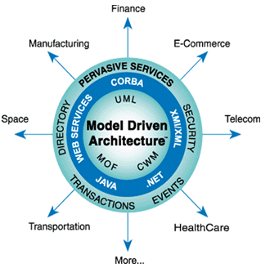

Slide 70
code
only
code
visualisation
roundtrip
engineering
model-
centric
model
only
model
model
model
model
code
code
code
code
what is
a model?
the code
is the model
code and
model coexist
the model
is the code
let's do
some design

Slide 71
level
name
characteristics
domain
eukarya
nucleus, organelles
kingdom
animalia
ingests food, multicellular, no cell wall
phylum
chordata
spinal cord
subphylum
vertebrata
segmented backbone
superclass
tetrapoda
four limbs
class
mammalia
nurse offspring
subclass
theria
live birth
order
primates
high level of intelligence
family
hominidae
walk upright
genus
homo
human
species
homo sapiens
modern human

Slide 72
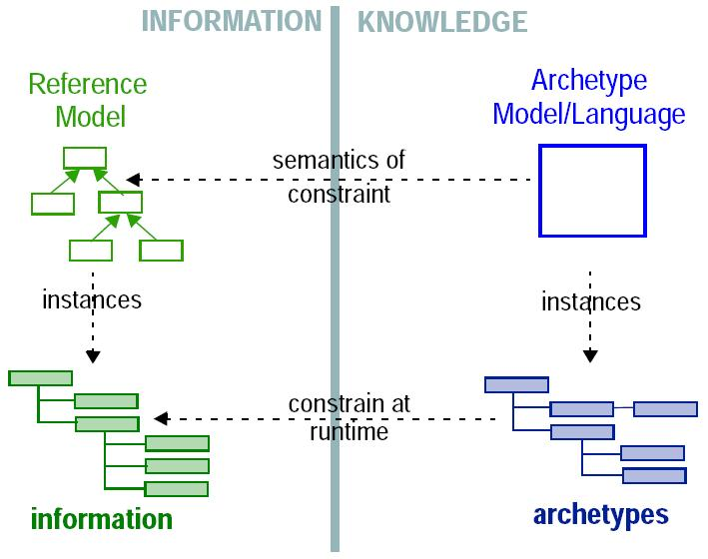

Slide 73
statics & dynamics
state & logic
philosophy
automation
body & mind
i/o data & control rules
system & knowledge
state & logic
informatics
software
software
software
software
neurology
persistent & transient
sensoric & motoric
statics & dynamics
translator logic
biology
social
cell separation & dna
communication
static knowledge
partner & language
knowledge schema
psychology
physics
linguistics
recognition & thinking
dimensions
quality & quantity
knowledge schema
position information
term & number

Slide 74
research 1
mind &
brain
system control
knowledge

Slide 75
research 1
research 2
mind &
brain
human
thinking
system control
knowledge
hierarchical knowledge

Slide 76
research 1
research 2
research 3
mind &
brain
human
thinking
data
& rules
system control
knowledge
hierarchical knowledge
state
logic
hierarchical knowledge

Slide 77
research 1
research 2
research 3
mind &
brain
human
thinking
data
& rules
system control
knowledge
hierarchical knowledge
state
logic
hierarchical knowledge
dynamics
statics
cyboi
cybol
cybop

Slide 78
statics &
dynamics

Slide 79
nervous system
peripheral
central
autonomic
somatic
brain
spinal cord
sympathetic
parasympathetic
forebrain
midbrain
hindbrain
telencephalon
diencephalon
mesencephalon
metencephalon
myelencephalon
cerebral cortex
thalamus
tectum
pons
medulla
basal ganglia
hypothalamus
tegmentum
cerebellum
hippocampus
amygdala

Slide 80
memory
sensory
short-term
long-term
iconic
acoustic
working
procedural
declarative
episodic
semantic

Slide 81
rehearse
sense
information
from
environment
sensory
memory
short term
memory
retrieve
long term
memory
transfer
transfer
forget
forget

Slide 82
concern
common
crosscutting
domain knowledge
statics
system control
dynamics
production
development
change monitoring
context passing
providing consistent behaviour
tracing, profiling, logging
pre- / post conditions
contract enforcement
configuration management

Slide 83
application
domain
knowledge
MVC View
User Interface
MVC Model
Domain Model
DTO
system
MVC Controller
Process/ Thread
Data Mapper
DB Access
Communication
EJB Persistence

Slide 84









Slide 85
knowledge
cybol
control software
cyboi
operating system
hardware
computer

Slide 86
startup
system
memory
processing
knowledge
unix socket
signal
loop
signals
win socket
internals
tcp socket
main
input output
x windows
ms windows
running
console tui
shutdown

Slide 87
knowledge
schema

Slide 88
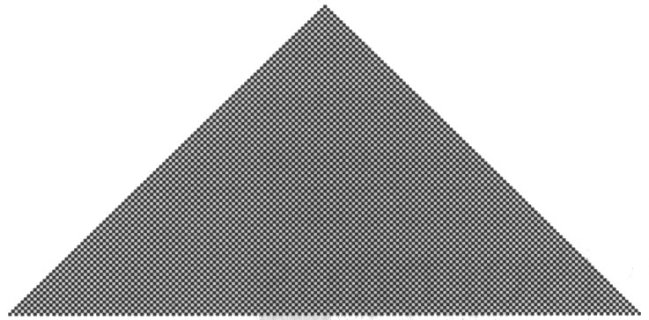
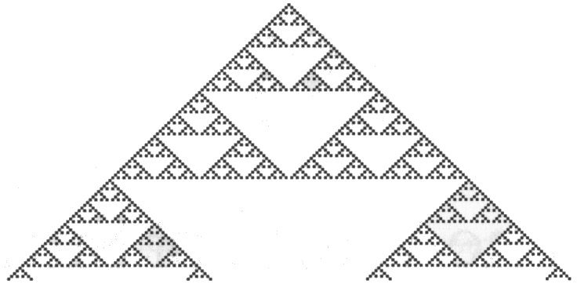


  repetition
  nesting
  randomness
  localised structures

Slide 89

universe
conglomerate
dialectics
absolute 01
abstraction
imaginary phenomena

Slide 90
category
(living thing)
super
is-a
sub
item
(human being)
has-a
compound
(brain)
whole
part

Slide 91
nature
unenlivened
enlivened
plant
animal
human

Slide 92


Slide 93


Slide 94


Slide 95
person
name
sex : boolean
first_name : string
birth_date : date
last_name : string
title : string
address
post_code : int
country : string
person
name
true
max
1970-01-01
mustermann
dr.
address
12345
deutschland

Slide 96
person
name
item
sex : item
name : string
address
birth_date : item
value : object
person
name
max
true
1970-01-01
mustermann
dr.
address
12345
deutschland

Slide 97
model
name : string
primitive
compound
value : object
person
name
max
true
mustermann
1970-01-01
dr.
address
12345
deutschland

Slide 98
view
controller
model

Slide 99
health_record
health_record
record
record
address
address
unit
unit
problem
problem
subjective
subjective
model
heading
heading
objective
objective

Slide 100
health_record
record
insurance_record
address
unit
problem
subjective
model
heading
objective
blood_pressure
description
body_mass_index
principle
term

Slide 101
heal_illness
diagnose
treat
prevent
evaluate_history
examine_patient

Slide 102
Health Level 7 - RIM
Reference Information Model
scheduling
message
finance
role
service
entity
role-role-relation

Slide 103
Entity: Organisation, Living Subject, Material, Health Chart, Location
Living Subject: Person, Non Person

Slide 104
java.lang.Object
Living Subject
Address address;
void set_address(Address a) {
this.address = a;
}
Address get_address() {
return this.address;
}
birthdate: Calendar
set_birthdate(d: Calendar): void
get_birthdate(): Calendar
Person
address: Address
set_address(a: Address): void
get_address(): Address

Slide 105
java.lang.Object
Address a = (Address) get("address");
Address a = (Address) get(Person.address);
parts: HashMap
set(n: String, o: Object): void
get(n: String): Object
remove(n: String): void
parts
0..*
Living Subject
void set_address(Address a) {
this.address = a;
get_manager().update(this);
}
void some_method() {
..
part.set_address(a);
get_manager().update(part);
}
static birthdate: String
Person
static address: String

Slide 106
party_relation
party
organisation
person
staff_member
patient
nurse
consultant

Slide 107
item
category
compound
schema
item
+ category
+ compound
name
abstraction
= schema
model
details
1..1
1..1
0..*
0..*
relations
unidirectional

Slide 108
part
0..*
panel
button
0..*
property
meta information
size
properties:
position, size, colour, order, weight
constraints:
minimum, maximum, choice
0..*
constraint
minimum

Slide 109

meta properties
happy, sad, aggressive
head, eyes, ears, mane
black, brown, white
state structure
shape, size
smell
tail, legs, hoofs
feed, hay, dung
canter, gallop, tantivy
ride, saddle, reins, stable
change logic
external concepts

Slide 110
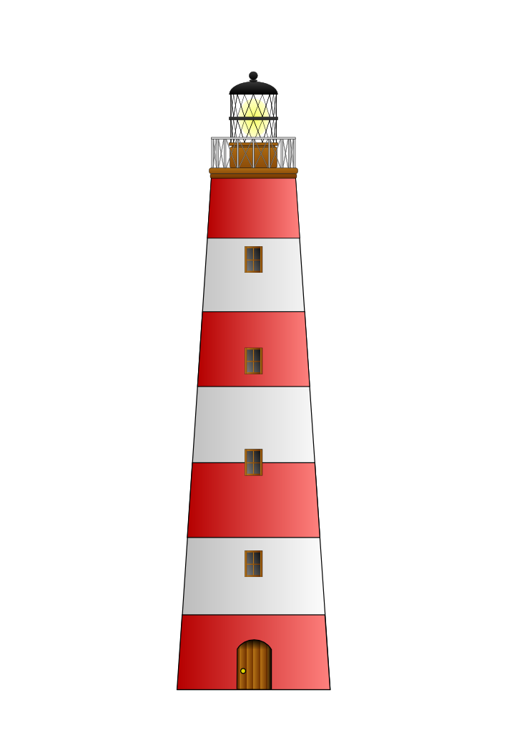




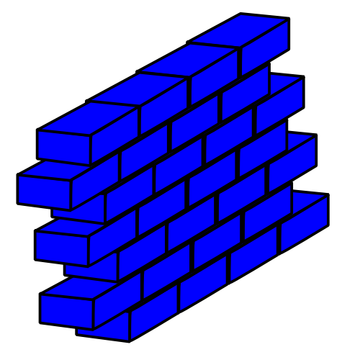


components do not
match into every
application framework

Slide 111




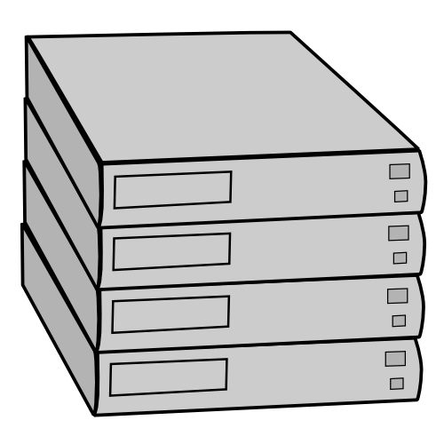
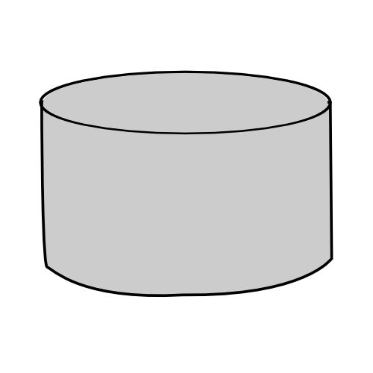
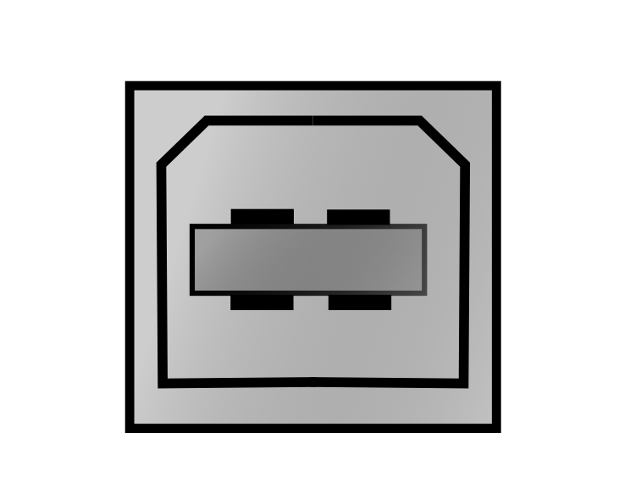




Bank
library
Insurance
gui
tui
Hospital
Institution
file
db
socket

Slide 112
traditional
cybop
program
structure
runtime
structure

Slide 113
state
& logic

Slide 114
feedback
system
input
output

Slide 115
feedback
system
logic knowledge
formulas, rules
input
output
business logic, workflow
manipulate
state knowledge
input / output models
domain models

Slide 116
input
output
eye
larynx
ear
extremity
nose
tongue
skin

Slide 117
input
output
camera
loudspeaker
scanner
monitor
sensor
printer
keyboard
braille panel
mouse

Slide 118
system
mouse
screen
handler
translator
processor
wait
receive
handle
decode
process
encode
send

Slide 119
channel
source
encoder
message
decoder
destination
noise

Slide 120
message
interpreter
interpreter
encoder
decoder
decoder
encoder
message

Slide 121
who
what
channel
whom
effect

Slide 122
model view controller
data transfer
object
mouse
gui
corba
soap
human
user
application
server
remote
server
data
mapper
jdbc
database
server

Slide 123
user
system
view
controller
domain model
domain model
data mapper
assembler
entity relationship model
data transfer object
database system
remote process

Slide 124
user
system
view
view
logic
state
controller
controller
domain model
domain model
domain model
data mapper
data mapper
assembler
assembler
entity relationship model
entity relationship model
data transfer object
data transfer object
database system
remote process

Slide 125
tui
gui
wui
tui_translator
gui_translator
wui_translator
domain
xdt_translator
hxp_translator
cda_translator
xdt
hxp
cda

Slide 126
knowledge
knowledge
knowledge
knowledge
view
partview
partview
knowledge.view.partview
logic
partlogic
knowledge.domain.partdomain
partlogic
domain
partdomain
partdomain

Slide 127
procedure(int** flag) {
while (1) {
if (**flag) {
break;
}
create_rows(flag);
}
}
operation
break
model
<model>
<part name="creat_table_body" channel="inline" abstraction="operation" model="loop">
<property name="break" channel="inline" abstraction="knowledge" model="domain.flag"/>
<property name="model" channel="inline" abstraction="knowledge" model="logic.create_rows"/>
</part>
</model>

Slide 128
procedure(int** index, int** count) {
if (**index >= **count) {
true_model();
} else {
false_model();
}
}
procedure(int** index, int** count, int** flag) {
if (**index >= **count) {
**flag = 1;
}
if (**flag) {
true_model();
} else {
false_model();
}
}
<model>
<part name="comparison" channel="inline" abstraction="operation" model="compare">
<property name="operand_1" channel="inline" abstraction="knowledge" model="domain.index"/>
<property name="operand_2" channel="inline" abstraction="knowledge" model="domain.count"/>
<property name="operator" channel="inline" abstraction="string" model="greater_or_equal"/>
<property name="result" channel="inline" abstraction="knowledge" model="domain.flag"/>
</part>
</model>
<model>
<part name="if-then-example" channel="inline" abstraction="operation" model="branch">
<property name="criterion" channel="inline" abstraction="knowledge" model="domain.flag"/>
<property name="true" channel="inline" abstraction="knowledge" model="domain.true_model"/>
<property name="false" channel="inline" abstraction="knowledge" model="domain.false_model"/>
</part>
</model>

Slide 129
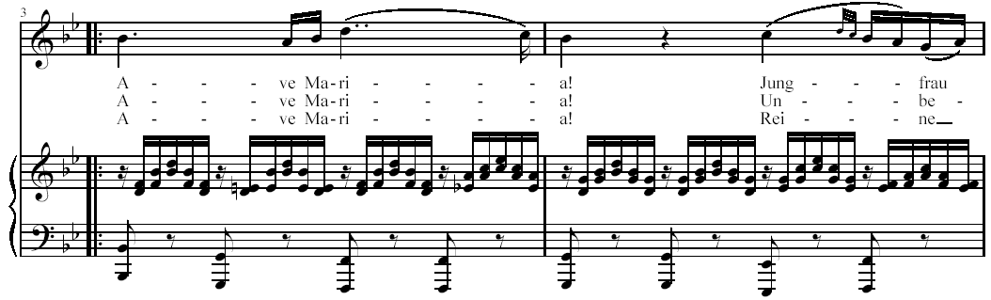

Slide 130
dialogue
&
name
channel
abstraction
model
inline
string
Res Medicine
title
file
cybol
/resmedicinae/gui/menu_bar.cybol
+
menu_bar
file
cybol
/resmedicinae/gui/tool_bar.cybol
file
cybol
/resmedicinae/gui/panel.cybol
+
tool_bar
file
cybol
/resmedicinae/gui/status_bar.cybol
&
panel
&
button
whole-part relation
label
-
status_bar
-
size
meta information
minimum
&
colour

Slide 131
menu_bar
file_item
edit_item
view_item
help_item
tool_bar
dialog
file_open_icon
title
file_save_icon
menu_bar
cut_icon
tool_bar
copy_icon
panel
panel
paste_icon
status_bar
instruction_label
zoom_icon
tab_pages
button
button
label
glyph
status_bar
status_panel
insert_overwrite_panel

Slide 132
dialogue
title
file_item
edit_item
...
menu_bar
tool_bar
panel
button
label
glyph
status_bar

Slide 133
logic
domain
administrative
clinical
user_interface
tui
gui
wui

Slide 134
patient_user
wui
id
person_identification
nurse_user
gui
ehr_manager
image
image_storage
doctor_user
tui
document
hospital_system

Slide 135

cyboi
  globals
  memoriser
  applicator
  controller
  constants
  array
  boolean
  cyboi
  variables
  creator
  comparison
  manager
  logger
  accessor
  arithmetic
  checker
  tester
  communicator
  creation
  handler
  converter
  lifecycle
  translator
  communication

Slide 136
memoriser
applicator
controller
handler
cyboi
manager
checker
  cyboi part dependencies
  cyboi control flow

Slide 137
stream
structure
  data
  input
  data
  output
knowledge
  receive
  parse
  decode
  encode
  serialise
  send
  communicator
  converter
  translator

Slide 138




  http://savannah.gnu.org
  http://developer.berlios.de
  http://freshmeat.net
  http://sourceforge.net

Slide 139
summary, title, status, licence, language
homepage, web site space
mailing list server
forum, news server
concurrent versions system (cvs)
bug tracker, feature requests
patches, sourcecode solutions
documentation, manual, faq
tasks, project management
support, help
ftp space, public files
surveys, user opinions

Slide 140

  http://www.resmedicinae.org
  Res Medicinae
ResAdmin
Record
electronic
health
record
Reform
Reagenz
Roentgen
Rechnung

Slide 141
ISO/ TC215
Health Informatics
CEN/ TC251
Health Informatics
DIN NAMed FB G
Medizinische Informatik
WG1
Health Records and
Modelling Coordination
WG I
Information Models
AA G 1
Modellierung
WG2
Messaging and
Communication
WG IV
Technology for
Interoperability
AA G 2
Kommunikation
WG3
Health Concept
Representation
WG II
Terminology and
Knowledge Bases
AA G 3
Terminologie
WG4
Security
WG III
Security, Safety and Quality
AA G 4
Sicherheit
WG5
Health Cards
Task Force
Cards
AA G 5
Karten

Slide 142
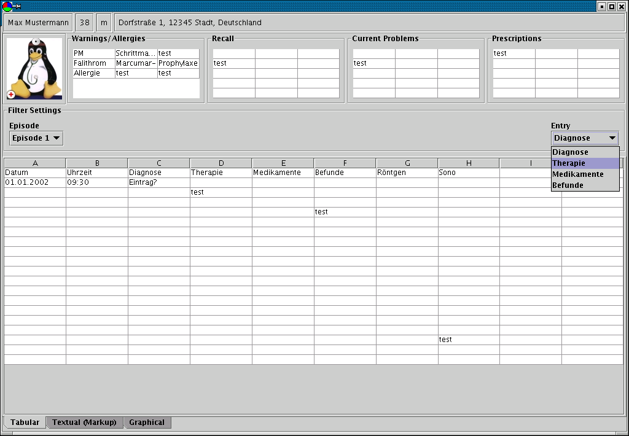

Slide 143
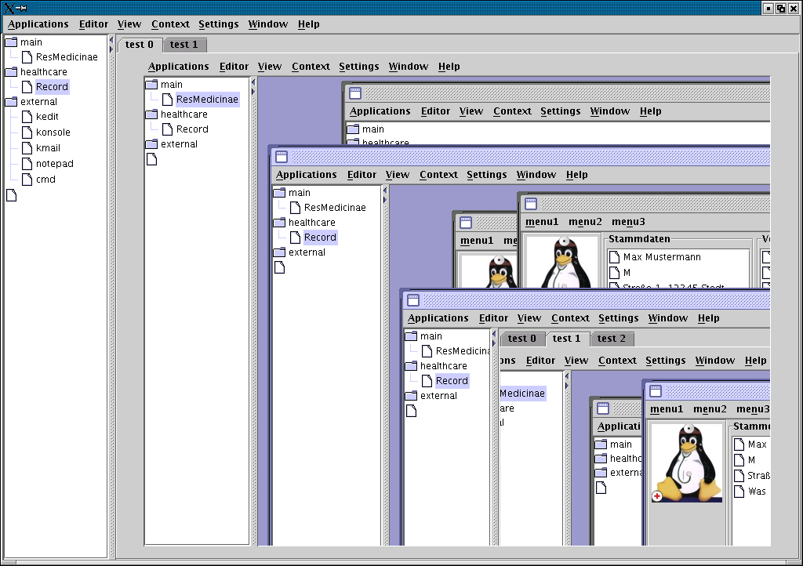

Slide 144
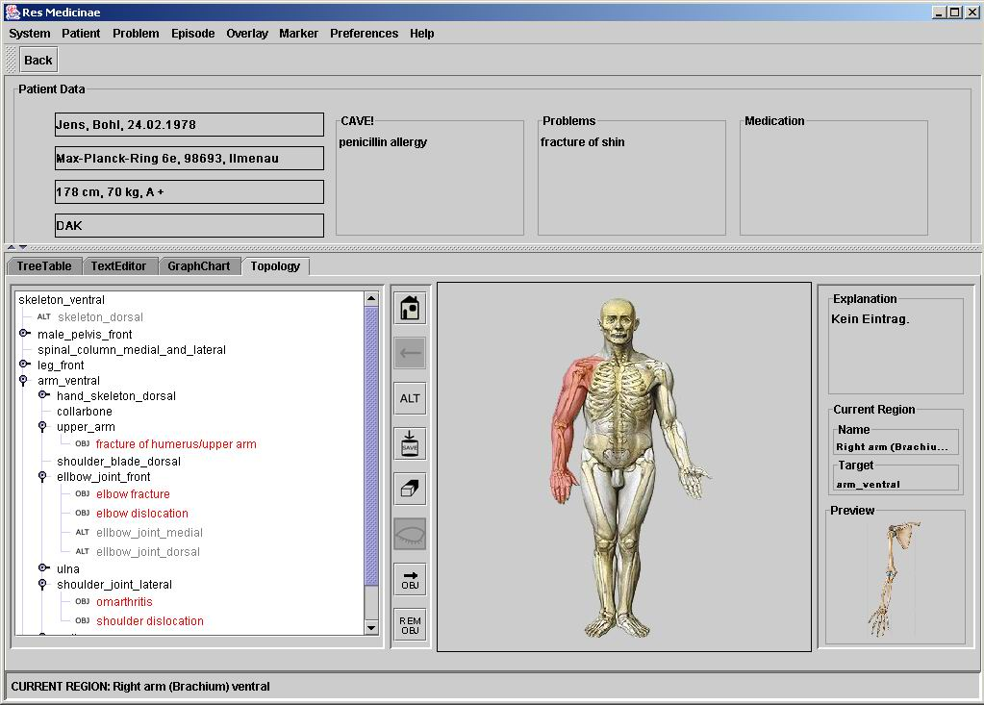

Slide 145
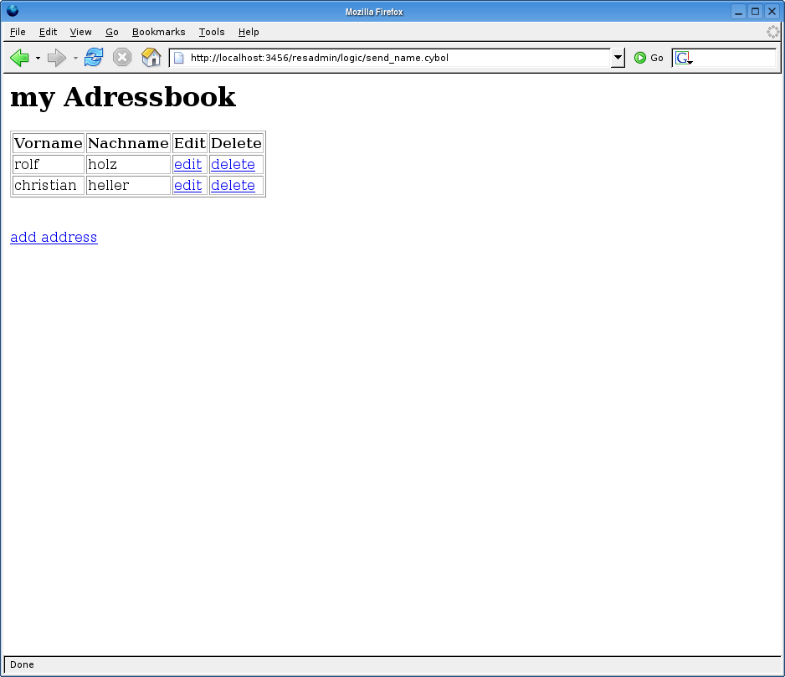

Slide 146
domain
address_book
name
addresses
address_count
address_$0
first_name
address_$1
last_name
street
wui
head
meta_data
body
book_name
address_table
table_header
first_name
row_break
last_name
add_button
edit_link
logic
startup
delete_link
add_address
table_row_$0
refresh_wui
table_row_$1
send_address

Slide 147



influence
influence
instantiation
template
schema
model
statics
structure
dynamics
cybol language
cybop concepts
cyboi interpreter
analysis / design time
research time
runtime
domain expert /
application developer
knowledge architect /
information scientist
systems developer

Slide 148
software engineering process
software engineering process
analysis
analysis
design
design
implementation
requirements
document
feature
model
state knowledge
architecture
diagrams
source
code
logic knowledge
common knowledge abstraction

Slide 149
abstraction
level
formal
cybernetics oriented programming
traditional
programming
semi-formal
informal
software
development
process
analysis
design
implementation

