Slide 1

Cybernetics Oriented Programming
(CYBOP)
An Investigation on the Applicability
of Inter-Disciplinary Concepts
to Software System Development
LinuxTag 2007, Berlin, Germany
Dr. Christian Heller
  Copyright © 2002-2007. Christian Heller. All rights reserved.
  http://www.cybop.net <christian.heller@tuxtax.de>

Slide 2

contents
introduction
reflexions
statics and dynamics
double-hierarchy knowledge
state and logic
realisation
cybol language
cyboi interpreter
res medicinae
summary and future

Slide 3

contents
introduction
reflexions
statics and dynamics
double-hierarchy knowledge
state and logic
realisation
cybol language
cyboi interpreter
res medicinae
summary and future

Slide 4


introduction
  knowledge
  software
  human being
  hardware
  information
  data
  knowledge
  fact or message with recognisable news in semantic context
  (machine-readable) characters / numbers that may contain information
  structured data which are inter-related (associated)

Slide 5
introduction
practice
structure for states and logic
theory
physical dimensions
double-hierarchy knowledge
human thinking
universal translator pattern
human communication
system-knowledge separation
body and mind
top-level container
hierarchical universe
monolithic java application
constructive development – complexity – example

Slide 6
introduction
bundling of attributes and methods – coupling, no flexibility
reflective meta architectures – bidirectional dependencies
bidirectional dependencies – complexity, circular references
global / static data access – untraceable data manipulation
container inheritance – falsified container content
problems – more in cybop book

Slide 7
introduction
Hashtable
put(Object key, Object value)
ExtendedHashtable
  old
  new
put(Object key, Object value)
  dog,
  dogs
  dog,
  dogs,
  dogs,
  dogss
  super.put(key, value);
  super.put(key + “s”, value);
  copy
  falsifying container inheritance [iaq, dr. norvig]

Slide 8
introduction
traditional
programming
structure
procedure
class
inheritance
cybop
statics & dynamics
knowledge schema
state & logic
+/-
scientific
disciplines
new
concept
ideas

Slide 9
introduction
  cybernetics (kybernetes = steersman)
  science of information and control
  in living things or machines (norbert wiener)
  bionics (bio-cybernetics)
  biological principles applied to
  study and design of engineering systems
  relation
  software engineering = systems engineering
  system as a whole gains in importance
  biological / human → software system
  physical brain: neural network
  logical mind: concepts
inter-disciplinary
CYBOP

Slide 10
contents
introduction
reflexions
statics and dynamics
double-hierarchy knowledge
state and logic
realisation
cybol language
cyboi interpreter
res medicinae
summary and future

Slide 11
statics and dynamics
category
(living thing)
discrimination
psychology
online thinking (1st order)
offline thinking (2nd order)
self Concept
thinking = association of:
- sensoric signals with
- terms of a language
categorisation
plato – aristotle – alexander
category
living thing
human, animal, plant
generalisation
specialisation
composition
gottfried wilhelm leibnitz
monades
human being
eye, brain, arm
container
element
super
is-a
sub
item
(human being)
has-a
compound
(brain)
whole
part

Slide 12
statics and dynamics
Health Level 7 - RIM
Reference Information Model
scheduling
message
finance
role
service
entity
role-role-relation

Slide 13
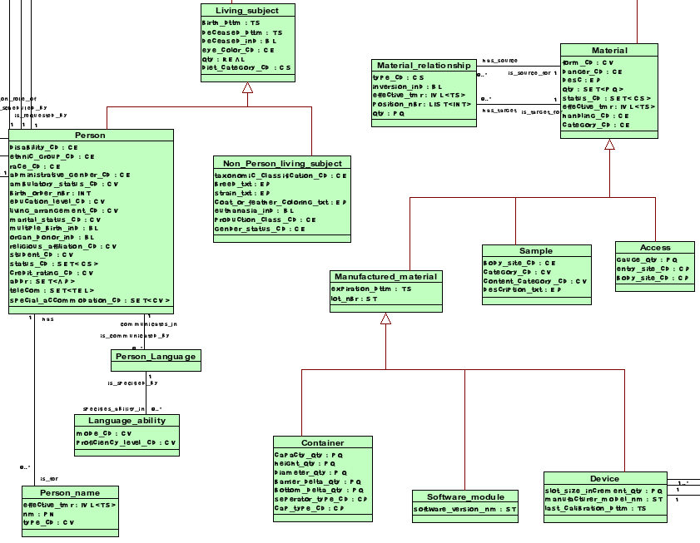


statics and dynamics
  discrimination
  categorisation
  composition

Slide 14
statics and dynamics
java.lang.Object
Address a = (Address) get("address");
Address a = (Address) get(Person.address);
parts: HashMap
set(n: String, o: Object): void
get(n: String): Object
remove(n: String): void
parts
0..*
Living Subject
Living Subject
Address address;
void set_address(Address a) {
this.address = a;
}
Address get_address() {
return this.address;
}
code cover
static birthdate: String
birthdate: Calendar
set_birthdate(d: Calendar): void
get_birthdate(): Calendar
Person
Person
address: Address
set_address(a: Address): void
get_address(): Address
static address: String
  extract knowledge

Slide 15








statics and dynamics
  system owns knowledge (also: biological cell + dna)

Slide 16
contents
introduction
reflexions
statics and dynamics
double-hierarchy knowledge
state and logic
realisation
cybol language
cyboi interpreter
res medicinae
summary and future

Slide 17

double-hierarchy knowledge
properties
happy, sad, aggressive
head, eyes, ears, hair
black, white
state structure
shape, size
smell
arms, legs
food, book
walk, run, limp
clothes, shoes, hat
change logic
external concepts

Slide 18
double-hierarchy knowledge
part
0..*
human being
legs
0..*
property
parts make up a whole
another example:
hydrogen (H2) becomes
water (H2O) with a totally
different character,
when just one
oxygen (O) atom is added
per hydrogen molecule
meta information
size
properties:
position, size, colour, order, weight
constraints:
minimum, maximum, choice
0..*
constraint
minimum
  double hierarchy – in space, time etc.

Slide 19
double-hierarchy knowledge
item
compound
schema
human mind
structures world
into
discrete items
compound
knows about
its parts
parts can be
compounds
or primitives
indicated by
abstraction
item
+ category
+ compound
name
abstraction
= schema
model
details
1..1
1..1
0..*
0..*
items may
belong to
a category
relations
unidirectional

Slide 20
double-hierarchy knowledge
traditional
cybop
program
structure
runtime
structure
  universal memory structure – flexibility

Slide 21
contents
introduction
reflexions
statics and dynamics
double-hierarchy knowledge
state and logic
realisation
cybol language
cyboi interpreter
res medicinae
summary and future

Slide 22






state and logic
interact
presentation
client
read / write
configure
application
server
read / write
administer
database
server
read / write
misleading tiers – inflexible software architecture

Slide 23
state and logic
model view controller
data transfer
object
mouse
gui
corba
soap
human
user
application
server
remote
server
data
mapper
jdbc
database
server
  communication patterns

Slide 24
state and logic
user
system
view
view
logic
state
controller
controller
domain model
domain model
domain model
data mapper
data mapper
assembler
assembler
entity relationship model
entity relationship model
data transfer object
data transfer object
database system
remote process

Slide 25
state and logic
tui
gui
wui
tui_translator
gui_translator
wui_translator
domain
xdt_translator
hxp_translator
cda_translator
xdt
hxp
cda
  star-like (not layer-like) translator architecture

Slide 26
contents
introduction
reflexions
statics and dynamics
double-hierarchy knowledge
state and logic
realisation
cybol language
cyboi interpreter
res medicinae
summary and future

Slide 27
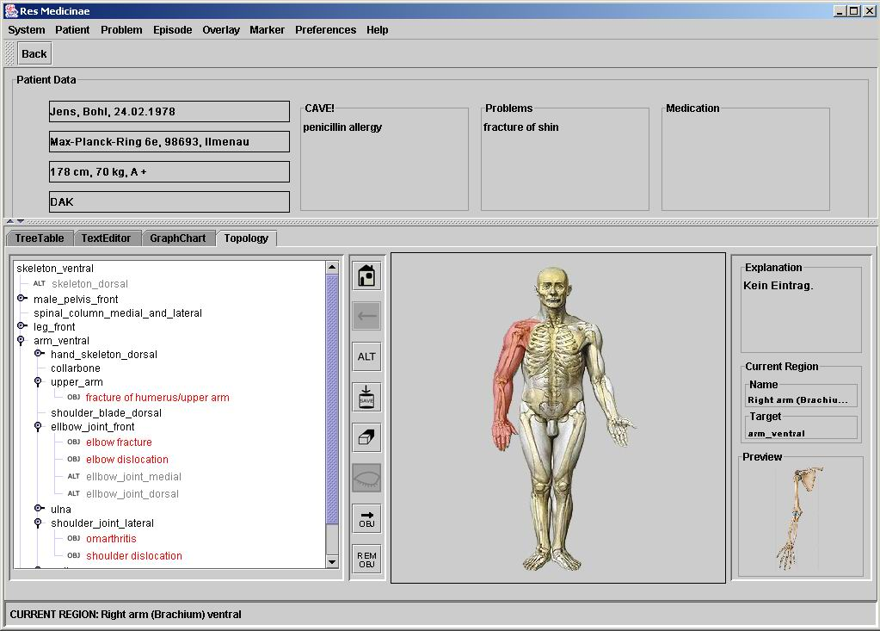
cybol language

Slide 28
cybol language
<model>
<part name="title" channel=”inline” abstraction=”character” model="Res Medicinae">
<property name=”size” channel=”inline” abstraction=”integer” model=”600,20,1”>
<constraint name=”minimum” channel=”inline” abstraction=”integer” ... />
<constraint name=”maximum” channel=”inline” abstraction=”integer” ... />
</property>
<property name=”position” channel=”inline” abstraction=”integer” model=”0,0,0”/>
<propertyname="layout"channel="inline"abstraction="character"model="coordinate"/>
<property name="colour" channel="inline" abstraction="character" model="blue"/>
</part>
<part name="menu_bar" ...
<part name="tool_bar” ...
<part name="content” ...
<part name="status_bar” channel=”file” abstraction="compound" model="status.cybol”>
<property name="layout" channel="inline"abstraction="character"model="compass"/>
<property name="cell" channel="inline" abstraction="character" model="north"/>
</part>
</model>
<model>
<part
<property
<constraint
<model>
<part name="title" channel=”inline” abstraction=”character” model="Res Medicinae">
<property name=”size” channel=”inline” abstraction=”integer” model=”600,20,1”>
<constraint
<model>
<part name="title" channel=”inline” abstraction=”character” model="Res Medicinae">
<property name=”size” channel=”inline” abstraction=”integer” model=”600,20,1”>
<constraint name=”minimum” channel=”inline” abstraction=”integer” ... />
<constraint name=”maximum” channel=”inline” abstraction=”integer” ... />
</property>
<property name=”position” channel=”inline” abstraction=”integer” model=”0,0,0”/>
<propertyname="layout"channel="inline"abstraction="character"model="coordinate"/>
<property name="colour" channel="inline" abstraction="character" model="blue"/>
</part>
<part name="menu_bar" ...
<part name="tool_bar” ...
<part name="content” ...
<part name="status_bar” channel=”file” abstraction="compound" model="status.cybol”>
<property name="layout" channel="inline"abstraction="character"model="compass"/>
<property name="cell" channel="inline" abstraction="character" model="north"/>
</part>
</model>
  cybol tags + attributes, abstraction principles

Slide 29
cybol language
dialogue
&
name
channel
abstraction
model
inline
character
Res Medicine
title
file
compound
/resmedicinae/gui/menu_bar.cybol
+
menu_bar
file
compound
/resmedicinae/gui/tool_bar.cybol
file
compound
/resmedicinae/gui/panel.cybol
+
tool_bar
file
compound
/resmedicinae/gui/status_bar.cybol
&
panel
&
button
whole-part relation
label
-
status_bar
-
size
meta information
minimum
&
colour
  template editor with double hierarchy and triple click

Slide 30
contents
introduction
reflexions
statics and dynamics
double-hierarchy knowledge
state and logic
realisation
cybol language
cyboi interpreter
res medicinae
summary and future

Slide 31
cyboi interpreter
knowledge
cybol
control software
cyboi
operating system
hardware
computer

Slide 32
cyboi interpreter
criterion
java world
cybop world
theory
oop
(object oriented programming)
cybop
(cybernetics oriented programming)
language
java
cybol
(cybernetics oriented language)
interpreter
jvm
(java virtual machine)
cyboi
(cybernetics oriented interpreter)

Slide 33
cyboi interpreter
memoriser
applicator
controller
handler
cyboi
manager
checker
  cyboi part dependencies
  cyboi control flow

Slide 34
contents
introduction
reflexions
statics and dynamics
double-hierarchy knowledge
state and logic
realisation
cybol language
cyboi interpreter
res medicinae
summary and future

Slide 35

res medicinae
  http://www.resmedicinae.org
  Res Medicinae
  (Free Software)
Revue
Residenz
electronic
health
record
Record
Reagenz
Roentgen
Reform

Slide 36
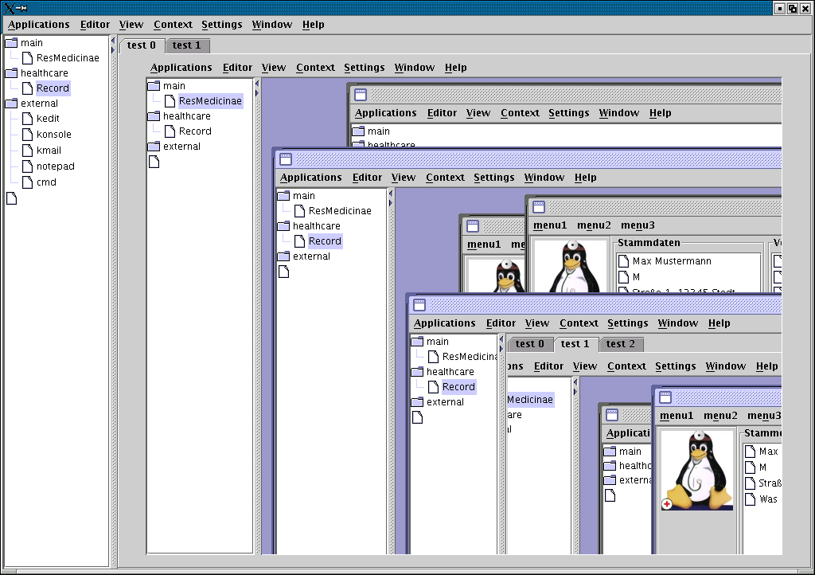
res medicinae

Slide 37
res medicinae
knowledge
knowledge
knowledge
residenz
view
partview
partview
residenz.view.partview
logic
partlogic
residenz.domain.partdomain
partlogic
domain
partdomain
partdomain
  runtime model hierarchy
  with logic accessing states

Slide 38
contents
introduction
reflexions
statics and dynamics
double-hierarchy knowledge
state and logic
realisation
cybol language
cyboi interpreter
res medicinae
summary and future

Slide 39



summary and future
influence
influence
instantiation
template
schema
model
statics
structure
dynamics
cybol language
cybop concepts
cyboi interpreter
design time
analysis time
runtime
domain expert /
application developer
knowledge architect /
information scientist
systems developer
  knowledge triumvirate

Slide 40
summary and future
software engineering process
analysis
design
implementation
requirements
document
feature
model
state knowledge
architecture
diagrams
source
code
logic knowledge
1a
1b
2
1
common knowledge abstraction
abstraction gaps

Slide 41


summary and future
traditional
cybop
models suffer from complexity
strong coupling / dependencies
inflexible
difficult to maintain
one schema as memory structure
directed acyclic graph (tree)
easily extensible
long-life software system
  limits: only standard-, no real-time applications

Slide 42

summary and future
  call for developers
  future works
  x windows, linux console, tcp sockets
  database access via sql, graphics with OpenGL/ Mesa 3D
  signalling mechanism, threading, mutexes
  port to ms windows using cygwin
  parser/ serialiser to convert different file formats
  debian package, autoconf/ automake --> official GNU
  cybol knowledge templates for various domains

Slide 43
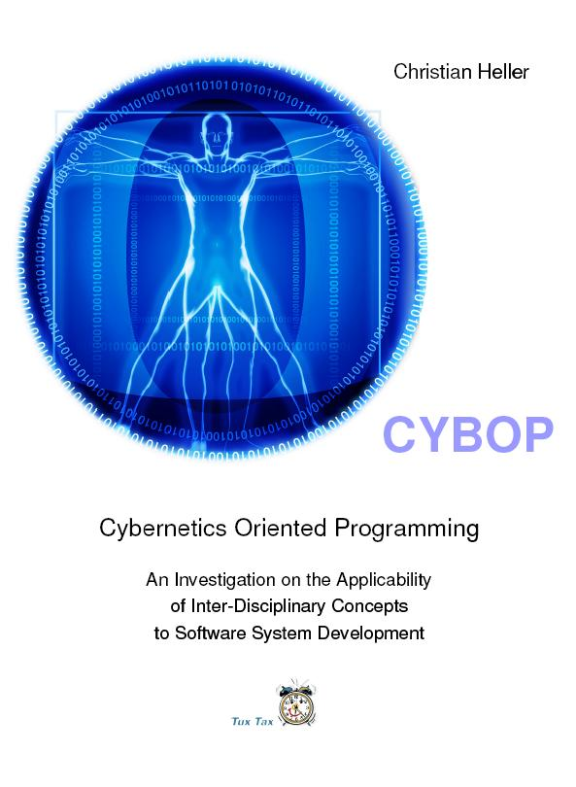
  thank you!
  http://www.cybop.net
  hardcover: 536 pages
  1st edition (January 19, 2007)
  language: english
  license: gnu fdl
  50,00 EUR

