Slide 1
Continuous Delivery Techniques for SQL Server Databases Use free tools to improve your development process
Michael Erpenbeck
Talk’s resources: http://erpenbeck.io/2017/04/25/ssdt

Slide 2

Reach out to me
B: http://erpenbeck.io
T: @Erpenbeck
L: http://linkedin.com/in/erpenbeck

Slide 3
Why this talk?!?

Slide 4
Why this talk?!?
Not a vendor/consult selling a product
Not an evangelist
Not a DBA
Just a developer who has worked with SSDT and has seen how productive it can make a team

Slide 5
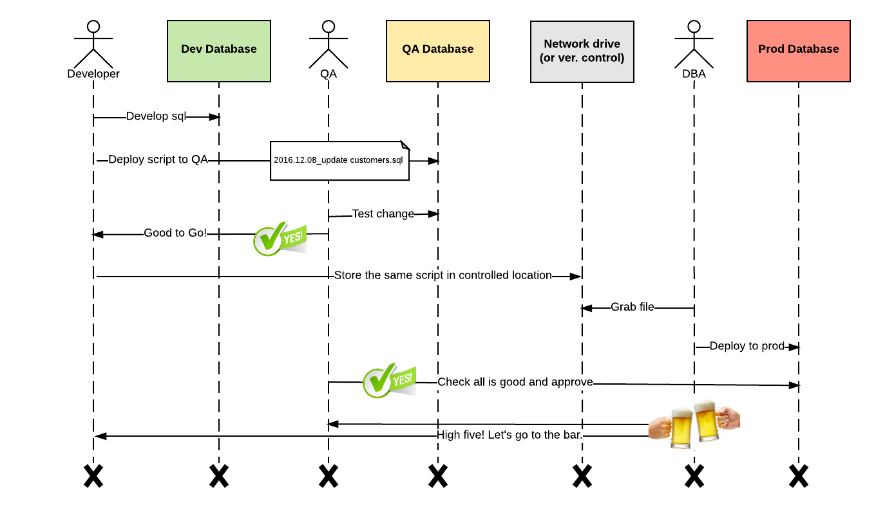
Early in my career, I learned to deploy databases using this process

Slide 6

So what’s the problem?

Slide 7
So what’s the problem?
It never REALLY happens that way!!!
Often problems with the scripts are found in production while deploying.
Even more scary…sometimes those problems are NOT found while deploying…they are found by the customers.

Slide 8
What happened?
Each environment (Dev/QA/Prod) is different
The metric for this is called “Drift”
Hot-fixes:
were applied to Prod with good intentions but…
not applied to lower-environments.
Developer changes:
were applied to lower-environments changes but…
without incorporating changes to Prod.

Slide 9
Demo: LocalDB
A fast and lightweight version of SQL Server Express created specifically for developers.
SSDT installs and uses it.
Used as a debug database to provide a sandboxed environment for building, testing, and debugging your project.
Demo
1

Slide 10
LocalDB – Default instances
(localdb)\ProjectsV13
Created by SQL Server Data Tools (SSDT), used for debugging in Visual Studio 2015.
(localdb)\v11.0
Created by SQL Server 2012 LocalDB default instance name.
(localdb)\MSSQLLocalDB
Created by SQL Server 2014/2016 LocalDB as default instance name. Note MS is trying to get away from version numbering.

Slide 11
What is SSDT?

Slide 12
SSDT – What is it?
Stands for “SQL Server Data Tools”
Data tools available for developers within Visual Studio that allow you to:
Connected Development - perform database tasks (SSOX);
Disconnected Development - create and manage database objects (Database Projects);
and easily deploy database changes (DACPACs).
Demo
2

Slide 13
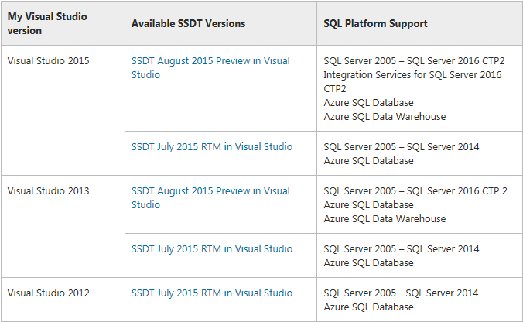
SSDT – What are the versions?
Source: http://www.sqlsaturday.com/SessionDownload.aspx?suid=10701

Slide 14
SSDT – What are the versions?
General Availability (GA) Release of SSDT 17.0 (April 2017)
Source: http://www.sqlsaturday.com/SessionDownload.aspx?suid=10701

Slide 15
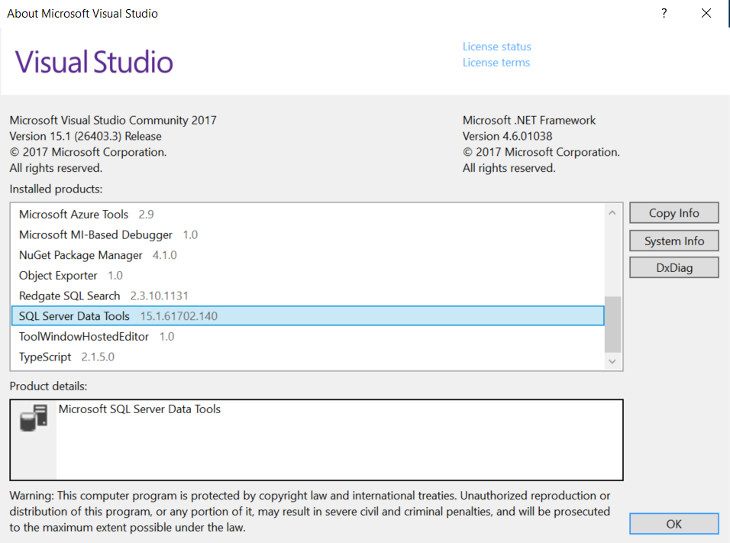
How to determine the version
Help->About Microsoft Visual Studio menu option

Slide 16
Demo: Basic Import and Publish
Will discuss each element after the demos
“environments” LocalDB instance with 3 databases
Dev database
QA database
Prod database
Let’s import our first Database Project…
Demo
2

Slide 17
Notes on Importing
Set Target platform to the desired version
(Project>Properties>Target platform)
Note: Permissions to import a database:
VIEW DEFINITION

Slide 18
Let’s make a change
Add a new column named “Email” as NVARCHAR(256) and Allow Nulls
Press F5 to deploy to (localdb)\ProjectsV13
Note: Control-Shift-R in SSMS to refresh cache
Demo
2

Slide 19
Deployment approaches

Slide 20
Deployment approaches
Migration-based (aka: transition-based)
State-based (aka: declarative)

Slide 21
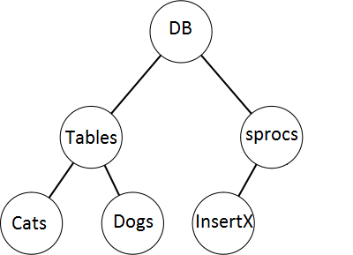
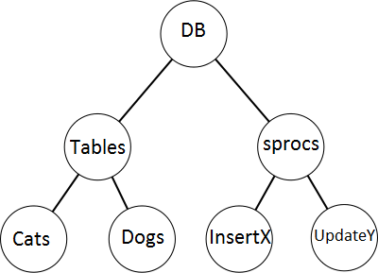
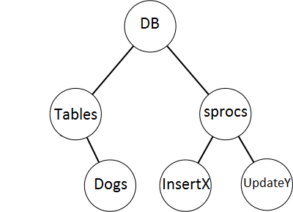
Deployment approaches
Migration-based (aka: transition-based)
State-based (aka: declarative)
+UpdateY
-Cats

Slide 22
Deployment approaches
Migration-based (aka: transition-based)
State-based (aka: declarative)
The source of truth = how the database should change
Think of a SQL Server upgrade script - Like the one in the original process.
E.g., DbUp

Slide 23
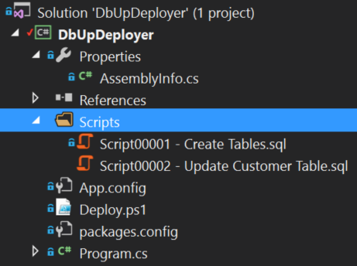
Deployment approaches
Migration-based (aka: transition-based)
State-based (aka: declarative)

Slide 24
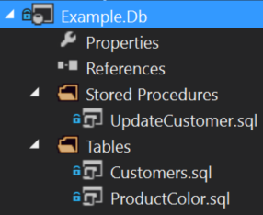
Deployment approaches
Migration-based (aka: transition-based)
State-based (aka: declarative)
The source of truth = how the database should be
Desired State of the database is saved and tools are used to transform the database from one state to another.
E.g., Visual Studio Database Projects,
RedGate SQL Source Control

Slide 25
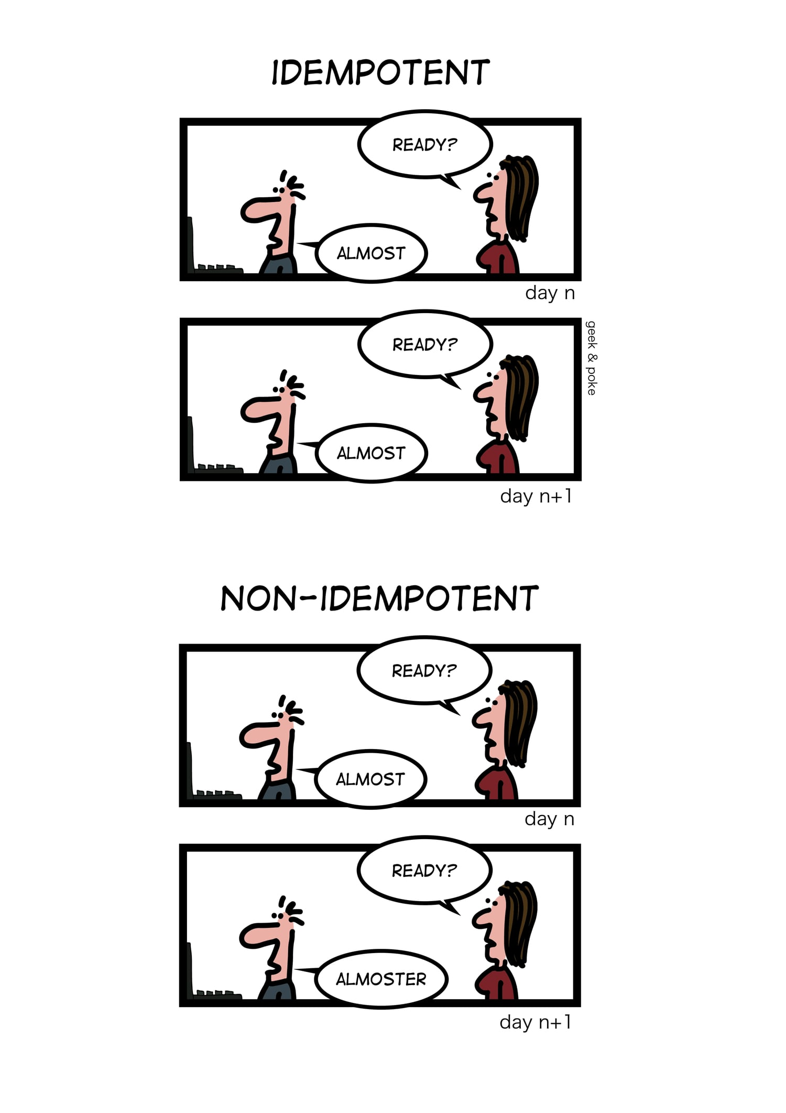
Idempotency
Definition:
In computing, an idempotent operation is one that has no additional effect if it is called more than once with the same input parameters.
CREATE vs ALTER
Demo
3

Slide 26
What’s the best approach?!? Architect answer – it depends
Let’s discuss this more fully at the end of the talk once you’ve seen both approaches in action.

Slide 27
State-based approach in action

Slide 28
Visual Studio Database Projects
“Build" your database with:
Like Lint for your database
Schema validation
Static code analysis for database objects
Intellisense when writing sprocs/etc
F12 to “Go to definition”
Error in static code analysis = no publish
Demo
3

Slide 29
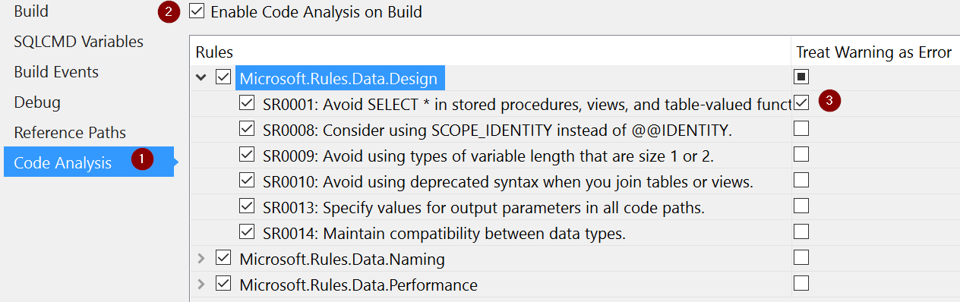
Visual Studio Database Projects: Rules
Rules can be selected
Demo
3

Slide 30
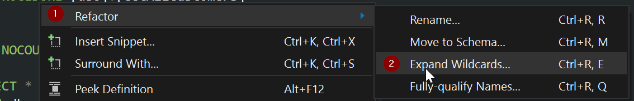
Refactor Wildcards
CREATE PROCEDURE [dbo].[GetAllCustomers]
AS
BEGIN
SET NOCOUNT ON;
SELECT *
FROM dbo.[Customers]
END
Demo
3

Slide 31
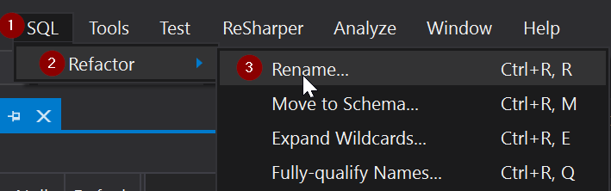
Refactor Rename
Rename
Consider renaming LastName to Surname
Refactor.log
Demo
3

Slide 32
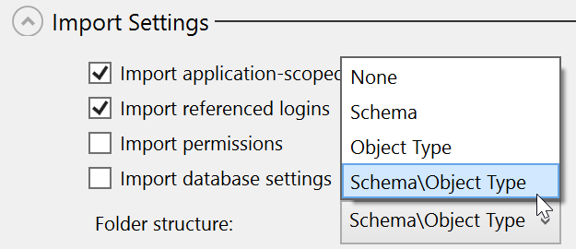
Import options - Schema
Import database schema from an existing database
Demo
3

Slide 33
Compare
Compare Schema
Measure Drift
Note: DriftReport
Compare:
DB vs. DB
DB vs. Visual Studio Database Project
Store .scmp Into DB Project
Demo
4

Slide 34
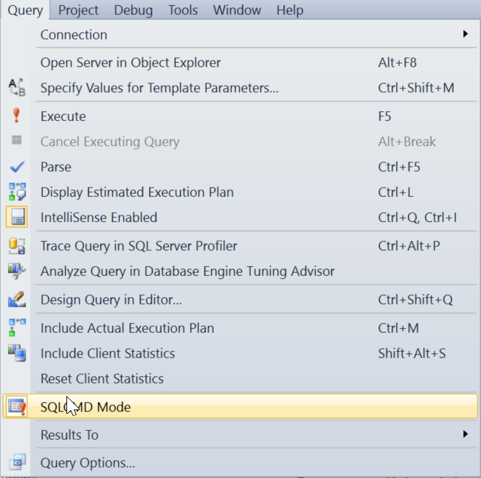
Generate a script (and send to DBA)
Use the “Generate Script” button instead.
It generates SQLCMD script.
In SSMS, don’t forget to run in SQLCMD Mode.
Demo
4

Slide 35
Pre/Post Deployment scripts
Only can have one Pre-Deployment script
Only can have one Post-Deployment script
Demo
4

Slide 36
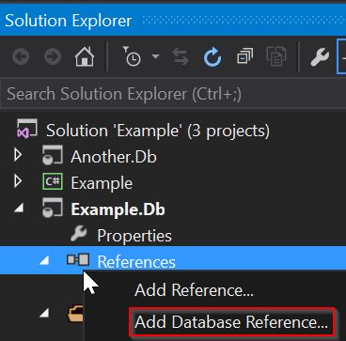
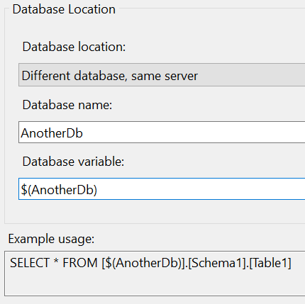
Database Reference Variables
Demo
4

Slide 37
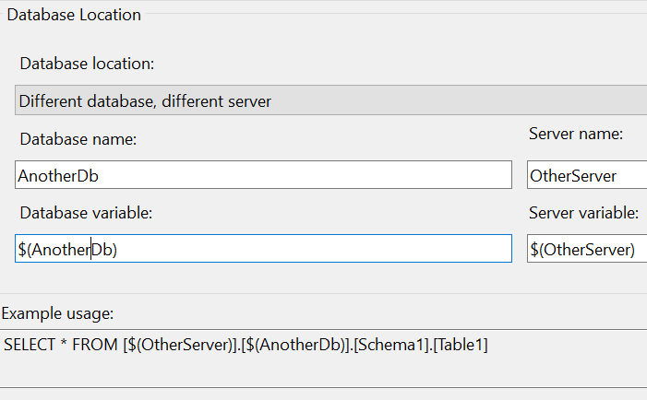
Database Reference Variables Linked Servers
Demo
9

Slide 38
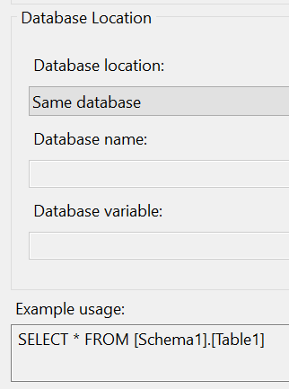
Database Reference Variables

Slide 39
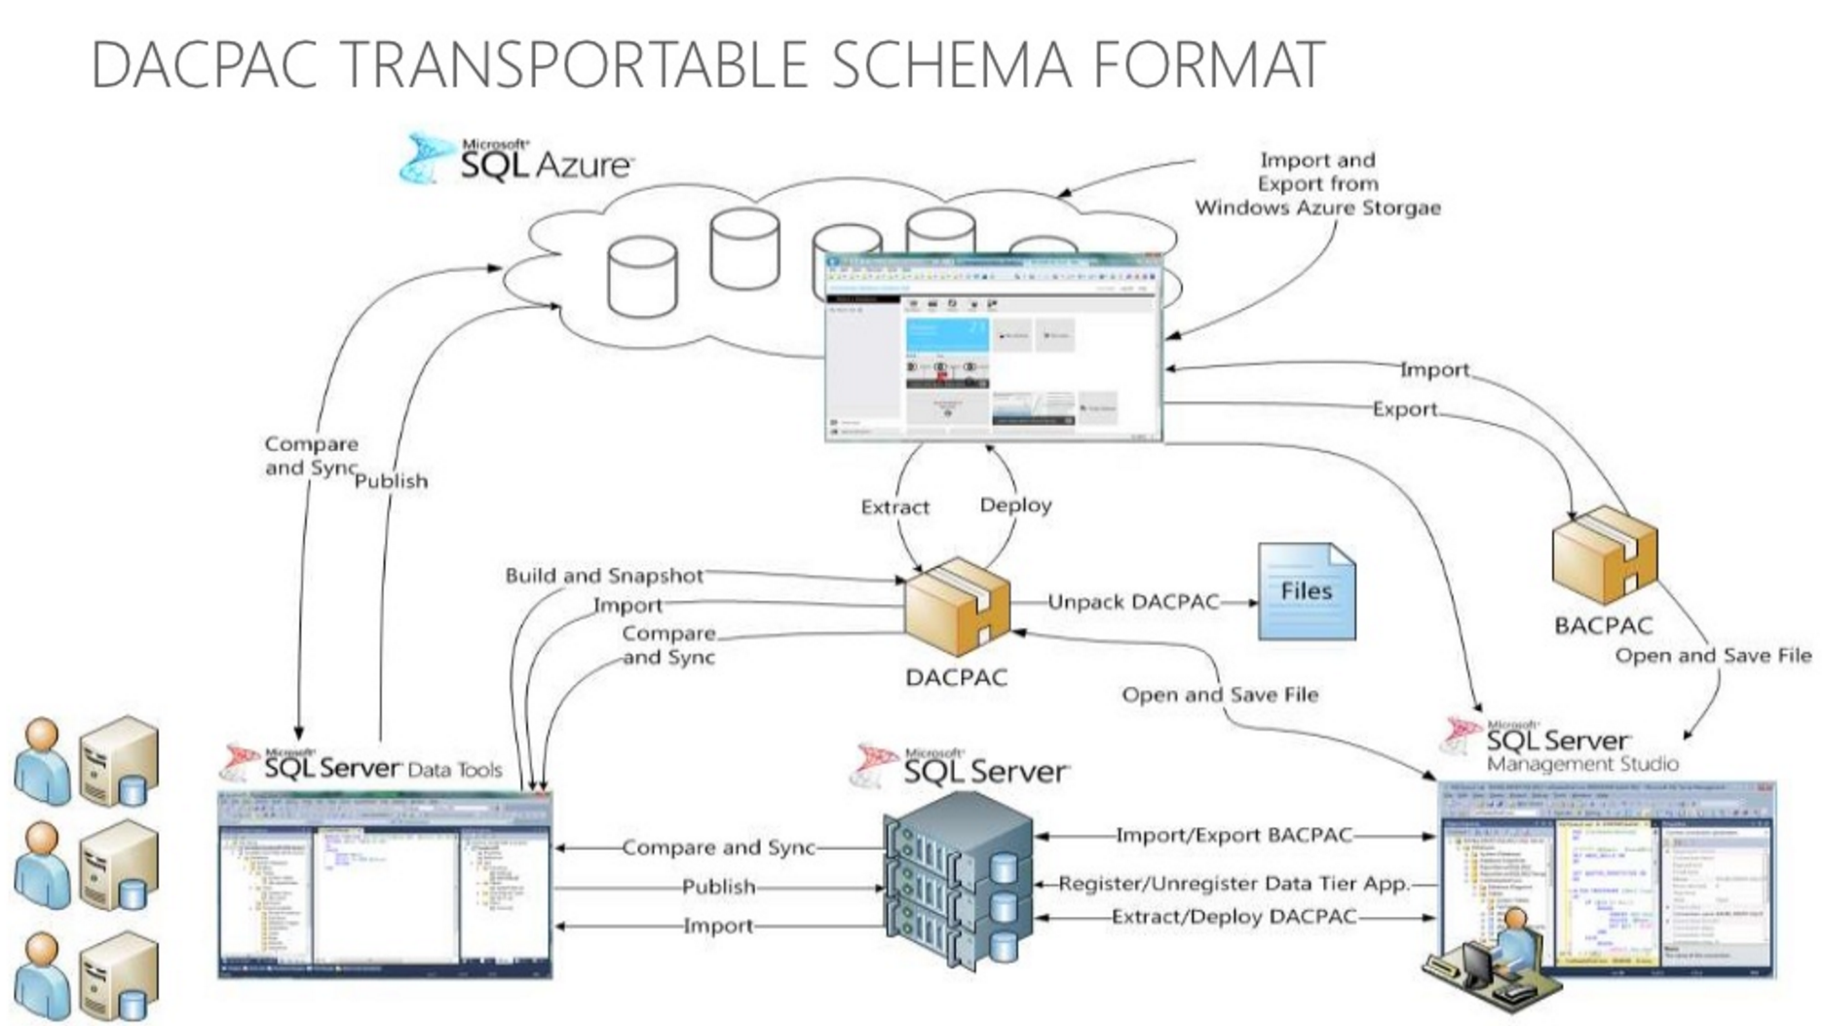
Database Schema Management by Gert Drapers

Slide 40
DACPAC
Data-Tier Application Package (DACPAC)
XML files in a zipped directory
represents the database model of the database’s metadata.
DACPAC – Only Schema
BACPAC – Schema + Data
Demo
5

Slide 41
Demo: Scripting deployments
SqlPackage.exe - command line utility that automates the following database development tasks:
Extract: Creates a database snapshot (.dacpac) file from a live SQL Server or Microsoft Azure SQL Database.
Publish: Incrementally updates a database schema to match the schema of a source .dacpac file. If the database does not exist on the server, the publish operation will create it. Otherwise, an existing database will be updated.
Export: Exports a live database - including database schema and user data - from SQL Server or Microsoft Azure SQL Database to a BACPAC package (.bacpac file).
Import: Imports the schema and table data from a BACPAC package into a new user database in an instance of SQL Server or Microsoft Azure SQL Database.
DeployReport: Creates an XML report of the changes that would be made by a publish action.
DriftReport: Creates an XML report of the changes that have been made to a registered database since it was last registered.
Script: Creates a Transact-SQL incremental update script that updates the schema of a target to match the schema of a source.
Demo
5

Slide 42
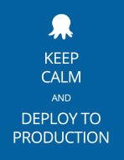

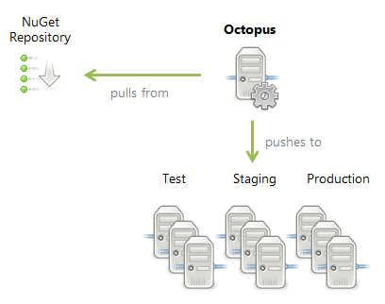

Octopus Deploy
Commit change
Git, TFVC, SVN, etc
NuGet Package
Push to
Octopus’
NuGet
Repo
Commit
trigger
Publish
Profile
Deploy
PowerShell
Octopack
Team City,
TFS, etc
Pack NuGet
Source: https://octopus.com/blog/rfc-deployment-process-changes

Slide 43
Demo: Octopus Deploy
NuGet Package
Push to
Octopus’
NuGet
Repo
HACK
Publish
Profile
Deploy
PowerShell
Octopack
msbuild
Pack NuGet
Demo
6
Source: https://octopus.com/blog/rfc-deployment-process-changes

Slide 44
Merging

Slide 45
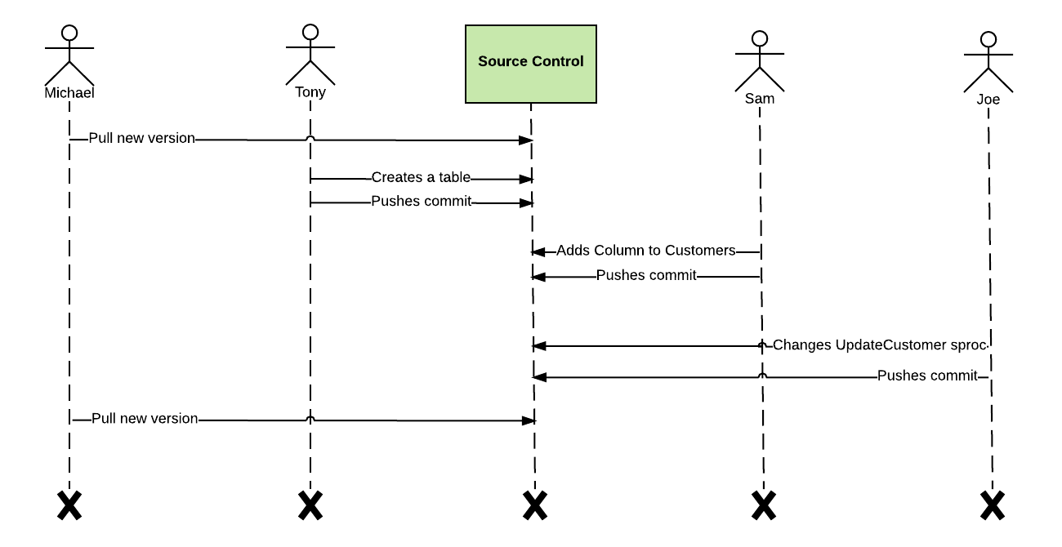
A Real-Life Story of Database CI

Slide 46
A Real-Life Story of Database CI
Notes on Git commands:
gst – git status --short
gaa – git add –all
gcmm – git commit –m
gpush – git push -u origin $(current_branch)
gpullo - git pull origin $(current_branch)
gll - !git --no-pager log --graph --pretty=format:'%Cred%h%Creset -%C(yellow)%d%Creset %s %Cgreen(%cr) %C(bold blue)<%an>%Creset' --abbrev-commit --date=relative

Slide 47
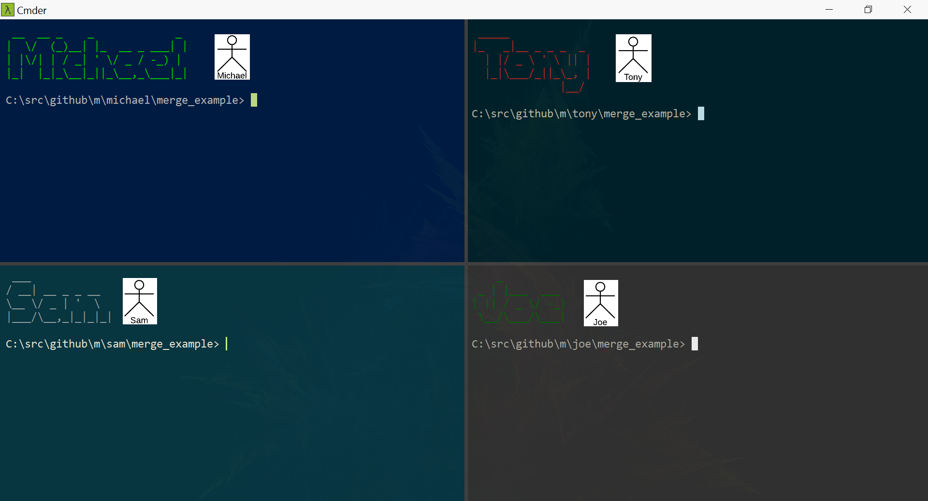
Demo

Slide 48
A Real-Life Story of Database CI
Demo
M

Slide 49
Unit and Integration Testing

Slide 50
SSDT Unit testing
Built on the same framework as .NET unit testing, CodedUI, Load testing, etc.
CREATE PROCEDURE [dbo].[GetAllCustomers]
AS
BEGIN
SET NOCOUNT ON;
SELECT [CustomerId], [FirstName], [LastName], [Age]
FROM dbo.[Customers]
END
Demo
7

Slide 51
tSQLt - Install
tSQLt
http://tsqlt.org/user-guide/quick-start/
Note: RedGate SQL Test is a nice paid product for a better UI to tSQLt.
Demo
7

Slide 52
tSQLt Deployment
Notice the Deploy/Post-Deployment =
tSQLt.RunAll
Not suggested to install tSQLt on Prod due to security changes that the scripts perform
Demo
8

Slide 53
Integration Testing the Repository Pattern
DacSmash
DACFx:
Microsoft.SqlServer.Dac namespace

Slide 54
Migration-based approach in action

Slide 55
Migration-based approach
The actual state is not saved, instead incremental change scripts are saved and then can be run in forward or backward to gain the desired database state.

Slide 56
Example Migration-based Tools
FluentMigrator
https://github.com/schambers/fluentmigrator
DbUp
http://dbup.readthedocs.io/en/latest/

Slide 57
DbUp: Uses console application
This has many benefits:
Works w/other automated deployment solutions.
Can be run manually.
Can be run to setup a developer’s workstation.
I’ve documented how to do this at:
http://erpenbeck.io/2016/12/04/dbup
Demo
15

Slide 58
SELECT TOP 1000 [Id]
,[ScriptName]
,[Applied]
FROM [DbUpExample].[dbo].[SchemaVersions]

Slide 59
Deploy to Octopus
execute octo_push.bat
Demo
15

Slide 60
What’s the best approach?!? Architect answer – it depends
State-based if:
A lot of logic in the database, e.g. sprocs
Large distributed team
Better for merge-conflict resolution
Migration-based if:
Multiple production databases from the same source database
Small local team
Source: http://app.pluralsight.com/courses/database-delivery-best-practices

Slide 61
Acknowlegements
The following people initially turned me on to these techniques:
Mike Gayeski - Architect
Jai Kang - DevOps

Slide 62
Reach out to me
B: http://erpenbeck.io
T: @Erpenbeck
L: http://linkedin.com/in/erpenbeck
R: http://erpenbeck.io/2017/04/25/ssdt

