Slide 1
McMaster Autonomous Electric Vehicle (MacAEV)
ELECENG 3EY4: Electrical Systems Integration Project
Shahin Sirouspour
Winter 2025

Slide 2
Plan for Second Part of Course
Explore autonomous driving concepts with MacAEV
Lectures, tutorials and laboratories are organized around weekly milestones
Lectures introduce theoretical concepts at high level with some technical details left out due to time constraints
Tutorials mostly focus on Lab Project Activities
Resources and references are made available so students can explore and develop deeper understanding of these concepts on their own
Lab hours are used to help students with project implementation issues and to assess their progress

Slide 3
Key Points to Consider
This is a project-based course, so you should expect to spend time outside regular class and lab hours towards achieving the objectives
There are many steps in algorithm development and implementation that can be carried out at home, and you are strongly encouraged to do so
In fact, it is quite likely that you would not be able to finish everything if you were to work exclusively during the lab time
You will submit group reports for laboratory activities. Due dates will be posted on Avenue to Learn

Slide 4
Milestones
Lab 6 (Feb. 24-28): Setting Up Simulation Environment and Manual Driving of MacAEV
Lab 7 (March 3-7, 10-14) Localization and Mapping with MacAEV
Lab 8 (March 17-21, 24-28, April 1-4): Autonomous Driving with MacAEV

Slide 5
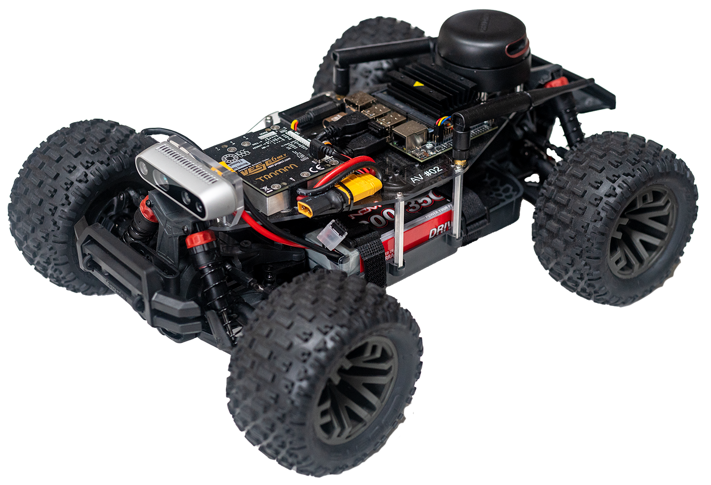
McMaster AEV
Vehicle built on a 1/10th scale RC hobby platform (ARMA GRANITE 4x4 link)
Nvidia Jetson Nano AI Computer
RPLIDAR A2 LiDAR
TRAMPA VESC 6 MkV
BNO055 9DOF IMU
WiFi Antenna
VENOM 3S LiPo Battery
Intel RealSense Depth Camera D435i

Slide 6
Onboard Computer

Slide 7
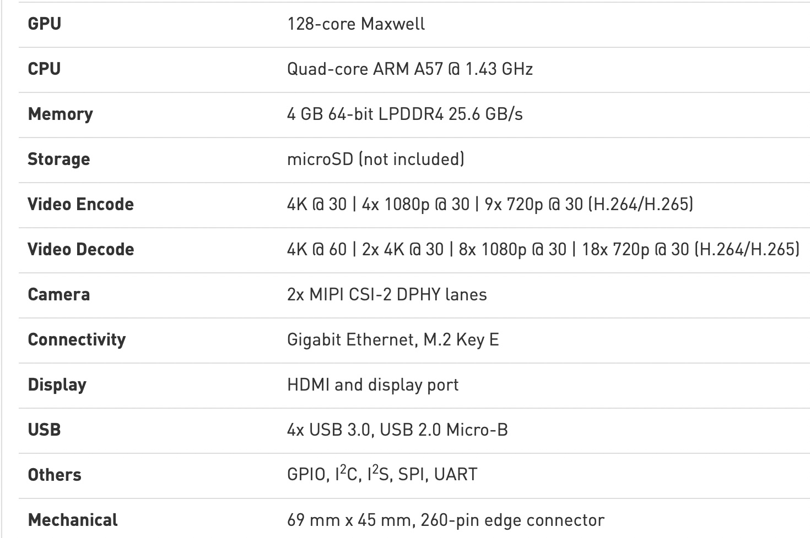
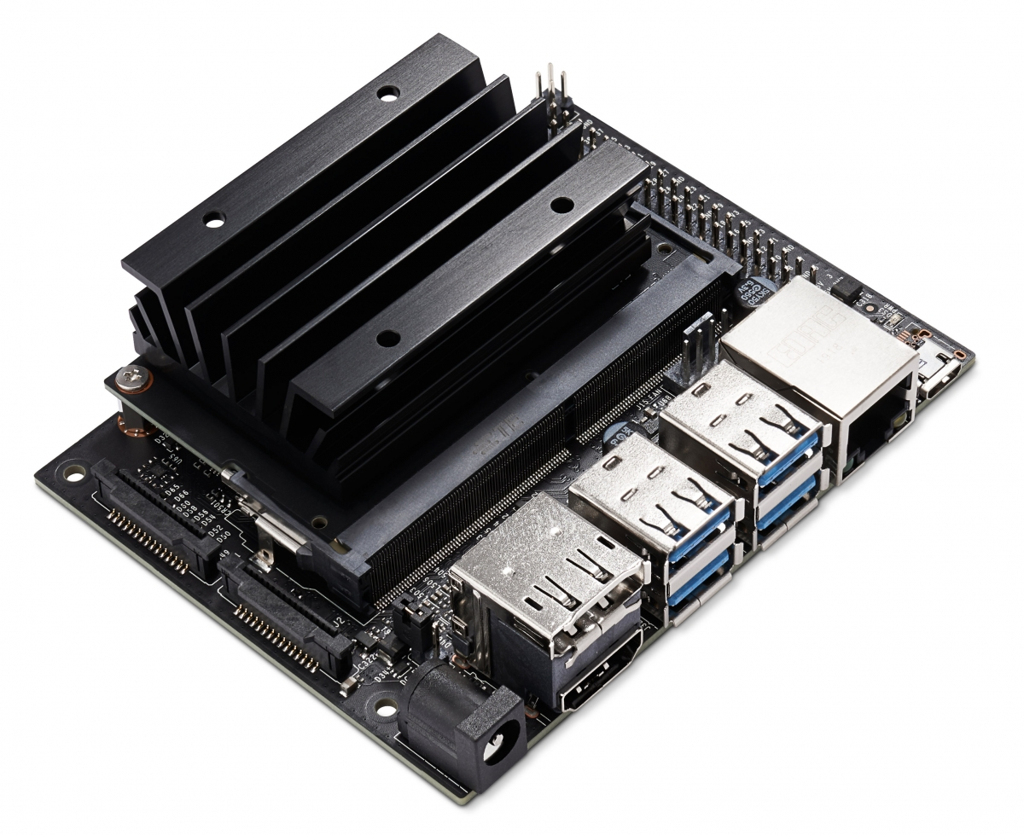
NVIDIA Jetson Nano

Slide 8
NVIDIA Jetson Nano
Nvidia JetPack SDK link
Jetson Linux Driver Package (L4T)
OS: Linux kernel 4.9, filesystem based on Ubuntu 18.04
TensorRT: Built on Nvidia CUDA, is a high-performance deep learning inference runtime for image classification, segmentation, and object detection neural networks.
cuDNN: CUDA Deep Neural Network library provides provides highly tuned implementations for standard routines such as forward and backward convolution, pooling, normalization, and activation layers
CUDA: Toolkit provides a development environment for GPU-accelerated applications
Computer Vison: Computer Vision / Image Processing algorithms implemented on PVA (Programmable Vision Accelerator), GPU and CPU. Supports OpenCV (Open-source library for computer vision) and VisionWorks ( a software development package for Computer Vision (CV) and image processing)
Multimedia API: Camera Application API (low-level frame-synchronous API for camera applications, with per frame camera parameter control, multiple camera support, and EGL stream outputs). Sensor driver API (enables video decode, encode, format conversion and scaling functionality)

Slide 9
The Robot Operating System (ROS)
“The Robot Operating System (ROS) is a set of software libraries and tools that help you build robot applications. From drivers to state-of-the-art algorithms, and with powerful developer tools, ROS has what you need for your next robotics project. And it's all open source.” link
You have already installed ROS 1 long-term distribution Melodic which primarily targets the Ubuntu 18.04 (Bionic) release
ROS provides a communication and modular application development framework targeting robotics applications
All application developments in the remainder of the course will be based on ROS using Python and some C++ programing languages, as needed

Slide 10
Sensing Modules

Slide 11
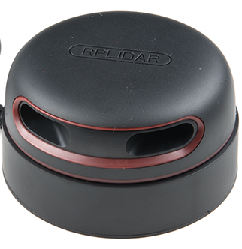
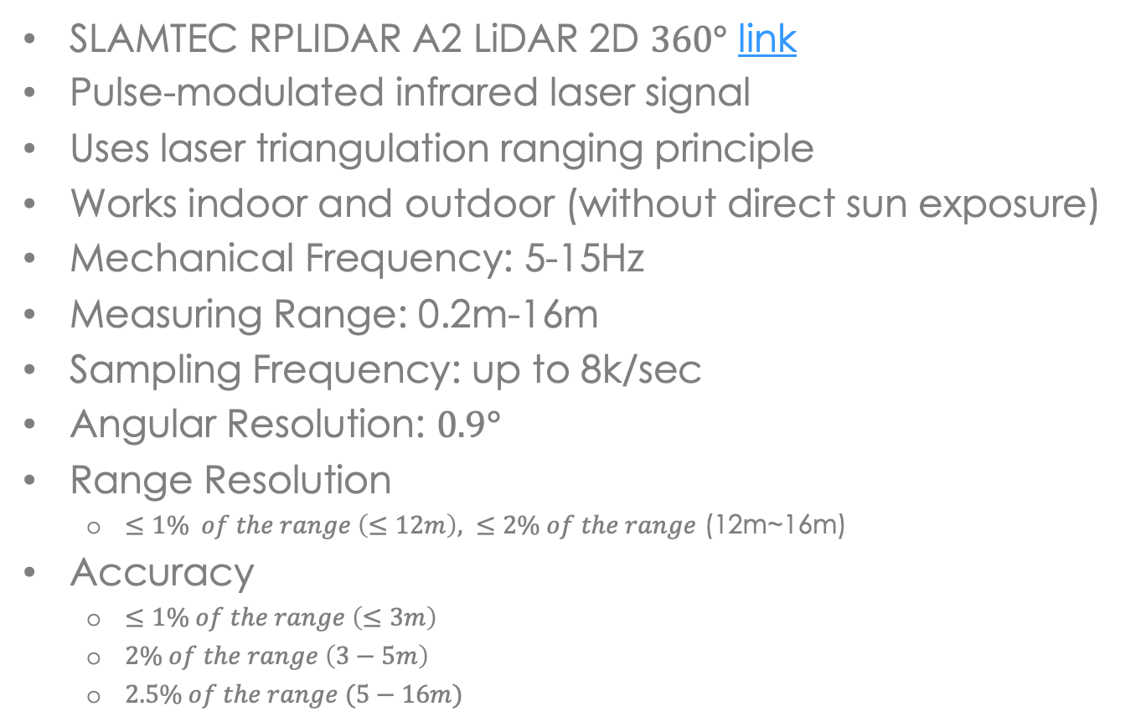
RPLIDAR A2 LIDAR
SLAMTEC RPLIDAR A2 LiDAR 2D $360°$ link
Pulse-modulated infrared laser signal
Uses laser triangulation ranging principle
Works indoor and outdoor (without direct sun exposure)
Mechanical Frequency: 5-15Hz
Measuring Range: 0.2m-16m
Sampling Frequency: up to 8k/sec
Angular Resolution: $0.9°$
Range Resolution
$≤1\% of the range \left(≤12m\right), ≤2\% of the range$ (12m~16m)
Accuracy
$≤1\% of the range \left(≤3m\right)$
$2\% of the range \left(3−5m\right)$
$2.5\% of the range (5−16m)$

Slide 12
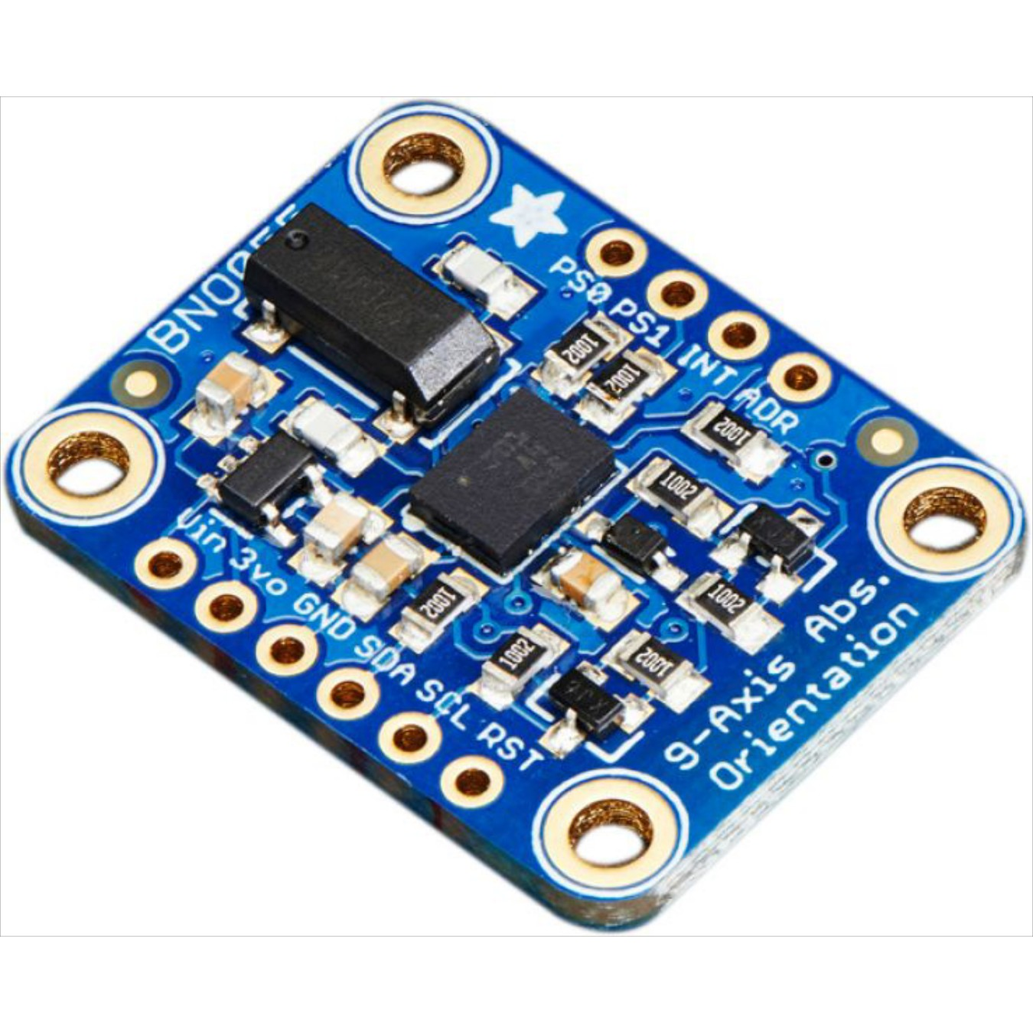
Adafruit BNO055 IMU
9 DOF Inertial Measurement Unit (IMU) link
Combines a MEMS accelerometer, magnetometer, and gyroscope on a single die
ARM Cortex-M0 based processor fuses and filters sensory information to produce:
Absolute Orientation (Euler angles or Quaternion at 100 Hz)
Angular Velocity Vector 3x1 (100 Hz)
Acceleration Vector 3x1 - gravity + linear acceleration (100 Hz)
Linear Acceleration Vector 3x1 (100 Hz)
Magnetic Field Strength Vector 3x1 (20 Hz)
Gravity Vector 3x1 (100 Hz)
Ambient Temperature (1 Hz)

Slide 13
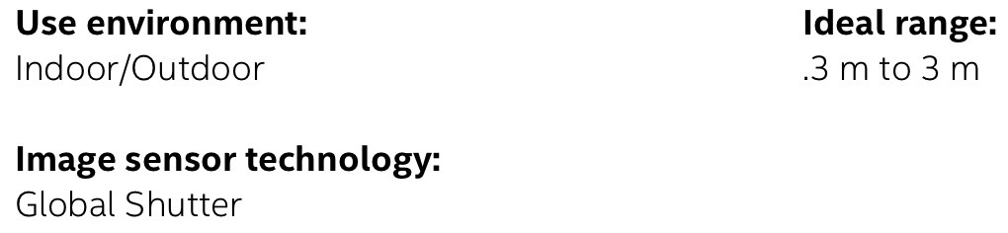
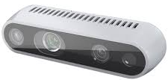
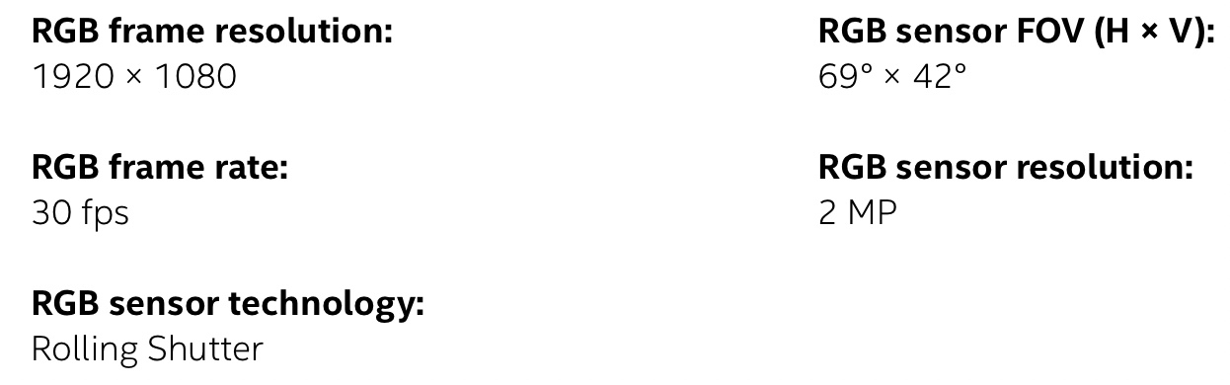
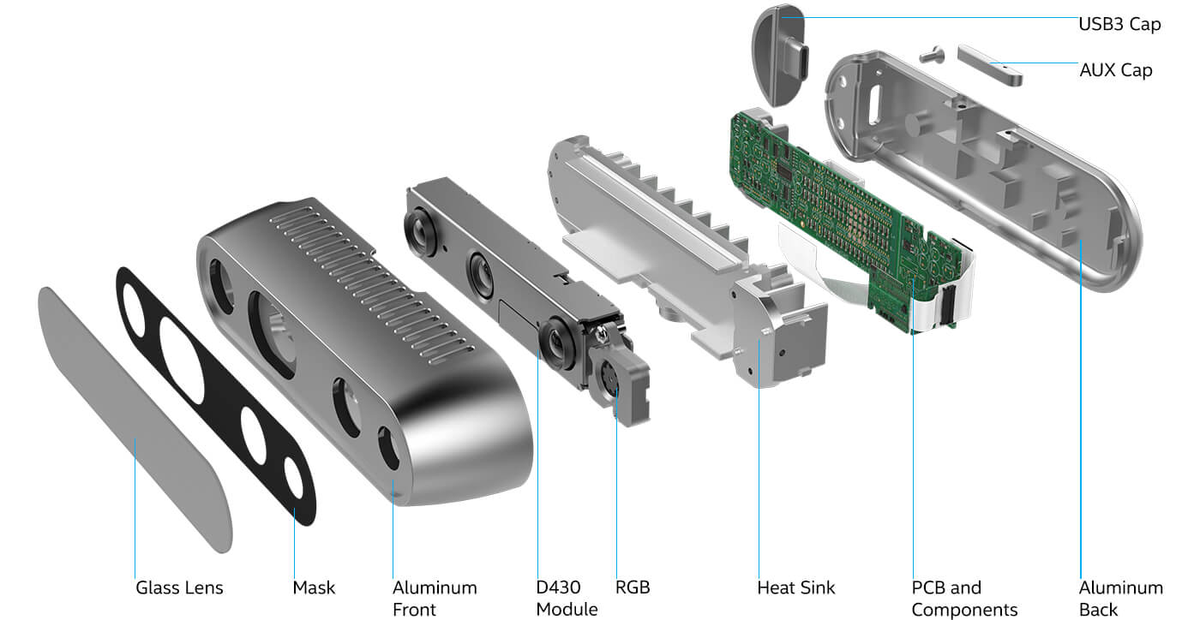
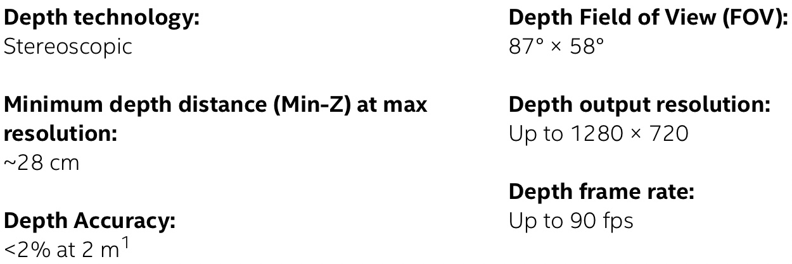
Intel D435i Depth Camera
Combines an RGB camera, an active infrared stereoscopic depth camera and IMU link
Built-in Intel RealSense Vision Processor D4

Slide 14
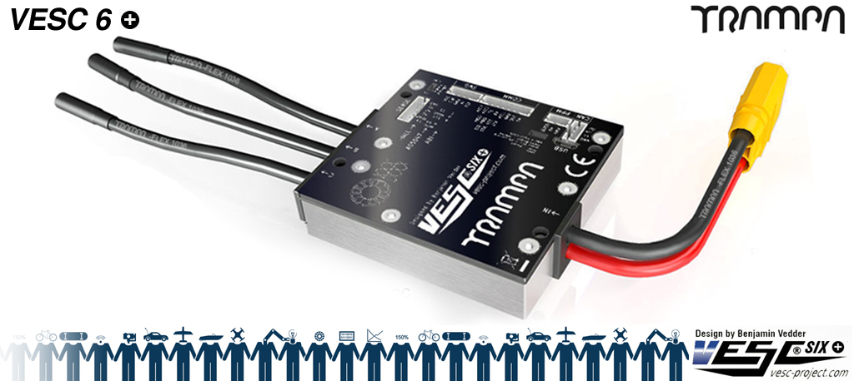
TRAMPA VESC 6 Mark V
Can operate in BLDC and FOC modes. We use it in FOC mode due to smoother and more efficient operation
Built-in safety protection for overcurrent and LiPo battery low voltage
Initial set-up and tuning up of the parameters with VESC tool
Provides an estimation of motor velocity for use in wheel odometry
Connects to Jetson Nano via USB port
Powered by 3S LiPo battery
Provides PPM control signal for steering servomotor
ROS based drivers are used to communicate with VESC
Can incorporate motor position sensors (not used here)

Slide 15
Software

Slide 16
F1/10 Simulator
A lightweight 2D simulator of UPenn F1TENTH Racecar. The simulator can be built with ROS or as a standalone C++ application
We will build on F1/10 Simulator package available on GitHub link
We will make changes as necessary to accomplish project-specific objectives
Using this code structure makes the transition from simulation to experiment seamless
Control algorithms and codes will be developed and tested on the simulation platform first
This allows for safe debugging and performance evaluation before testing new algorithms on the vehicle
Same control code can then be used for driving the actual vehicle

