Slide 1
Acknowledgment Messages

Slide 2
Types of Acknowledgments
MDN - only for AS2
997 - most common
TA1 - not used much
999 - for HealthCare (replaces the 997)

Slide 3
MDN (An AS2 level message)
Only used when use are using AS2.
Can be synchronous (returned in an http request/response), or can be asynchronous (returned to a URL you specify).

Slide 4
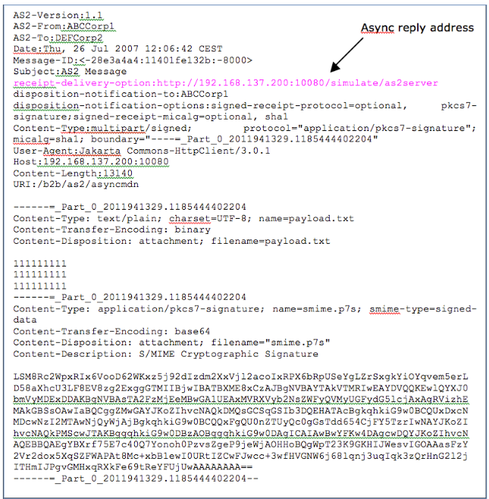
MDN Example
Your AS2 server will handle this for you.
You would only look at an MDN file if an error was reported by your AS2 server.
Maybe useful when first on-boarding an AS2 Client.

Slide 5
997 - page 1 of 5
The 997 is a Functional Acknowledgment (sometimes known as an “FA”).
It can be sent in response to any EDI transaction received.
When you receive an EDI 997 in response to a transaction you sent previously, you only know that your document arrived and was processed by the recipient’s EDI translator.
Discuss with your Trading Partner as to whether they will send 997s and whether or not they expect 997s from you.

Slide 6
997 - page 2 of 5
It does not provide any indication that the trading partner agrees with the contents of the prior transaction, or that the transaction met all their business requirements.
Example: An EDI 855 tells the buyer that you have approved or rejected their 850 PO. a 997 just tells the buyer that you got their 850 PO and parsed it successfully.
Validation may be very simple or very involved.

Slide 7
997 - page 3 of 5
ST*997*4887~ AK1*SS*13418~ [matches back to GS01 and GS06] AK2*850*000101112~ [matches back to ST01 and ST02] AK5*A~ <-- A=Accept, R=Reject, E=Errors AK2*850*000101113~ AK5*A~ AK9*A*2*2*2~ [Summary]
We will compare the above to the implementation guide in an upcoming video. The 997 only references back to the control numbers. So for example, for the 850 PO, it will NOT have the PO# in it.

Slide 8
997 - page 4 of 5
What do you do with the 997s received?
If you have an EDI software package, it will probably handle it for you.
If you are writing your own EDI system, you would do the following:
Loop through each AK2/AK5 segments pairs
Assuming you have a database table of all the EDI messages you sent out, with the control numbers in it, you would flag the appropriate ones as been acknowledged (for example, put current date/time in a column called Ack997DateTime, and some flag that indicates success or error)
Send an alert email if any error

Slide 9
997 - page 5 of 5
Why use 997? For example, to know if the partner got your 850 purchase order. You can have reports or automated emails if 997 is not received after x minutes.
A good resource for the error codes:
Google: edifabric 997 acknowledgement
Page:
https://support.edifabric.com/hc/en-us/articles/360000380131-X12-997-Acknowledgment-Error-Codes

Slide 10
TA1 - Technical Ack.
According to the IBM site: The TA1 is not typically used because it indicates only that an envelope was received, not what was inside the envelope.
TA1 is used to confirm ISA and IEA interchange envelopes syntactically where it is not acknowledged as a separate transaction
If ISA14 is set to 1 that means you are requesting a TA1. If ISA14 is set to 0 then that means TA1 will only be sent on errors in the ISA/IEA pair.

Slide 11
999
Replace the 997 for Healthcare. Both 997 and 999 are used to confirm that the file was received, however 999 includes additional information about whether the received transaction had errors, such as being in compliance with HIPAA requirements.

Slide 12
BOTS - page 2
BOTS has grammars for many releases and messages types (both X12 and EDIFACT):
https://bots.readthedocs.io/en/latest/quick-start-guide/
I downloaded X12_004010_all_transactions_and_segments.zip
Since we have been using 4.01 release/version.
Filename: X12.4010\850004010.py 238 lines - mostly definition of a big structure.

Slide 13

Finding a Word Doc to Start with
Use the “filetype:” google keyword to limit search to word documents. Try .doc and maybe .docx.
Or find a PDF you like, and use a PDF to Word Converter something like https://www.pdftoword.com

