Slide 1
GS Header and ST Header
Envelope Structure

Slide 2
GS Header Overview
An EDI file has one ISA Header, but contain multiple “Functional Groups”. Each “Functional Group” begins with a GS Header and ends with a GE Footer.
Frequently, there is just one “Functional Group” per EDI file.
Each “Functional Group” (or “inner envelope”) is made up of one or more Transaction Sets, all of the same type.

Slide 3
GS Header Overview
Each transaction starts with an “ST” segment. For example, an ST*856 would be an “Advanced Shipment Notice”, and an ST*810 would be an Invoice.
If a vendor shipped 10 products on the same truck, it could send one EDI file with two “Functional Groups”, one for all the 856s and one for all the 810s. This is often known as batching.
Many parties will send separate files rather than batching.
In my experience, 810 Invoices are often batched, but other transactions are not.

Slide 4
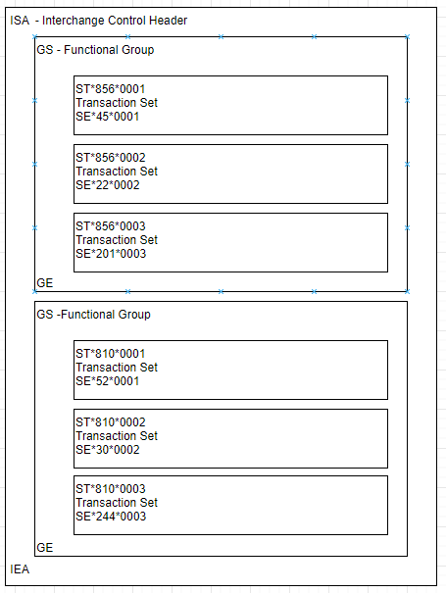
ISA/IEA - one per file
GS/GE - one per “functional group” (often just one)
ST - one per Transaction Set
ST*xxx*##### Where xxx is EDI Document Number, and #### is a sequence number.
SE*yyy*##### Where yyy is number of included segments, and #### is same sequence number on corresponding ST segment.

Slide 5
GE Trailer (for the GS Header)
GS*PO*SENDER*RECEIVER*20200622*0900*159*X*004010~ Data (one or more Transaction Sets Starting with ST and ending with SE) GE*1*159
Let’s starts with the trailer. GE01 - Number of Transaction Sets Included GE02 - Group Control Number, matching back to GS06

Slide 6
GS Header Overview - GS01-GS04
GS*PO*SENDER*RECEIVER*20200622*0900*159*X*004010~ Data (one or more Transaction Sets Starting with ST and ending with SE) GE*1*159
GS01 - Functional Identifier Code - may not matter, but if it does, Follow the codes given to you in the implementation guide. GS02 - Sender Code - often same as ISA06 GS03 - Receiver Code - often same as ISA08 GS04 - Date - CCYYMMDD

Slide 7
GS Header Overview - GS05-GS08
GS*PO*SENDER*RECEIVER*20200622*0900*159*X*004010~ Data (one or more Transaction Sets Starting with ST and ending with SE) GE*1*159
GS05 - Time Usually HHMM or HHMMSS (can optionally include decimal seconds) GS06 - Group Control Number (originated/maintained by the sender) GS07 - Responsibility Agency Code - X = Accredited Standards Committee X12 GS08 - EDI Version/Release Identifier 004010 represents 4.01

