Slide 1
E-Commerce Purchase Orders And Related Documents

Slide 2
E-Commerce Purchase Orders - Most Common
One example with Purchase Orders:
Buyer sends Purchase Order (EDI 850) to Vendor
Vendor confirms to buyer with EDI 855
Vendor ships the product then sends Advance Shipping Notice (EDI 856) to buyer
Vendor then sends Invoice (EDI 810) to buyer
Vendor sends nightly inventory (EDI 846) to buyer
Both buyer and vendor must interface the EDI messages to their ERP [Enterprise Resource Planning] (backend) systems.

Slide 3
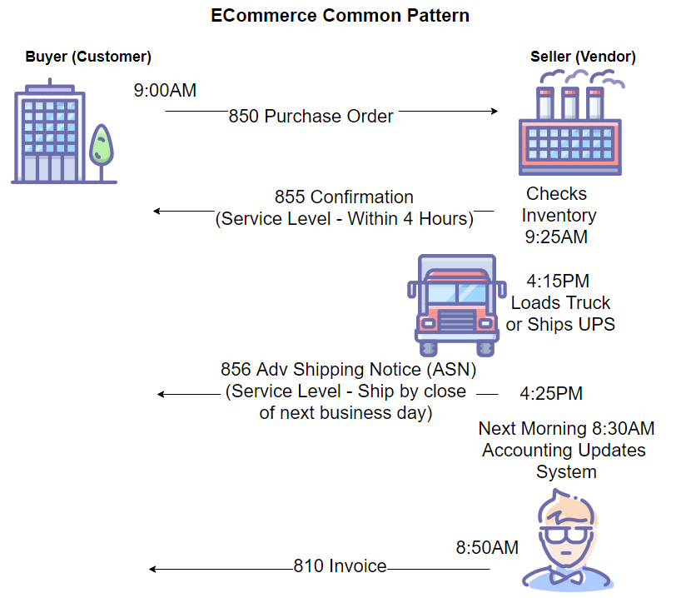

Slide 4
E-Commerce - Less Common
811 - Consolidated Service Invoice/Statement - for structured for very complex billing applications (up to nine hierarchical levels). Widely used in Telecom industry.
812 - Credit/Debit Adjustment - equivalent of a paper credit or debit memo, related to a previously transmitted 810 Invoice or previously received 850 PO. Can be triggered by: - Item was defective - Product ordered not received - Items being returned - Quantity delivered different from ordered - Error in pricing

Slide 5
E-Commerce - Less Common
816 Organization Relationships - Two formats, one for location addresses, second organizational relationship between locations, such as store and warehouse. When used, the 850 can refer to the location by code, and not repeat the address.
820 Payment Order/Remittance Advice - Used with electronic funds transfer (EFT), often via ACH (Automated Clearinghouse). Can be used to instruct bank to make a payment or to communicate details of a payment.
824 Application Advice - Typically used to communicate errors with previously sent transactions.

Slide 6
E-Commerce - Less Common
830 Planning Schedule with Release Capacity - Can be used to send a forecast (of sales,and optionally order release levels and authorization for recipient to commit to resources) - usually manufacturer sending to their suppliers. Allows the supplier/seller to plan resources such as labor and material and to fill orders automatically based on customer’s inventory levels.
832 Price/Sales Catalog - replaces a paper catalog, usually includes product information and prices. May include seller/contact, terms, item identification & description, packaging, minimum order quantities, quantity discounts…

Slide 7
E-Commerce - Less Common
840 Request for Quotation - Allows potential buyers to request information regarding price, delivery schedule, or other details.
843 Response to Request for Quotation - see 840 above
844 Product Transfer Account Adjustment Transaction - Send debit, credit, or request for credit relating to pre-authorized product transfer actions 849 Response to Product Transfer Account Adjustment Specifications - Response to 844 above
845 Price Authorization Ack/Status Transactions - vendor or manufacturer can send data related to status of or change to outstanding price authorizations.

Slide 8
E-Commerce - Less Common
847 Material Claim Transactions - Provides trading partners a way to advise each other on the costs and charges involved in fabricated or purchased material which has been determined to be damaged, unusable, or obsolete. Seller can use to inform buyer of costs and charges resulting from canceled or changed orders, or for buyer of material to inform seller of costs and charges resulting from material which was deemed damaged or unusable.
848 Material Safety Data Sheet - Can communicate chemical characteristics, hazards, and precaution for safe handling and use of materials (data for MSDS Material Safety Data Sheet required by OSHA - Occupational Safety and Health Admin)

Slide 9
E-Commerce - Less Common
851 Asset Schedule Transactions - Establishes a precise list of assets. Most often used when two parties agree upon a contract dealing with assets and terms relating to them (such as leasing or selling).
852 Product Activity Data - for providing suppliers with information need to plan, ship and set reorder and stocking levels. Usually sent on a regular schedule. May include UPC and item description, quantity sold, on hand, on order, forecast sales, sales history.
853 Routing and Carrier Instruction - provides the sender with the capability to transmit detailed routing and carrier info Related to the route.

Slide 10
E-Commerce - Less Common
854 Shipment Delivery Discrepancy Information - Used by carrier to notify a shipper of discrepancies between tendered freight and actual delivered freight (due to damage, overage, and shortages). Not used to ack receipt of goods.
857 Specification - Provides the recipient of a shipment with data for both receipt planning and payment generation. Can replace 856 (ASN) & 810 (Invoice); perhaps used when exact prices are not known in advance.

Slide 11
E-Commerce - Less Common
858 Shipment Information Transactions - helps in exchanging the Transportation Control & Movement Documents (TCMDs), the Government Bill of Lading (GBL), the Personal Property Government Bills of Lading (PPGBL), and also the Commercial Bills of Lading (CBL). The transaction set may also be used by the United States Civilian Government, the United States Department of Defense or any of the trading partners for exchanging information regarding a shipment’s freight, passengers, or household commodities. EDI 858 complies with the requirement of the information as established by the United States Government rules and regulations of transportation movement.

Slide 12
E-Commerce - Less Common
858 Shipment Information Transactions - used by the supplier to indicate to the buyer bill-of-lading, rating and scheduling information for a given shipment. The 858 EDI document can also be used for Government or Commercial bills-of-lading or transportation control movement documents.
859 Freight Invoice - provide the sender with the capability to transmit an invoice, including charges, allowances, and details, for transportation services rendered.
860 Purchase Order Change Request (Buyer Initiated) - Used to amend a previous transmitted 850 PO (e.g. add/change items, change dates, Change quantity or price, reschedule)

Slide 13
E-Commerce - Less Common
EDI 861 Receiving Advice/Acceptance Certificate File Format EDI 862 Shipping Schedule Transactions EDI 863 Report of Test Results EDI 864 Text Message EDI 865 Purchase Order Change Acknowledgment/Request – Seller Initiated EDI 866 Production Sequence EDI 867 Product Transfer and Resale Report File Format EDI 868 Electronic Form Structure EDI 869 Order Status Inquiry

Slide 14
E-Commerce - Less Common
EDI 870 Order Status Report EDI 871 Component Parts Content EDI 872 Residential Mortgage Insurance Application EDI 873 Commodity Movement Services EDI 874 Commodity Movement Services Response EDI 875 Purchase Orders for Grocery Products EDI 876 Grocery Products Purchase Order Change EDI 877 Manufacturer Coupon Family Code Structure EDI 878 Product Authorization/De-authorization EDI 879 Price Information

Slide 15
E-Commerce - Less Common
EDI 880 Grocery Products Invoice EDI 881 Manufacturer Coupon Redemption Detail EDI 882 Direct Store Delivery Summary Information EDI 883 Market Development Fund Allocation EDI 884 Market Development Fund Settlement EDI 885 Retail Account Characteristics EDI 886 Customer Call Reporting EDI 887 Coupon Notification EDI 888 Item Maintenance EDI 889 Promotion Announcement

Slide 16
E-Commerce - Less Common
EDI 891 Deduction Research Report EDI 893 Item Information Request EDI 894 Delivery/Return Base Record EDI 895 Delivery/Return Acknowledgment or Adjustment EDI 896 Product Dimension Maintenance

Slide 17
E-Commerce - Less Common
EDI 920 Loss or Damage Claim – General Commodities EDI 924 Loss or Damage Claim – Motor Vehicle EDI 925 Claim Tracer EDI 926 Claim Status Report and Tracer Reply EDI 928 Automotive Inspection Detail EDI 940 Warehouse Shipping Order Specifications EDI 943 Warehouse Stock Transfer Shipment Advice EDI 944 Warehouse Stock Transfer Receipt Advice EDI 945 Warehouse Shipping Advice EDI 946 Delivery Information Message

