Slide 1
HealthCare (HIPAA) EDI Messages

Slide 2
HIPAA - Most Common EDI Documents
837 Health Care Claims
835 Payment and Remittance Advice

Slide 3
HIPAA
HIPAA - Health Insurance Portability and Accountability Act was enacted by US Congress in 1996. A key component of HIPAA is the establishment of national standards for electronic health care transactions and national identifiers for providers, health insurance plans and employers.
Pharmacies transactions (HHS) is not done in X12 EDI.

Slide 4
HIPAA - Misc
CMS - Centers for Medicare and Medicaid Services (http://CMS.Gov)
HIPAA uses 5.01 (5010) release/version (since March 31, 2012).

Slide 5
HIPAA - TPA
TPA = Third Party Administrator = another term for the organization responsible for accepting and processing medical insurance claims from doctors, hospitals, and pharmacies.
Often, in the case of insurance claims, a TPA handles the claims processing for an employer that self-insures its employees. Thus, the employer is acting as an insurance company and underwrites the risk. The risk of loss remains with the employer, and not with the TPA.

Slide 6
HIPAA - Privacy 1
Because of rules surrounding privacy - you may find more security involved when working with companies that process HIPAA claims.
The HIPAA Privacy Rule establishes national standards to protect individuals’ medical records and other personal health information and applies to health plans, health care clearinghouses, and those health care providers that conduct certain health care transactions electronically. The Rule requires appropriate safeguards to protect the privacy of personal health information, and sets limits and conditions on the uses and disclosures that may be made of such information without patient authorization. The Rule also gives patients rights over their health information, including rights to examine and obtain a copy of their health records, and to request corrections.

Slide 7
HIPAA - Privacy 2
A DEFINITION OF HIPAA COMPLIANCE
The Health Insurance Portability and Accountability Act (HIPAA) sets the standard for sensitive patient data protection. Companies that deal with protected health information (PHI) must have physical, network, and process security measures in place and follow them to ensure HIPAA Compliance. Covered entities (anyone providing treatment, payment, and operations in healthcare) and business associates (anyone who has access to patient information and provides support in treatment, payment, or operations) must meet HIPAA Compliance. Other entities, such as subcontractors and any other related business associates must also be in compliance.

Slide 8
Medicare vs Medicaid
CMS - Centers for Medicare and Medicaid Services (http://CMS.Gov)
Medicare is a federal program that provides health care coverage for people 65 and older, or those with a disability, regardless of income.
Medicaid is a state and federal program that provides health coverage to those with very low income.

Slide 9
HIPAA 837
The EDI 837 transaction set is the format established to meet HIPAA requirements for the electronic submission of healthcare claim information.
Is sent by providers (doctors, hospitals) to payers (insurance companies, health maintenance organizations (HMOs), preferred provider organizations (PPOs), or government agencies such as Medicare and Medicaid.
For a single care encounter between patient and provider, the claim includes:
A description of the patient
The patient’s condition for which treatment was provided
The services provided
The cost of the treatment

Slide 10
HIPAA 837
837s have “substandards” or “de-facto” standards as follows:
837P - Professional billing generated by physicians and other non-institutional providers that perform outpatient and inpatient healthcare services.
837I - Institutional billing provides claim information by hospitals and nursing facilities.
837D - Dental Claims

Slide 11
HIPAA 837
837 is broken into blocks of “loops” such as:
2000A - Billing Provider
2000B - Subscriber Information
2000C - Client Information if subscriber is included
2300 - Claim Information
2400 - Service Line Information

Slide 12
HIPAA 835 - Payment/Advice Transaction
The EDI 835 also called “Health Care Claim Payment and Remittance Advice”. Used by insurance plans to make payments to healthcare providers, to provide explanation of benefits (EOBs), or both.
Details:
What charges were paid, reduced, or denied
Whether there was a deductible, co-insurance, co-pay, etc
Any bundling or splitting of claims or line items
How the payment was made

Slide 13
HIPAA 835 - Payment/Advice Transaction
Is basically the response to the HIPAA 837 Claim. However one 837 might result in multiple 835s, and one 835 may cover multiple 837s.

Slide 14
Other HealthCare EDI Messages - 1
834 Benefit Enrollment - Used by employers, as well as unions, government agencies or insurance agencies, to enroll members in a healthcare benefit plan. Includes: 1) new enrollments, 2) changes in enrollment, 3) reinstatement of a member’s enrollment, 4) Disenrollment (termination of plan membership). Submitted, usually by employer or organization to organizations responsible for payment of claims and administering insurance and/or benefits.
The proper response is the EDI 999 Implementation Acknowledgement, which confirms the file was received and provided feedback on the acceptance of the document.

Slide 15
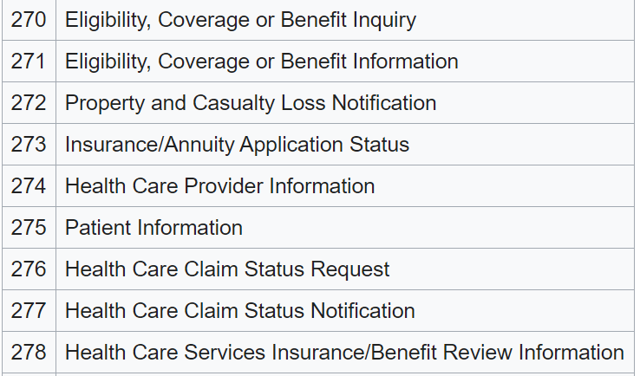
Other HealthCare EDI Messages - 2

