Slide 1
Message Transport
AS2

Slide 2
More About AS2
“Applicability Statement 2”
Based on HTTP (optionally HTTPS) and S/MIME .
Optionally uses Private/Public Key Pairs to encrypt, decrypt, to sign.
Files are encoded as "attachments" in a standardized S/MIME message (an AS2 message). The contents of the files are not specified by AS2. Usually the file contents are in a standardized format that is separately agreed upon, such as XML or X12.
Messages may request a Message Disposition Notification (MDN) back if all went well, but do not have to request such a message.

Slide 3
More About AS2
Walmart was the first major retailer to require its suppliers to use the AS2 protocol instead of relying on dial-up modems for ordering goods. Amazon, Target, Lowe's, Bed, Bath & Beyond and thousands of others followed suit. Now, many other industries use the AS2 protocol, including healthcare, as AS2 meets legal HIPAA requirements.
In some cases, AS2 is seen as a way to bypass expensive value-added networks previously used for data interchange.

Slide 4
Making Your AS2 Server Public
Your AS2 server is basically a web server, and must be set up by your infrastructure team in the same way (DNS, firewall rules, DMZ, etc…)
Example URL: http://AS2.MyCompany.com
Question: Do you need a separate AS2 server for each environment: Development, QA, and Production?

Slide 5
Managing the Key Files
Knowing when your certificate expires and changing it before time.

Slide 6
MFT - Managed File Transfer
Larger companies often use enterprise software called MFT.
The next slide lists some popular commercial products and vendors,
and the features of “Managed File Transfer”.
If your company already uses a MFT software for SFTP, it might have an AS2 server already built-in!

Slide 7


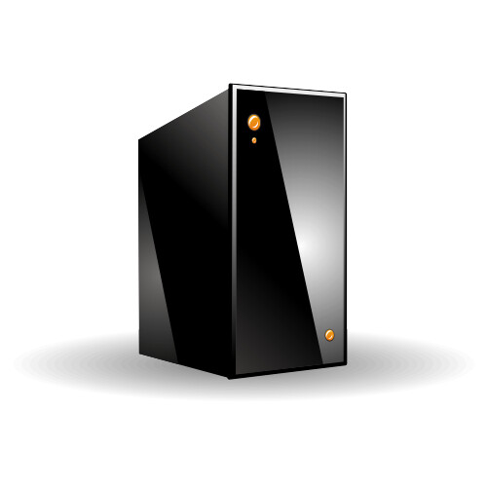

MFT - Managed
File Transfer
Vendors or Products
GoAnywhere MFT
IBM Sterling B2B Integrator
Axway - Amplify MFT
Cleo MFT
Ipswitch MOVEit
TIBCO Cloud Integration
Many others
Features:
Multiple communications methods
Reporting (database)
Non-repudiation
Audit trails
Global visibility
Security (e.g. LDAP integration)
Automation
Metrics/Monitoring

Slide 8
OpenAS2
OpenAS2 is a open source java-based implementation of the AS2 standard.
http://openas2.sourceforge.net/
https://github.com/OpenAS2
Might not have much documentation.

Slide 9
Many EDI Software Packages Include AS2
Not a complete list:
Microsoft BizTalk Server
Axway Amplify
TIBCO
Dell Boomi
Some of these tools only have “connectors” to AS2, so often hard to tell by looking at their websites.

Slide 10
Microsoft BizTalk Server
Microsoft BizTalk Server includes AS2 as well as adaptors for converting XML to and from EDI files. It contains a full library of XSD schemas for all the various EDI documents and different releases.

Slide 11
Amazon AWS Cloud Images
Vantage QU4TET AS2 Gateway 1.0
JSCAPE MFT Server
EFT Enterprise (Globalscape)
ArcESB EDI and/or MFT
PONTON X/P Messenger
PragmaEdge - Community Manager
GoAnywhere MFT for Windows

Slide 12
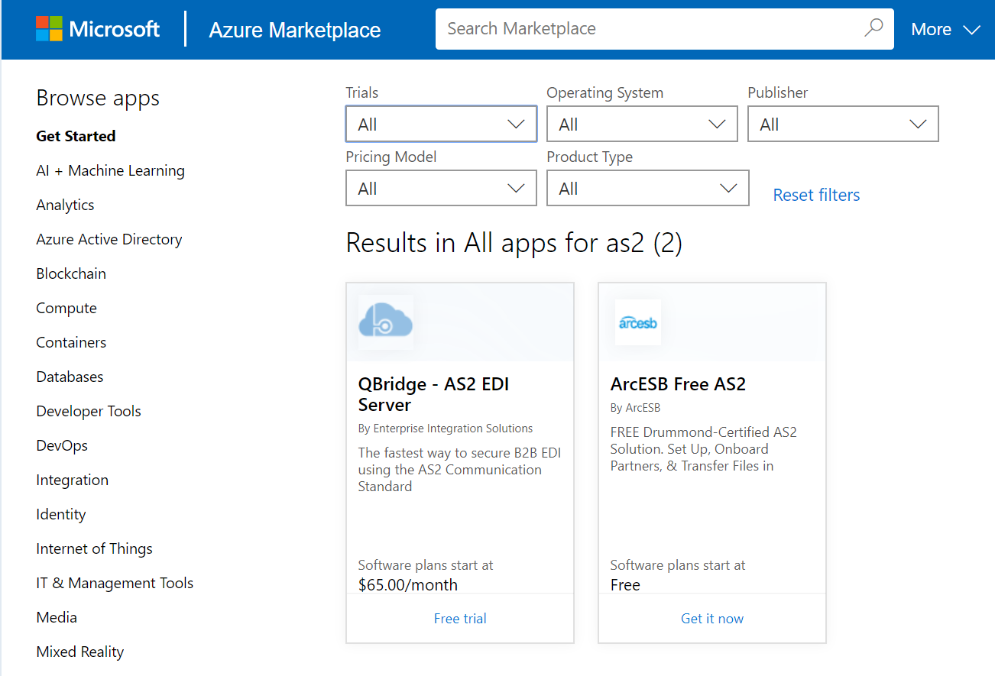
Microsoft Azure Cloud Images

