Slide 1
NodeJS EDI/X12 Alternatives

Slide 2
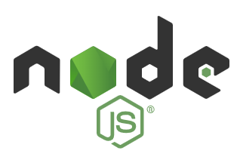
What is NodeJS
As an asynchronous event-driven JavaScript runtime, Node.js is designed to build scalable network applications.
While many use NodeJS as a web server, it has ability to read and write to disk, which regular JavaScript lacks.
It can also access database, send email, and there are thousands of plug-in libraries available.
It is based on Chrome’s JavaScript Engine. It is open source and cross-platform.

Slide 3
TigerShark
TigerShark is an X12 EDI message parser that can be tailored to a specific partner in the health care payment ecosystem.
It contains a test directory, tools and a demo web application that does a little bit of claim display and edit.
This does not (currently) have a proper Python ``setup.py`` script for installation, since this is such a random mixture of components.

Slide 4
BOTS - page 1
Open Source EDI Translator - but only Python 2.7
https://sourceforge.net/projects/bots/files/grammars/

Slide 5
BOTS - page 2
BOTS has grammars for many releases and messages types (both X12 and EDIFACT):
https://bots.readthedocs.io/en/latest/quick-start-guide/
I downloaded X12_004010_all_transactions_and_segments.zip
Since we have been using 4.01 release/version.
Filename: X12.4010\850004010.py 238 lines - mostly definition of a big structure.

Slide 6

Finding a Word Doc to Start with
Use the “filetype:” google keyword to limit search to word documents. Try .doc and maybe .docx.
Or find a PDF you like, and use a PDF to Word Converter something like https://www.pdftoword.com

