Slide 1
X12 Non-Numeric Data Types

Slide 2
AN - AlphaNumeric
A sequence of any printable characters (left justified)
Any leading spaces are considered to be part of the value.
Trailing spaces should NOT be included.
Length is determined by the “Min/Max” specification.

Slide 3
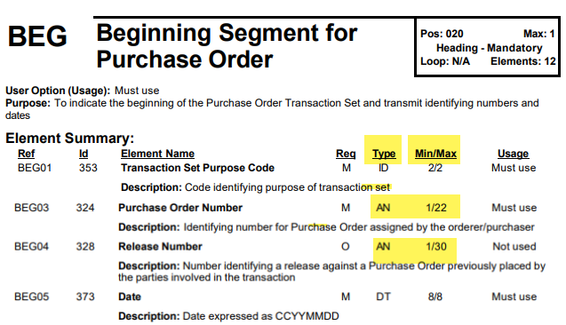
AN - AlphaNumeric - Example

Slide 4
Dates and Times
DT is YYMMDD or CCYYMMDD depending on the maximum length.
TM is HHMM, HHMMSS, or HHMMSSD, or HHMMSSDD (where D is decimal seconds)

Slide 5
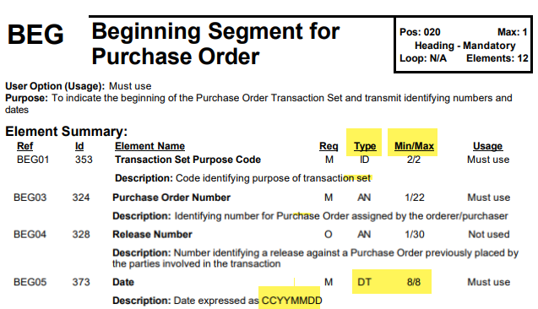
Dates - Example 1 - 8 character date

Slide 6
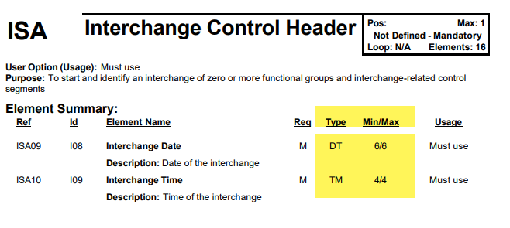
Dates - Example 2 - 6 character date (with Time)

Slide 7
ID / Codes
ID is a code value taken from a predefined list distributed by X12, UCS, VICS, or the trading partner.

Slide 8
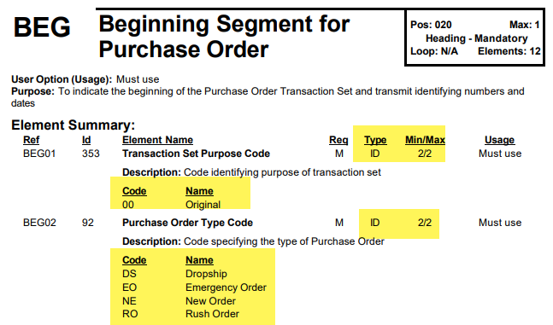
ID / Codes - Example 1

Slide 9
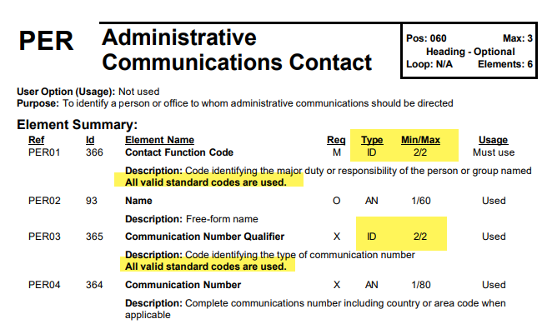
ID / Codes - Example 2

Slide 10
B = Binary
Binary - is very rare. Not intended to be read by human.
I’ve never actually seen it used.
Could be used to include XML (see next page), a CAD drawing, or maybe a .jpg image or Word Document in the EDI file.
Example - maybe a product image as part of the 846 Product Catalog?

Slide 11
B = Binary - Example
See https://stackoverflow.com/questions/807871/does-anyone-have-a-sample-file-in-x12-or-edifact-that-contains-binary-data
This is rare, but possible:
BIN*4896*<levelone xmlns="urn:hl7-org:v3/cda" xmlns:v3dt="urn:hl7-org:v3/v3dt" xmlns:xsi="http://www.w3.org/2001/XMLSchema-instance" xsi:schemaLocation="urn:hl7-org:v3/cda levelone_1.0.attachments.xsd"> <clinical_document_header> <id EX="a123" RT="2.16.840.1.113883.3.933"/> <document_type_cd V="99999-7" DN="Imidazole-Related Antifungals Attachment"/> <origination_dttm V="2006-01-05"/> <provider> <provider.type_cd V="PRF"/> <person>

