Slide 1
X12 Numeric Data Types

Slide 2
X12 Numeric Data Types
There are two types of numeric fields:
N or Nx
R or Rx
With the “R” type, the x digits past the decimal are required to be typed in the value.
With the “N” type, the x digits to the right of the decimal are implied (explained on upcoming slide). N0 would be an integer.

Slide 3
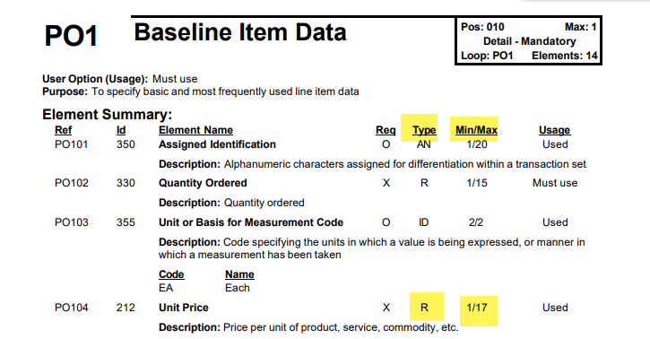
X12 Numeric Data Types
Data Type is one definition, and Min/Max Length is another. Example R 1/17

Slide 4
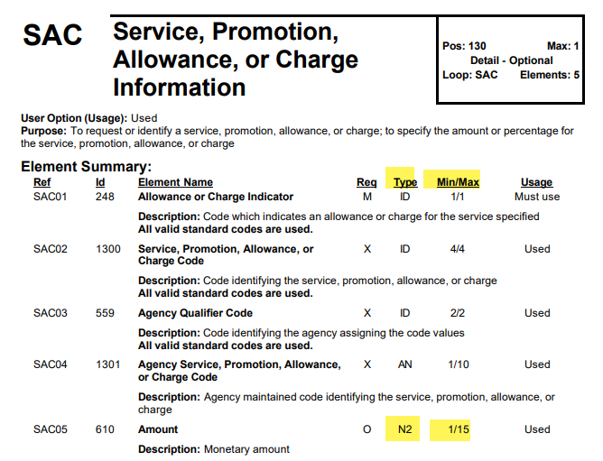
X12 Numeric Data Types
Data Type is one definition, and Min/Max Length is another. Example N2 1/15.

Slide 5
X12 Numeric Data Types - Implied Decimal
Leading zeroes are suppressed unless needed to satisfy the minimum length. Negative starts with a minus sign and the minus sign does not count towards the length.
N# - means there is # implied digits to the right of the decimal, for example:
N2 - means there are two implied digits to the right of the decimal. Example: 12345 would be interpreted as 123.45 And -789 would be interpreted as -7.89 N and N0 are equivalent - no implied decimal

Slide 6
X12 Numeric Data Types - Implied Decimal (p3)
Now going the other way, if you are building a file, and a field is N2.
Let’s say you need to send the value $125.00, you would put 12500 in the field.
If you need to send $.01, then you could put 1 in the field.

Slide 7
X12 Numeric Data Types - Implied Decimal (p2)
Is is possible to have fewer digits in the field than the N#.
N6 means 6 implied digits to the right of the decimal.
If a field is N6 and it contains 123, it would be interpreted as .000123
This is rare, but possible:

Slide 8
X12 Numeric Data Types - Decimal Numeric
R2 would be the maximum number of digits to the right of the decimal is 2.
125.00 legal
125.123 illegal value
125 legal and best way to specify when no decimal values
NEVER include commas or + sign in the number. - sign is used for negative. Signs and decimal points do not count toward the length.

Slide 9
X12 Numeric Data Types - Decimal Numeric (p2)
If the type is R1, and the field contains 150.23. It is either invalid, or should be considered 150.2

