Slide 1
Reading EDI Overview

Slide 2
Reading EDI Overview
We will go into more detail in future lessons. In this lesson, we will just look at a partial fragment of EDI file.
It will already have line breaks in it to make it more readable.
We will ignore the headers and footers for now.

Slide 3
Partial Sample from an EDI 850
ST*850*0001~ BEG*00*NE*1234567890**20080827~ REF*VR*2046159~ PER*BD*JANE WATSON*TE*800-555-1234*FX*800-555-5678~ N1*ST*MARVEL STUDIOS*92*SPID~
https://www.erico.com/public/library/edi/ERICO850_4010.pdf
Segment identifiers above are ST, BEG, REF, PER, N1

Slide 4
Segment Identifiers in Yellow
ST*850*0001~ BEG*00*NE*1234567890**20080827~ REF*VR*2046159~ PER*BD*JANE WATSON*TE*800-555-1234*FX*800-555-5678~ N1*ST*MARVEL STUDIOS*92*SPID~
Each line starts with a segment identifier.

Slide 5
Let’s Zoom-in on the BEG Segment - 1
BEG*00*NE*1234567890**20080827~ Delimiters can be different, but it is very common to use * for element (field) delimiter and ~ for the segment delimiter.

Slide 6
Segment Identifiers in Yellow
BEG*00*NE*1234567890**20080827~ The segment identifier is in yellow. The elements are identifier in green. The above contains 5 elements (but the 4th one is empty, between the **).

Slide 7
How Elements are “Named”?
BEG*00*NE*1234567890**20080827~ Each element can be “addressed” by it’s segment and element number: BEG01=00 BEG02=NE BEG03=1234567890 BEG04=[empty/null] BEG05=20080827 [date yyyy-mm-dd]

Slide 8
How Do We Know What an Element Is?
BEG*00*NE*1234567890**20080827~ BEG02=NE BEG03=1234567890
We need to look at the implementation guide

Slide 9
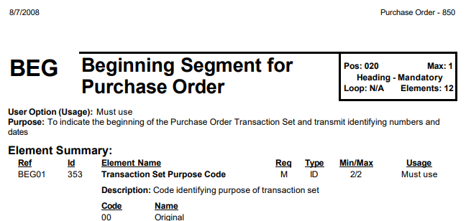
How Do We Know What an Element Is? (1 of 2)
BEG*00*NE*1234567890**20080827~

Slide 10
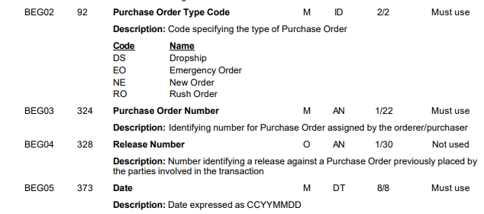
How Do We Know What an Element Is? (2 of 2)
BEG*00*NE*1234567890**20080827~

Slide 11
Notice that BEG04 os “O” = “Optional”
BEG*00*NE*1234567890**20080827~

Slide 12
How Do We Know What an Element Is?
BEG*00*NE*1234567890**20080827~ The general layout of the 850 is the same regardless of which company you are working with. However, each company makes modifications to fit their business needs. For example, with this company, the only valid value for BEG01 was “00” for “Original”.

Slide 13
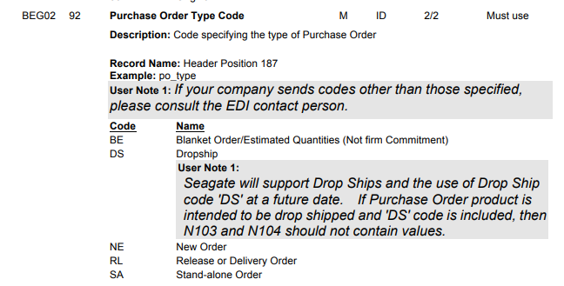
Example: Seagate 850 has the following values
BEG*00*NE*1234567890**20080827~

Slide 14
BEGin Segment - What rarely changes
You can almost always be assured:
Every PO will have a “BEG” segment.
BEG03 will be the P.O. Number
BEG05 will be the P.O. Date

Slide 15
Can you now recognize the BEG segment below?
ST*850*0001~ BEG*00*NE*1234567890**20080827~ REF*VR*2046159~ PER*BD*JANE WATSON*TE*800-555-1234*FX*800-555-5678~ N1*ST*MARVEL STUDIOS*92*SPID~
Let’s do the same for the PER segment.

Slide 16
Understanding the “PER” (Person) Segment
PER*BD*JANE WATSON*TE*800-555-1234*FX*800-555-5678~

Slide 17
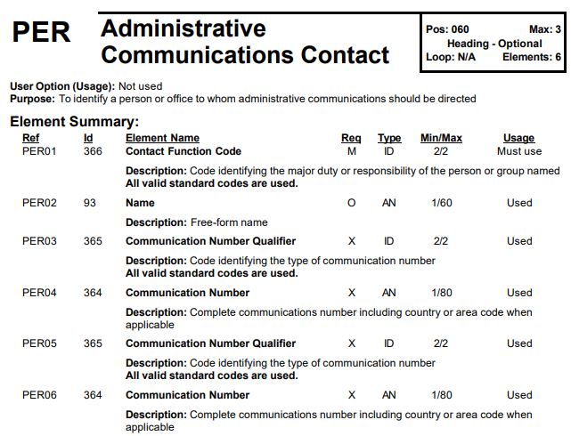
PER...
PER* BD* JANE WATSON* TE* 800-555-1234* FX* 800-555-5678~

Slide 18
The “Master” Source
Try: https://webstore.ansi.org/ or https://www.nex12.org/ (licensing, see next page) or https://www.infoconn.com/EDI/Partners/Direct_Buy.htm
If it exists, I have heard it cost several thousand dollars to get a copy, and nowhere that I’ve worked has bought it.
Thus, we often rely on “Googling” to find ideas, for example, looking at the 850 of 10 different companies to try to get a consensus of what is most commonly used.

Slide 19
The “Master” Source
https://www.nex12.org/
Annual licensing fees
User - $180
Developer - $1,200
Internal Use - $3,600
Commercial Use Partner - based on terms of Partner Agreement

Slide 20
Schemas Example
Supposedly ANSI maintains schema for all the EDI. I haven’t been able to find them.
With Microsoft BizTalk Server, the enterprise license includes the XSD schemas files, which may have come from ANSI, but were probably enhanced by Microsoft.
But the developer edition (beginning with BizTalk 2020 does not).

