Slide 1
XSLT Mapping with EDI
XML and Extensible Stylesheet Language (XSLT)

Slide 2
Why use XML/XSLT with EDI?
An EDI file can be converted easily to XML, as shown in each programming languages in the previous sections.
Once in XML, XSLT is the language of choice for mapping one XML to another.
Enterprise Application Integration software, B2B Software and Middleware often use XML to exchange data between systems and trading partners.
Many commercial software systems support import/export of XML.

Slide 3
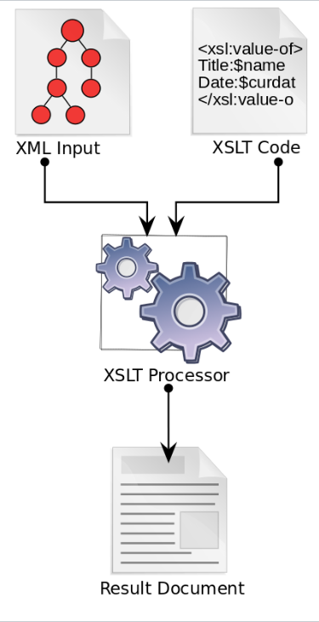
XSLT - page 1
XSLT processors take two files as input. 1) an XML document (for example, your EDI converted to XML)
2) XSLT code
and it creates a new text file (which can be XML, HTML, a CSV or any other text)

Slide 4
XSLT - page 2
XSLT is written in XML.

Slide 5
XSLT - page 3
.NET 4.7 currently includes only XSLT 1.0.
XSLT 1.0 became a recommendation in 1999, but since then, 2.0 came out in 2007 and 3.0 in 2017.
Despite its age, XSLT 1.0 is still popular.
To use XSLT 3.0, download Saxonica (it has a command line version and libraries for .NET and Java).

Slide 6
XSLT - Key Points
XSLT matches XML based on XPath.
<ISAControlNumber> <xsl:value-of select="substring(ISA/ISA13,1,8)"/> </ISAControlNumber> Xslt statements start with “<xsl:” The select statement contains XPath. Anything outside of the “<xsl:” statements gets written to the output file. XPath includes many built-in functions, such as position(), max(), substring(), etc…

Slide 7
XSLT - Key Points
<LineItems> <xsl:for-each select="PO1Loop"> <LineNumber> <xsl:value-of select="PO1/PO101"/> </LineNumber> </LineItems>
The xsl:for-each statements iterates over repeating XML elements. Inside the for-each loop, the XPath statements are relative to the node retrieved by the for-each statement.

Slide 8
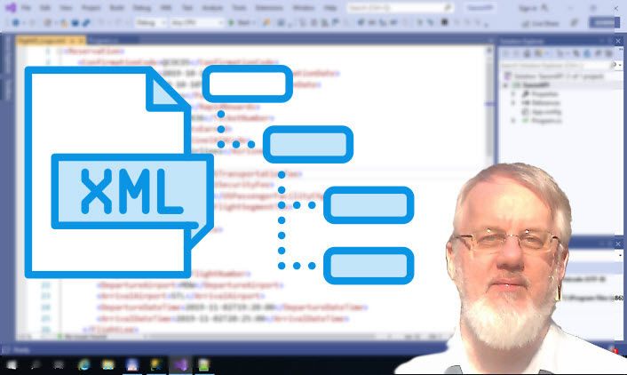
My XML/XSLT course
The Complete Guide to XML for Microsoft Developers
Basics of XML
XSLT language
XPath
XQuery
XML Schemas (XSD)
SQL Server and XML

