Slide 1
SECURE DATA HIDING IN IMAGE USING STEGANOGRAPHY
Presented By : Praphul Shukla
Student Name : Praphul Shukla
College Name & Department : Shri Guru Ram Rai University, Dehradun, Master of Computer Applications

Slide 2
OUTLINE :
Problem Statement
Technology used
Wow factor
End users
Result
Conclusion
Source Code
Git-hub Link
Future scope

Slide 3
Problem Statement
In today’s digital world, securely transmitting sensitive information without drawing attention is a major challenge. Encryption protects data but reveals its existence, which makes it target of attackers. Image steganography can solves this by hiding information within images, ensuring secrecy while maintaining the appearance of normal images. In This report we explores how image steganography can address these challenges and its potential for secure communication.

Slide 4
Technology used
Language used : Python
Libraries used : Open CV2, OS, String
System used: VS code
Platform used : Windows Operating System

Slide 5
Wow factors
Data Security & Hidden Communication
Lossless Encoding with PNG Format
Simple Yet Powerful Implementation
Password-Protected Decryption

Slide 6
End users
Cybersecurity Enthusiasts & Ethical Hackers for data transmission.
Journalists to communicate securely and maintaining privacy.
Government & Military Organizations to embed classified informations.
Digital Forensics & Law Enforcement for evidence security.
Multi National Companies for secure data transmissions.
General Users Concerned about their Privacy.

Slide 7
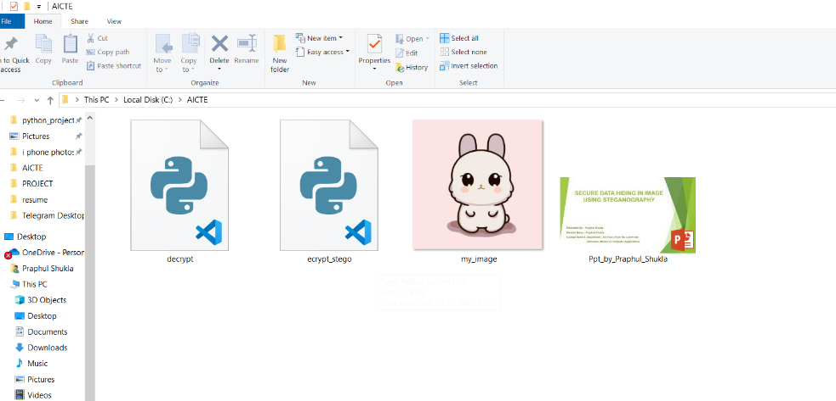
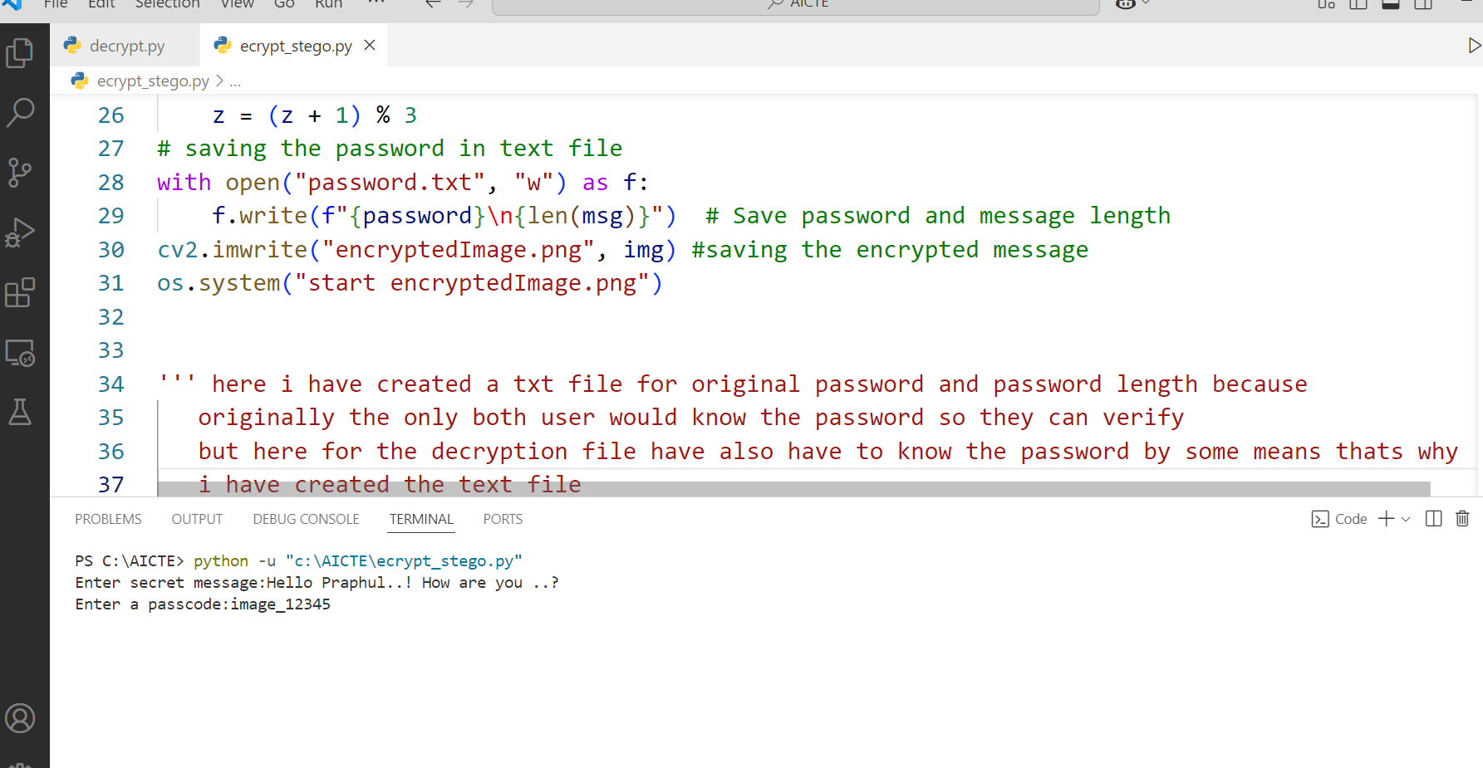
Results We got surprisingly good results in many steps :
When the Encryption file was not
executed in the folder there was
only encryption, decryption,
image, and presentation files.
When Encryption file executed :
It asked for secrete message
and then password.

Slide 8
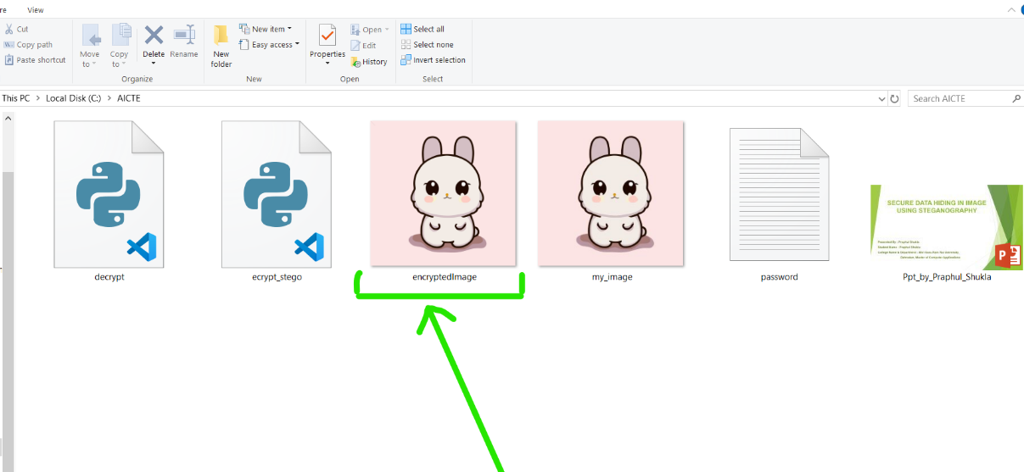
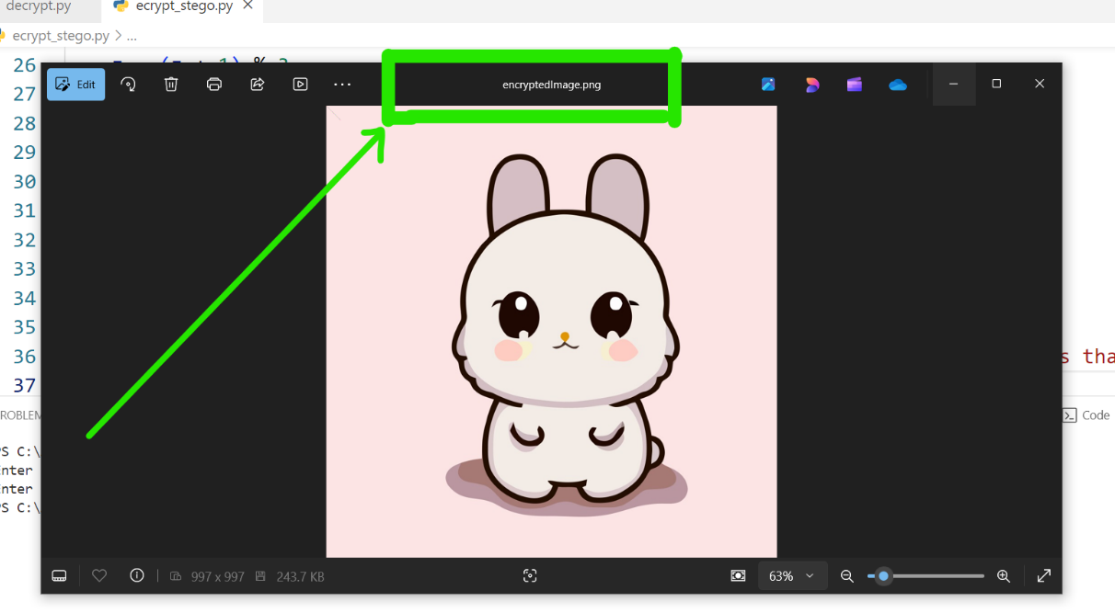
After entering the password an
encrypted imaged and the
password text files were
Generated and saved.
And Encrypted image opened :
Encrypted image opened with
name as “encyptedImage.png”
the image format was saved as
png because it’s lossless and
pixel values stay exactly same.

Slide 9
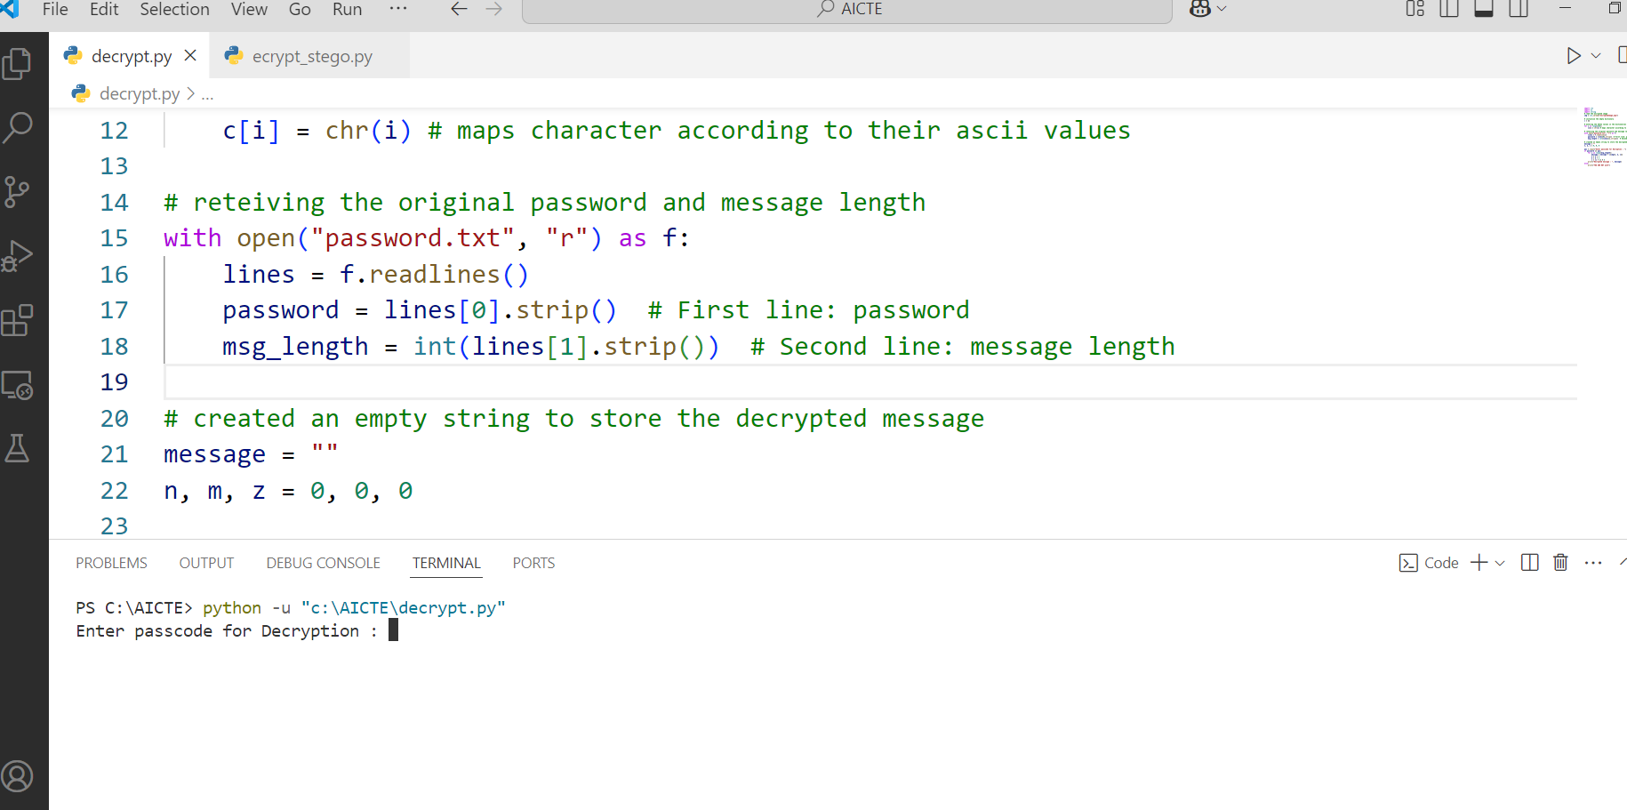
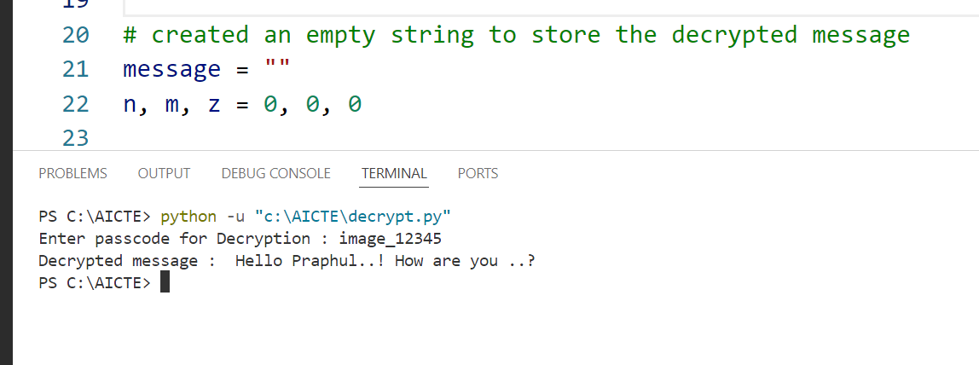
After executing decryption file :
it asked for the password for
decryption.
After providing password
it returned the secret
text as it was sent during
encryption.

Slide 10
Conclusion
This project successfully implements the concept of Image Steganography which means hiding or securing data in image using Python. In this Project we have used the concept of Least Significant Bit (LSB) modification to encode text information in pixel value of image while also maintaining the visual integrity of image. The password protection also maintain confidentiality of secrete message and conversion of jpg file to png maintain lossless encryption maintaining unwanted pixels value loss.

Slide 11
Source Code
Encryption Code :
import cv2
import os
import string
# provide image path
img = cv2.imread("my_image.jpg")
# inputh the secret message
msg = input("Enter secret message:")
# input the password
password = input("Enter a passcode:")
# intialize the empty dictionaries
d = {}
# entering the ASCII values in the distionaries as key value pair
for i in range(255):
d[chr(i)] = i # maps ascii values according to characters
# initialing variable m,n for pixel postions and color(z)
m,n,z = 0,0,0
# now loops through the secret message
for i in range(len(msg)):
img[n, m, z] = d[msg[i]]
n = n + 1
m = m + 1
z = (z + 1) % 3
# saving the password in text file
with open("password.txt", "w") as f:
f.write(f"{password}\n{len(msg)}") # Save password and message length
cv2.imwrite("encryptedImage.png", img) #saving the encrypted message
os.system("start encryptedImage.png")

Slide 12
Decryption Code :
import cv2
import os
import string
# read the encrypted image
img = cv2.imread("encryptedImage.png")
# initialize the empty dictionary
c = {}
# entering the ASCII values in the distionaries as key value pair
for i in range(255):
c[i] = chr(i) # maps character according to their ascii values
# reteiving the original password and message length
with open("password.txt", "r") as f:
lines = f.readlines()
password = lines[0].strip() # First line: password
msg_length = int(lines[1].strip()) # Second line: message length
# created an empty string to store the decrypted message
message = ""
n, m, z = 0, 0, 0
pas = input("Enter passcode for Decryption : ")
if password == pas:
for i in range(msg_length):
message = message + c[img[n, m, z]]
n = n + 1
m = m + 1
z = (z + 1) % 3
print("Decrypted message : ", message)
else:
print("YOU ARE NOT authorized person")

Slide 13
GitHub Link
https://github.com/GitPraphul47/Steganography.git

Slide 14
Future scope
There are many things we can practice in this project in future :
Decryption Message Length : In this right now we needed to deploy secrete message length to decryption file but can be a threat to privacy so we can create program where sender need not to send message length.
Dynamic File Selection : User could select any file dynamically to encrypt it.
User Friendly GUI : We can make a user friendly graphical interface for the general user to use it as well.

Slide 15
THANK YOU

