Slide 1
Max Power Point Tracker
Embedded Systems Design
CU-Boulder
Fall 2019
Prof: Dr. Linden McClure
J. Hittle – Firmware Controls
R. Kumar – Firmware Interfaces
N. Gupta – Hardware Interfaces

Slide 2
Project Overview
The Tesla Model 3 can store between 50 to 75kWhr of energy in its batteries. The high voltage 350Vdc battery system stores enough energy to propel the car between 220 and 325 miles on a single charge¹, depleting the battery energy in approximately 3-4.5 hours during a high-speed cross-country trip.
Recent advancements in photovoltaic (PV) technology have also made it possible to extend the range of the Tesla Model 3 by approximately 10% if the glass roof is replaced with a PV roof, allowing for approximately 40 sq. ft. of solar array area². Although PV advancements still have significant growth hurdles to overcome to make this technology practical for automobiles and the consumer market, these hurdles are expected to be overcome in the next several years as demand for electric vehicles and longer ranges continue to increase. In addition, PV charge control systems are not a new concept and have been used for quite some time in aerospace, grid power, and portable devices and therefore the techniques learned in this project will be highly applicable in many other applications that the students may find themselves working in the future.
This project will focus on the design of a MPPT in four phases of charge control development. 1) boost 2) maximum power point tracking (MPPT) 3) buck 4) and buck-boost
To maintain student safety and a reasonable price-point, these projects will introduce concepts at approximately 1:10 reduced voltage scale. Because these voltages are still well above the voltage allowable by a modern microcontroller, the students will also be introduced to high-voltage interfacing of their microcontroller. The students will also be introduced to control theory, power systems, and simulations.
¹ - https://en.wikipedia.org/wiki/Tesla_Model_3
² - https://www.spectrolab.com/photovoltaics/XTJ-CIC_Data_Sheet.pdf

Slide 3
Primary Requirements
Charge Battery via a Solar Array
Control loops – All regulated within firmware
  Output charge current. (2kHz)
  Maximum output voltage. (200Hz)
  Input peak power control. (20Hz)
Safety modes
  Battery disconnected
  Battery full
  Solar disconnected
  Soft start
LCD battery Ahr monitor with reset
  Software based Ahr monitor to measure state of charge
  Use Ahr to start building neural network to describe batter life and SOC
Luminocity / converter shutdown
Battery and Solar Array Temp
^{All specifications are TBR}

Slide 4
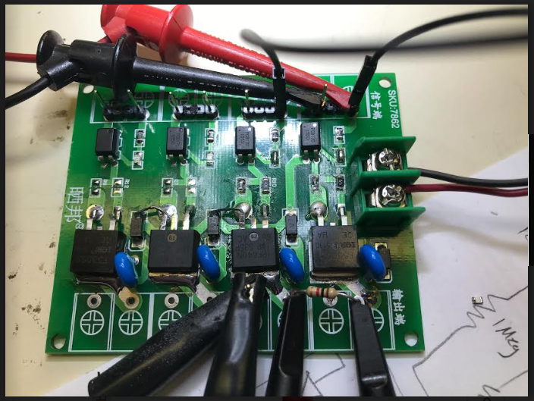
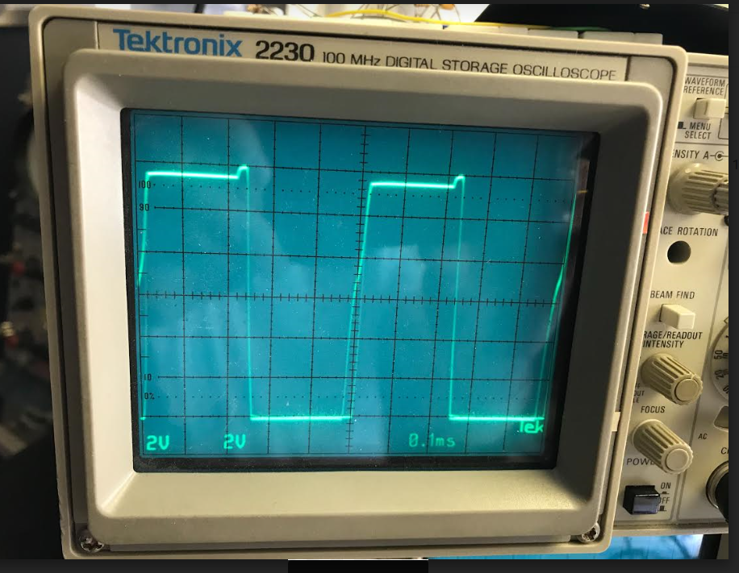
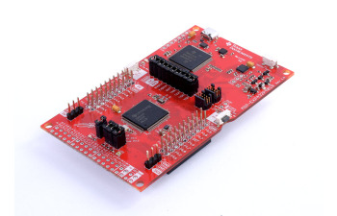
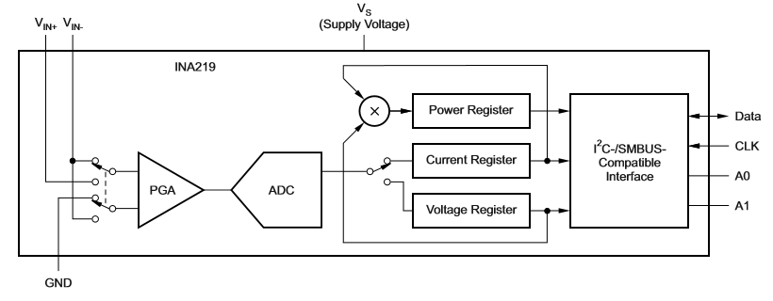
Topology
Buck-Boost Converter
V – Voltage
I – Current
T – Temp
L - Luminosity
uC
INA219/T/L Sense
V/I/T Sense
LCD Display
8x2
Image credits:
INA219
MSP-EXP432P401R

Slide 5
Milestones
Buck-Boost
Boost
MPPT
Buck
Source Input Voltage
Source Input Current
Source Ouput Voltage
Output Current
INA 219
Solar Array
MPPT Algorithm
Load Battery Implementation
Temperature Detection
Lumens Detection
Primary
Secondary
Major Milestones
Intermediate Milestones

Slide 6
Schedule
Items in bold are critical deadlines
Oct 21 - PDR
  Hardware prototype interfaces selected and ordered.
  Basic architecture complete.
  Git Repository established for the team.
Nov 4 – Initial Hardware Prototypes
  HW: Power stage and output voltage and current monitoring assembled.
  FW - Interfaces: Drivers for output voltage and current monitoring complete.
  FW – Controls: Conceptualize (Simulate?) initial control loops and soft-start.
Nov 11 – Boost Control Complete
  HW: Prototype builds with all peripherals complete.
  FW – I: Drivers for input current and voltage, temp, and luminosity complete
  FW – C: Boost Control Completed with soft-start (Output Side)
Nov 18 – MPPT Control Complete, Final Hardware Design Completed
  HW: Final PCB and parts ordered.
  FW – I: Refine interfaces as required. Finalize LCD display.
  FW – C: MPPT control completed (Input Side)
Nov 25-29 – No work – Fall break
Dec 2 – HW complete, Final Hardware Assembled
  HW: Finish building Final Assemblies
  FW – I: Ahr monitor
  FW – C: Incorporate buck/buck-boost if time permits.
Dec 9 – Demo Day
  All: Divide Final Project
Dec 14 – Final Project Report Submitted

