Slide 1


BE Project Presentation on “COVID-19 Disease Dynamics”
Developed By -
Abhishek Shelke

Slide 2
OUTLINE
Introduction
Problem Statement
Motivation
Literature Survey
System Architecture
System Diagrams
Algorithm
Screenshots
Mathematical Model
Requirements
Technical Risks
Advantages and Limitations
Conclusion
References

Slide 3
INTRODUCTION
In December 2019, the novel and contagious virus belonging to the coronavirus COVID-19 outbreak started from the town of Wuhan, China. Also called the “severe acute respiratory syndrome coronavirus 2 (SARS-CoV-2)” being genetically close to the coronavirus that caused the SARS outbreak in 2003. The pandemic has become a major threat to the world.
There is a need for innovative solutions to develop, manage and analyze big data on the growing network of infected subjects, patient details, their community movements, and integrate with clinical trials and, pharmaceutical, genomic and public health data.
Over the last few decades, machine learning (ML) has gained a great deal of attention from researchers due to its capacity for solving complex real-world problems.
Several ML algorithms have been used to predict future events in various applications.
So we are going propose a machine-learning model that predicts the peak for Covid-19 infection spread in country so government can propose specific restrictions over population till the pandemic ends.

Slide 4
PROBLEM STATEMENT
Visualize & Predict Covid-19 Outbreak throughout the given timeframe with the number of active cases on a rise in Worldwide, a predictive model can help predict the trend of cases going on and help find out when the rise will peak and number of cases will drop down. The social effects of COVID-19 are also seen.

Slide 5
MOTIVATION
COVID-19 was identified in 2019, and officially declared a pandemic by the WHO in March 2020. Since then, millions of people have been infected with COVID-19 and at least a million have died as the virus spread rapidly.
Even as vaccines have been developed, hundreds of thousands of people are affected in employment, education, and other environments daily, mostly through close contact with other persons who carry the virus.
These circumstances underline the need for the detection of COVID-19 presence as soon as possible in specific neighborhood, in order to protect those who do not yet have been infected.
To achieve this purpose, we aim to design a machine-learning-based forecasting model that can accurately predict COVID-19 spread.

Slide 6
LITERATURE SURVEY
Sr. No. | Title | Publications | Year | Description
[1] | COVID-19 Prediction Models | National Library Of Medicine | 2021 | To identify the methods techniques, models that support the prediction of covid-19 infections.
[2] | A Machine Learning Based Exploration Of COVID-19 Mortality Risk | PLOS ONE | 2021 | To develop a mortality prediction model from patient first day of admission routine clinical data using svm.
[3] | Machine Learning Models For Covid-19 Future Forecasting | National Library Of Medicine | 2020 | To develop a COVID-19 prediction system to contribute to the current human crisis.
[4] | Covid-19 Forecast Using Holt-Winters Exponential Smoothing | IOPScience: Journal of Physics | 2021 | The purpose of this study is to find the best forecasting model with appropriate smoothing parameters.
[5] | Daily Tracking and Forecasting of the Global COVID-19 Pandemic | THE LANCET by SSRN | 2020 | We used exponential smoothing methods to track on a daily basis as well as predict the trend of covid-19..
Table: Literature Survey

Slide 7
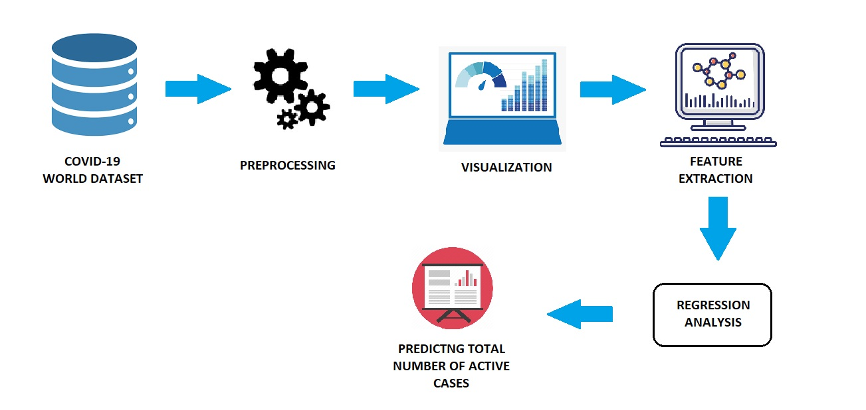
SYSTEM ARCHITECTURE
Figure: System Architecture

Slide 8
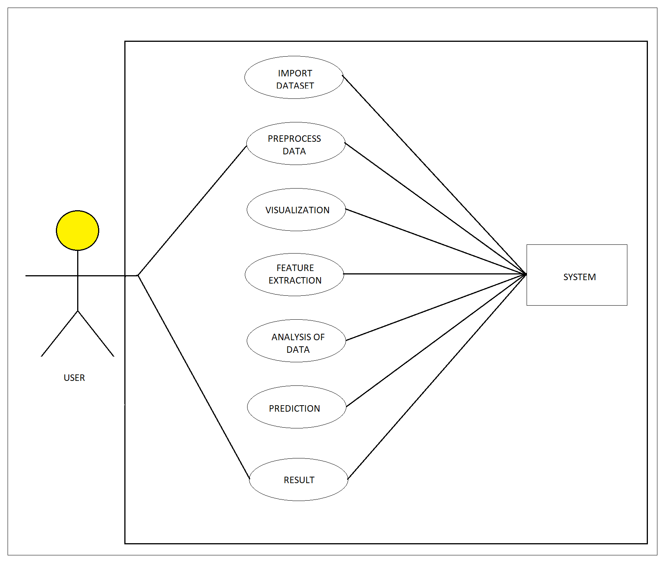
SYSTEM DIAGRAMS
USE-CASE DIAGEAM
Figure: Use-case diagram

Slide 9
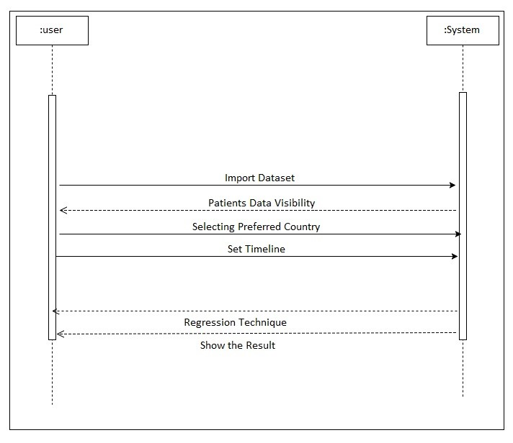
SEQUENCE DIAGEAM
Figure: Sequence Diagram

Slide 10
ALGORITHM
Linear Regression -
Linear regression is a statistical regression method which is used for predictive analysis.
It is one of the very simple and easy algorithms which works on regression and shows the relationship between the continuous variables.
It is used for solving the regression problem in machine learning.
Linear regression shows the linear relationship between the independent variable (X-axis) and the dependent variable (Y-axis), hence called linear regression.

Slide 11
Support Vector Machine(SVM) –
Support Vector Machine(SVM) is a supervised machine learning algorithm used for both classification and regression. Though we say regression problems as well its best suited for classification.
The objective of SVM algorithm is to find a hyperplane in an N-dimensional space that distinctly classifies the data points.

Slide 12


Polynomial Kernelling
Linear Kernelling

Slide 13
Holt’s Winter Model –
Holt’s Winter Model, also known as linear exponential smoothing, is a popular smoothing model for forecasting data with trend.
Holt's model has three separate equations that work together to generate a final forecast.

Slide 14
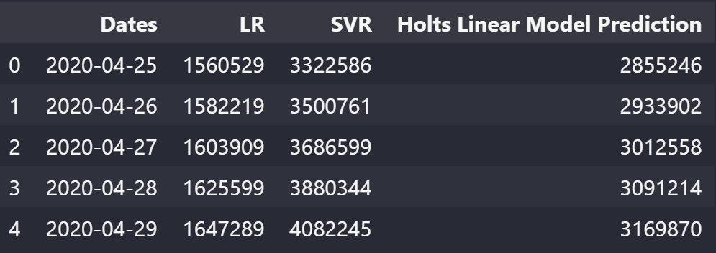
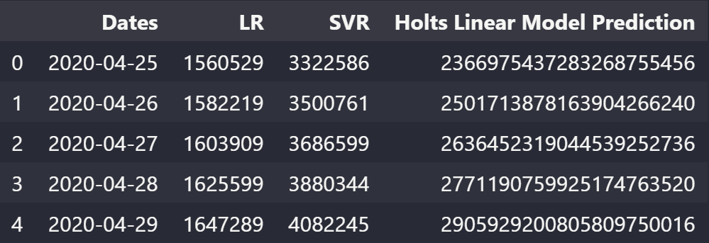
Smoothing Level : 1.4 (Correct)
Smoothing Level : 1.8 (Incorrect)

Slide 15
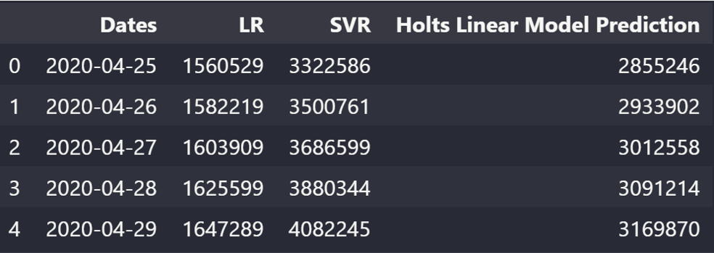
SCREENSHOTS
Prediction Output
Figure: Prediction Output

Slide 16
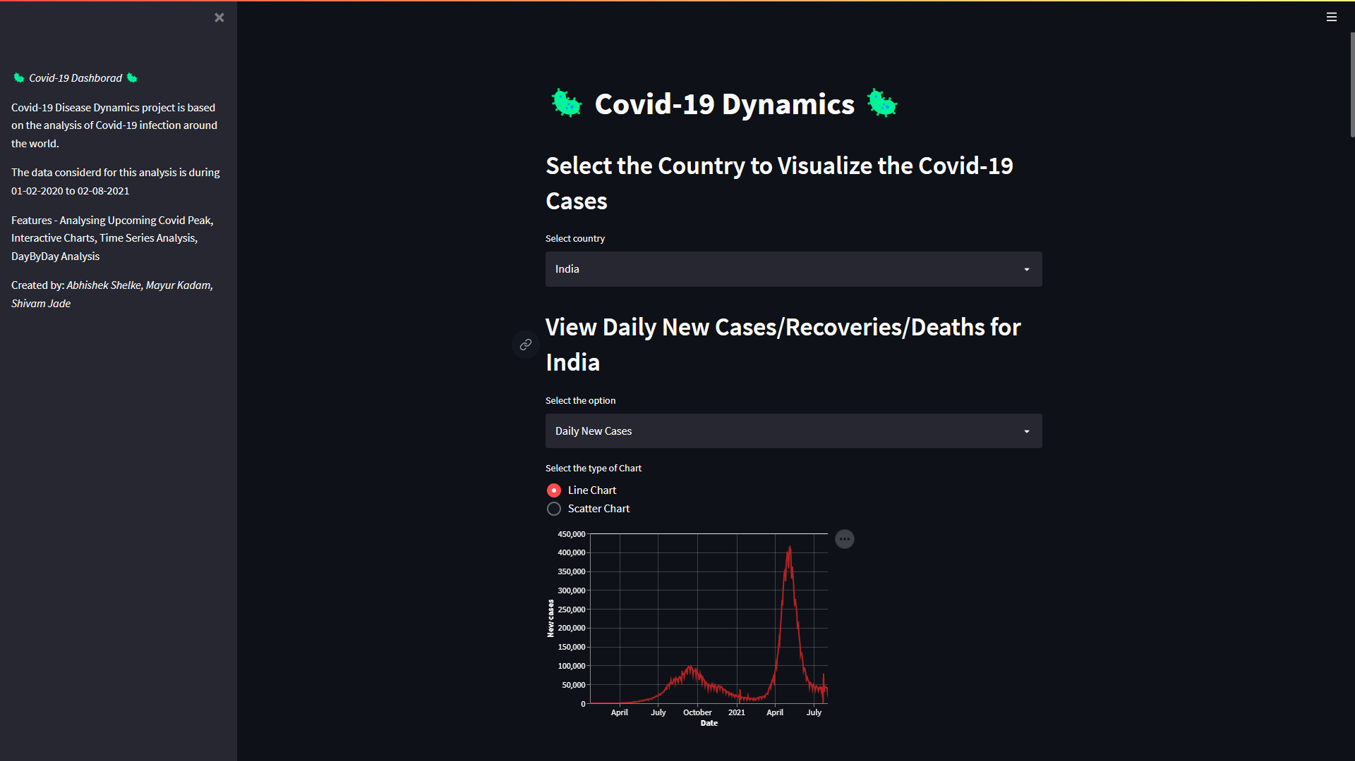
Graphical User Interface
Figure: GUI output

Slide 17
MATHEMATICAL MODEL
Active Cases:
Active Cases = Confirmed Cases – (Recovered Cases + Death Cases)
Closed Cases:
Closed Cases = Recovered Cases + Death Cases
Mortality rate: (Mortality rate is measure of number of death in a particular population)
Mortality rate = (Death Cases / Confirmed Cases) x 100

Slide 18
Recovery Rate:
Recovery Rate = (Recovered Cases / Confirmed Cases) x 100
Growth Factor: (Growth factor is the factor by which a quantity multiplies itself over time)
Formula = Current new (Confirmed, Recovered, Deaths)
(Confirmed, Recovered, Deaths) on the previous day.

Slide 19
REQUIREMENTS
Software requirements
Any Python IDE (e.g. PyCharm-IDE)
Python 3.7
Jupyter Notebook
Streamlit Library
Scikit Learn
Libraries like Pandas, NumPy, Altair, Plotly
Hardware requirements
Active internet connection.
Operating System - Windows 10

Slide 20
TECHNICAL RISKS
Unintentional network failure
Power loss
System crash
Data Corruption

Slide 21
ADVANTAGES
Impactful study on Covid-19 cases worldwide.
Predicting accurate results with some minor variations.
System can be used from anywhere if hosted on internet.

Slide 22
LIMITATIONS
The system is dataset dependent.
Will work only for Regression Analysis.
Frequent Data Cleaning required.
Gets unexpected results for some countries due to unavailability of accurate data.

Slide 23
CONCLUSION
The COVID-19 pandemic outbreak has devastated the whole world and lead to a state of worldwide health emergency. Several efforts have been performed to combat this pandemic. In this study, we aimed to explore the impact of vital signs, chronic disease, preliminary clinical data, and demographic features to predict the COVID-19 transmission trends among countries using supervised machine learning algorithms.

Slide 24
REFERENCES
[1] "COVID-19 Prediction Models" - Sheikh Muzaffar Shakeel, Nithya Sathya Kumar, Pranita Pandurang Madalli, Rashmi Srinivasaiah, and Devappa Renuka Swamy, - 2021 Aug: Vol. 12(4): 215–229
[2] "A Machine Learning Based Exploration Of COVID-19 Mortality Risk" – Mahdi Mahdavi , Hadi Choubdar , Erfan Zabeh , Michael Rieder, Safieddin Safavi- Naeini, Zsolt Jobbagy, 2021 July: PLoS ONE 16(7): e0252384
[3] "Machine Learning Models For Covid-19 Future Forecasting" - Ramesh Kumar Mojjada, Arvind Yadav, A.V. Prabhu and Yuvaraj Natarajan, 2020 Dec: Elsevier Public Health Emergency Collection -PMC7723767
[4] "Covid-19 Forecast Using Holt-Winters Exponential Smoothing" – Djakaria and S E Saleh, Djakaria and S E Saleh 2021 J. Phys.: Conf. Ser. 1882 012033
[5] "Daily Tracking and Forecasting of the Global COVID-19 Pandemic" – Zhanduo Zhang, Xiaona Wang , 2020 Apr: THELANCET-D-20-05175

Slide 25
THANK
YOU!

