Slide 1

Semaphore:
  An integer value used for signalling among processes.
Only three operations may be performed on a semaphore, all of which are atomic:
  initialize,
  Decrement (semWait)
  increment. (semSignal)

Slide 2

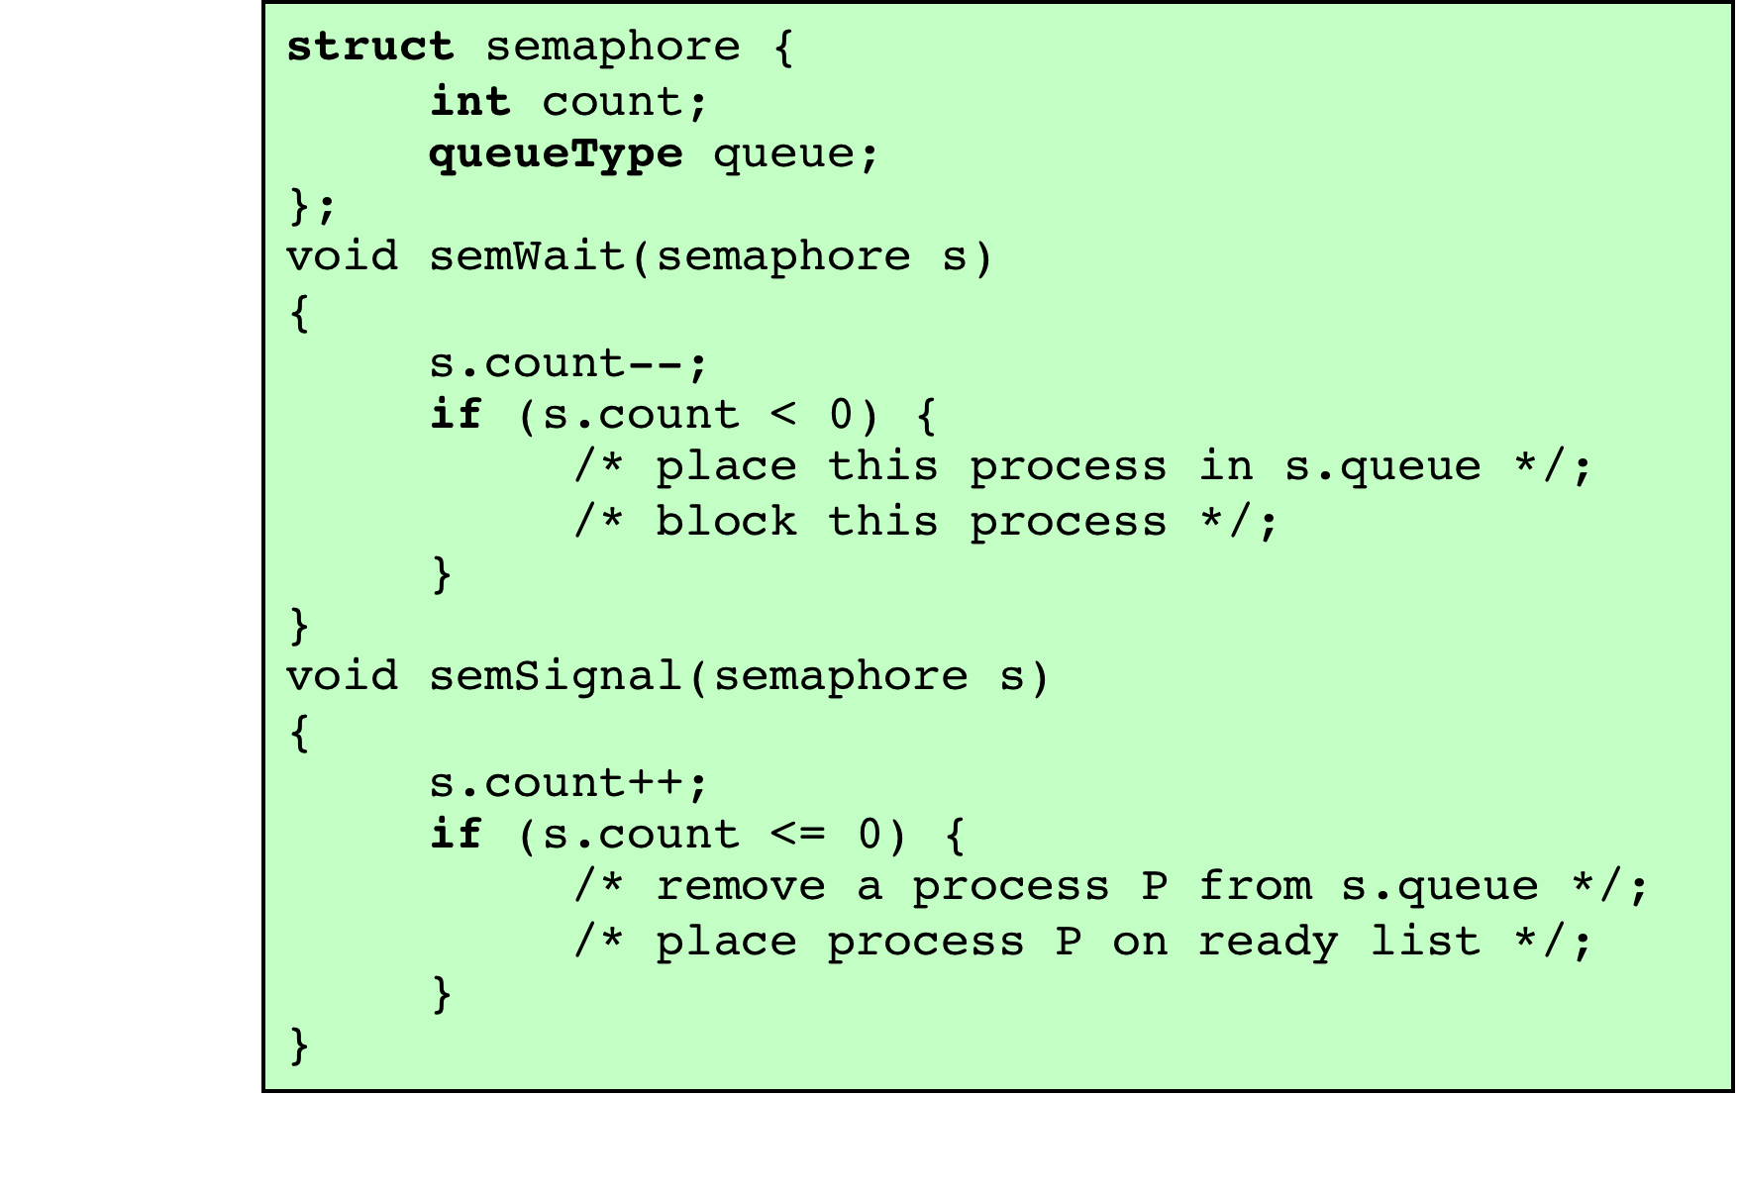

Slide 3

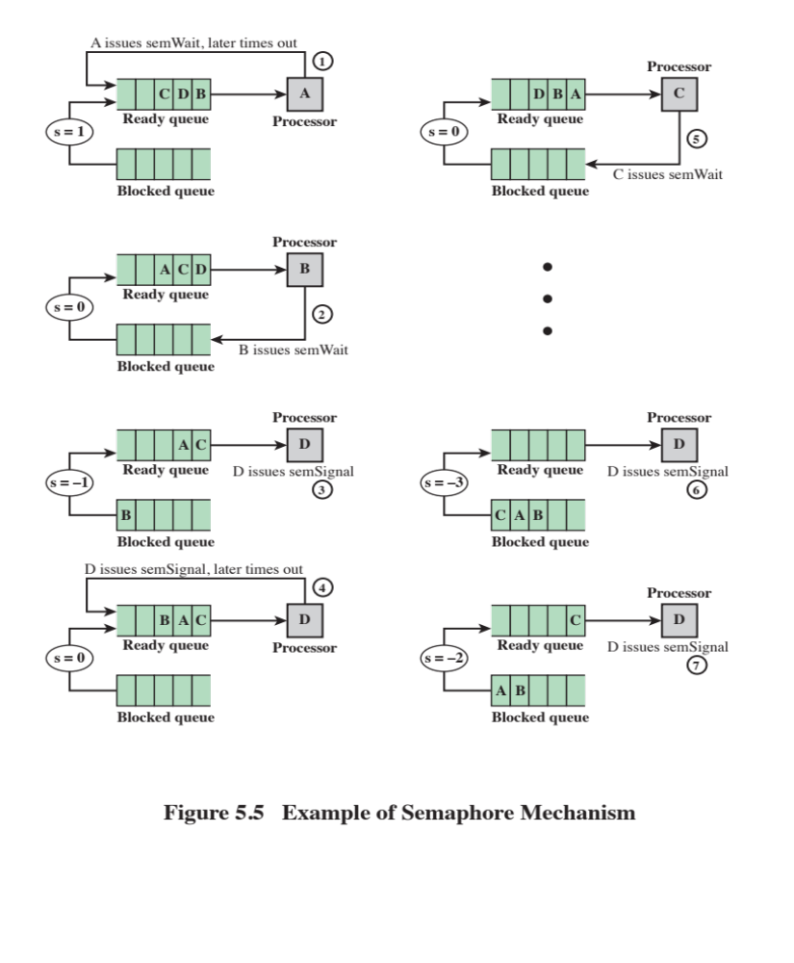

Slide 4

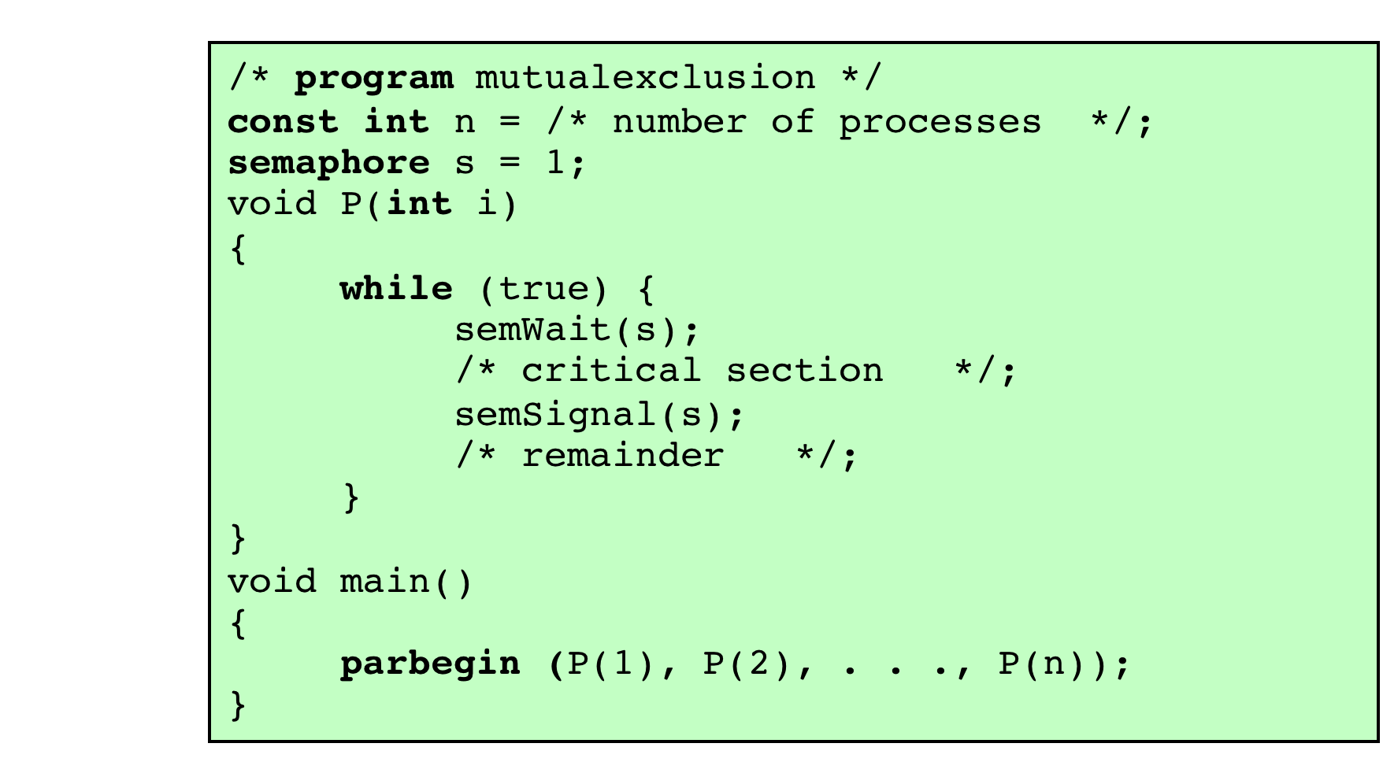

Slide 5

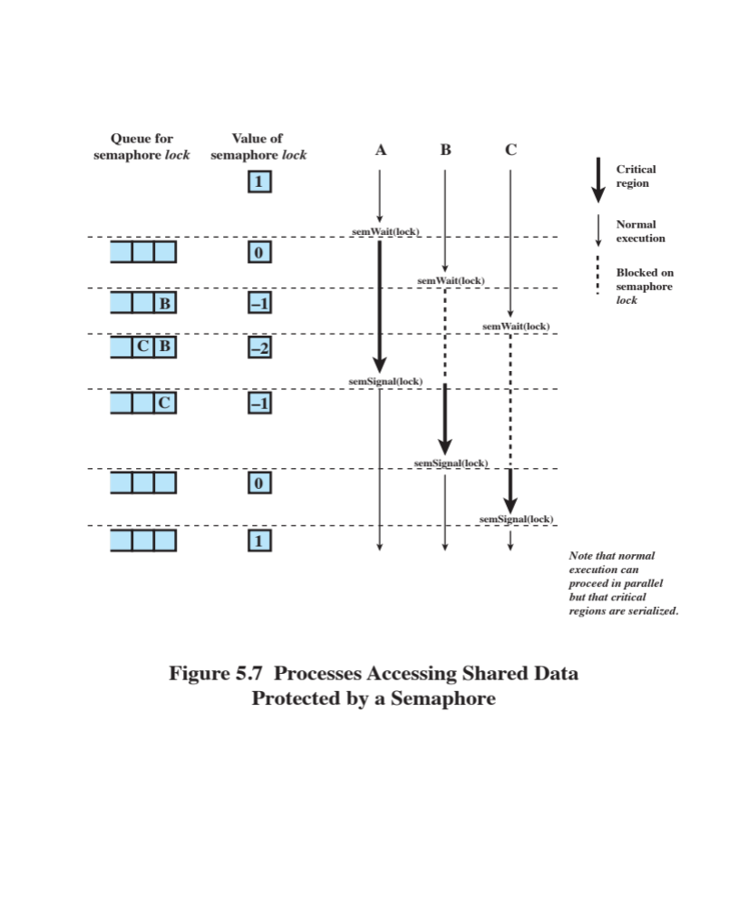

Slide 6

General Situation:
  One or more producers are generating data and placing these in a buffer
  A single consumer is taking items out of the buffer one at time
  Only one producer or consumer may access the buffer at any one time
The Problem:
  Ensure that the Producer can’t add data into full buffer and consumer can’t remove data from empty buffer

Slide 7

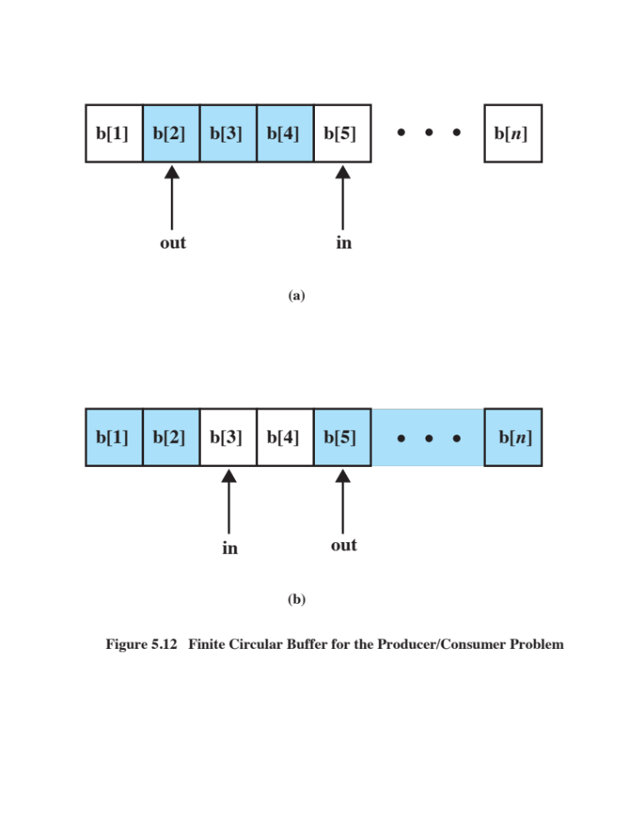

Slide 8

Producer | Consumer
while (true) { /* produce item v */ while ((in + 1) % n == out) /* do nothing */; b[in] = v; in = (in + 1) % n } | while (true) { while (in == out) /* do nothing */; w = b[out]; out = (out + 1) % n; /* consume item w */ }

Slide 9

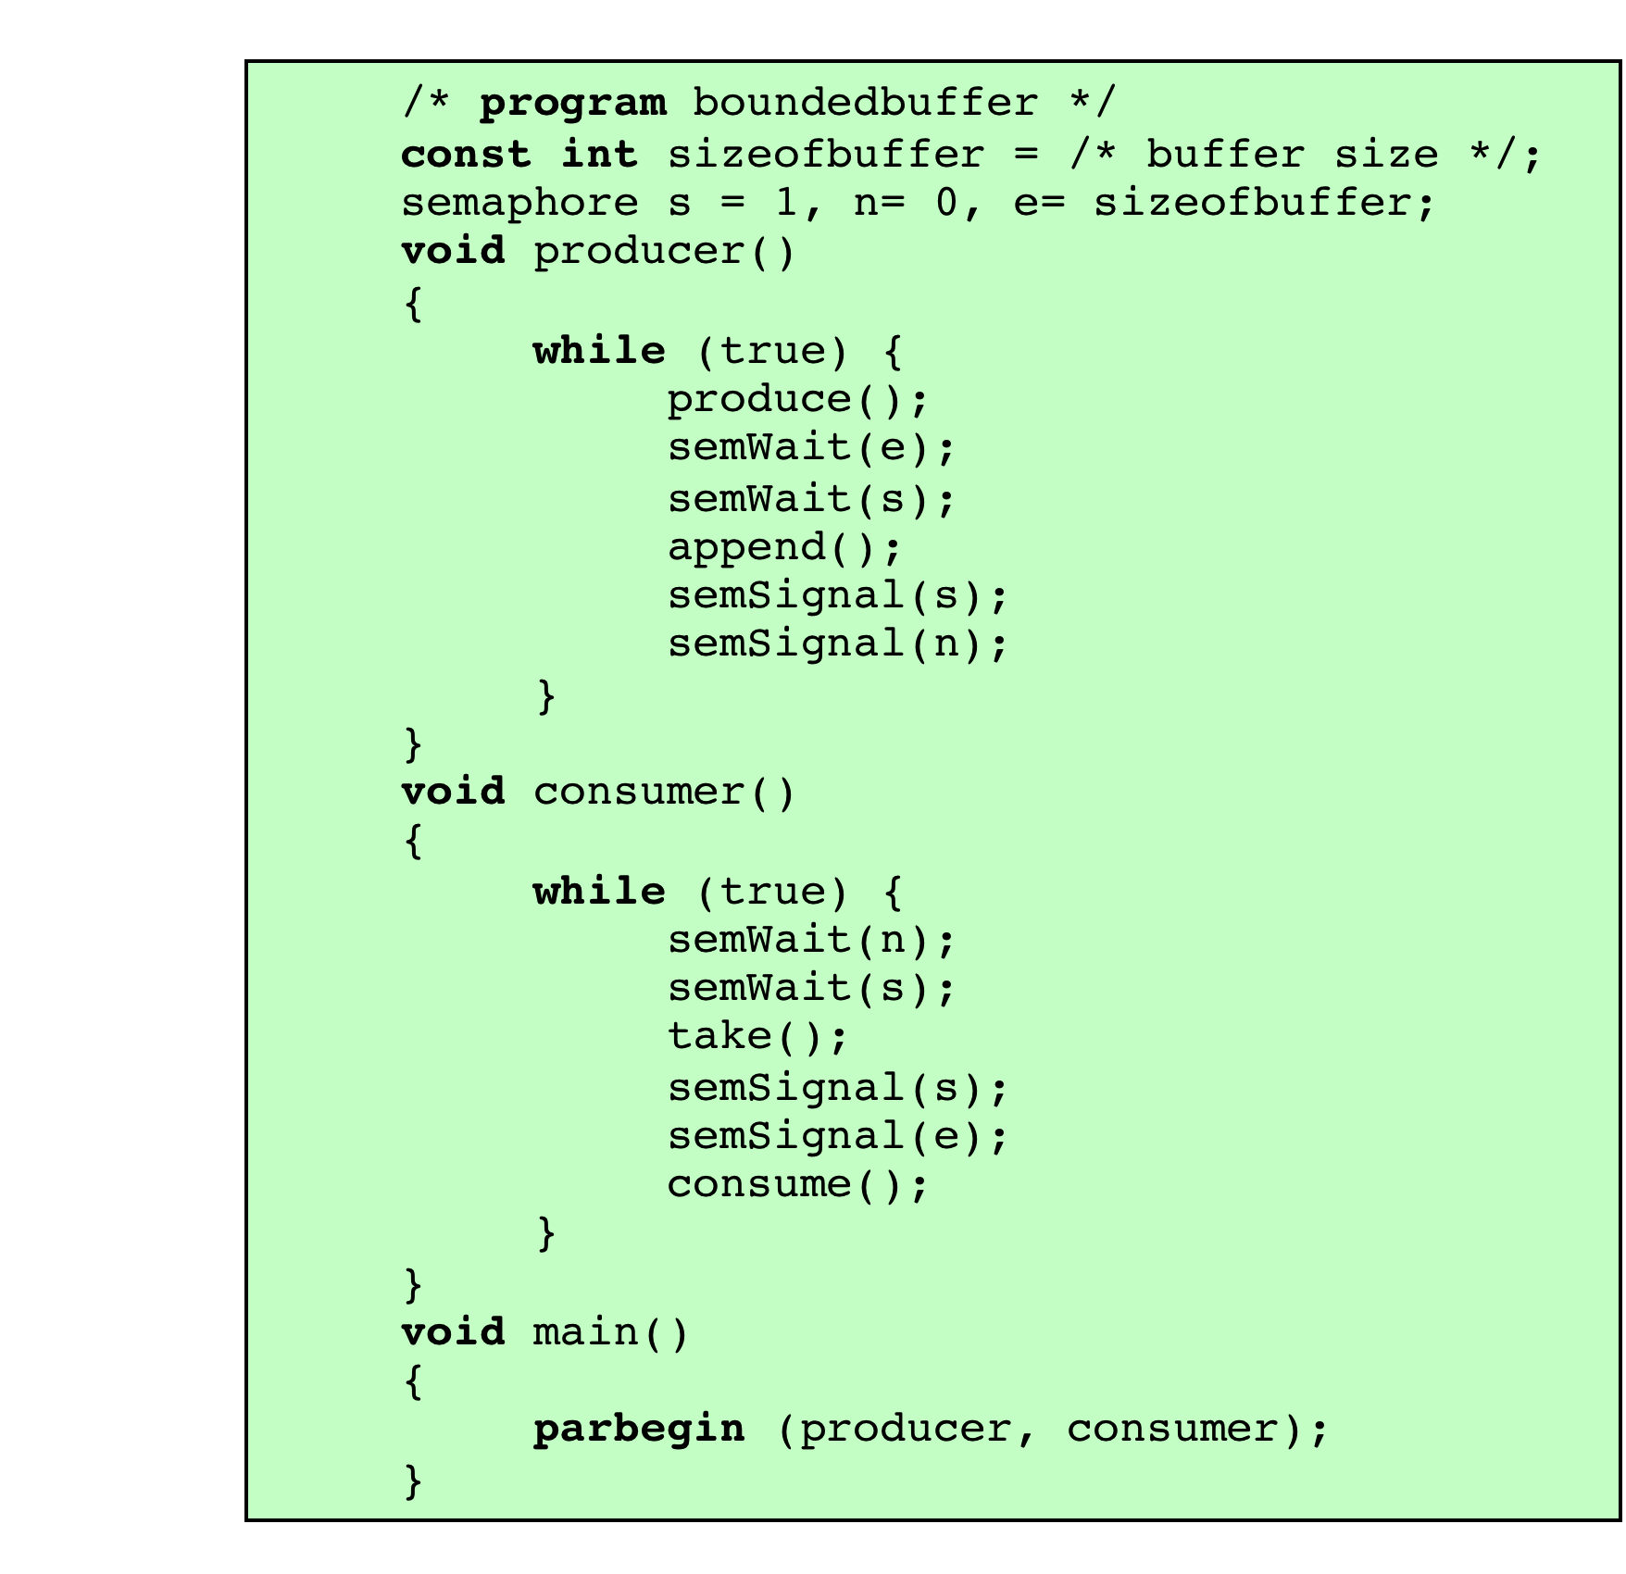

Slide 10

A data area is shared among many processes
  Some processes only read the data area, some only write to the area
Conditions to satisfy:
  Multiple readers may read the file at once.
  Only one writer at a time may write
  If a writer is writing to the file, no reader may read it.

Slide 11

