Slide 1


OTI Common Services
Office of Technology & Innovation
Notes:
https://m2.material.io/resources/color/#!/?view.left=1&view.right=0&primary.color=D32F2F&secondary.color=F48FB1
Borders are
1

Slide 2

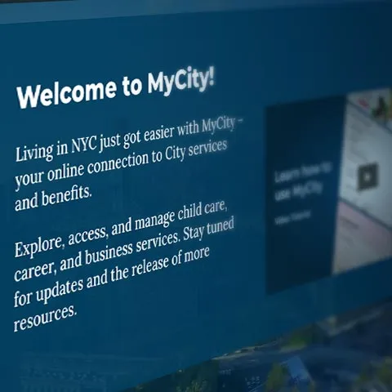
Transforming Public Service Delivery
MyCity is a unified digital platform designed to streamline how New Yorkers access City services. It simplifies the user experience and enhances operational efficiency for government agencies.
For Residents: One-stop access to all City services.
For Agencies: Increased efficiency and collaboration through shared infrastructure.
Notes:
Lack of Mayoral mandate; little to no governance to align agencies on a single digital platform; information was still reliant on agencies and in agency-speak; it became a platform for promoting the administration’s priorities and less about end-user needs
4

Slide 3

Key Benefits for Agencies
Automate workflows and reduce redundant tasks, improving overall productivity.
Near real-time data sharing speeds up service delivery across departments.
Seamless data integration enables better cross-agency coordination.
Shared infrastructure reduces operational and maintenance costs.
Secure services with encryption and compliance with industry standards.
Notes:
9

Slide 4
Key Benefits for Residents
TIME SAVINGS & ACCESSABILITY
DOCUMENT
HANDLING
PERSONALIZED EXPERIENCE
Use one login to access all City services, with personal information reused across platforms to minimize repetitive data entry.
Store, reuse, and manage documents securely across all services, reducing paperwork and administrative hassle.
Receive real-time notifications tailored to your needs, with multi-language support and accessibility features for all users.
Notes:
8

Slide 5
Strategic Roadmap
OTI Common Services Timeline
Core Services 2023-2025
MyCity portal and Common Services launched:
Service Delivery History Dashboard
Unified Profiles
Doc Vault / Services
Email & SMS Messaging
Recommendations
Service Expansion 2026-2027
Common Intake
Expanded Profiles
Consent Management
Future Innovations
Inbox / Outbox Secure Doc Exchange
Lightweight Fulfillment Backend
Payments
Case Management
Notes:
23

Slide 6
Common Services Integration Playbook
Add a grounding statement here... "OTI provided integration playbook materials will help Agencies understand the MyCity mission, concepts, and summarize 'How' to deliver the Agency system integration"
Office Hours
01
To support agencies throughout the integration, we offer dedicated office hours where our technical team is available to provide guidance, troubleshoot issues, and answer questions in real-time.
SDK Development
Business Playbook
Technical Playbook
02
We've built a Software Development Kit (SDK) to simplify the integration process, providing reusable components, APIs, and documentation that accelerate development and ensure consistency across all services.
Continuous Updates
03
The handbook is a living document, with regular updates to keep agencies aligned with the latest features, system improvements, and security protocols.
Notes:
We have seen major growth of 311 and its role in providing information and even public health campaigns, but when it first started it was just a phone number.
I think I was actually the one to create the images for this page
11

Slide 7
Services
Notes:
311 is an incredibly vital information service to New Yorkers and a voice for them when there’s a problem. This is a key difference with MyCity.
13

Slide 8
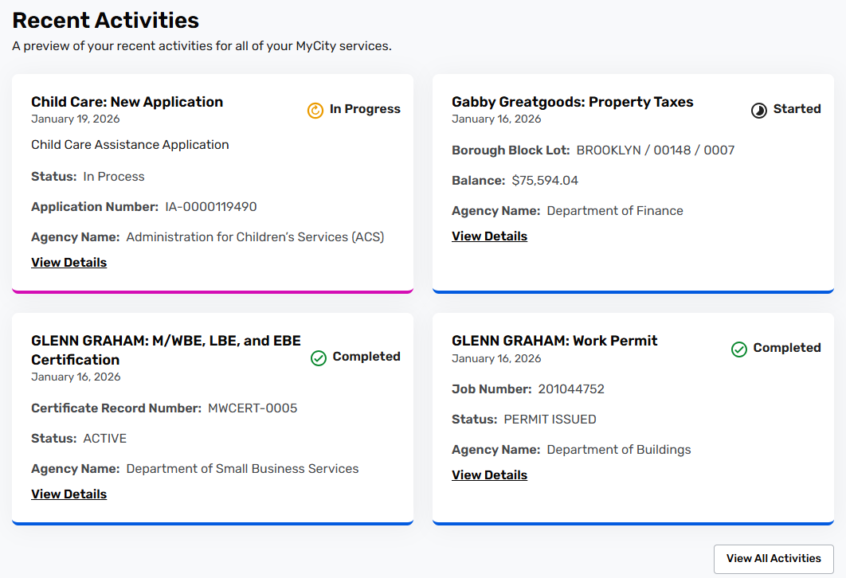
Activity Dashboard
The Activity Dashboard displays user activity history across City agencies and applications
Activity Dashboard The Activity Dashboard gives residents a single, consolidated view of their service history across all City agencies. Residents can track active applications, see completed interactions, and monitor status — without having to contact each agency individually.
Service Dependencies Consent Management – to allow users to provide approval to share their activity history
Notes:
The integrations with agencies is important for City operations, but the growth of what are known as knowledge articles written by the content team at 311 is important because of the policy information being conveyed to regular people.
12

Slide 9
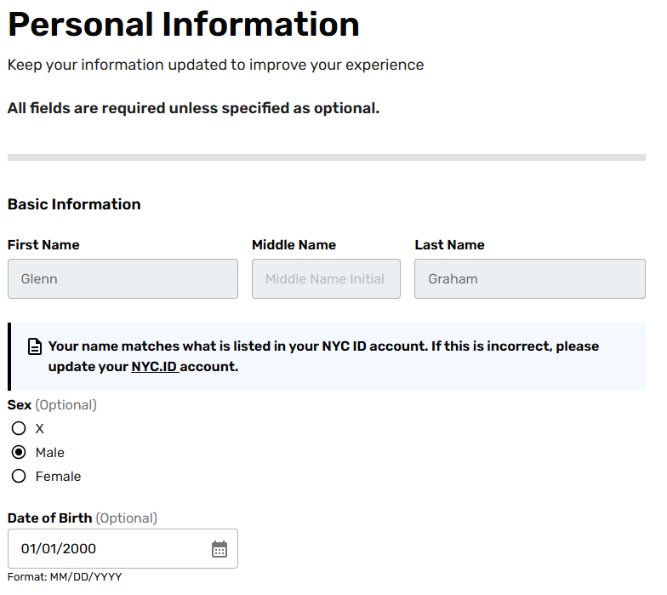
Unified Profile
Users can save commonly used data about themselves for use in other City applications
Unified Profile Unified Profiles store resident, business, (household data) in a single secure repository. Residents enter their information once, and it's automatically available across every integrated City service - eliminating repetitive data entry and reducing form abandonment.
Service Dependencies NYC.ID - Identify Management
Notes:
The integrations with agencies is important for City operations, but the growth of what are known as knowledge articles written by the content team at 311 is important because of the policy information being conveyed to regular people.
12

Slide 10
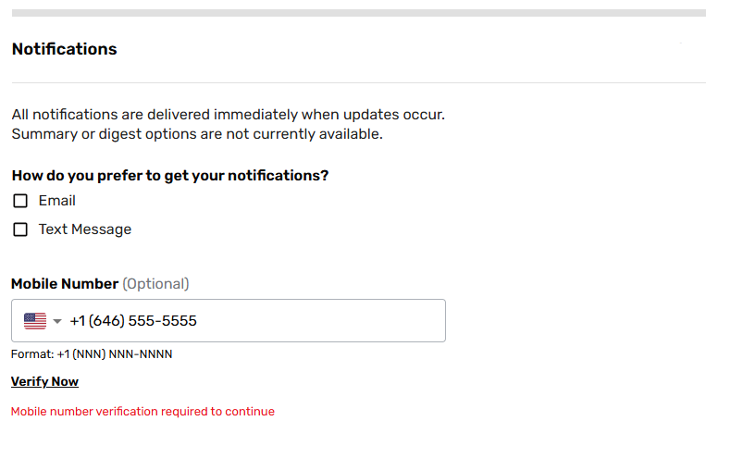
SMS and Email Messaging
The messaging service supports outbound email and SMS messaging to users
SMS and Email Messaging
The Messaging service lets agencies send timely outbound SMS and email notifications to residents without building their own messaging infrastructure. Agencies configure templates and trigger notifications via the Common Services API, ensuring consistent City-branded communications.
Service Dependencies User Profile is required for SMS messaging to allow users to provide and validate a mobile phone number
Notes:
The integrations with agencies is important for City operations, but the growth of what are known as knowledge articles written by the content team at 311 is important because of the policy information being conveyed to regular people.
12

Slide 11
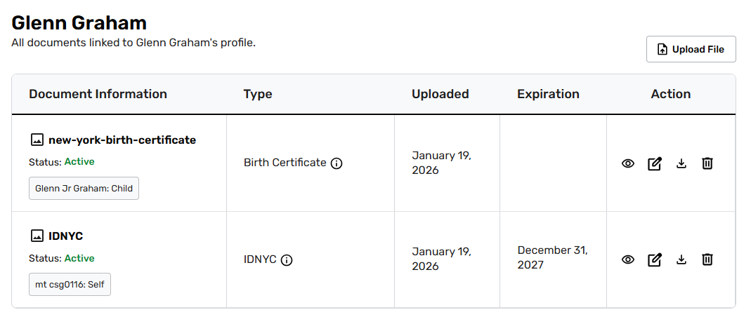
User Document Vault
Users can save commonly used documents for re-use in other City applications
User Document Vault
The Document Vault lets residents securely store important documents - birth certificates, proof of residency, permits - once and reuse them across multiple City services. Agencies can request documents from the vault instead of asking residents to re-upload, with built-in expiration alerts to keep documents current.
Document Services handles file upload, virus scanning, and storage on behalf of agencies through shared infrastructure. Agencies integrate once and offload all document management — no need to build or maintain their own file handling systems.
Service Dependencies Unified Profile for persistent account documents
Notes:
The integrations with agencies is important for City operations, but the growth of what are known as knowledge articles written by the content team at 311 is important because of the policy information being conveyed to regular people.
12

Slide 12
Document Services
Agencies can “outsource” file upload, virus scanning, and storage through Document Services
Document Services Features:
Users can upload files required by agency applications
Virus scanning handled natively within the service
File storage included
(cost recovery?)
Document Services
Document Services handles file upload, virus scanning, and storage on behalf of agencies through shared infrastructure. Agencies integrate once and offload all document management — no need to build or maintain their own file handling systems.
Service Dependencies Unified Profile for connected file storage
Notes:
The integrations with agencies is important for City operations, but the growth of what are known as knowledge articles written by the content team at 311 is important because of the policy information being conveyed to regular people.
12

Slide 13
UI Library
Other Services Dependencies:
Notes:
The integrations with agencies is important for City operations, but the growth of what are known as knowledge articles written by the content team at 311 is important because of the policy information being conveyed to regular people.
12

Slide 14
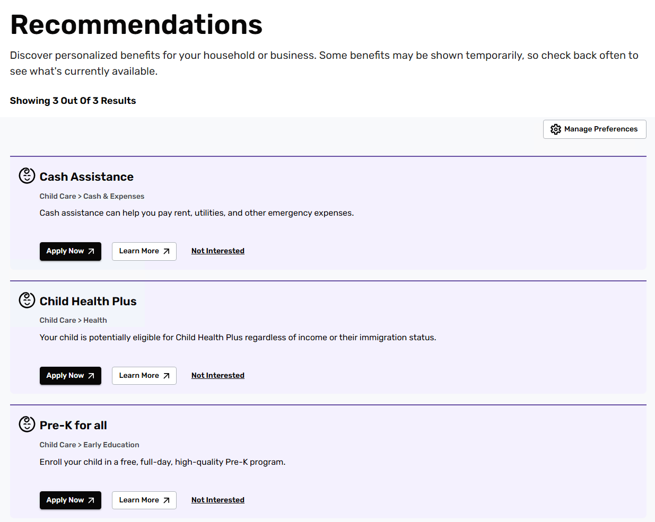
Recommendations
Users can opt to receive Recommendations based on information they have provided in their Profile or other City applications
Recommendations
The Recommendations service proactively surfaces relevant City programs and benefits to residents based on their profile data and service history. Residents opt in and receive personalized suggestions for services they may not have discovered on their own, driving enrollment for agency programs.
Service Dependencies Unified Profile is recommended to personalize recommendations based on resident data and service history
Notes:
The integrations with agencies is important for City operations, but the growth of what are known as knowledge articles written by the content team at 311 is important because of the policy information being conveyed to regular people.
12

Slide 15
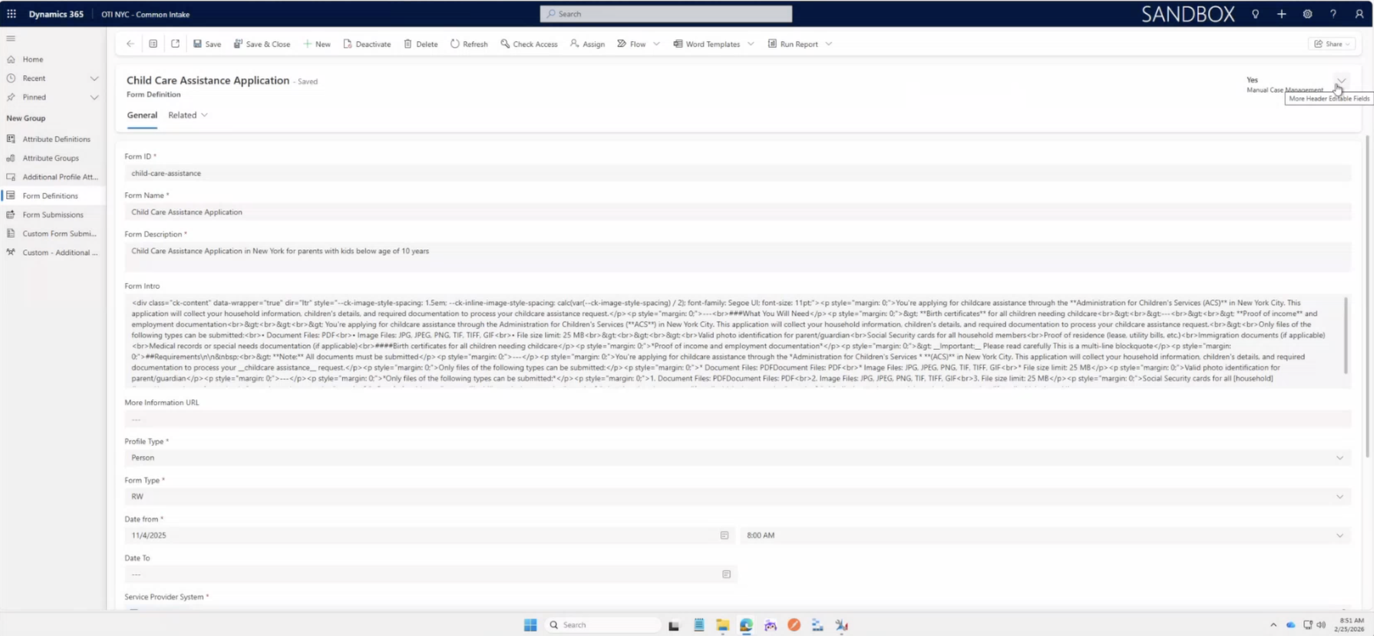
Forms Builder / Common Intake
A JSON-based form building and hosting service fronting either integrations with agency applications or a lightweight Power Platform fulfillment service
Forms Builder / Common Intake Forms Builder is a JSON-based service for building and hosting digital intake forms. Forms can route submissions directly to existing agency backends, or to the Lightweight Fulfillment service for agencies that don't yet have a backend system — enabling rapid service digitization without full backend integration.
Service Dependencies Unified Profile is required to re-use profile data
Notes:
The integrations with agencies is important for City operations, but the growth of what are known as knowledge articles written by the content team at 311 is important because of the policy information being conveyed to regular people.
12

Slide 16
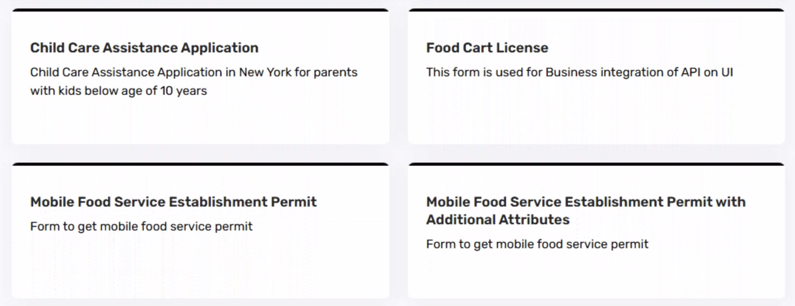
Common Intake Lightweight Fulfillment
A lightweight Power Platform fulfillment service with basic workflow and routing functionality where integrations with backend agency applications is not required
Common Intake Lightweight Fulfillment
The Lightweight Fulfillment service provides a Power Platform-based workflow and routing backend for agencies that don't have an existing application system. Working directly with Forms Builder, it delivers end-to-end digital intake without requiring custom development.
Service Dependencies Unified Profile is recommended to personalize recommendations based on resident data and service history
Notes:
The integrations with agencies is important for City operations, but the growth of what are known as knowledge articles written by the content team at 311 is important because of the policy information being conveyed to regular people.
12

Slide 17
Contact
https://mycity.nyc.gov/
MyCityIntegrations@oti.nyc.gov
Notes:
311 is an incredibly vital information service to New Yorkers and a voice for them when there’s a problem. This is a key difference with MyCity.
13

Slide 18
Resources
Common Services Integration Playbook
Integration of Public-Facing Digital Services Standard
Integration Request Form (via Service Now)
Notes:
311 is an incredibly vital information service to New Yorkers and a voice for them when there’s a problem. This is a key difference with MyCity.
13

Slide 19

Thank you

