Slide 1
Wk 6 – Ch 11&12 Collaborative Filtering

Slide 2
Model Evaluation
Chapter 11 examines strategies for evaluating the quality of models
Cross-Validating Models
Cross-validation is a statistical method used to estimate the skill of machine learning models
If we train our model using our data, it might not work well on different data
If we train our model using only part of our data, we still have the remaining part of our data to apply the model to see if it is achieving our desired goal
K-Fold Cross Validation (KFCV)
Instead of dividing the data into training and test sets, we divide it into folds
All the folds except one is used for training, that one is used for testing
Sample code for 11.1, 11.2 and 11.8 is available in Weekly Resources

Slide 3
Binary Classifiers
Binary Classifiers are data that can be assigned to one of two categories.
Examples: Male/Female, Smoker/NonSmoker
A common measure of a classifier’s performance is how much better it is than random guessing

Slide 4
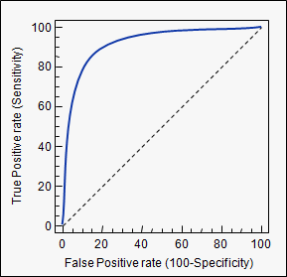
Receiving Operating Characteristic (ROC) Curve
ROC analysis evaluates the quality of a binary classifier
Looking at the graph below
the solid blue line shows a classifier that predicts every observation correctly
The dotted line shows a classifier that predicts at random
A good quality binary classifier is one that predicts anywhere between the two lines.

Slide 5
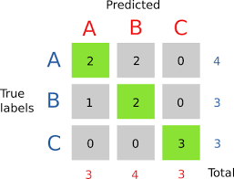
Confusion Matrix
A visualization tool for depicting a classifier’s performance
Compares True (rows) and Predicted (columns) classes
At the top left (A:A) – A was predicted twice and A was correct twice
Moving across the row (A:B) – B was predicted 2 times but both times it was A
Moving across the row (A:C) – C was not predicted
Continue through the rest of the matrix.
A Perfect Model will have values along the diagonal and zeros everwhere else
Good for depicting how the model was wrong and where it is wrong
Notice that the “extra” numbers are all associated with B!

Slide 6
Chapter 12: Model Selection
Model selection is the task of selecting a statistical model from a set of candidate models
If the model is too complex, it will fit the data used to construct the model very well but generalize poorly to unseen data (overfitting)
If the complexity is too low the model won’t capture all the information in the data (underfitting)
A key balancing act is choosing an appropriate level of model complexity

