Slide 1

Analysis on Airline Safety
Facts and Figures
Tinto T. Kurian
Notes:
Hi All,
I am Tinto Kurian, Student in Master of Science in Data Science at Bellevue university.
Due to recent unfortunate airline crashes, the media has been promoting statistics stating air is no longer a safe way to travel.
What was previously thought as the safest way to travel, especially when compared to automobiles, is now being presented as one of the most dangerous to the public. But are any of these claims based on facts?
We are going to do a data-based analysis on these claims, to better understand the realities behind these claims.
We are going to understand if airlines are still a safe travel option ? and compare the incidents, fatal accidents and fatalities of air travel Vs Motor vehicle road travel.

Slide 2
Number of Airline passengers is increasing
The data clearly indicates that the number of passengers in the airlines are seeing a steady increase
Analysis on Airline Safety - Facts and Figures
Notes:
Number of Airline passengers is increasing
The data clearly indicates that the number of passengers in the airlines had been seeing a steady increase pre COVID.

Slide 3
Distribution of passengers in airlines across the globe
Notes:
With the given distribution we can see that America, Europe, China are the countries with the most passengers using airlines.

Slide 4
Is really Driving Safer ?
The data clearly indicates the fatalities on road are multi fold when compared to airline fatalities.
Notes:
Is really Driving Safer?
In the graph we can see that the red line indicates the Airline fatalities vs the blue line which indicates the road fatalities
The data clearly indicates the fatalities on road are multi fold when compared to airline fatalities.
Airlines continues to remain safer than road travel though media is paining a different picture

Slide 5
Are Airline fatalities increasing?
We can see that there had been a consistent decline in the fatalities in airlines from the early 80s.
Notes:
We can see that there had been a consistent decline in the fatalities in airlines from the early 80s.

Slide 6
Fatalities per Airlines
Notes:
This chart shows that there are few airlines that mainly contribute to the airline fatalities.

Slide 7
Airplane Fatalities 2000 to 2014 per One Trillion Kilometers
Notes:
This graph shows Airplane Fatalities from year 2000 to 2014 per One Trillion Kilometers

Slide 8
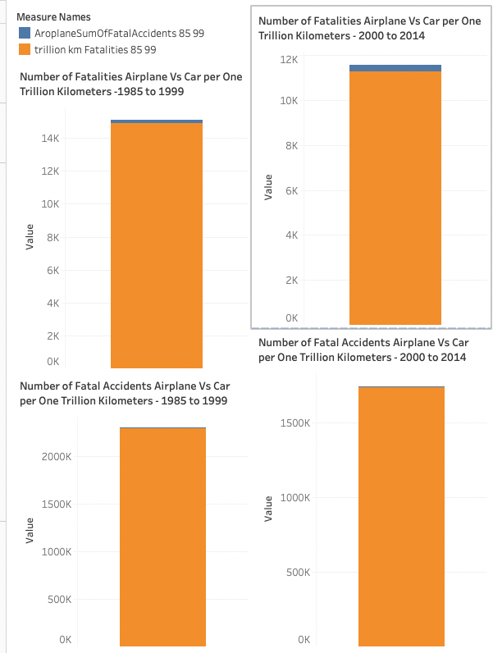
Notes:
From the graphs we can see that
There were only
180 Airplane Fatalities VS ~15K Car Fatalities per One Trillion Kilometers -In years 1985 to 1999.
and in years 2000 to 2014 there were 306 Airplane Fatalities VS ~11K Car Fatalities per One Trillion Kilometers - In years 2000 to 2014.
180 Airplane Fatal Accidents Vs ~2.2 MM Car Fatal Accidents per One Trillion Kilometers - In years 1985 to 1999.
and in In years 2000 to 2014 there were only
62 Airplane Fatal Accidents Vs ~1.7 MM Car Fatal Accidents per One Trillion Kilometers -

Slide 9
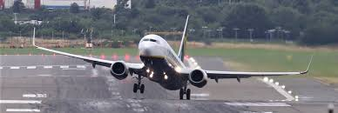

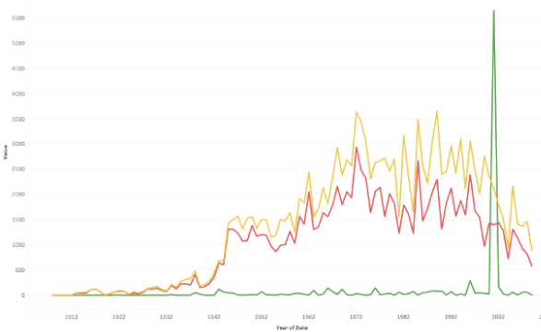
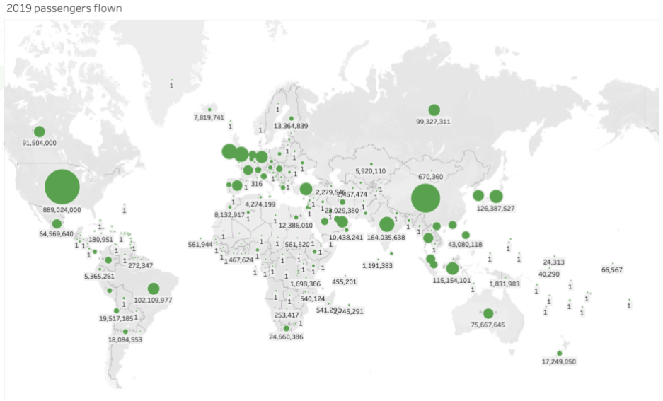


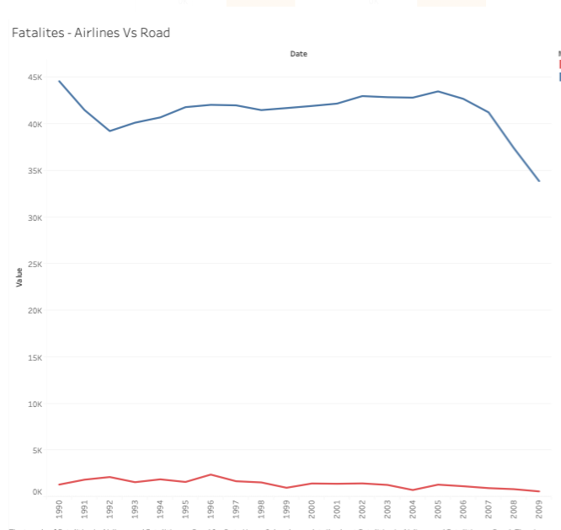
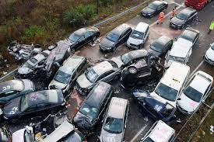


Airline Safety : Facts and Figures
The overall accidents and incidents on Airlines have come down over the years
US, Europe & China has the most airline travelers
There were only 180 Airplane Fatalities VS ~15K Car Fatalities per One Trillion Kilometers In years 1985 to 1999.
There were only 306 Airplane Fatalities VS ~11K Car Fatalities per One Trillion Kilometers In years 2000 to 2014.
The total number of Airline fatalities are minuscule compared to fatalities on road
Notes:
Conclusion:
From the above analysis we can conclude that airlines are still very much safer than road travel. Both the data of air travel vs motor travel from periods 1985 to 1999 as well as 2000 to 2014 confirms this fact.

Slide 10

Thank you, Professor Benjamin Schneider, for all the support and guidance through out this project.
Bibliography and link to the Git Hub
airplane-crashes-since-1908. (n.d.). Retrieved from https://www.kaggle.com/saurograndi/airplane-crashes-since-1908
data.worldbank.org. (n.d.). Retrieved from https://data.worldbank.org/indicator/IS.AIR.PSGR?end=2019&start=1970&view=chart
fivethirtyeight. (n.d.). Retrieved from https://github.com/fivethirtyeight/data/tree/master/airline-safety
GitTInto. (n.d.). Retrieved from https://github.com/GitTInto/DataPresentationAndVisulization/blob/main/week3_4/fivethirtyeight/airline-safety/data_wrangling_cleaning.ipynb
GitTInto_Dashboard. (n.d.). Retrieved from https://github.com/GitTInto/DataPresentationAndVisulization/blob/main/week3_4/fivethirtyeight/airline-safety/2.3%20Project%20Task%20-%20DashBoard%20Airline%20Saftey.pdf
motor-vehicle-safety-data. (n.d.). Retrieved from https://www.bts.gov/content/motor-vehicle-safety-data.
Notes:
I would like to thank Professor Benjamin Schneider, for all the support and guidance through out this project
Also, here I have given links to the data sources that have been used for this analysis and links to the githib repo showing the analysis and the work.
Thank you.

