Slide 1
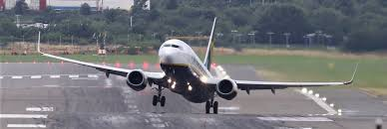

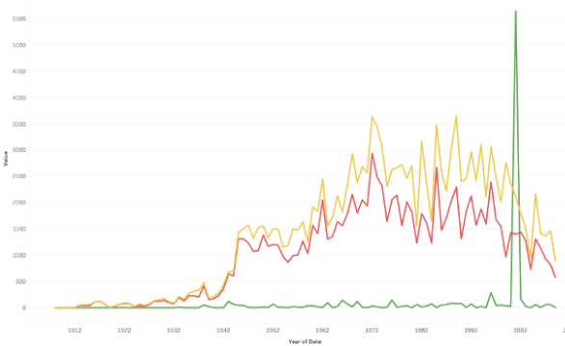
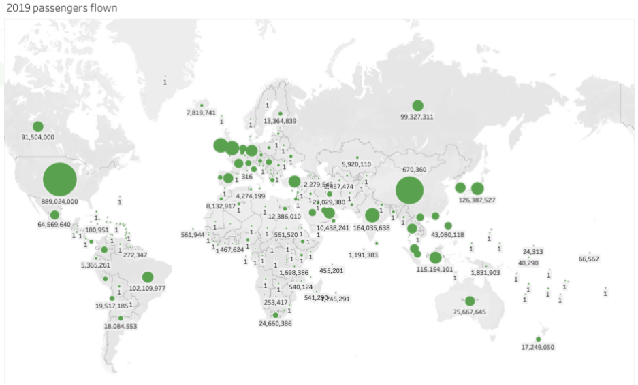


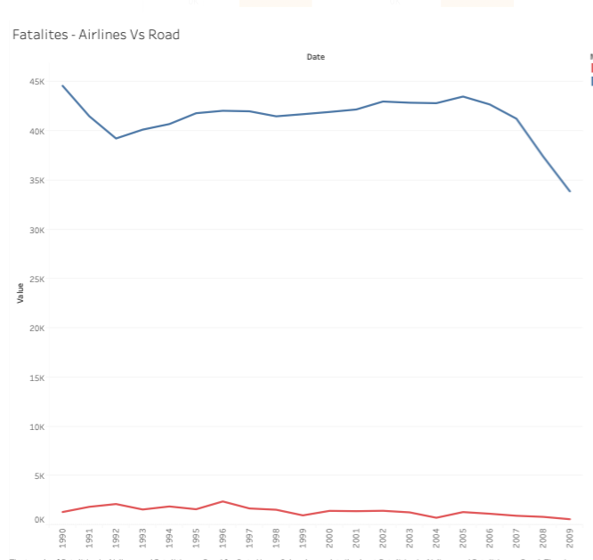
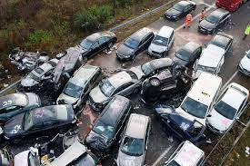


Airline Safety : Facts and Figures
The overall accidents and incidents on Airlines have come down over the years
US, Europe & China has the most airline travelers
There were only 180 Airplane Fatalities VS ~15K Car Fatalities per One Trillion Kilometers In years 1985 to 1999.
There were only 306 Airplane Fatalities VS ~11K Car Fatalities per One Trillion Kilometers In years 2000 to 2014.
The total number of Airline fatalities are minuscule compared to fatalities on road

