Slide 1
Object Oriented Programming

Slide 2
Key Topics
Object Oriented Programming concepts.

Slide 3
Why
This session explains the concepts of Object Oriented Programming.

Slide 4
Object Oriented Programming

Slide 5
Object Oriented Programming Concepts
Encapsulation
Polymorphism
OOPS
Abstraction
Inheritance
Notes:
Object Oriented programming is a programming style which is associated with the concepts like class, object, Inheritance, Encapsulation, Abstraction, Polymorphism (Concepts will discussed in detail as the session progresses).

Slide 6
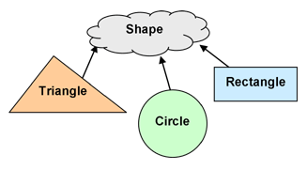
Inheritance
Inheritance in Java is a mechanism in which one object acquires all the properties and behaviors of a parent object.
Shape is called the super or base or parent class.
Triangle, Circle, Rectangle are child or sub class which inherits the properties of the base class shape.
Notes:
The idea behind inheritance in Java is that we can create a new classes that are built upon existing classes.
While we inherit from an existing class, we can reuse methods and fields of the parent class.
Also we can add new methods and fields to the current class.

Slide 7

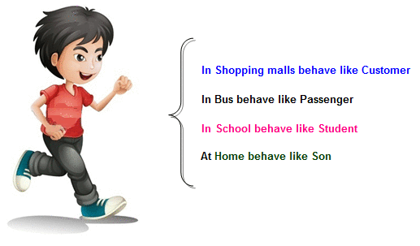
Polymorphism
A single action can be performed in different ways is called polymorphism.
Example 1
Example 2

Slide 8

Abstraction
Representing the essential features without including the background details.
Hiding unnecessary details from the user and making the application user-friendly is called as abstraction.
Ex. – User don’t want to know how ATM machine operates inside.

Slide 9
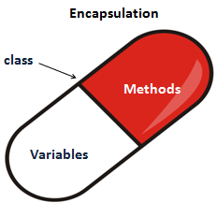
Encapsulation
Encapsulation in Java is a mechanism of wrapping the data (variables) and code acting on the data (methods) together as a single unit
It is known as data hiding.
Notes:
Variable : is a piece of memory that can contain a data value. A variable has a data type.
Datatype: is type of data
Name refers string data type
Age refers integer data type.
Method: is a collection of statements that are grouped together to perform an operation

Slide 10
Test Your Understanding
What are the four OOP concepts?
Which OOP concept helps in inheriting the data of the parent class?
3. Which OOP concept indicate the data hiding?
4. Which concept of OOP help in presenting only the essential features to the user?

Slide 11
RECAP
In this chapter we have learnt what are the four main OOP concepts that are used in Java.

Slide 12
You have successfully completed Object Oriented Programming Concepts

