Slide 1
Core Java
Access Specifiers, Methods & Encapsulation

Slide 2

Enabling Objectives
After completing this chapter, in the next 40 minutes you will be able to:
Demonstrate on access specifier by writing a Java class
Implement Java methods
Explain on Encapsulation

Slide 3
Key Topics
        Access Specifiers
        Write a java method
        Explain encapsulation

Slide 4
Access Specifiers

Slide 5
Purpose of Access Specifier?
Using access specifier, the scope of a variable/methods can be restricted.
Public
Private
Protected
Default
Access Specifier
Notes:
Access specifier is important for Object Oriented Language for encapsulation and information hiding.
Encapsulation: It is a way to bind data members and member functions to make a single unit. In OOPs, class is used to make data members and member functions to bind each other.
As a best practice, it is recommended to use private data members so that information can be hidden from the outside world. Using access specifier, developers can secure their methods/ variables by defining different access level.

Slide 6
Public Access
Class members (variables or methods) are accessible to anyone
Both inside/outside of the class and outside of the package.
Syntax:
public datatype <method/variable name>
Notes:
Example:
Public variable:
public int x = 0;
Public Method:
public addNumbers(int x, int y){
// some code here
}

Slide 7
Illustration for public access
Same Package Different Package
B
C
A
C
public
public
public
Notes:
Assume there are 3 java classes A, B, and C
Classes A & B are in the same package where as Class C is in a different package
Class A has a public variable
Class B will be able to access the public variable in Class A
Class C will be able to access the public variable in Class A

Slide 8
Private access
Class member are only accessible by the class in which they are defined.
Cannot be accessed by any other class.
Syntax :
private datatype <variable/method name>
Notes:
Example:
Private variable:
private int x = 0;
Private Method:
private addNumbers(int x, int y){
// some code here
}

Slide 9

Illustration for private access:
Same Package Another Package
A B
C
private
Notes:
Taking the same example illustrated before
Class A has a private variable
Class B will not be able to access the private variable in Class A
Class C will not be able to access the private variable in Class A
Only methods in class A can access the private variable in Class A.

Slide 10
Protected access
Class members/methods are accessible to only the methods in that class, classes from same package and the subclasses of the class.
The subclass can be in any package.
Syntax:
protected datatype <variable/method name>
Notes:
Example:
Protected variable:
protected int x = 0;
Protected Method:
protected addNumbers(int x, int y){
// some code here
}

Slide 11

Illustration for protected access:
Same Package Another Package
A B
C D extends A
protected
Notes:
Class A has a protected variable.
Protected variable in Class A can be accessed by Class B in the same package
It can be accessed by class D since Class D is a subclass of Class A
It cannot be accessed by class C since class C is in a different package and is not a sub class of class A.

Slide 12
Default access
Classes in the same package can have access to the variables and methods of the other class
No keyword is required for the default modifier and it is applied in the absence of an access modifier.
Notes:
Example:
Private variable:
private int x = 0;
Private Method:
private addNumbers(int x, int y){
// some code here
}

Slide 13
Illustration for default access:
Same Package Another Package
A B
C
default

Slide 14
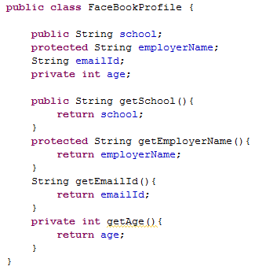
Code Example
Public access to variable
Protected access to variable
Default access to variable
Private access to variable
Public access to method
Protected access to method
Default/no access to method
Private access to method

Slide 15
Specifiers in a nutshell
Access Modifiers | Same Class | Same Package | Subclass | Other packages (Non-subclass)
public | Y | Y | Y | Y
Protected | Y | Y | Y | N
No access modifier | Y | Y | N | N
Private | Y | N | N | N
Notes:
Private Access specifier is used to denote most of the data members. Whereas, protected specifier to used to a data member which can be accessed in derive class as well.
It is recommended to use private or protected access specifier for data members.

Slide 16
Test your understanding
  Why do you need access specifiers?
  What are the types of access specifiers?
A method declared protected can it be accessed from other class residing in another package?
A variable declared private can it be accessed from other class residing in the same package?
What is the access specifier used to prevent sub classes accessing the methods and variables?

Slide 17
Lend a hand
Refer Access Specifier - Hands-on.docx document file

Slide 18
Practice Check
Refer Access Specifier - knowledge Check.xls document file

Slide 19
        Write a java method

Slide 20
What is a method?
A method is a finite set of statements to perform a desired functionality which can be included inside a java class.
  Example: main method in class A invokes method “add” in class B and method “multiply” in class C.
ClassA{
public static void main{
  Statement 1
  add();
  Statement 2
  multiply();
}
}
ClassB{
add(){
//write code here
}
}
ClassC{
multiply(){
// write code here
}
}
Notes:
This set of statements can be called (invoked) at any point in the program by using the method name.

Slide 21
Method Declaration
How to declare a method?
  Syntax:
    <specifier> <returnType> <methodName>(<parameter-list>) {
    <statement>
    }
Notes:
<Specifier> : is the place holder that specifies the visibility /accessibility of the method.
<returnType>: is the place holder that indicates the data type of the return value
<methodName>: is the place holder for method name. This can be any meaningful word that describes the purpose of the method.
<parameter-list>: is the place holder for zero or more parameters or arguments pass to this method as an input.
Example:
public int add(int x, int y){ // x and y are the input to the add function
int sum = x+y; // the statement represent the business logic
return sum; // the result value that is being sent back to the calling method
}

Slide 22
Encapsulation

Slide 23


Encapsulation
The actual medicine is hidden inside the capsule. The patient is not aware of the contents of the medicine.
Notes:
Encapsulation is defined as the wrapping up of data under a single unit. It is the mechanism that binds together code and the data it manipulates. Other way to think about encapsulation is, it is a protective shield that prevents the data from being accessed by the code outside this shield.
Technically in encapsulation, the variables or data of a class is hidden from any other class and can be accessed only through any member function of own class in which they are declared.
As in encapsulation, the data in a class is hidden from other classes, so it is also known as data-hiding.
Encapsulation can be achieved by: Declaring all the variables in the class as private and writing public methods in the class to set and get the values of variables.

Slide 24
What is Encapsulation?
  Encapsulation is one of the fundamental OOP concepts
  It is the protective barrier that prevents the data in a class from being directly accessed by the code outside the class.
  Access to the data and code is tightly controlled by using an interface.
  Example:
  In Face book people don’t share their age information.

Slide 25
How is Encapsulation achieved?
  The fields in a class are made private so that it cannot be accessed by anyone outside the class.
  Hence encapsulation is also called “Data Hiding”.
  The fields can be accessed only by using the public methods in the class.
  Encapsulated data is accessed using the “Accessor (getter)” and “Mutator (setter)” methods.
      Accessors – Methods to retrieve the hidden data.
      Mutators – Methods to change hidden data.

Slide 26
Lend a Hand - Encapsulation
In our FaceBook profile, we would like to hide the age, marital status and phone number information to the external world. This can be done using encapsulation where the fields are made private and can be accessed only by the accessor and mutator methods.

Slide 27
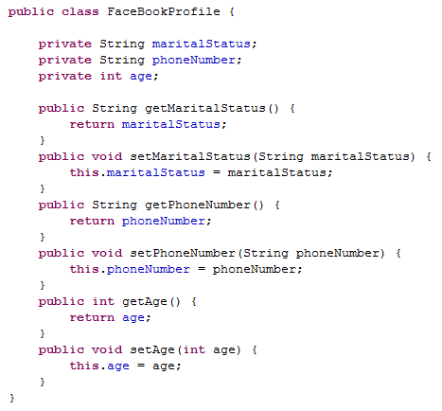
Lend a Hand - Encapsulation
The public methods are access points to the fields of this class. Hence, any class that wants to access the variables should access them through these getters and setters
Notes:
For example:
In our FaceBook profile, we would like to hide the age, marital status and phone number information to the external world. This can be done using encapsulation where the fields are made private and can be accessed only by the accessor and mutator methods.

Slide 28
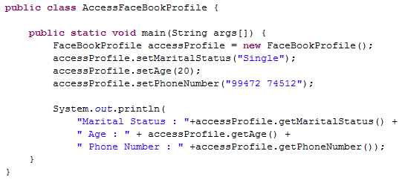
Lend a Hand - Encapsulation
The fields are set using the setter (Mutator) methods.
The values are got using the getter (Accessor) methods.

Slide 29
Returning values from a method
A method returns a value using the return keyword.
  Syntax:
      return <return Value>;
  Where <return Value> is a place holder for a variable whose value needs to be returned.
  The datatype of the “return Value” must be matched with the data type specified in the method declaration

Slide 30
Returning control from a method
  Returning control:
  If the method execution needs to be stopped and the control needs to be sent back to the calling method, then the return statement without a <variable name>is used.
      Syntax:
      public void Boo(int _bookID)
      {
      if(_bookID == 0 )
      return; // return statement
      // Some piece of code
      }

Slide 31
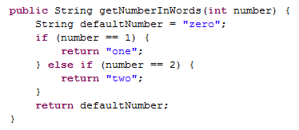
Multiple Return Statements from a method
A constant value is being returned
Returning a variable value
Notes:
A method can have multiple return statements.
One can use constants as return values instead of variables
NOTE: It is NOT a good practice to have multiple return statements from a method.
Let us look at a solution to fix this Best Practice violation in the next slide !!

Slide 32
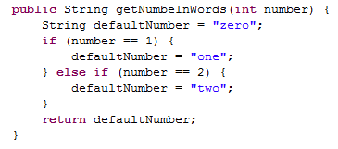
Return from a method
Value stored in a variable and returned from a single point
Notes:
Best Practice: A method should have only one return statement

Slide 33
Lend a hand - Methods
Let us develop a program with a method invocation
Create a Java class “Square.java” with a method “calculateArea” [ This method should accept length as an argument, calculate the area and return the area. ]
The main method should invoke the Square objects “calculateArea” method by passing a value for the length, say 20.
The main method should also print the area (result).

Slide 34
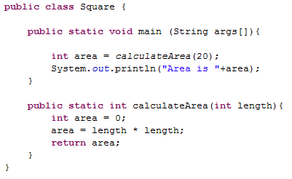
Lend a hand - Solution

Slide 35
Test your understanding
What is a method?
What are the building block elements of the method?
What is encapsulation?
How is a variable encapsulated?
How can we transfer the execution control to the calling method?
Can we have multiple return statements from a method?

Slide 36
Recap
In this chapter, you have learnt to :
Demonstrate on access specifier by writing a Java class
Implement Java methods
Explain on Encapsulation

Slide 37
  You have successfully completed –
  Access Specifiers, Methods & Encapsulation

