Slide 1
An Enigma wrapped in a Mystery.
He who is unaware of his ignorance will be only misled by his knowledge.
- Richard Whately

Slide 2
Project Steps
Talk to the customer (Joshua) to determine what they want.
Create a Requirements Document to describe the ‘thing’ to be built.
Design and build the ‘thing’ using the Requirements Document as a blueprint.

Slide 3
Verification and Validation (from System Engineering)
Verification: did you build the ‘thing’ right, i.e., did you satisfy all the points of the Requirements Document (RD)? This is a mechanical procedure wherein you simply check that each item of the RD is implemented in the design and build of the ‘thing’.
Validation: did you built the right ‘thing’, i.e., was the RD correct, in the first place? Does the RD accurately reflect the customer’s wishes? Not a mechanical process since it requires intelligence. If you built something other than what the customer wanted, you are so fired. Note, the word ‘validation’ means something different in software engineering, cf. p. 90 of our textbook.

Slide 4
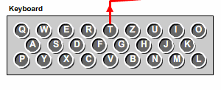
German Railway Enigma RD, 1 of 4
One (1) fixed rotor [Eintrittwalze or ETW] :
Mapping: QWERTZUIOASDFGHJKPYXCVBNML
NOTE, this mapping corresponds to the position of the letters on the Enigma keyboard, which is a QWERTZ as opposed to QWERTY keyboard, which has the ordering: QWERTYUIOPASDFGHJKLZXCVBNM. Other Enigma machines employ the mapping corresponding to the position of the letter in the alphabet: ABCDEFGHIJKLMNOPQRSTUVWXYZ.

Slide 5
German Railway Enigma RD, 2 of 4
Three (3) stepping rotors [Walzen] with the ring settings/positions [Ringstellung], notch positions, turnover positions, and the appropriate type of stepping (cyclometric or Engima [We are not sure which one was used in the German Railway Enigma, but most Enigma machines used Enigma stepping.]): See next slide, which was taken from:
David H. Hamer, Geoff Sullivan, Frode Weierud; Enigma variations: an extended family of machines; Cryptologia; Vol. 22; No. 3; July 1998; pp. 211-229; URL: http://home.comcast.net/~dhhamer/downloads/enigvar2.pdf .
NOTE, if you used the tables from the Wikipedia URL: http://en.wikipedia.org/wiki/Enigma_rotor_details, the notch position are wrong (Rotor I: Q, Rotor II: E, & Rotor III: V), the turnover positions are missing, and there is no mention of the stepping type for this particular machine.

Slide 6
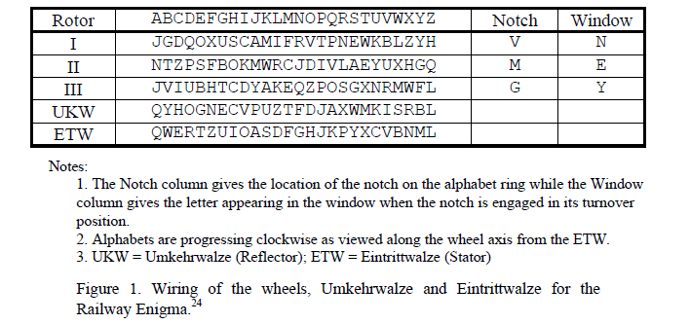
German Railway Enigma RD, 3 of 4

Slide 7
German Railway Enigma RD, 4 of 4
Stepping rotors pre-increment, i.e., ++i instead of i++.
“Alphabets are progressing clockwise as viewed along the wheel axis from the ETW.” [Hamer et al. 1998, p. 5 of enigvar2.pdf]
One (1) settable reflector [Umkehrwalze or UKW], see the next slide.
Mapping: see the previous slide.
Plug Board [Steckerbrett] is optional since the German Railway Enigma did not have one, see the next slide.

Slide 8
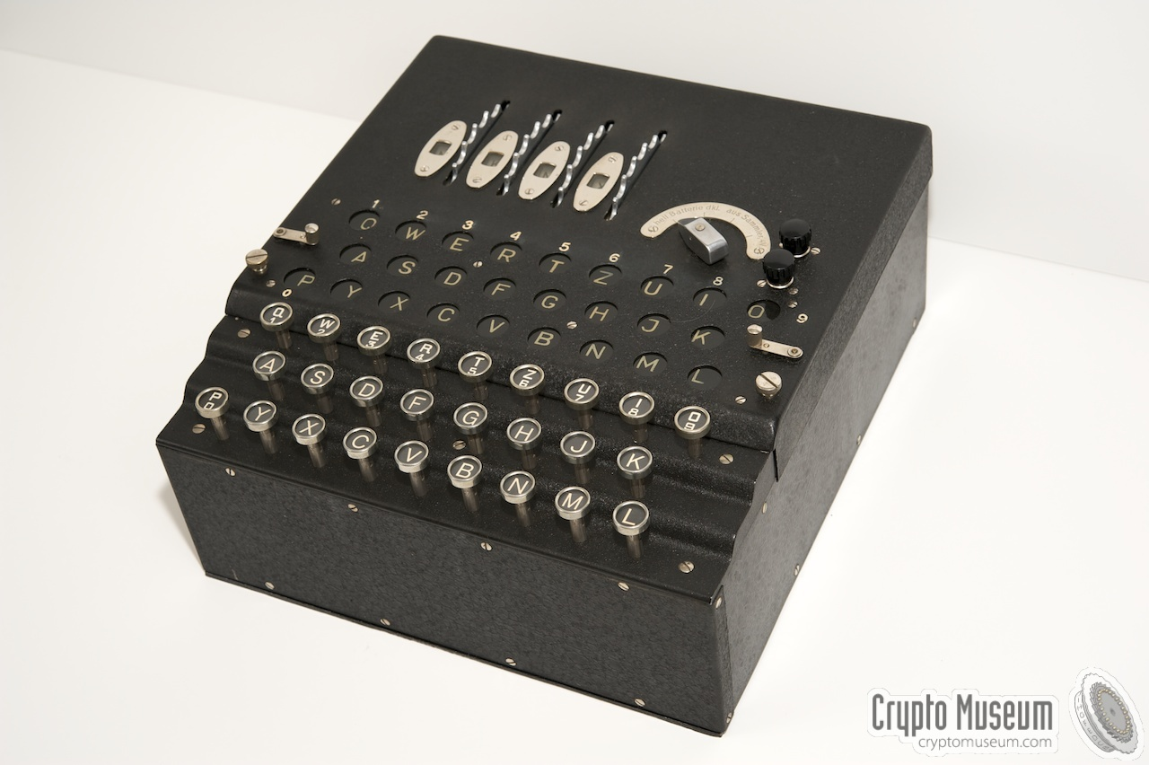
German Railway Enigma
Source: http://www.cryptomuseum.com/crypto/enigma/k/railway.htm .

Slide 9
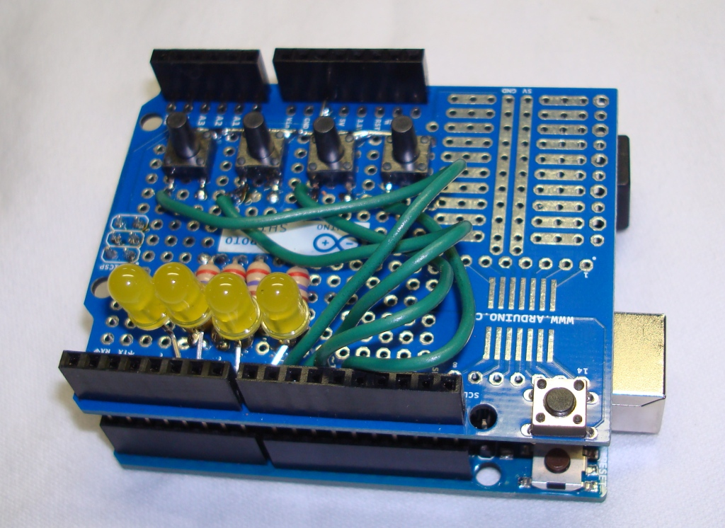
German Railway Enigma Implemented on an Arduino, model Uno Board

