Slide 1

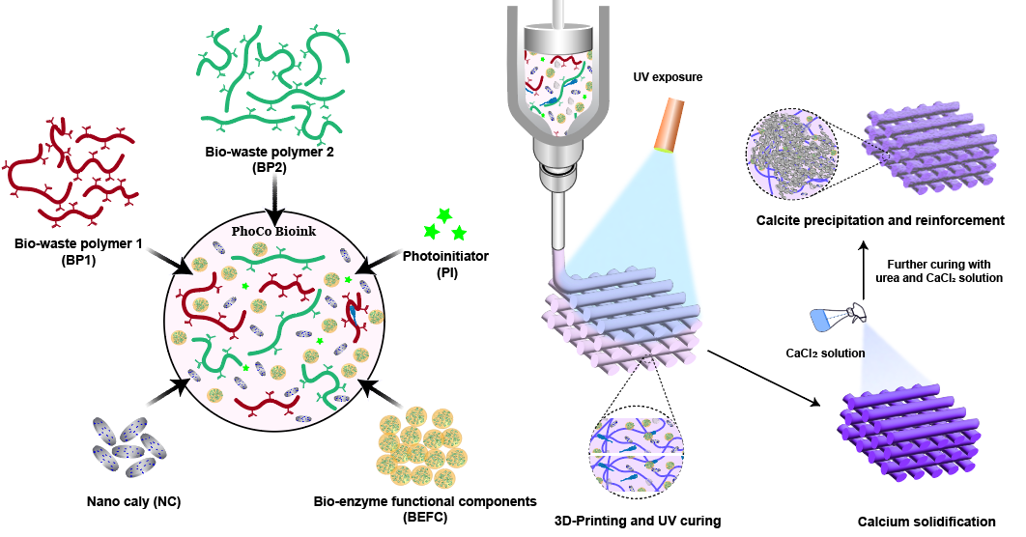
MATERIALS AND SURFACE ENGINEERING
DEPARTMENT OF CIVIL AND MECHANICAL ENGINEERING
PROJECT LEVEL: Master or bachelor
3D Printing of Living Materials for Future Sustainable Construction
SUPERVISORS
Mehdi Mehrali
meme@dtu.dk
Peng Jin
penji@dtu.dk
01 / PROJECT BACKGROUND
Conventional building materials, particularly Portland cement, contribute significantly to global carbon dioxide emissions. Developing alternative binders is therefore an important step towards more sustainable construction. Inspired by the formation of natural materials such as bone and nacre, this project explores biological calcium carbonate precipitation within 3D-printed hydrogel structures. Biomass-derived hydrogels provide a printable framework that carries biological components. Under suitable conditions, these components promote calcium carbonate formation within the hydrogel network, potentially producing a denser and stronger composite material.
02 / PROJECT AIM
The project aims to develop biomass-derived hydrogels suitable for 3D printing and compatible with biological mineralisation. The student will investigate how hydrogel composition and mineralisation conditions influence printability, calcium carbonate formation, microstructure and mechanical performance, with the broader goal of developing living materials for sustainable construction.
03 / PROJECT ACTIVITIES
Develop and optimise hydrogel formulations for printability, shape stability and compatibility with biological components.
Fabricate 3D-printed structures and investigate conditions that promote calcium carbonate precipitation within the hydrogel network.
Monitor mineralisation and evaluate its effects on microstructure, bonding mechanisms and mechanical properties.
04 / PRACTICAL NOTES
The project is primarily experimental and involves hydrogel preparation, 3D printing, controlled mineralisation and materials characterisation. Depending on the research focus, methods may include computed tomography (CT), X-ray diffraction (XRD), scanning electron microscopy (SEM), rheological measurements and mechanical testing.
An interest in chemistry, materials science and sustainable construction is encouraged. Specific activities can be adapted to the student’s academic background and interests.
DTU CONSTRUCT / MATERIALS AND SURFACE ENGINEERING

Slide 2
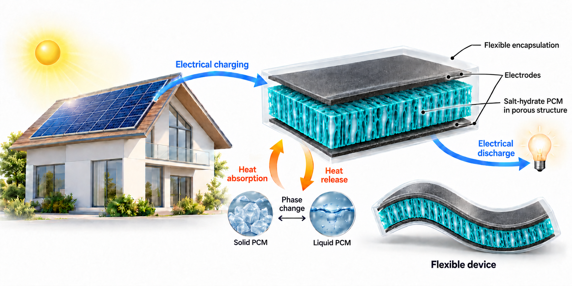
MATERIALS AND SURFACE ENGINEERING
DEPARTMENT OF CIVIL AND MECHANICAL ENGINEERING
PROJECT LEVEL: Master or bachelor
Flexible Phase Change Composites for Simultaneous Electrical and Thermal Energy Storage
SUPERVISORS
Mehdi Mehrali
meme@dtu.dk
Amir Reza Akhiani
amrekah@dtu.dk
01 / PROJECT BACKGROUND
Phase change materials (PCMs) absorb and release substantial amounts of latent heat at nearly constant temperatures during phase transitions. This makes them attractive for thermal energy storage and temperature regulation in applications such as buildings, solar energy systems, clothing and electronics. Integrating PCMs into flexible energy storage devices offers the opportunity to combine thermal management with electrical energy storage. This project explores salt-hydrate-based composites in which the PCM is intended to function both as a thermal energy reservoir and as an electrolyte within an electrochemical storage device. Incorporating these materials into a flexible foam structure could provide mechanical support and help retain the PCM during operation.
02 / PROJECT AIM
The project aims to develop and characterise flexible phase change composites capable of supporting both thermal and electrical energy storage. The student will investigate how salt hydrate composition, foam structure and encapsulation influence thermal storage capacity, electrochemical performance, flexibility and cycling stability.
03 / PROJECT ACTIVITIES
Prepare and optimise flexible PCM composites using different salt hydrates and suitable foam structures.
Develop encapsulation strategies to retain the PCM, minimise leakage and maintain flexibility during repeated phase transitions.
Fabricate prototype devices and evaluate their thermal and electrical energy storage performance, including stability during repeated cycling and bending.
04 / PRACTICAL NOTES
The project is predominantly experimental and involves composite preparation, PCM incorporation, encapsulation and device testing. Characterisation methods may include differential scanning calorimetry (DSC) to assess phase transitions and latent heat, X-ray diffraction (XRD) to investigate crystalline phases, and scanning electron microscopy (SEM) to examine the composite microstructure. Electrochemical measurements and mechanical testing will help evaluate energy storage performance and flexibility.
This project is suitable for students interested in energy storage and functional materials. The research focus can be tailored to the student’s background and learning goals.
DTU CONSTRUCT / MATERIALS AND SURFACE ENGINEERING

Slide 3
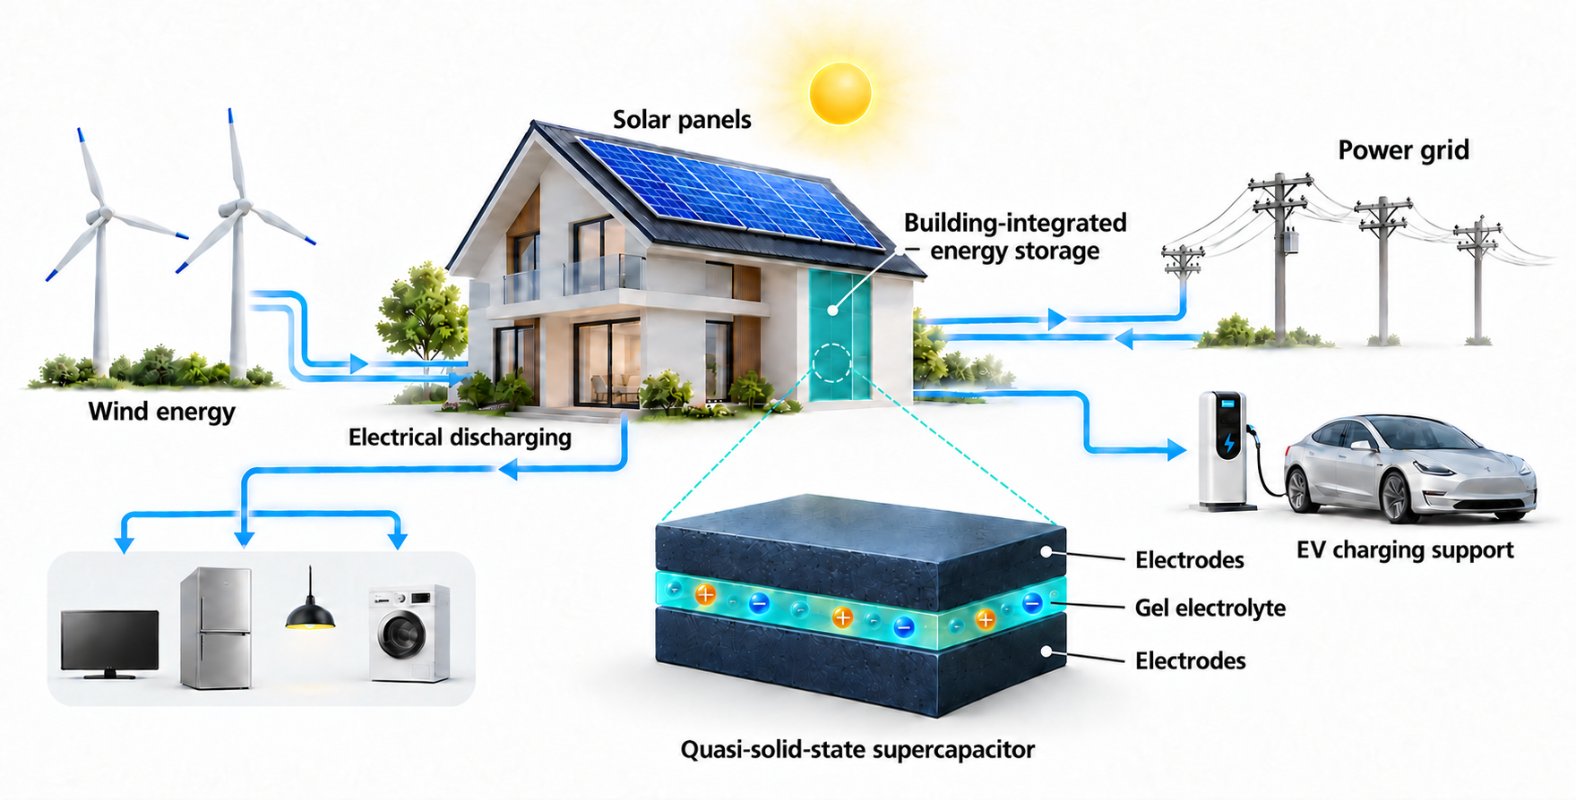
MATERIALS AND SURFACE ENGINEERING
DEPARTMENT OF CIVIL AND MECHANICAL ENGINEERING
PROJECT LEVEL: Master or bachelor
Smart Energy Building: Design and Fabrication of Quasi-solid-state Supercapacitor
SUPERVISORS
Mehdi Mehrali
meme@dtu.dk
01 / PROJECT BACKGROUND
Integrating energy storage into building materials offers opportunities to develop multifunctional construction components. Alongside their conventional roles, these materials could store electrical energy, support the use of renewable energy and provide short-term backup power.
Quasi-solid-state supercapacitors use gel electrolytes that enable ion transport while reducing the risk of electrolyte leakage compared with liquid systems. This project explores electrode and gel electrolyte materials for supercapacitors intended for integration into building components, combining materials development with device fabrication and performance evaluation.
02 / PROJECT AIM
The project aims to design, fabricate and characterise a quasi-solid-state supercapacitor for potential integration into building materials. The student will investigate how electrode composition, gel electrolyte properties and their interfaces influence capacitance, charge–discharge behaviour and cycling stability.
03 / PROJECT ACTIVITIES
Prepare and optimise electrode materials and gel electrolytes suitable for quasi-solid-state supercapacitors.
Characterise the physicochemical properties of the materials and investigate electrode–electrolyte compatibility.
Assemble prototype devices and evaluate their electrochemical performance, including capacitance, rate capability and cycling stability.
04 / PRACTICAL NOTES
The project is primarily experimental and involves materials preparation, device assembly and physicochemical and electrochemical characterisation. Depending on the research focus, methods may include Fourier-transform infrared spectroscopy (FTIR), contact angle measurements, X-ray photoelectron spectroscopy (XPS) and X-ray diffraction (XRD). Electrochemical testing may include cyclic voltammetry, galvanostatic charge–discharge measurements and electrochemical impedance spectroscopy.This project is suitable for students interested in energy storage and functional materials. The research focus can be tailored to the student’s background and learning goals.
Students will gain hands-on experience in materials preparation, supercapacitor fabrication and electrochemical testing. Specific activities can be adjusted to match the student’s interests and experience.
DTU CONSTRUCT / MATERIALS AND SURFACE ENGINEERING

