Slide 1

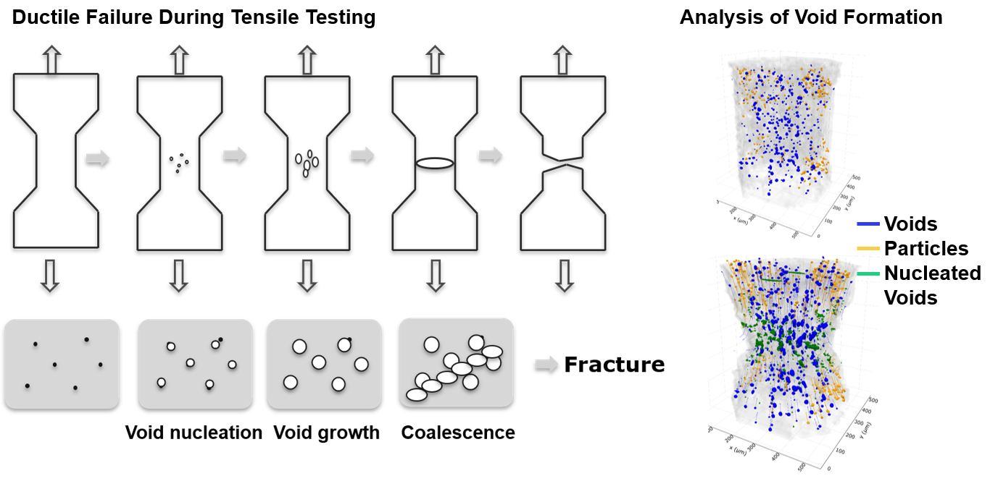
MATERIALS AND SURFACE ENGINEERING
DEPARTMENT OF CIVIL AND MECHANICAL ENGINEERING
PROJECT LEVEL: Master
X-Ray Tomography study on Void Growth in Ductile Failure
SUPERVISORS
Felix Frankus
fefra@dtu.dk
Michela La Bella
[INSERT PROJECT IMAGE]
mlabe@dtu.dk
Grethe Winther
grwi@dtu.dk
COLLABORATION
Workflow of the Project
DTU 3D Imaging Centre
01 / PROJECT BACKGROUND
Ductile failure is often desired because the material undergoes severe plastic deformation before rupturing. It requires high ductility, allowing the material to deform plastically under load. Failure occurs as voids form within the grain structure, typically at inclusions, second-phase particles, or grain boundaries. These voids grow and coalesce, progressively reducing the load-bearing volume. X-ray tomography can track this void evolution in situ and in 3D.
02 / PROJECT AIM
This project aims to study the in-situ formation of voids in AA1050 and AA2219 aluminum alloys and in low-alloyed steels using X-ray computed tomography. You will conduct tensile tests in a miniature load frame inside the X-ray scanner to track void nucleation, growth, and coalescence until failure, quantifying void count, size, and location. Comparing the materials will reveal the role of second-phase particles in void formation.
03 / PROJECT ACTIVITIES
Acquisition of X-ray CT-scans in the 3D Imaging Centre
Tensile testing and evaluation of stress-strain curves
Analysis of the CT-scans using particle tracking and segmentation algorithms.
04 / PRACTICAL NOTES
As the project deals with 3D imaging data and segmentation algorithms to track voids and second-phase particles. It will be necessary to conduct the 3D imaging analysis with Python and standard imaging analysis Libraries such as Scipy.
DTU CONSTRUCT / MATERIALS AND SURFACE ENGINEERING

Slide 2
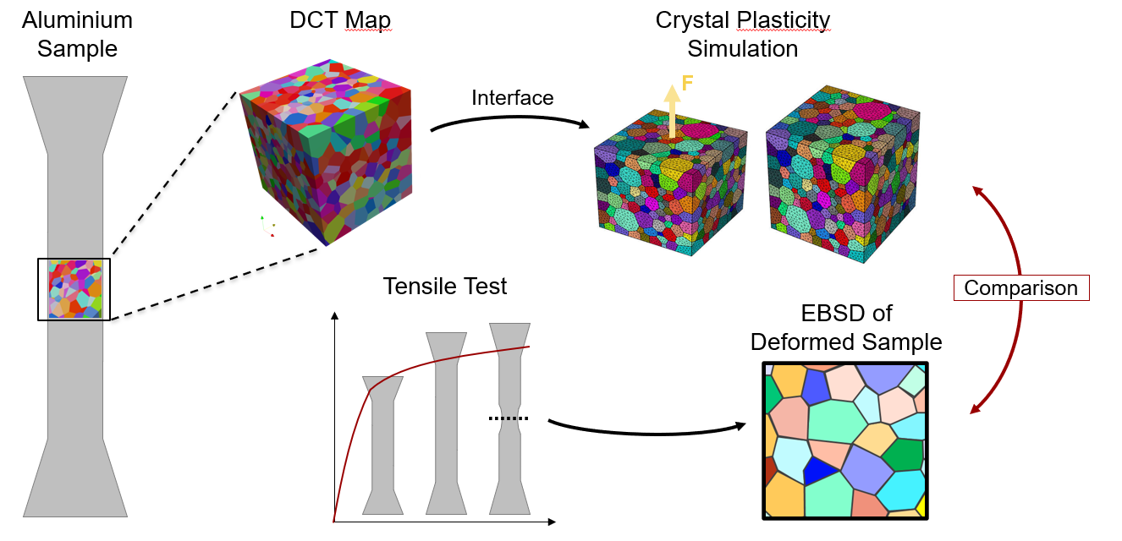
MATERIALS AND SURFACE ENGINEERING
DEPARTMENT OF CIVIL AND MECHANICAL ENGINEERING
PROJECT LEVEL: Master
Evolution of Grain Orientation During Tensile Deformation
SUPERVISORS
Felix Frankus
fefra@dtu.dk
Grethe Winther
[INSERT PROJECT IMAGE]
grwi@dtu.dk
Oleg Mishin
olmi@dtu.dk
COLLABORATION
Workflow of the Project
DTU 3D Imaging Centre
01 / PROJECT BACKGROUND
Grain orientation strongly controls how metals deform, because it constrains each grain’s response to load and its interaction with neighboring grains. Crystal Plasticity (CP) models capture these effects by simulating a meshed 3D grain map that encodes each grain’s shape and orientation. Laboratory Diffraction Contrast Tomography (Lab DCT) can produce such maps non-destructively. However, few studies test whether a CP simulation seeded with a measured grain map reproduces both the macroscopic response and the grain-level deformation of the same specimen.
02 / PROJECT AIM
This project compares simulated tensile tests using Crystal Plasticity, seeded with a Lab DCT grain map of a polycrystalline commercially pure aluminum sample, against experimental uniaxial tensile tests on the same specimen. To connect the two, you will develop code that imports the voxelized Lab DCT data into Neper, a meshing tool for crystal plasticity data generation, and then into the Finite Element Polycrystal Plasticity program FEPX. The simulated tensile test will be compared with experimental data from the previously scanned sample. After deformation, Electron Backscatter Diffraction (EBSD) data will be used to compare grain orientations and morphology between simulation and experiment.
03 / PROJECT ACTIVITIES
Acquisition of the grain maps using the LabDCT equipment in the 3D Imaging Centre
The interfacing between the grain map from LabDCT to Crystal Plasticity
Conducting a tensile test and characterizing the previously 3D-scanned region after deformation using EBSD
04 / PRACTICAL NOTES
As the project deals with complex data structures, you should be confident in using Python for analysis and interfacing between the different experimental and simulation data types and structures. Basic knowledge of Linux is beneficial for executing the simulations.
DTU CONSTRUCT / MATERIALS AND SURFACE ENGINEERING

