Slide 1

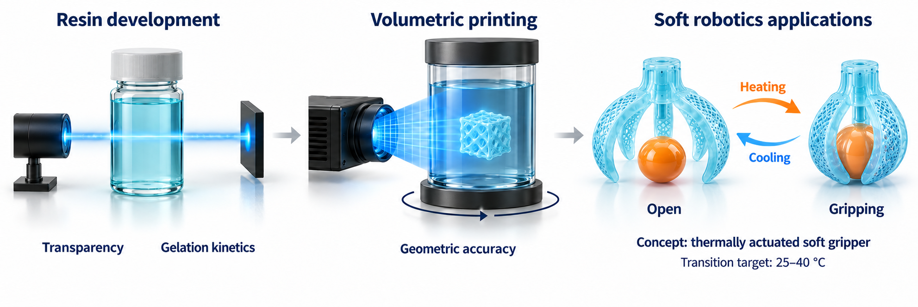
MATERIALS AND SURFACE ENGINEERING
DEPARTMENT OF CIVIL AND MECHANICAL ENGINEERING
PROJECT LEVEL: Master
Thermoresponsive Photopolymer Resins for 4D Volumetric Additive Manufacturing
SUPERVISORS
Masoud Hasany
[mahas@dtu.dk]
Mehdi Mehrali
[meme@dtu.dk]
COLLABORATION
Aminul Islam
[mais@dtu.dk]
Concept: VAM-printed PNIPAM soft gripper closing above its LCST
01 / PROJECT BACKGROUND
4D printing creates three-dimensional objects that change their shape or dimensions in response to an external stimulus, such as temperature. Poly(N-isopropylacrylamide) (PNIPAM) hydrogels are suitable candidates because they release water and shrink when heated above their thermal transition, and absorb water and swell again when cooled. Volumetric additive manufacturing (VAM) offers a route to printing these materials by curing selected regions within a resin volume using projected light. However, the resin must allow light to penetrate the full printing volume and gel under controlled exposure. Developing a formulation that meets these printing requirements while retaining reversible thermoresponsive behaviour after crosslinking is the central challenge of this project.
02 / PROJECT AIM
The project aims to develop and validate a PNIPAM-based photopolymer resin for printing thermoresponsive hydrogel structures using VAM. The formulation should combine sufficient optical transparency, suitable gelation kinetics, and a thermal transition within the 25–40 °C range after crosslinking. The project will establish suitable printing conditions and assess how accurately the printed structures reproduce their intended geometry. It will then determine whether the printed hydrogels retain reversible swelling and shrinkage over repeated heating and cooling cycles.
03 / PROJECT ACTIVITIES
Month 1 · Set-up: review PNIPAM photoresins and VAM literature; lab safety and VAM printer induction
Months 1–2 · Formulation: screen two PNIPAM resin strategies; tune photoinitiator and TEMPO inhibitor levels
Month 2 · Resin characterisation: optical clarity by UV-Vis, LCST by DSC, gel-point kinetics by photo-rheometry
Months 3–4 · VAM printing: calibrate light dose; print test geometries; verify print fidelity by micro-CT
Months 4–5 · 4D response: swelling by gravimetry and DIC over 25–40 °C cycles; print a soft-gripper demonstrator
Month 5 · Reporting: thesis write-up, documented data set and final presentation to the group
04 / PRACTICAL NOTES
Experimental MSc project combining polymer formulation, additive manufacturing, and hydrogel characterization. An interest in polymer chemistry and laboratory work is required.
DTU CONSTRUCT / MATERIALS AND SURFACE ENGINEERING

Slide 2
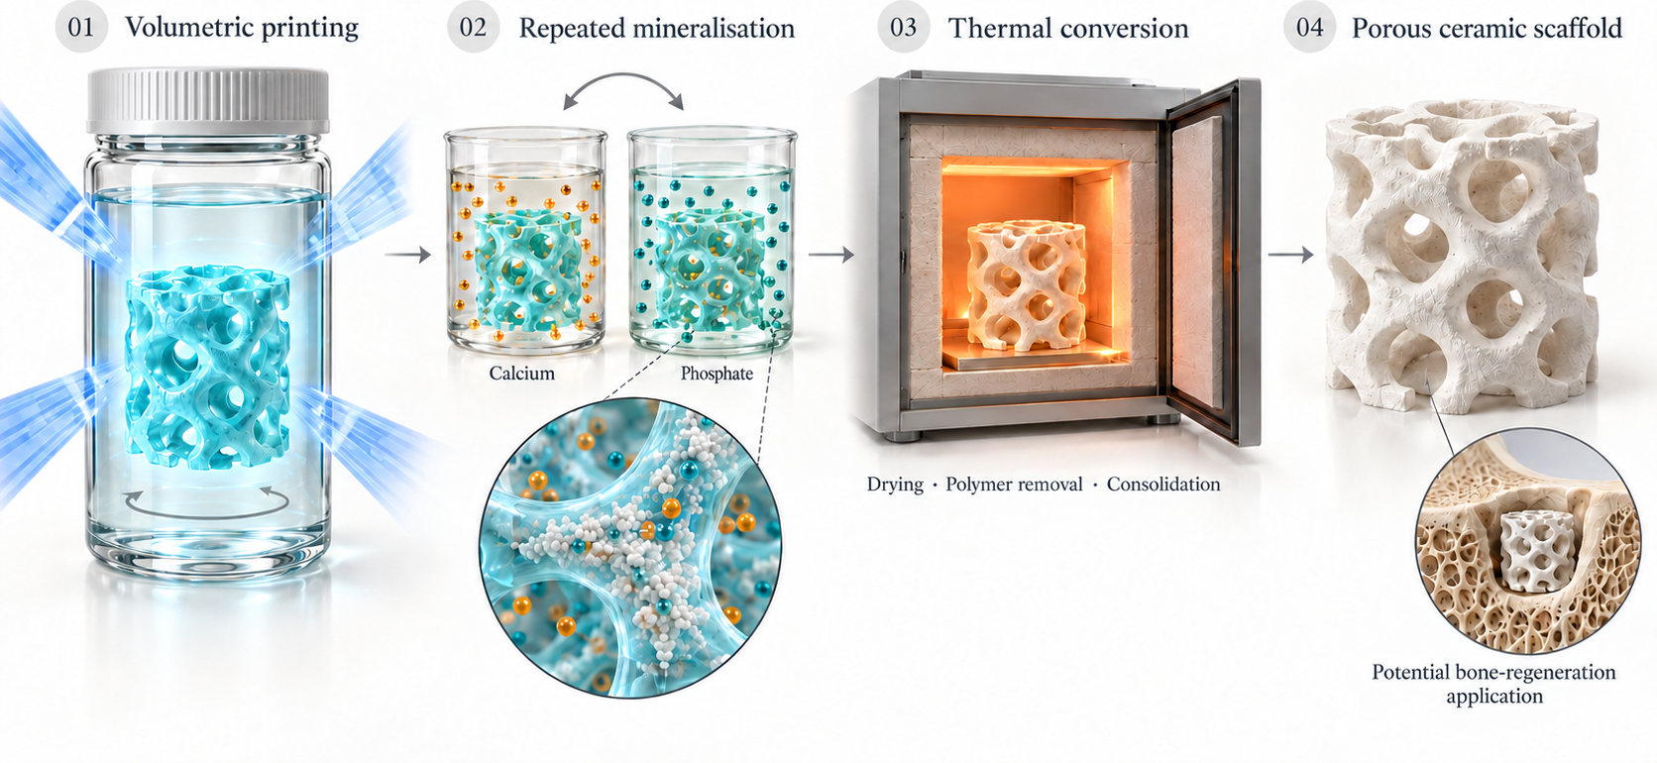
MATERIALS AND SURFACE ENGINEERING
DEPARTMENT OF CIVIL AND MECHANICAL ENGINEERING
PROJECT LEVEL: Master
Calcium-Phosphate Ceramic Scaffolds from Volumetrically Printed Hydrogel Templates
SUPERVISORS
Masoud Hasany
[mahas@dtu.dk]
Mehdi Mehrali
[meme@dtu.dk]
COLLABORATION
Aminul Islam
Proposed fabrication of porous calcium-phosphate ceramic scaffolds through volumetric hydrogel printing, repeated mineralisation, and thermal conversion.
[mais@dtu.dk]
01 / PROJECT BACKGROUND
Calcium-phosphate ceramics resemble the mineral component of bone and are widely investigated as scaffolds for bone regeneration. Their performance depends on both material composition and architecture, including pore connectivity, strut dimensions, and defects introduced during fabrication. Producing complex, interconnected structures while maintaining sufficient mechanical integrity remains a challenge. Volumetric additive manufacturing (VAM) enables rapid fabrication of three-dimensional structures within a photosensitive resin. However, incorporating ceramic particles directly into the resin can cause light scattering, restricting the achievable inorganic loading and printing accuracy. An alternative is to print a transparent hydrogel template first and introduce the inorganic material afterward.
02 / PROJECT AIM
This project explores repeated calcium-phosphate mineralization of VAM-printed hydrogel templates, followed by polymer removal and thermal consolidation. The central challenge is to form a sufficiently continuous mineral network throughout the template so that the resulting ceramic retains its architecture. The work will investigate how hydrogel composition and mineralization conditions influence this conversion. The intended outcome is a processing–structure–property relationship that identifies conditions suitable for producing ceramic scaffolds with preserved interconnected pores and reproducible mechanical properties. The materials will be developed as candidates for future bone-regeneration applications.
03 / PROJECT ACTIVITIES
Month 1 · Review hydrogel mineralisation, calcium-phosphate ceramics and VAM literature; lab safety and printer
Months 1–2 · Prepare hydrogel specimens, screen repeated calcium-loading and phosphate-exposure cycles
Months 3–4 · VAM-print porous lattices, refine mineralisation
Months 4–5 · Measure dimensional shrinkage and compression properties; assess pore connectivity and defects by micro-CT and microscopy
Month 5 · Thesis write-up, documented data set and final presentation to the group
04 / PRACTICAL NOTES
Experimental MSc project combining polymer formulation, additive manufacturing, and biomedical engineering. An interest in polymer chemistry and laboratory work is required.
DTU CONSTRUCT / MATERIALS AND SURFACE ENGINEERING

