Slide 1
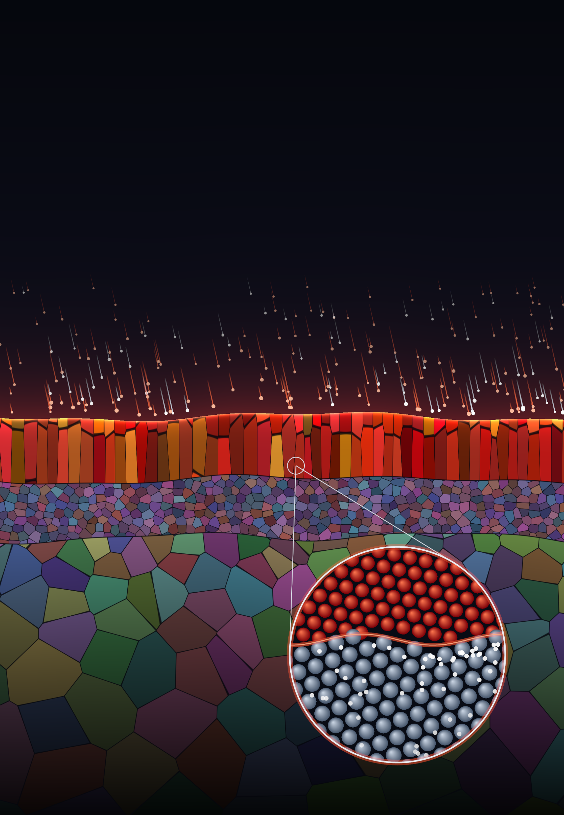

DTU Construct
Department of Civil and Mechanical Engineering
Materials and
Surface Engineering
Materiale- og overfladeteknologi
Student Projects 2026–2027
Coating
Diffusion zone
Substrate
Atomic structure at the interface

